Slide 1
Analyzing Website Data Collection Efficiency and Network Behavior Using Multiple Web Scraping Techniques
API vs BeautifulSoup vs Selenium • Network analysis • Machine learning
Jana Alamir & Rim Zoghbi
Notes:
Introduce yourselves and the topic: we scraped the same football data with three methods and compared them on the network, then used the data for ML.

Slide 2
Project goal
Collect the SAME data with three web scraping methods
• API (JSON) • BeautifulSoup (HTML) • Selenium (real browser)
Compare their efficiency and network behavior
• time, number of requests, bandwidth, latency
• live tools: ss, iftop, nload, tcpdump, Wireshark — and a ufw firewall test
Use the data for machine learning
• predict goals (regression) and W / D / L results (classification)
Notes:
Explain the 3 questions of the project. ~45 seconds.

Slide 3
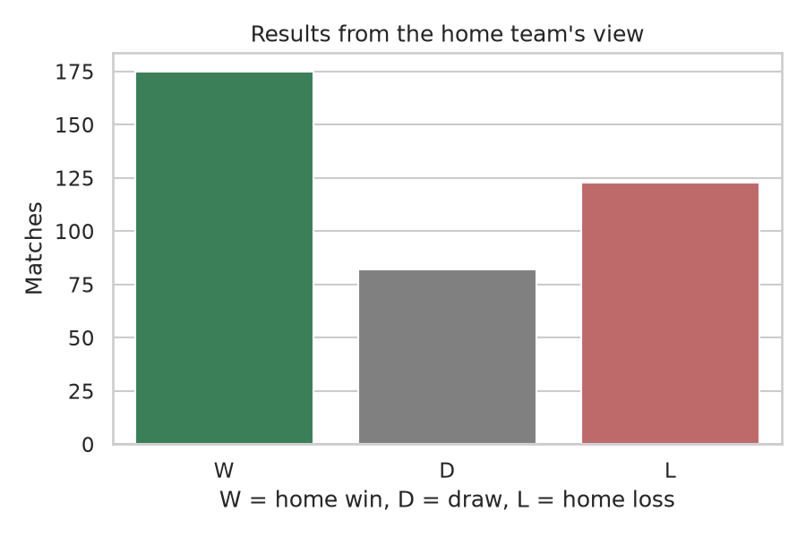
Website and data
TheSportsDB.com
• free sports database: website + JSON API (free test key)
English Premier League 2023-2024
• 20 teams, 38 rounds, 380 matches
7 columns for every method
• date, round, home_team, away_team, home_goals, away_goals, result (W/D/L for the home team)
Result: 380 matches from every method, files 100% identical
Notes:
Why TheSportsDB: it has both a website and an API with the same data, so the comparison is fair. Show the columns.

Slide 4
Three scraping methods
API
• eventsround.php: 1 request per round (38)
• season endpoint: only 15 matches with free key
• 4 s between requests, respects Retry-After
• + threaded version: 4 threads, shared rate limiter
BeautifulSoup
• requests + HTML parsing
• season page with ?all=1 = all 380 matches
• 1 request, 1 page
• reads <tr class='season-event-row'>
Selenium
• headless Chrome browser
• same page, waits for the table
• 1920x1080 window (only visible text is readable)
• requests counted with the browser's Performance API
Shared metrics.py: timer, request counter, bytes, latency -> data/metrics.csv • User-Agent, timeouts, error handling
Notes:
Explain each column. Mention the problems: free API key limited (15 matches) -> one request per round; website page shows 100 matches -> ?all=1; Selenium window size for visible text.

Slide 5
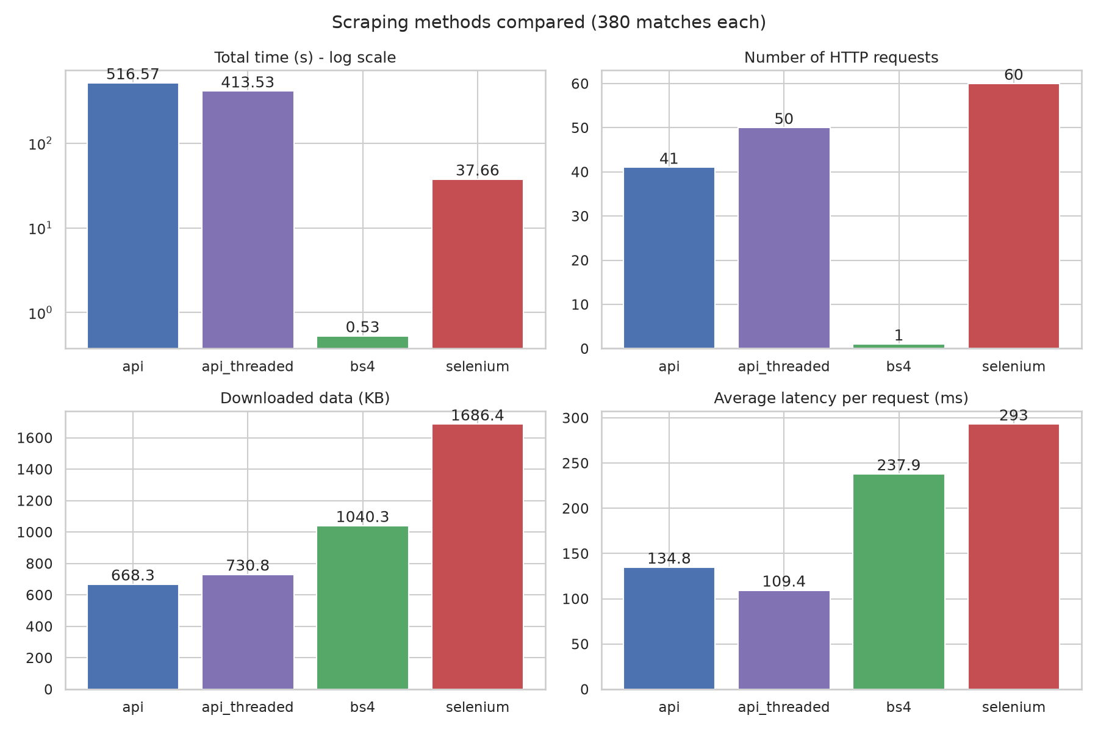
Performance comparison
BeautifulSoup: 0.53 s
• 1 request, whole season in one page
Selenium: 38 s
• browser + 60 files + slow WebDriver reading
API: 517 s
• ~99% waiting (rate limit)
• fastest per request (135 ms), least data (668 KB)
Threaded API: 414 s
• 12 errors 429 vs 3
Notes:
BeautifulSoup fastest: 1 request. API slowest in total but ~99% of its time is waiting (rate limit + 38 requests); per request it is the fastest and downloads the least. Threads: faster but more 429 errors.

Slide 6
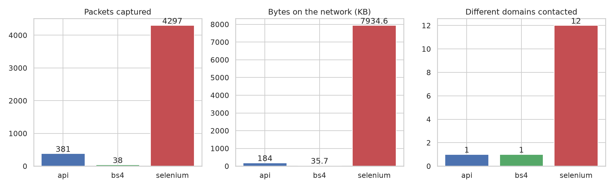
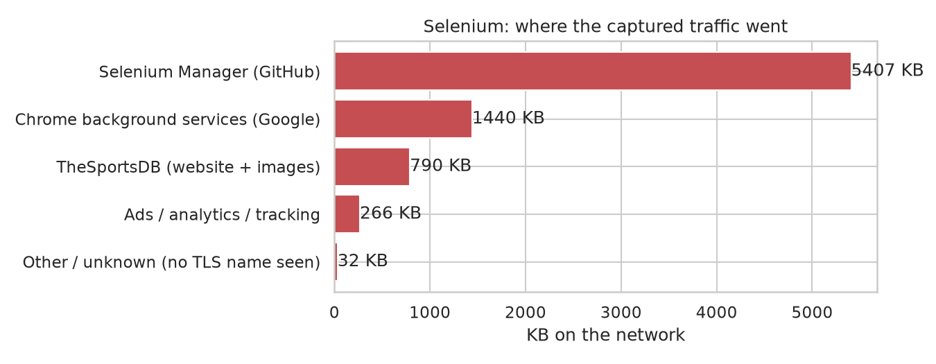
Network traces (tcpdump + scapy)
API & BeautifulSoup
• 1 TCP connection, 1 domain (www.thesportsdb.com)
Selenium
• 4297 packets, 7.7 MB
• 24 connections, 12 domains
• only 10% of the traffic was the website!
– Selenium Manager (GitHub), Chrome services, ads / trackers
Domain names visible even with HTTPS (TLS SNI)
Notes:
From the pcap files: API and BeautifulSoup = 1 TCP connection to 1 domain. Selenium = 24 connections, 12 domains. Only 10% of Selenium's traffic was the website: Selenium Manager downloads version lists from GitHub, Chrome contacts Google services, plus ads and trackers.

Slide 7
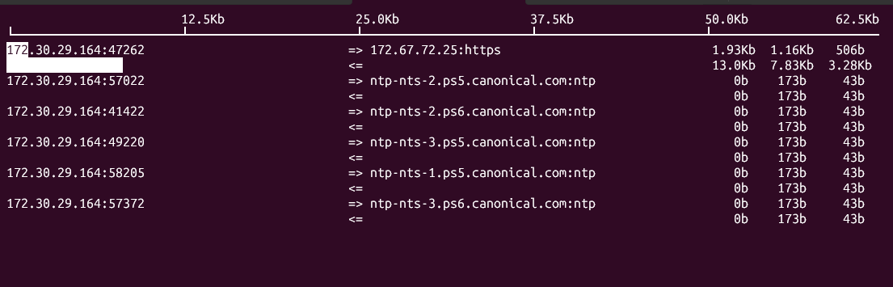
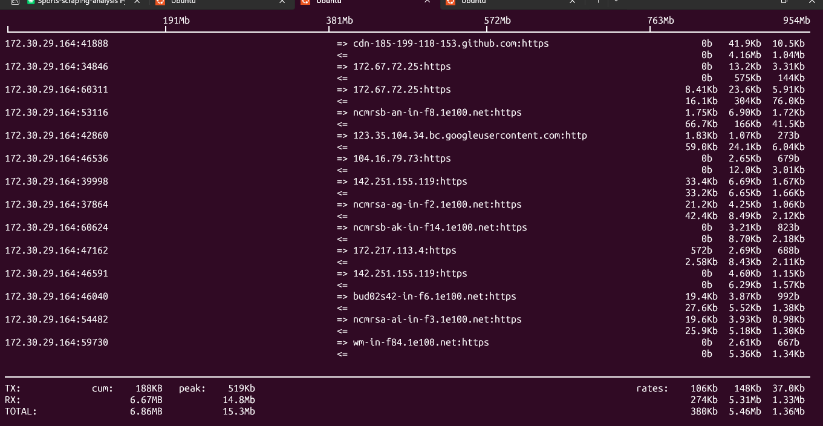
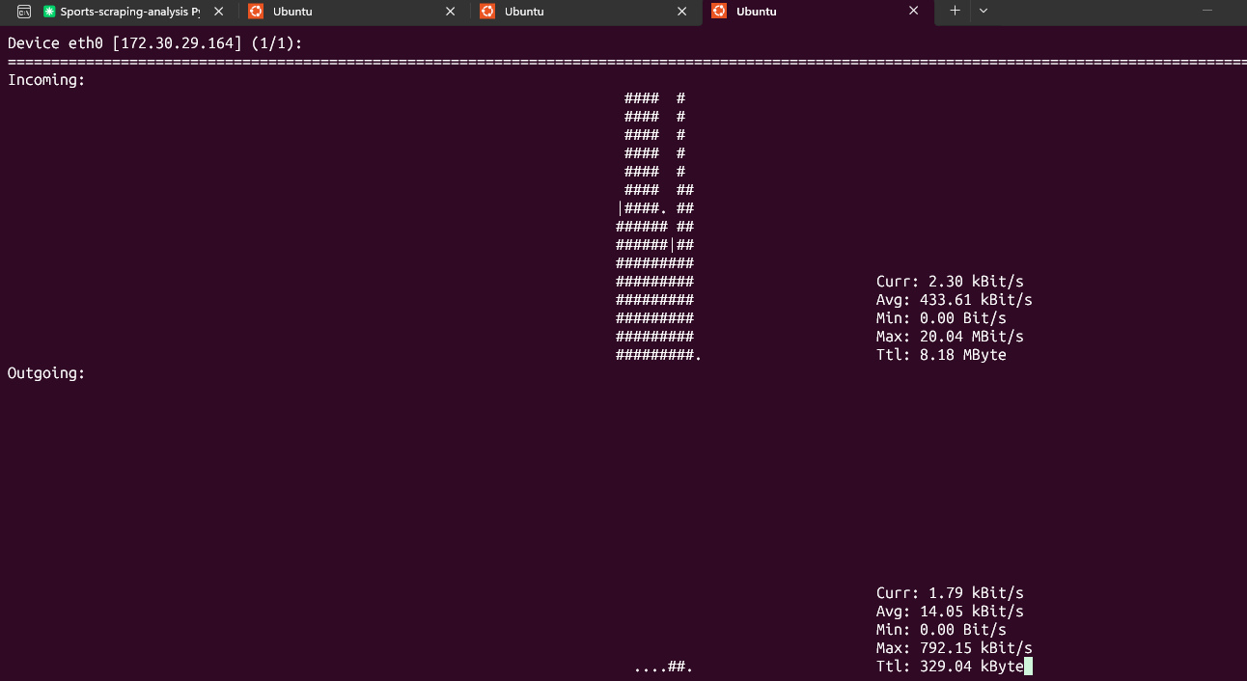
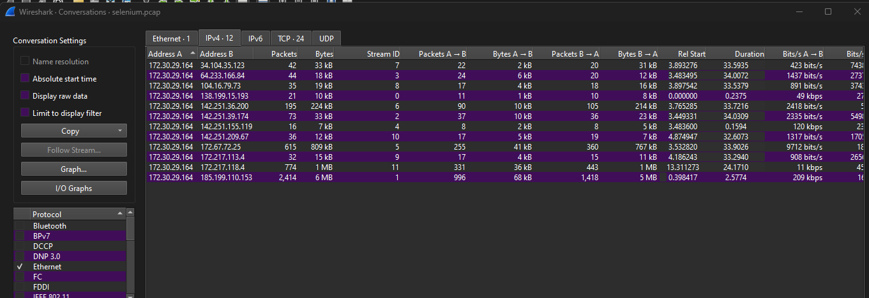
Live monitoring: ss, iftop, nload, Wireshark
iftop – API: one remote host
iftop – Selenium: many remote hosts
nload – Selenium traffic peak
Wireshark – Conversations
Notes:
Show the difference between API (one connection, small regular traffic) and Selenium (many connections, big peak). Wireshark protocol hierarchy: almost everything is TLS.

Slide 8
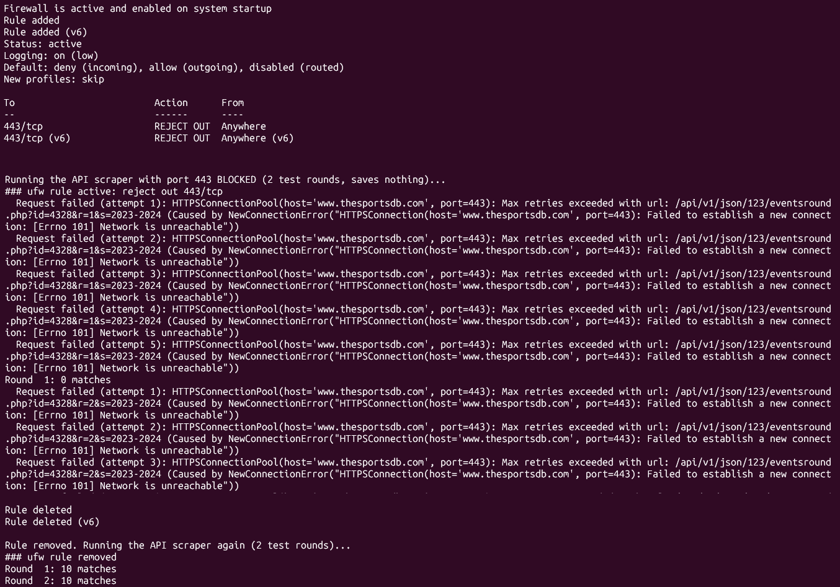
Security: ufw, rate limiting, multithreading
ufw firewall test
• sudo ufw reject out 443/tcp
• API scraper: 'Network is unreachable', 0 matches, no crash
• rule removed: 20 matches in 4.5 s
Rate limiting
• 2.5 s between requests -> 429 errors, only 210/380 matches
• 4 s + Retry-After -> 380/380 matches
Multithreading (4 threads)
• 20% faster, but 12 instead of 3 errors 429
ufw status + blocked API run
Notes:
ufw: we blocked outgoing port 443 -> the scraper got 'Network is unreachable', 0 matches, no crash. Removed the rule -> 20 matches in 4.5 s. Rate limit: going too fast cost us data (210/380 on the first run). Threads: faster but more 429 errors.

Slide 9
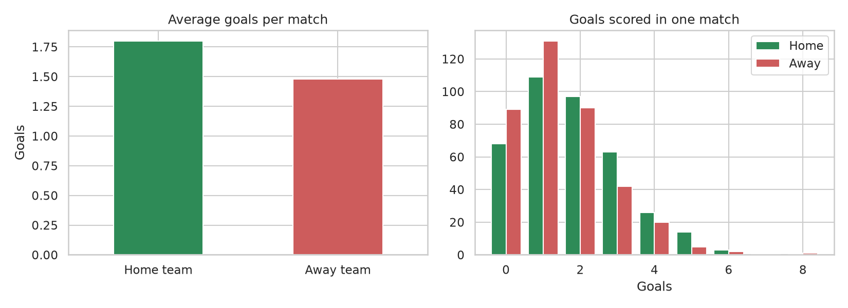
Machine learning: method
Features from the last 5 PREVIOUS matches (no data leakage)
• form = points in last 5 games (0-15)
• average goals scored / conceded
• for the home team and the away team (home/away)
Train / test split by time
• first 5 games of each team skipped -> 329 matches
• train: 229 earlier matches • test: last 100 matches
Models
• goals: Linear Regression, Random Forest (MAE)
• W/D/L: Logistic Regression, Random Forest (accuracy)
Notes:
Key point: no data leakage. Features only from matches BEFORE each game. Time-based split: train on the past, test on the last 100 matches.

Slide 10
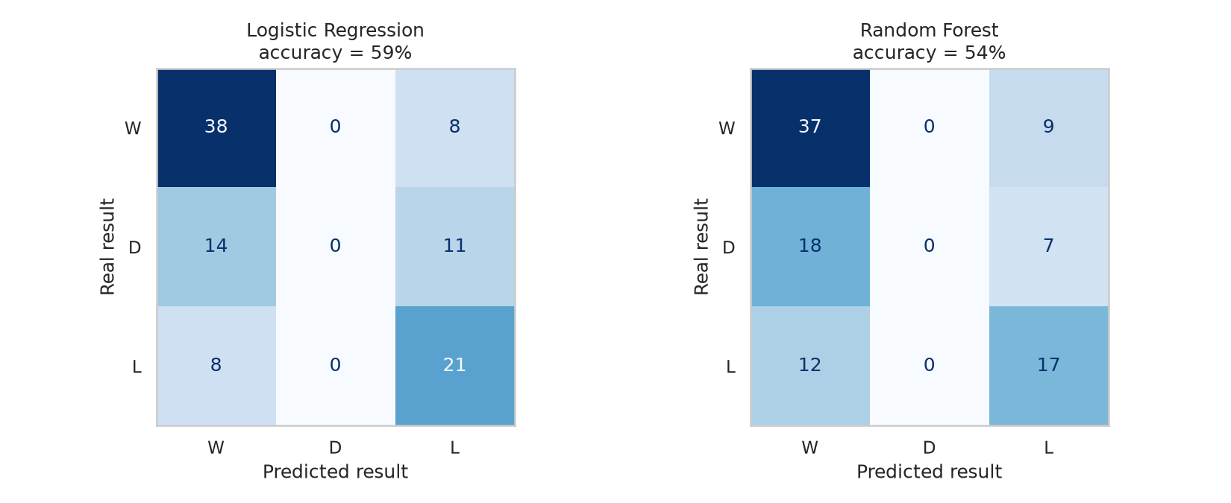
Machine learning: results
Classification (W/D/L)
• Logistic Regression: 59%
• baseline 'always home win': 46%
• +13 points
• draws are never predicted
Regression (goals)
• Linear Regression: MAE 1.01
• baseline: MAE 1.10
Notes:
Best classifier Logistic Regression: 59% vs 46% for always home win. Never predicts draws. Best regression Linear Regression: MAE about 1.0 goal, close to the average baseline: exact scores are very random.

Slide 11
Which method is best?
API — most efficient and most stable
• only the data, 1 server, 1 connection, clean JSON
• slow here only because of the free key (rate limit, 38 requests)
BeautifulSoup — fastest in our case
• 1 request, under 1 second — but breaks if the HTML layout changes
Selenium — only when the page needs JavaScript
• heavy: many files and domains, only 10% of its traffic was the website
Respect the rate limit: threads do not beat a server-side limit
Notes:
Our recommendation and why. API = most efficient; BeautifulSoup = fastest here; Selenium only when JavaScript is needed.

Slide 12
Conclusion
• Same 380 matches from all three methods — identical data
• Very different network behavior: API << BeautifulSoup << Selenium in traffic
• Access rules (rate limits, free vs paid key) matter as much as the technology
• Simple form features predict results with 59% accuracy (baseline 46%)
Thank you — questions?
Notes:
Summarize in 3 sentences, then thank the audience and take questions.

