Slide 1

The Minimum Viable Brain
Selection and investigation of unsupervised adaptive learners with minimal neuronal architecture
Dr. Jana Katharina Dahlmanns

Slide 2
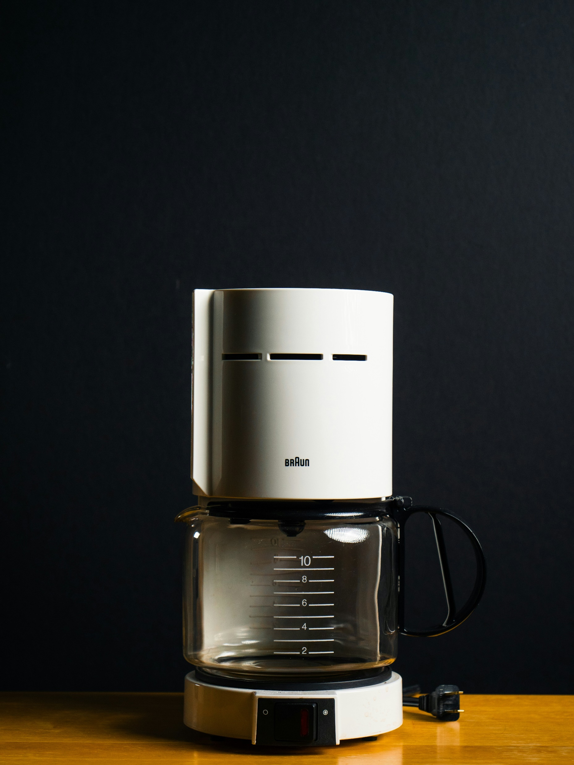
1 - Who here knows how to work a coffee maker?
Photo by Ronan Furuta on Unsplash

Slide 3
2 – Complete this sentence:
The weather outside is nice today, the sky is ________.

Slide 4
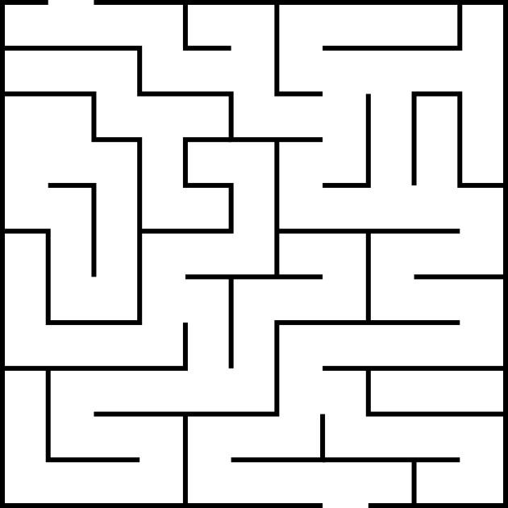
3 – Find the shortest path through this maze

Slide 5
Why are brains so good at
flexible generalization?

Slide 6
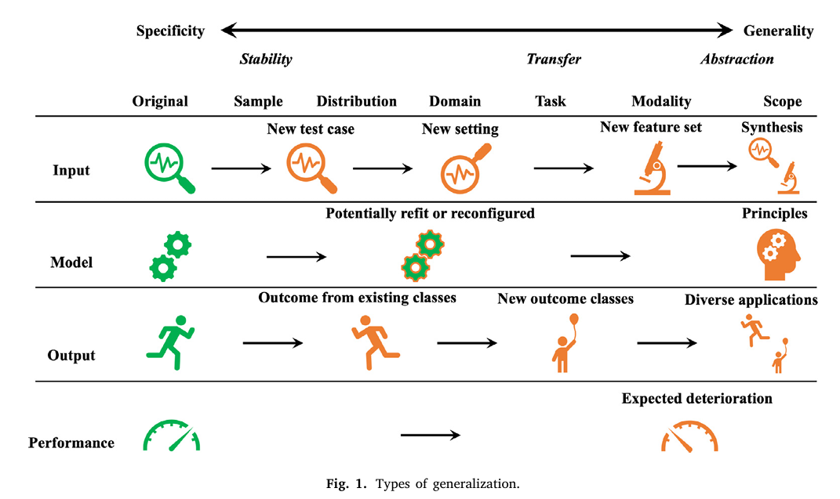
Generalization
https://www.sciencedirect.com/science/article/pii/S0925231224014723
CHAUDHURY, Subhajit; YAMASAKI, Toshihiko. Investigating generalization in neural networks under optimally evolved training perturbations. In: ICASSP 2020-2020 IEEE International Conference on Acoustics, Speech and Signal Processing (ICASSP). IEEE, 2020. S. 3617-3612.
JACOBSEN, Jörn-Henrik, et al. Excessive invariance causes adversarial vulnerability. arXiv preprint arXiv:1811.00401, 2018.
https://proceedings.mlr.press/v97/arora19a.html
Rohlfs (2025) Generalization in neural networks: A broad survey. Neurocomp
https://arxiv.org/pdf/1802.08760

Slide 7
„
Why Computational Neuroethology?
Studies of mechanisms of adaptive behavior generally focus on neurons and circuits.
But adaptive behavior also depends on interactions among the nervous system, body and environment:
sensory preprocessing and motor post-processing filter inputs to and outputs from the nervous system […] and continuous feedback between nervous system, body and environment are essential for normal behavior. […]
Computational neuroethology, which jointly models neural control and periphery of animals, is a promising methodology for understanding adaptive behavior.
„
Hillel Chiel & Randall Beer (1997) The brain has a body: adaptive behavior
emerges from interactions of nervous system, body and environment. Trends Neurosci

Slide 8
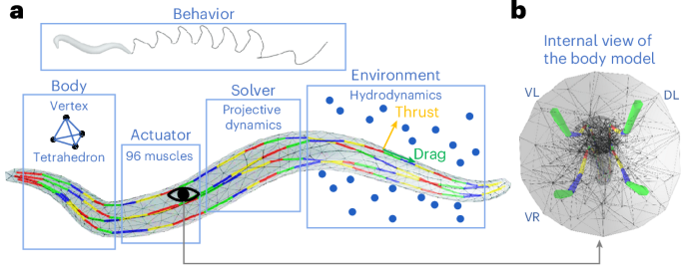
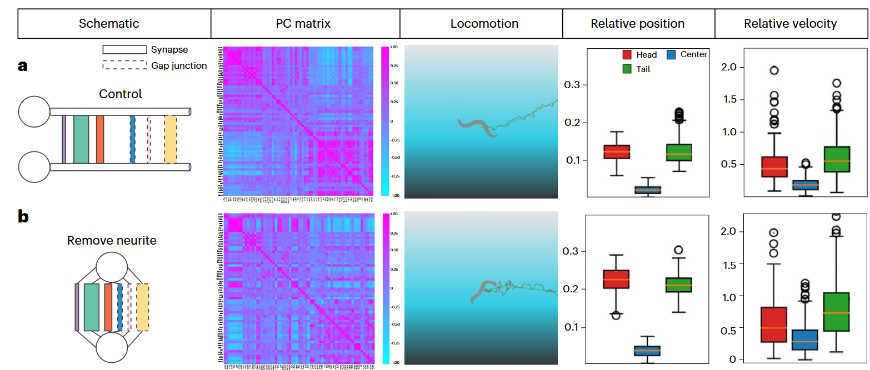
Models of Minimal Cognition
Embedding models into interactive environments can reveal neuronal dynamics and biologically realistic behavior not captured in isolated networks.
Zhao, M., Wang, N., Jiang, X. et al. (2024) An integrative data-driven model simulating C. elegans brain, body and environment interactions. Nat Comput Sci

Slide 9
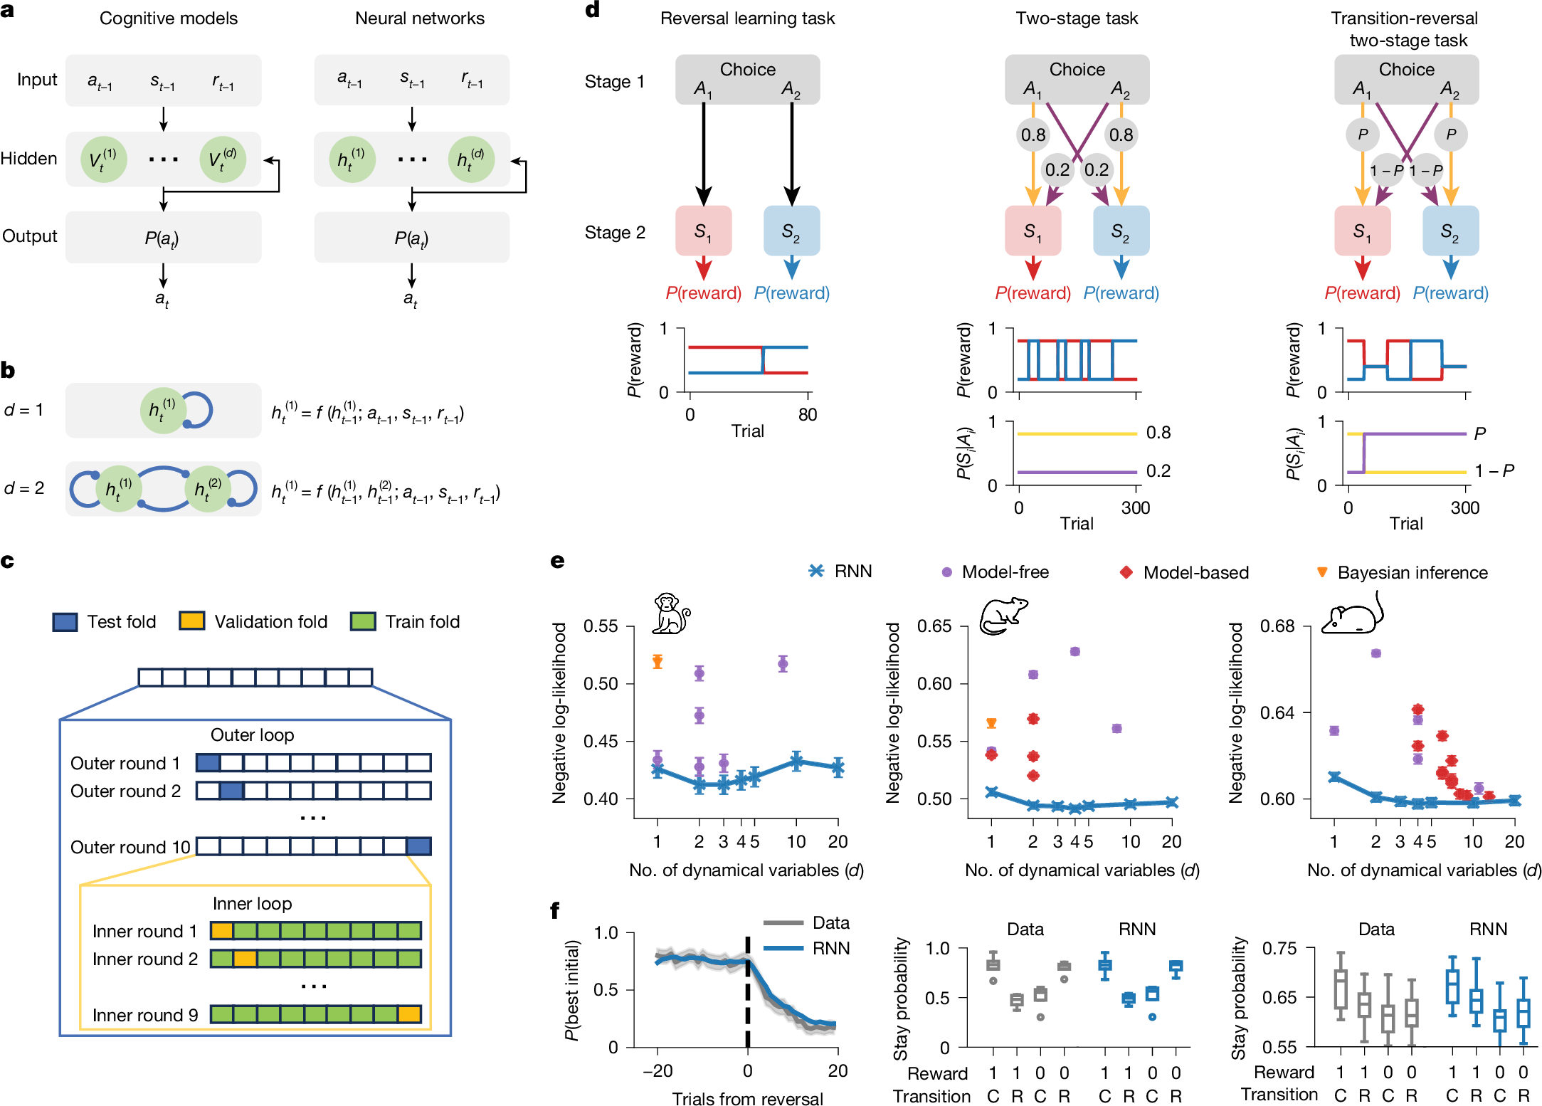
Models of Minimal Cognition
Tiny RNNs can capture complex behavior while remaining interpretable.
Ji-An, L., Benna, M.K. & Mattar, M.G. (2025) Discovering cognitive strategies with tiny recurrent neural networks. Nature

Slide 10
OUR QUESTION
Can minimal embedded networks evolve internal dynamics that support adaptation to changing task rules?

Slide 11
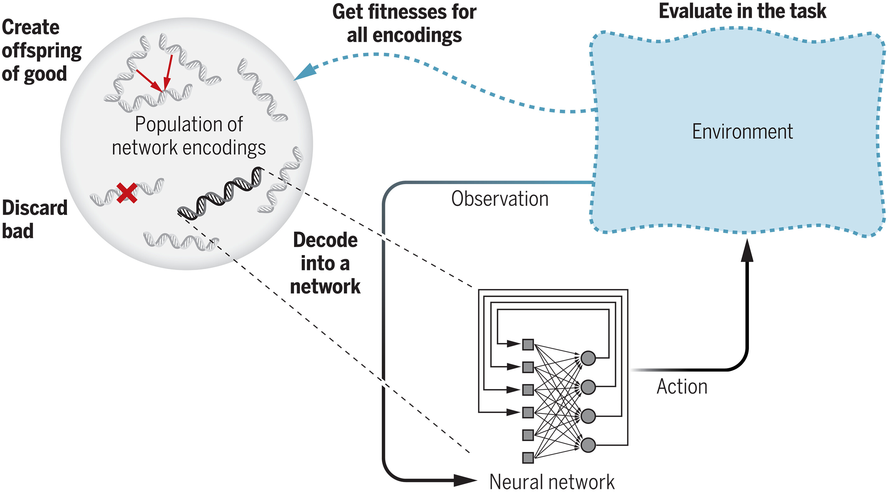
Can minimal embedded networks evolve internal dynamics that support adaptation to changing task rules?
Can minimal embedded networks evolve internal dynamics that support adaptation to changing task rules?
Evolutionary Algorithms
Embedded agents
Risto Miikkulainen (2025) Neuroevolution insights into biological neural computation. Science

Slide 12
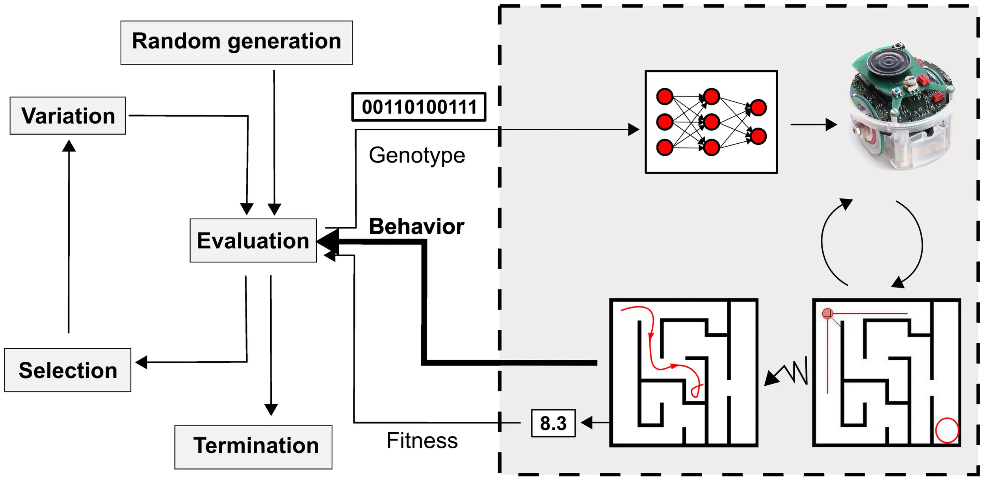
Can minimal embedded networks evolve internal dynamics that support adaptation to changing task rules?
Evolutionary Algorithms
Doncieux S, Bredeche N, Mouret J-B and Eiben AEG (2015) Evolutionary Robotics: What, Why, and Where to. Front. Robot. AI

Slide 13
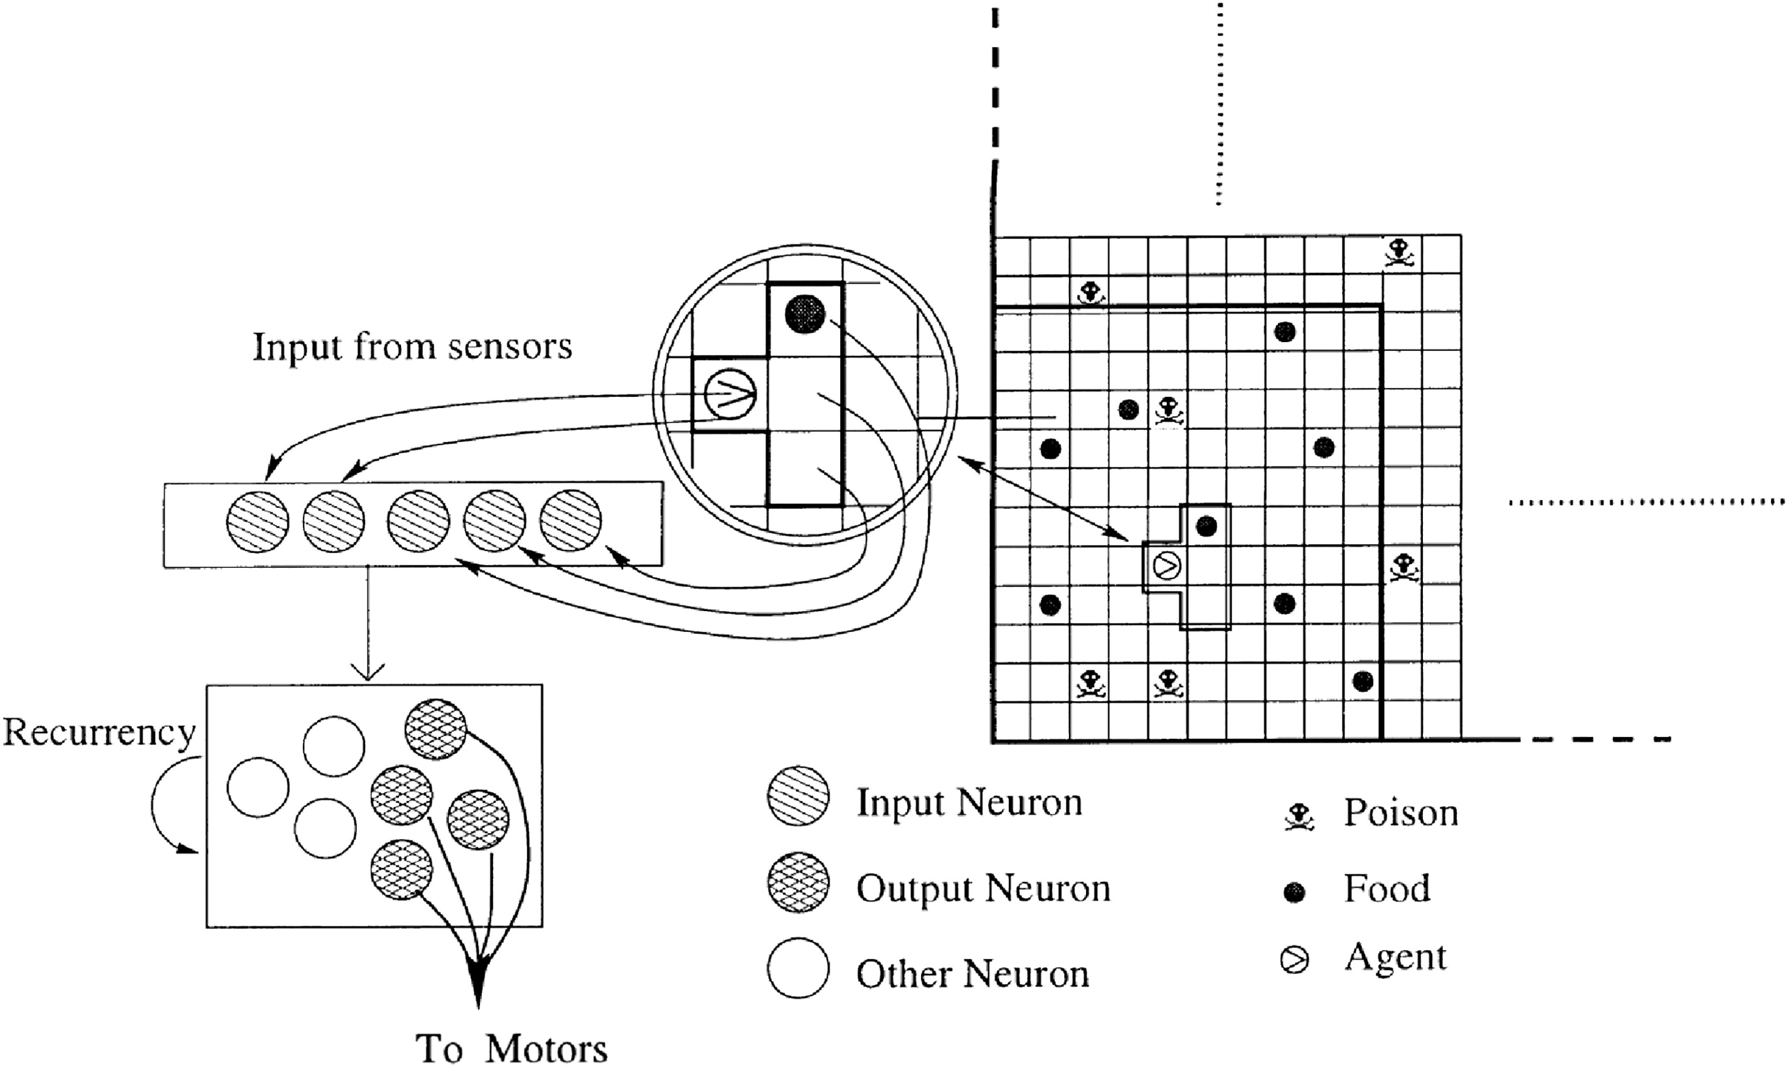
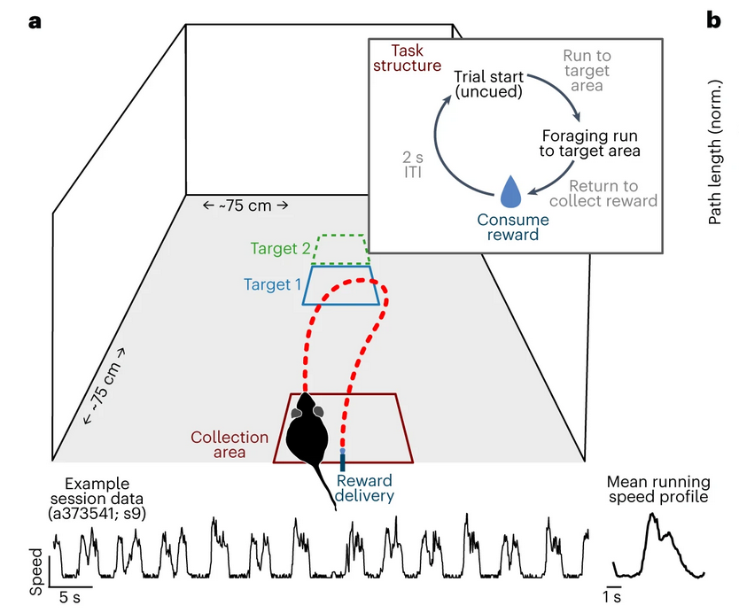
Can minimal embedded networks evolve internal dynamics that support adaptation to changing task rules?
Foraging Task
Risto Miikkulainen (2025) Neuroevolution insights into biological neural computation. Science
Jiang, WC., Xu, S. & Dudman, J.T. (2022) Hippocampal representations of foraging trajectories depend upon spatial context. Nat Neurosci

Slide 14
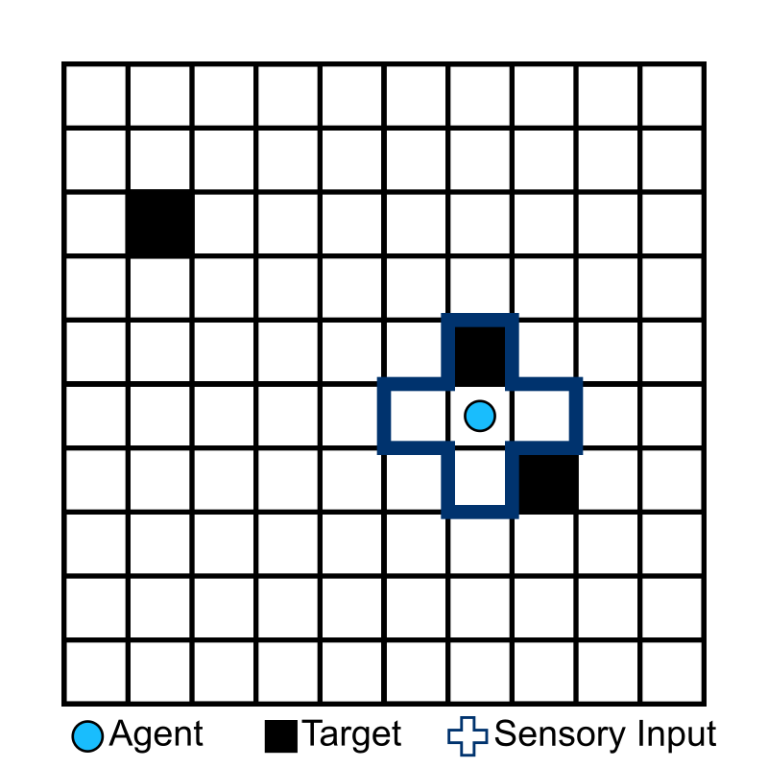
Can minimal embedded networks evolve internal dynamics that support adaptation to changing task rules?
Foraging Task
No poison
Sensory input: 4 directions + current field
Output: movement in 4 directions + stay signal to forage
Task:
Metabolic cost + Movement cost
Foraging = energy refill

Slide 15
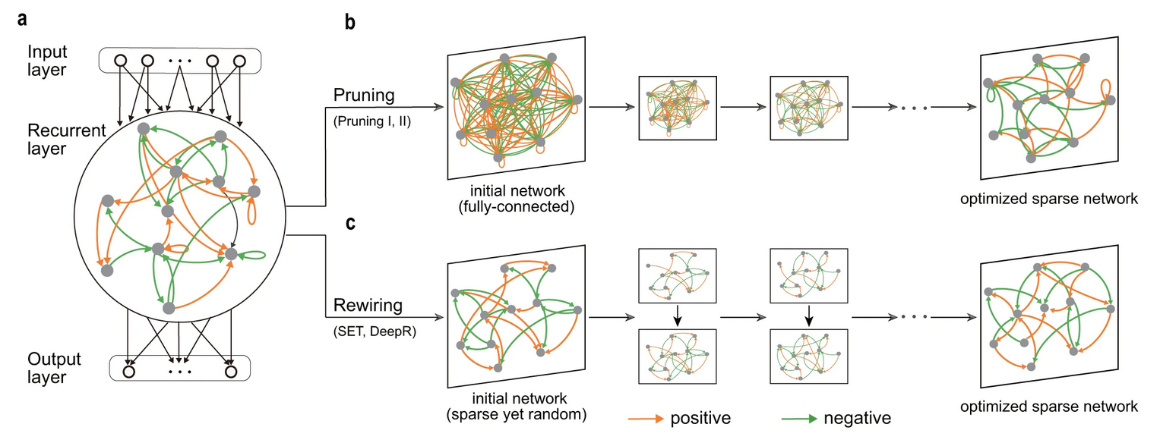
Can minimal embedded networks evolve internal dynamics that support adaptation to changing task rules?
Neuronal Network – The agent‘s brain
Zhang, XJ., Moore, J.M., Yan, G. et al. (2023) Universal structural patterns in sparse recurrent neural networks. Commun Phys

Slide 16
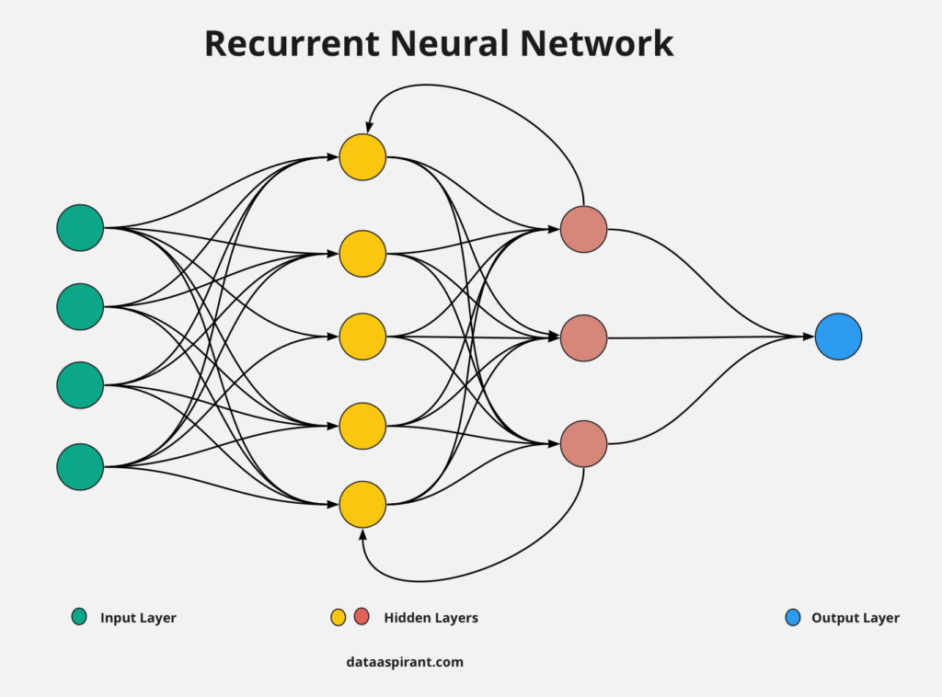
Can minimal embedded networks evolve internal dynamics that support adaptation to changing task rules?
Neuronal Network – The agent‘s brain
Zhang, XJ., Moore, J.M., Yan, G. et al. (2023) Universal structural patterns in sparse recurrent neural networks. Commun Phys

Slide 17
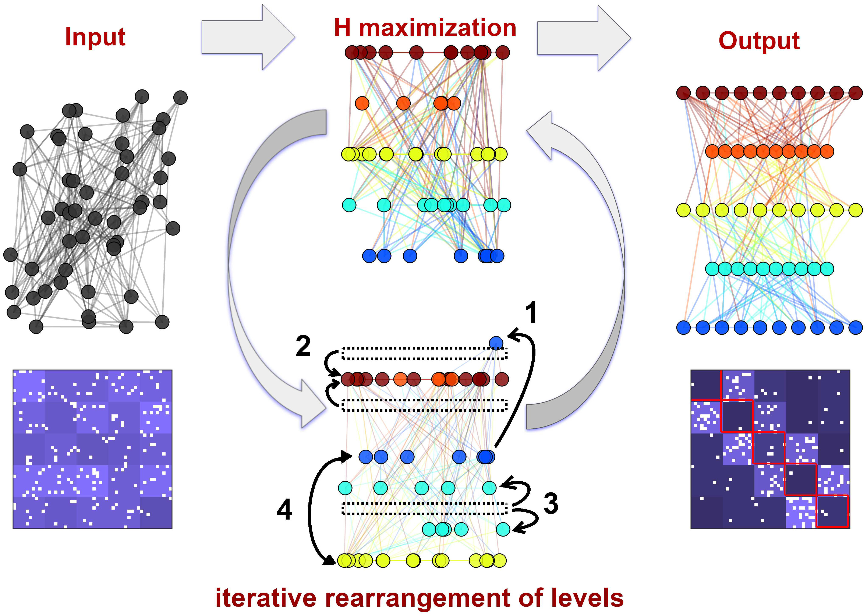
Can minimal embedded networks evolve internal dynamics that support adaptation to changing task rules?
Unstructured Neuronal Networks
Zhang, XJ., Moore, J.M., Yan, G. et al. (2023) Universal structural patterns in sparse recurrent neural networks. Commun Phys
A. Pathak, S.N. Menon, & S. Sinha (2024) A hierarchy index for networks in the brain reveals a complex entangled organizational structure, Proc. Natl. Acad. Sci. U.S.A.

Slide 18
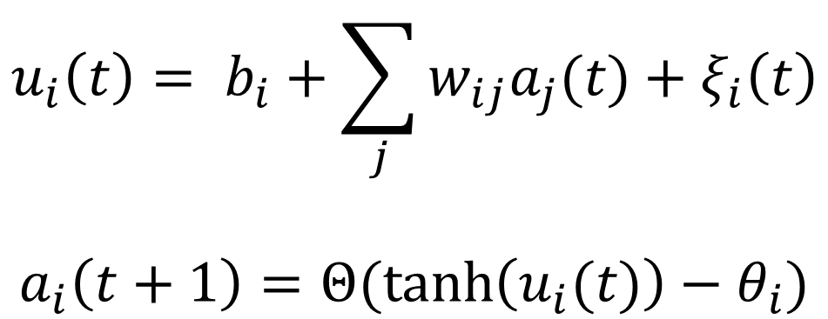
Can minimal embedded networks evolve internal dynamics that support adaptation to changing task rules?
The neurons
Weighted sum of inputs
Tonic activation bias
Random normal noise
$$u_{i}\left(t\right)= b_{i}+\sum_{j}{w_{ij}a_{j}(t)}+ξ_{i}\left(t\right)$$
$$a_{i}\left(t+1\right)=Θ(\tanh\left(u_{i}(t)\right)−θ_{i})$$
Threshold
Meaningful threshold mapping
Zhang, XJ., Moore, J.M., Yan, G. et al. (2023) Universal structural patterns in sparse recurrent neural networks. Commun Phys
Candadai M. et al. (2020) Universal structural patterns in sparse recurrent neural networks. Commun Phys

Slide 19
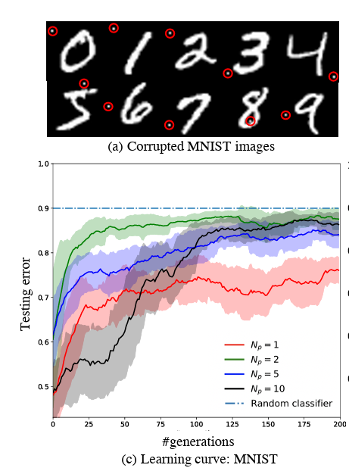
Can minimal embedded networks evolve internal dynamics that support adaptation to changing task rules?
Generalization through training perturbations
https://www.sciencedirect.com/science/article/pii/S0925231224014723
CHAUDHURY, Subhajit; YAMASAKI, Toshihiko. Investigating generalization in neural networks under optimally evolved training perturbations. In: ICASSP 2020-2020 IEEE International Conference on Acoustics, Speech and Signal Processing (ICASSP). IEEE, 2020. S. 3617-3612.
JACOBSEN, Jörn-Henrik, et al. Excessive invariance causes adversarial vulnerability. arXiv preprint arXiv:1811.00401, 2018.
Chaudhury S., Yamasaki, T. (2020) Investigating generalization in neural networks under optimally evolved training perturbations. arXiv
https://proceedings.mlr.press/v97/arora19a.html
https://arxiv.org/pdf/1802.08760

Slide 20
1
2
3
4
Static Task Phase
Train on static task w/ traditional evolution and define adaptability gap
Training & Testing EA with perturbations
Train variants w/ perturbed evolution and test performance and adaptability
Ablation
Ablate to necessary core and test adaptability on withheld scenarios
Wiring analysis
Analyze common patterns in adaptors and compare with biological wiring patterns

Slide 21
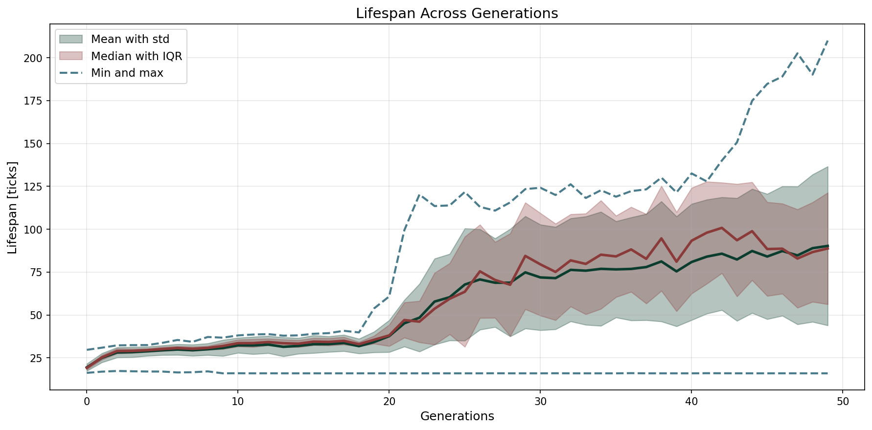
1
First results
EA evolved from random network initialization. Population size = 250, elite = 10
In generation 0: mean = 19.5, median = 19.2, max = 29.7
In generation 50: mean = 69.0, median = 74.22, max = 131.59

Slide 22
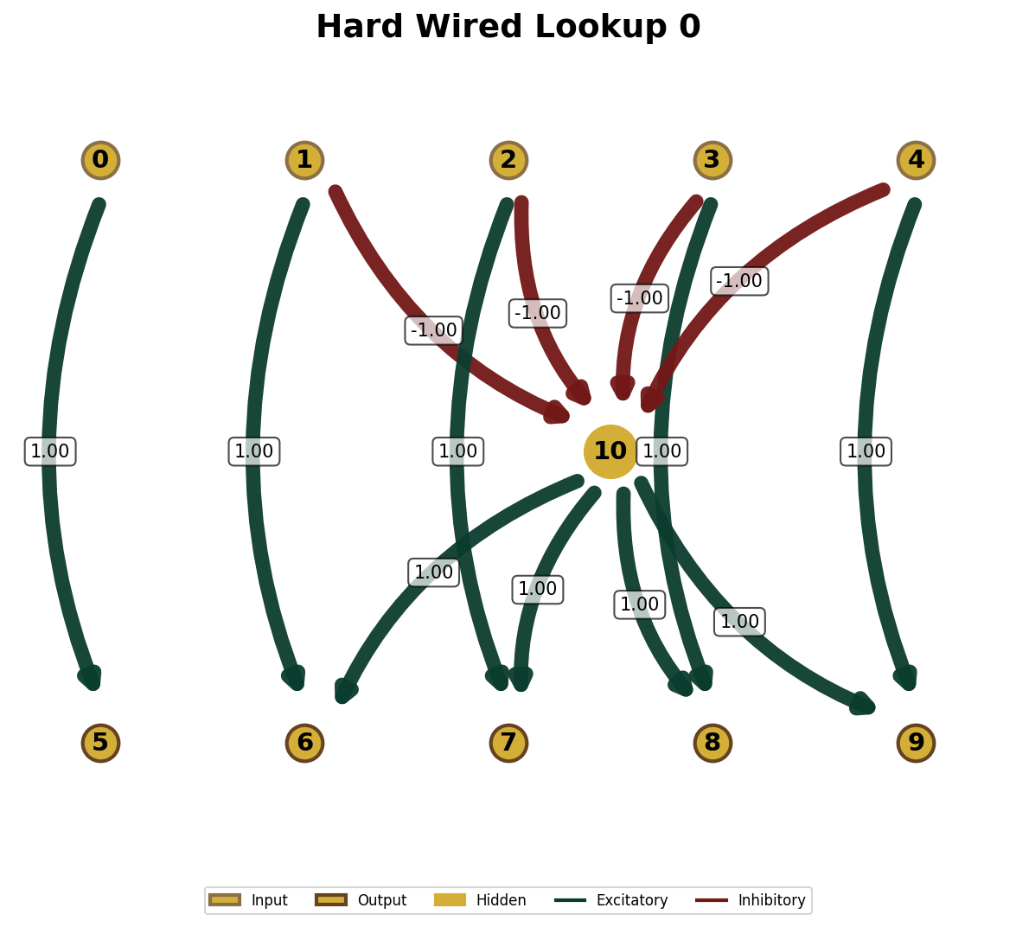
1
First results
Optimal solution?
If on food → stay and eat
If sensing food in one direction → move in that direction
If not sensing any food → move away in random direction
on food
food N
food E
food S
food W
stay
move N
move E
move S
move W

Slide 23
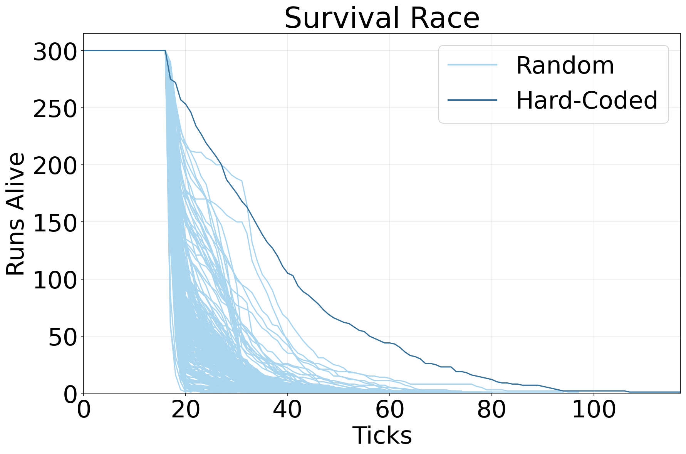
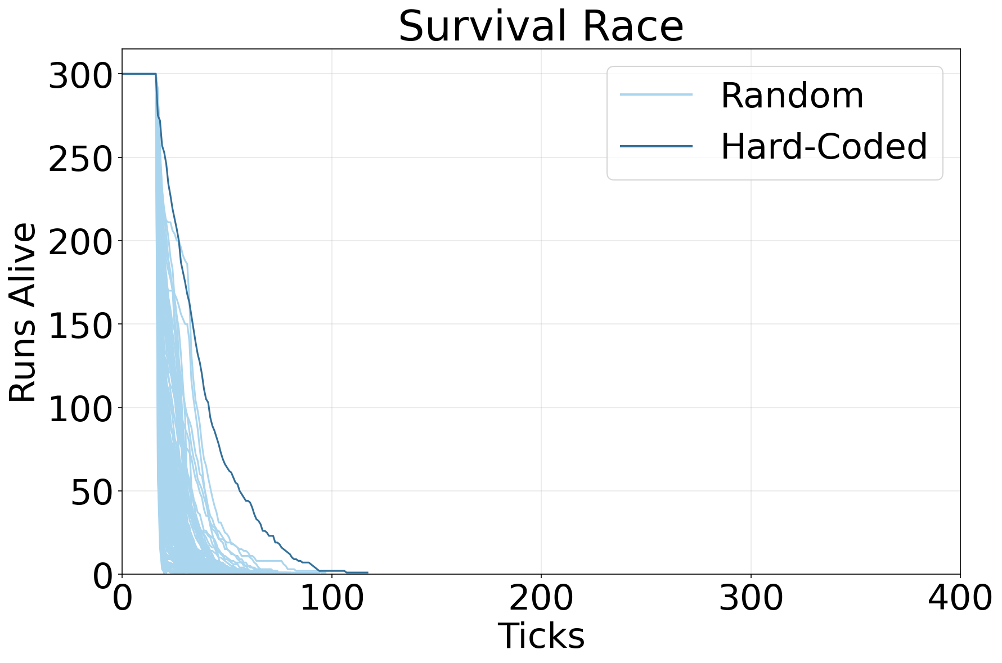
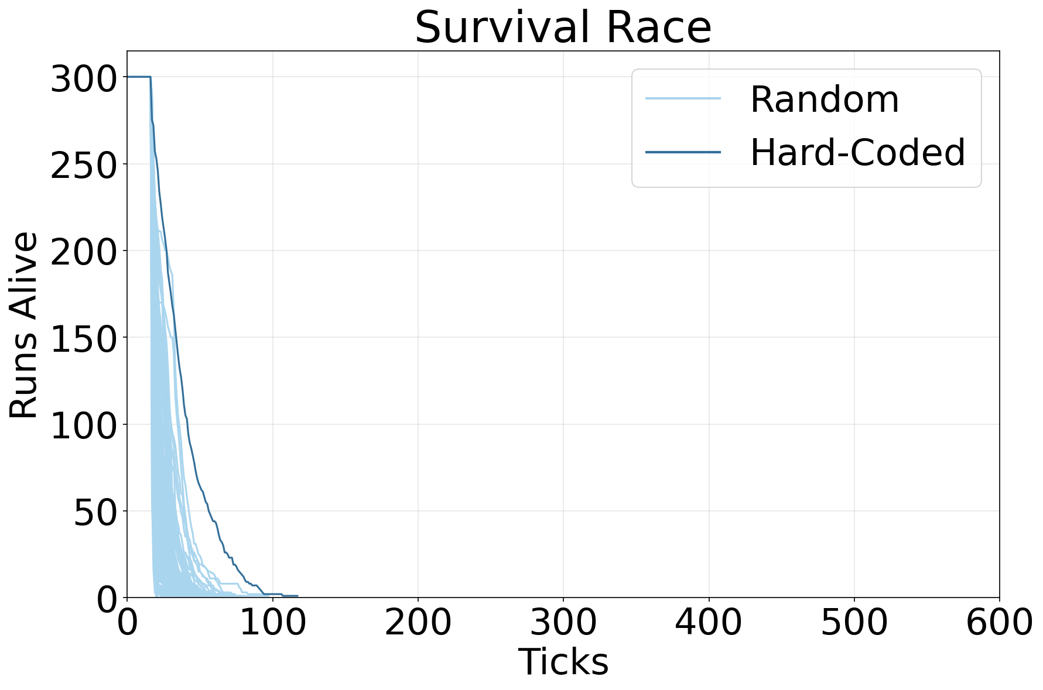
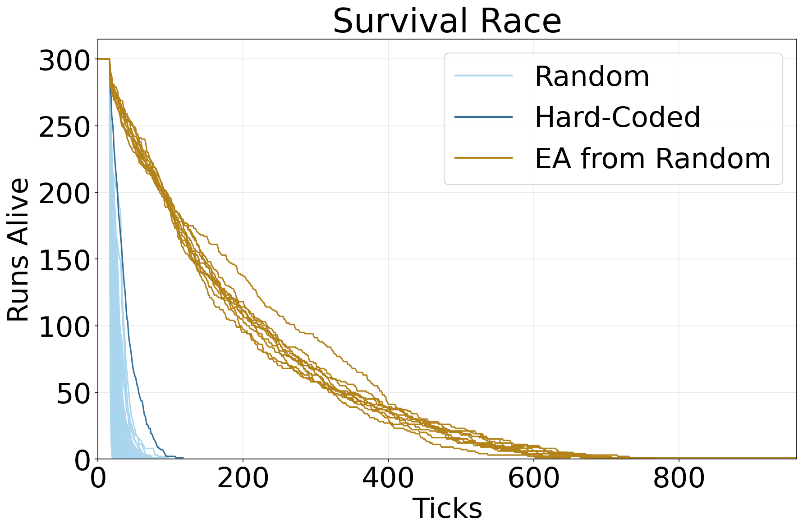
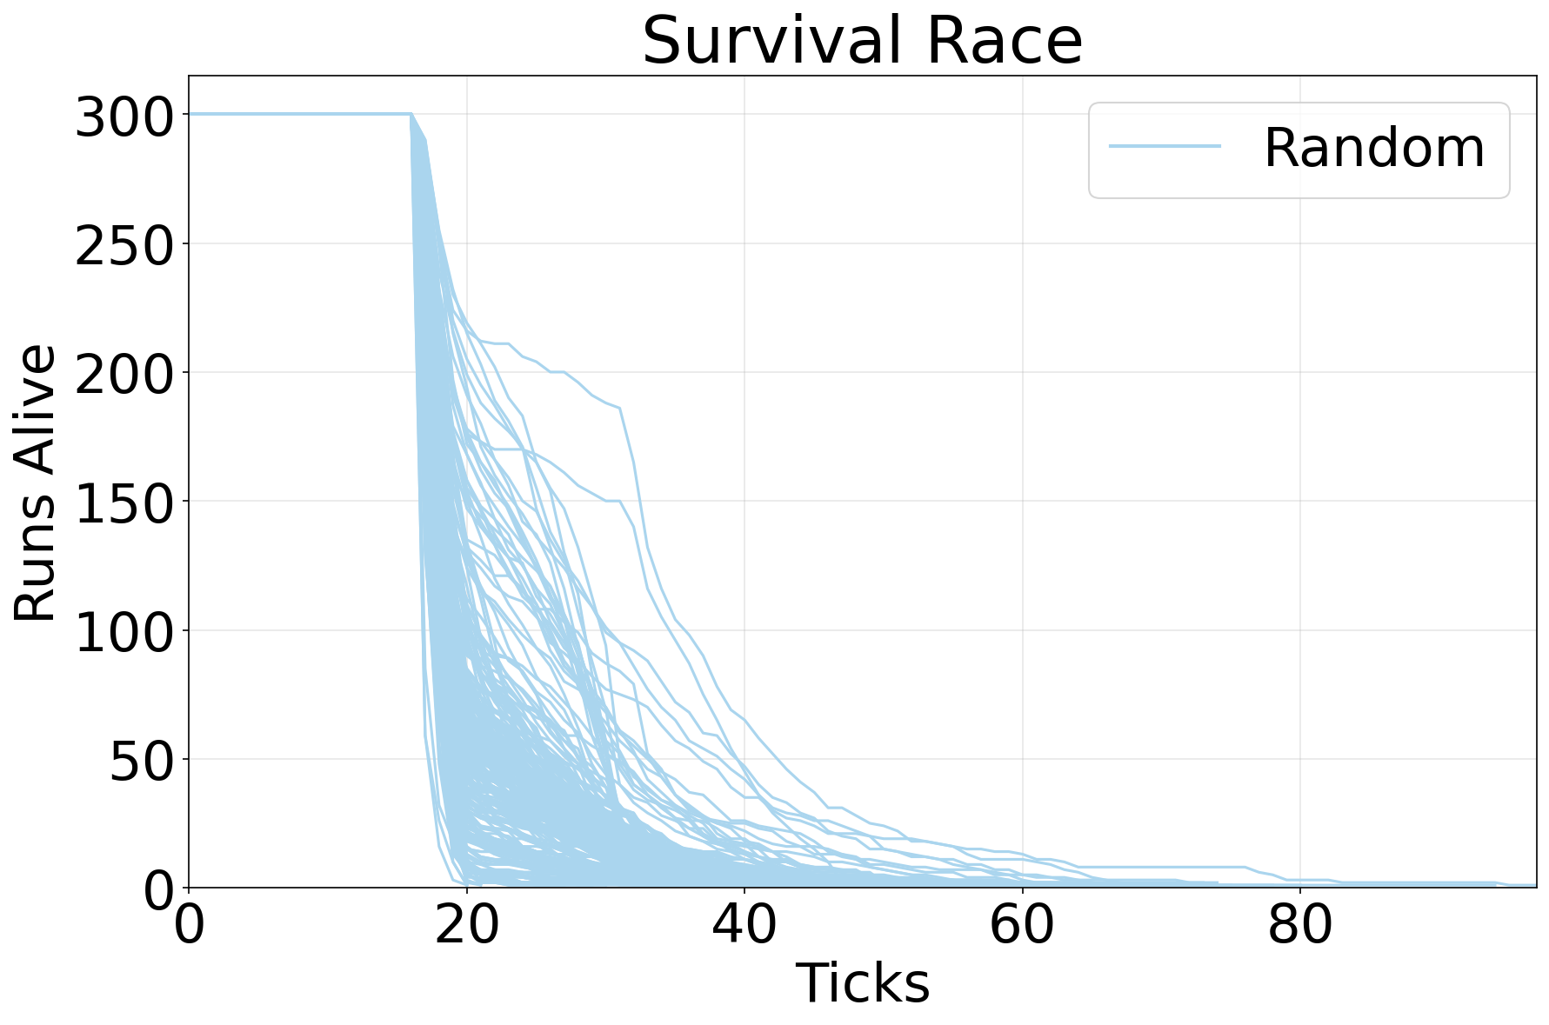
1
First results
Optimal solution?
No!
Why not and what did the evolutionary algorithm find?

Slide 24
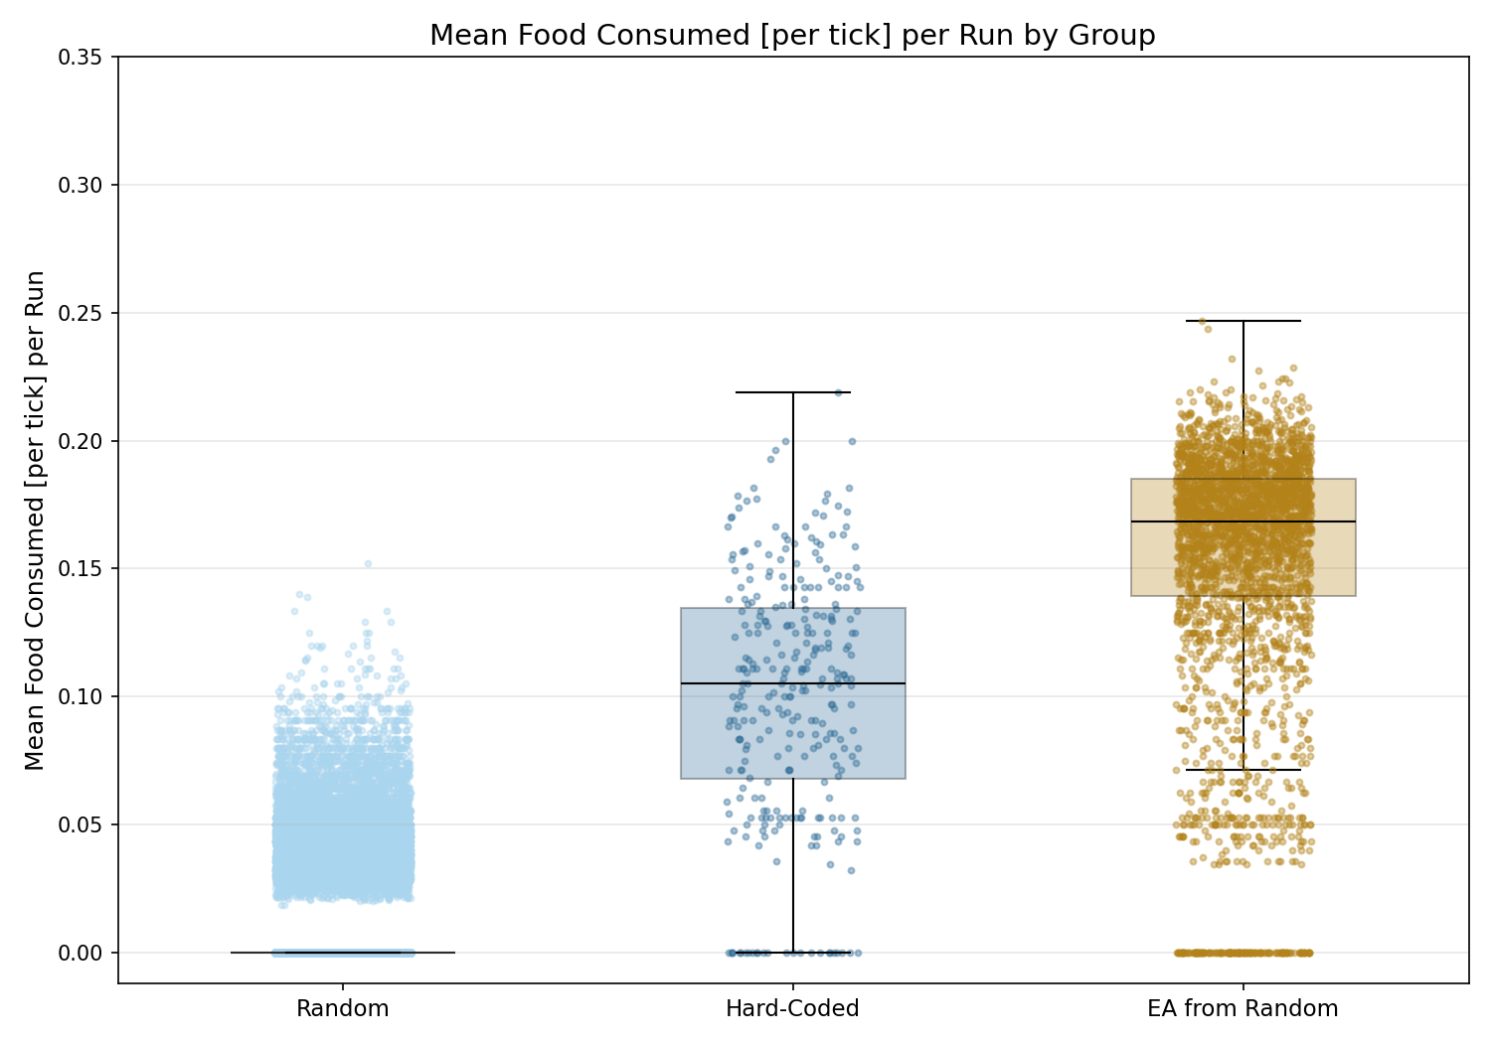
1
First results
****
****
****
The evolved variants found 15 times more food than the random variants!
Kruskal-Wallis: p << 0.01; ε² = 0.4 (large effect size)
MWU + Holm-Bonferroni:
Hard-Coded vs Random: p << 0.01; r = -0.87 (large effect size)
EA vs Random: p << 0.01; r = -0.97 (large effect size)
EA vs Hard-Coded: p = 9*10⁻⁹⁰; r = -0.7 (large effect size)

Slide 25
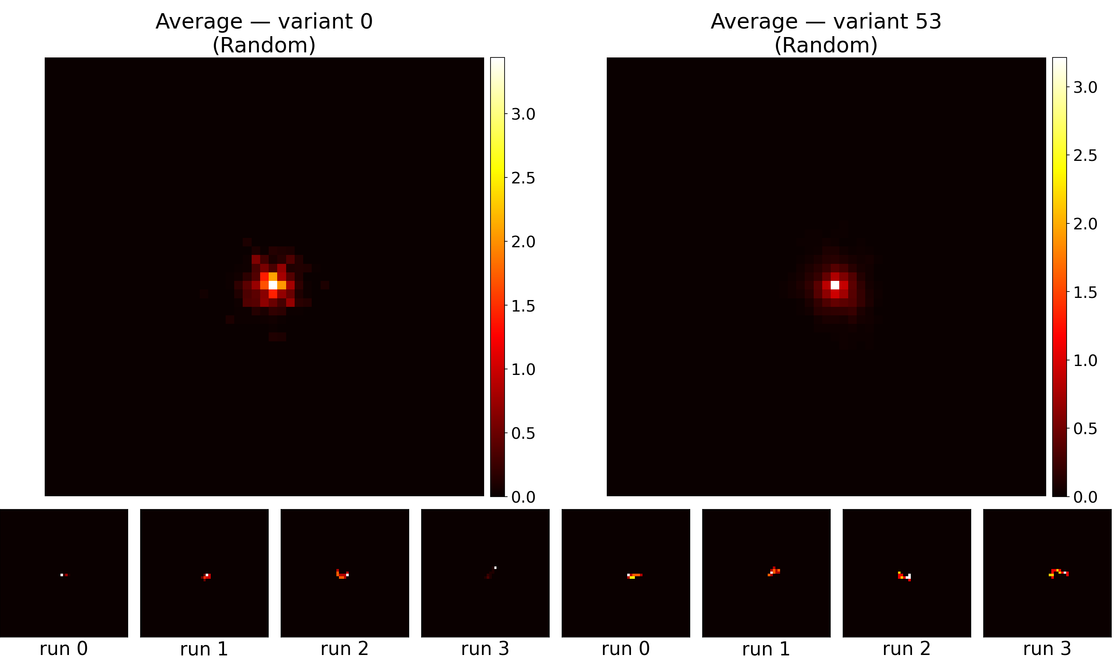
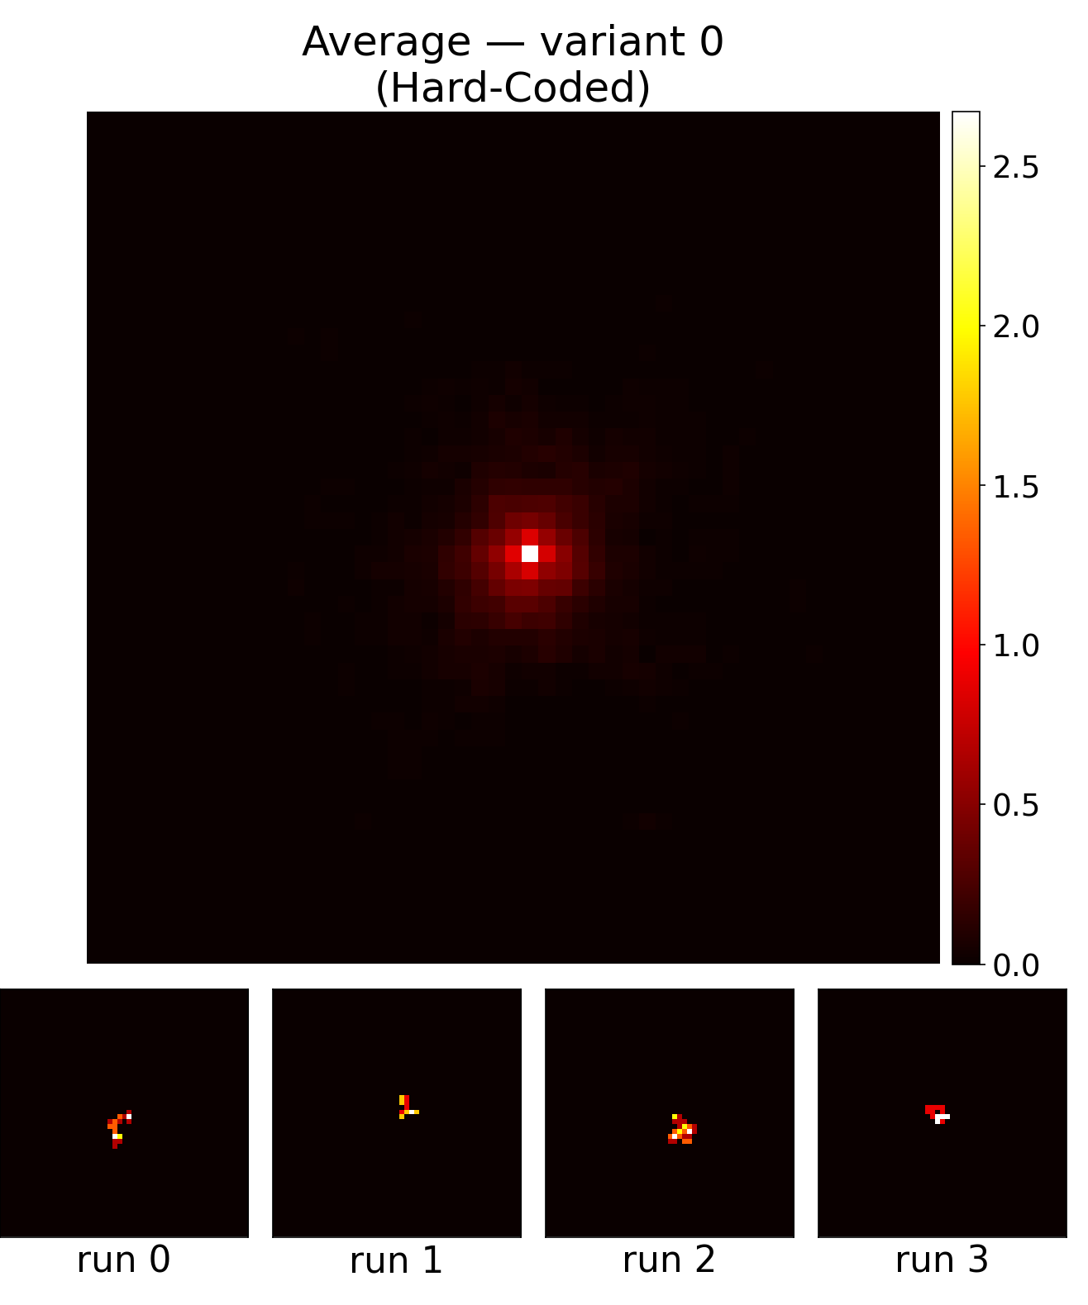
1
First results
In this scenario food once consumed does not regrow.
Randomly moving variants deplete their local supply.

Slide 26
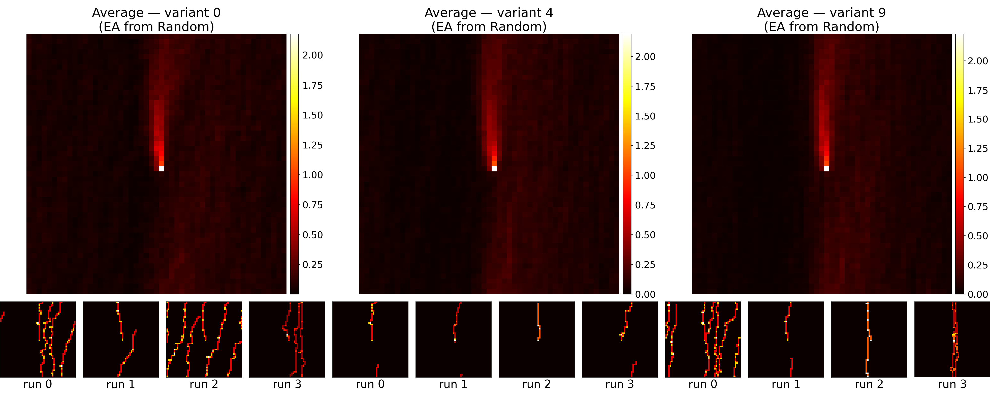
1
First results
Evolved variants developed a directional preference.

Slide 27
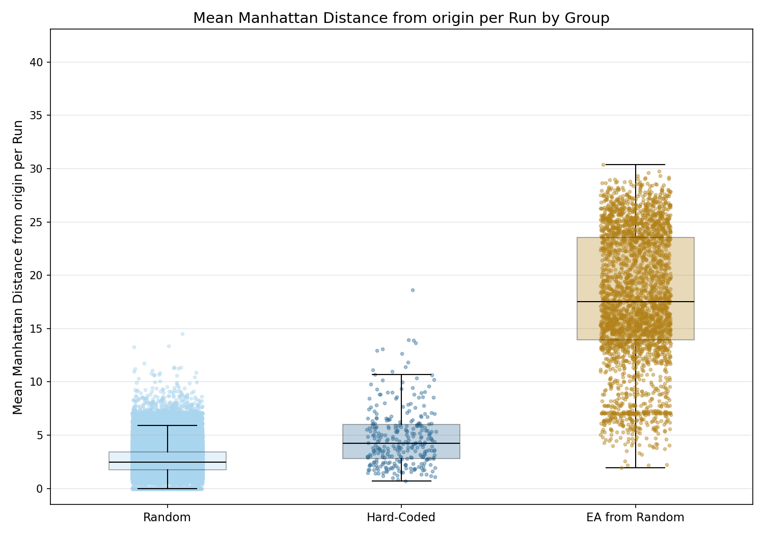
1
First results
****
****
****
The evolved variants travel further from the origin than the random variants!
Kruskal-Wallis: p ≈ 0.000; ε² = 0.1075 (medium effect size)
MWU + Holm-Bonferroni:
Hard-Coded vs Random: p = 1*10⁻⁵⁰; r = 0.499 (large effect size)
EA vs Random: p ≈ 0.000; r = 0.992 (large effect size)
EA vs Hard-Coded: p = 1*10⁻¹⁵⁹; r = 0.943 (large effect size)

Slide 28
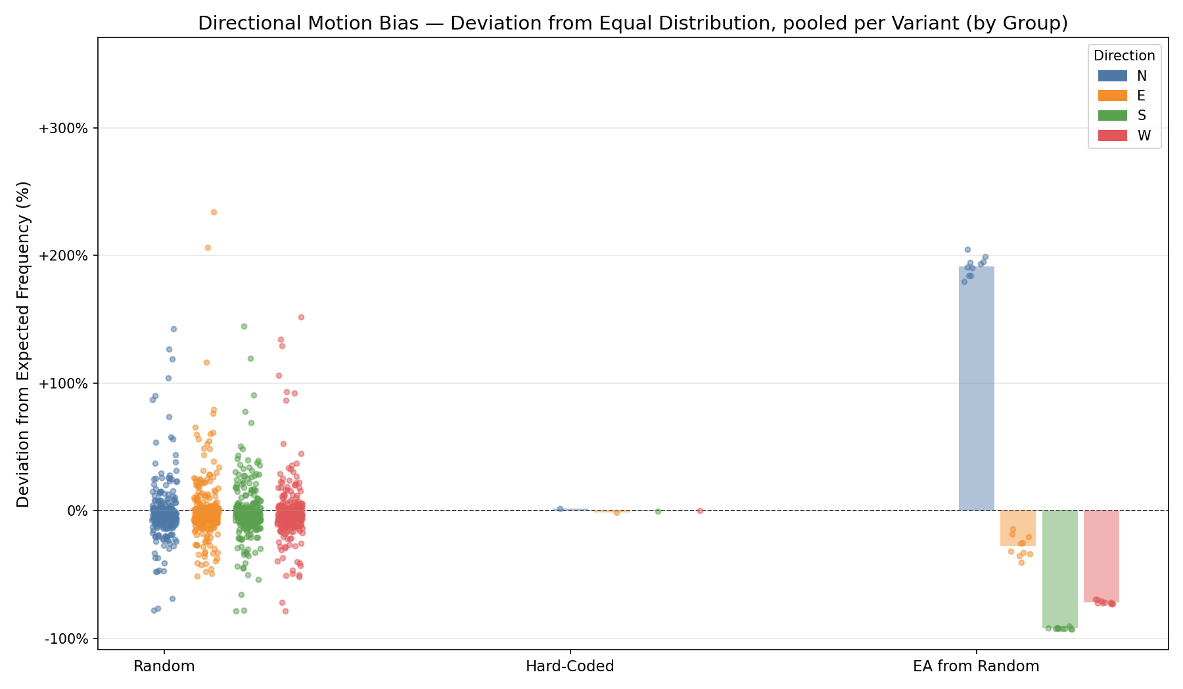
1
First results
Evolved variants developed a directional preference.
Random:
Kruskal-Wallis p = 10-40; ε2 < 0.01 (n.s. ES)
MWU + Holm-Bonferroni:
N vs. E: p ~ 0.1; r < -0.01 (n.s. ES)
N vs. S: p ~ 0.6; r < -0.01 (n.s. ES)
N vs. W: p ~ 4*10-29; r ~ -0.05 (n.s. ES)
E vs. S: p ~ 0.003; r ~ -0.01 (n.s. ES)
E vs. W: p ~ 2*10-20; r ~ -0.04 (n.s. ES)
S vs. W: p ~ 3*10-32; r ~ -0.06 (n.s. ES)
Hard-Coded:
Kruskal-Wallis p = 0.65; ε² < 0.01 (n.s. ES)
EA from Random:
Kruskal-Wallis p<< 0.001; ε² = 0.6 (large ES)
MWU + Holm-Bonferroni:
N vs. E: p<< 0.001; r = -0.7(large ES)
N vs. S: p<< 0.001; r = -0.99 (large ES)
N vs. W: p<< 0.001; r = -0.92 (large ES)
E vs. S: p<< 0.001; r = -0.7 (large ES)
E vs. W: p ~ 6*10⁻¹⁴²; r = - 0.4 (medium ES)
S vs. W: p<< 0.001; r = 0.6 (large ES)

Slide 29
1
First results
Evolutionary algorithm finds successful solutions to static tasks.
Can these adapt to run-time rule changes?

Slide 30
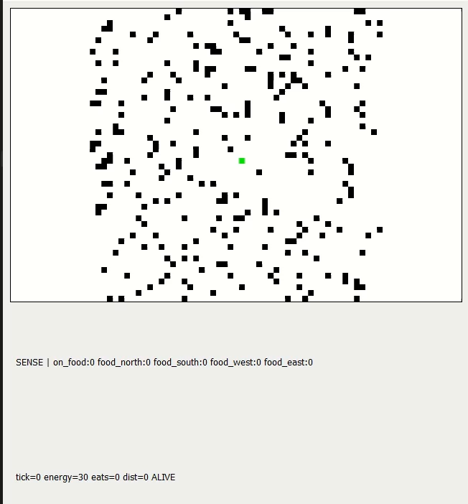
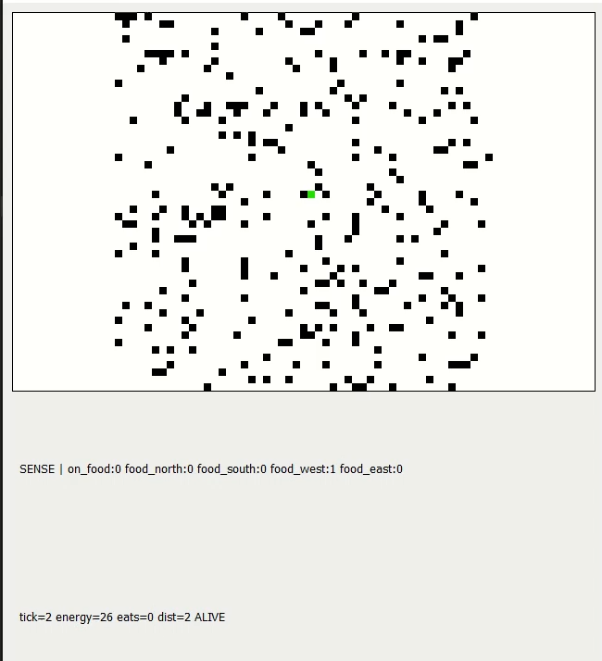
1
First results
Can these adapt to run-time rule changes?
Initially:
dense targets, no regrow
Tick 100:
sparse targets, fast regrow

Slide 31
1
2
3
4
Static Task Phase
Train on static task w/ traditional evolution and define adaptability gap
Training & Testing EA with perturbations
Train variants w/ perturbed evolution and test performance and adaptability
Ablation
Ablate to necessary core and test adaptability on withheld scenarios
Wiring analysis
Analyze common patterns in adaptors and compare with biological wiring patterns

Slide 32
Build minimal networks that can adapt to tasks they were never explicitly trained on,
and characterize what structural properties make that possible.
Candidate wiring motifs for targeted investigation in biological circuits / networks
Model for interpretation of data from complex circuits and brains
Outlook

