Slide 1

Selection and investigation of unsupervised adaptive learners with minmal neuronal architecture

Slide 2
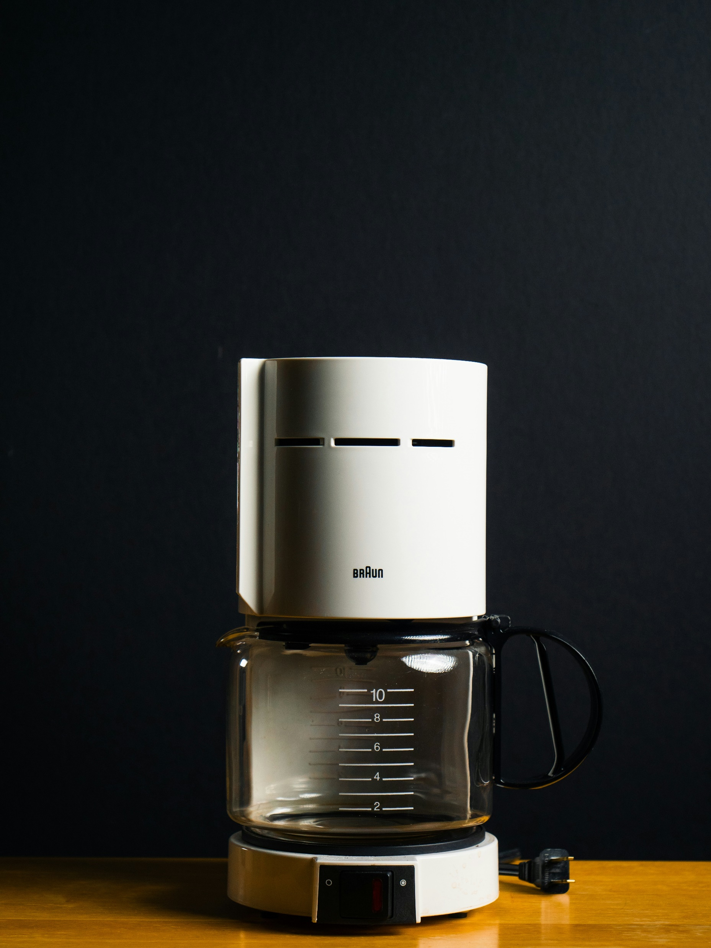
1 - Who here knows how to work the coffee maker?
Photo by Ronan Furuta on Unsplash

Slide 3
2 – Complete this sentence:
The weather outside is nice today, the sky is ________.

Slide 4
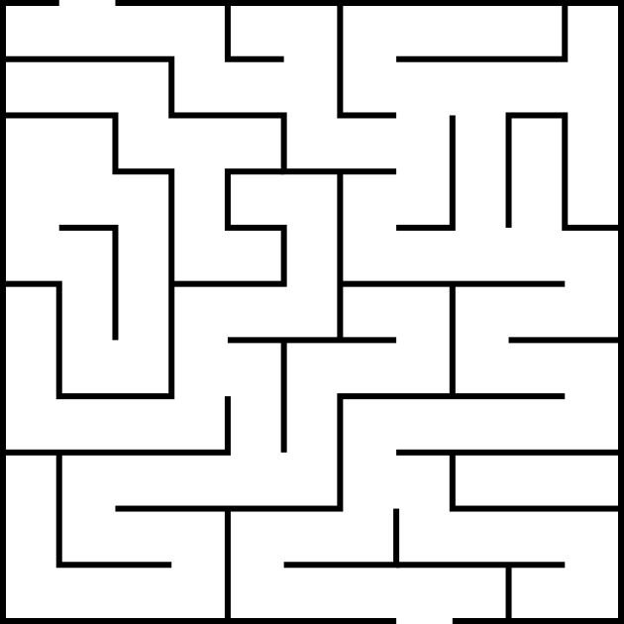
3 – Find the shortest path through this maze.

Slide 5
Why are brains so good at flexible generalization?
Why can‘t we explain it?
350 BCE
Aristotle in De Anima
substrate-independece of thought
1943 Mc Culloch and Pitts
immense computational power of simple neuronal networks
1982 Hopfield
Associative neuronal networks
1890s Cajal
Importance of plasticity
1949 Hebb
plasticity mechanism
1859 Darwin
‚brains that generalize survive‘
1930s Alan Turing
Computability
1990 Randall Beer
Intelligence as Adaptive Behavior
1948 Wiener
information processing and feedback
Today – we still don‘t know:
Rolf Pfeifer, Josh Bongard Embedded cognition
Kenneth Stanley NEAT algorithm
Izquierdo, Di Paolo Egbert – chemotaxis models / minimal life

Slide 6
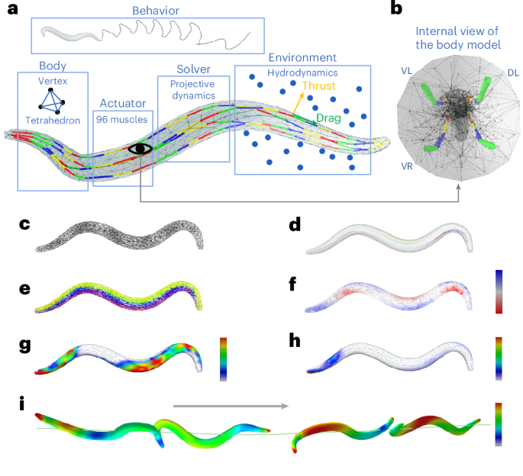
Why are brains so good at flexible generalization?
Why can‘t we explain it?
Recent studies on connectome modelling and some key results
E.g.
Zhao, M., Wang, N., Jiang, X. et al. An integrative data-driven model simulating C. elegans brain, body and environment interactions. Nat Comput Sci 4, 978–990 (2024). https://doi.org/10.1038/s43588-024-00738-w

Slide 7
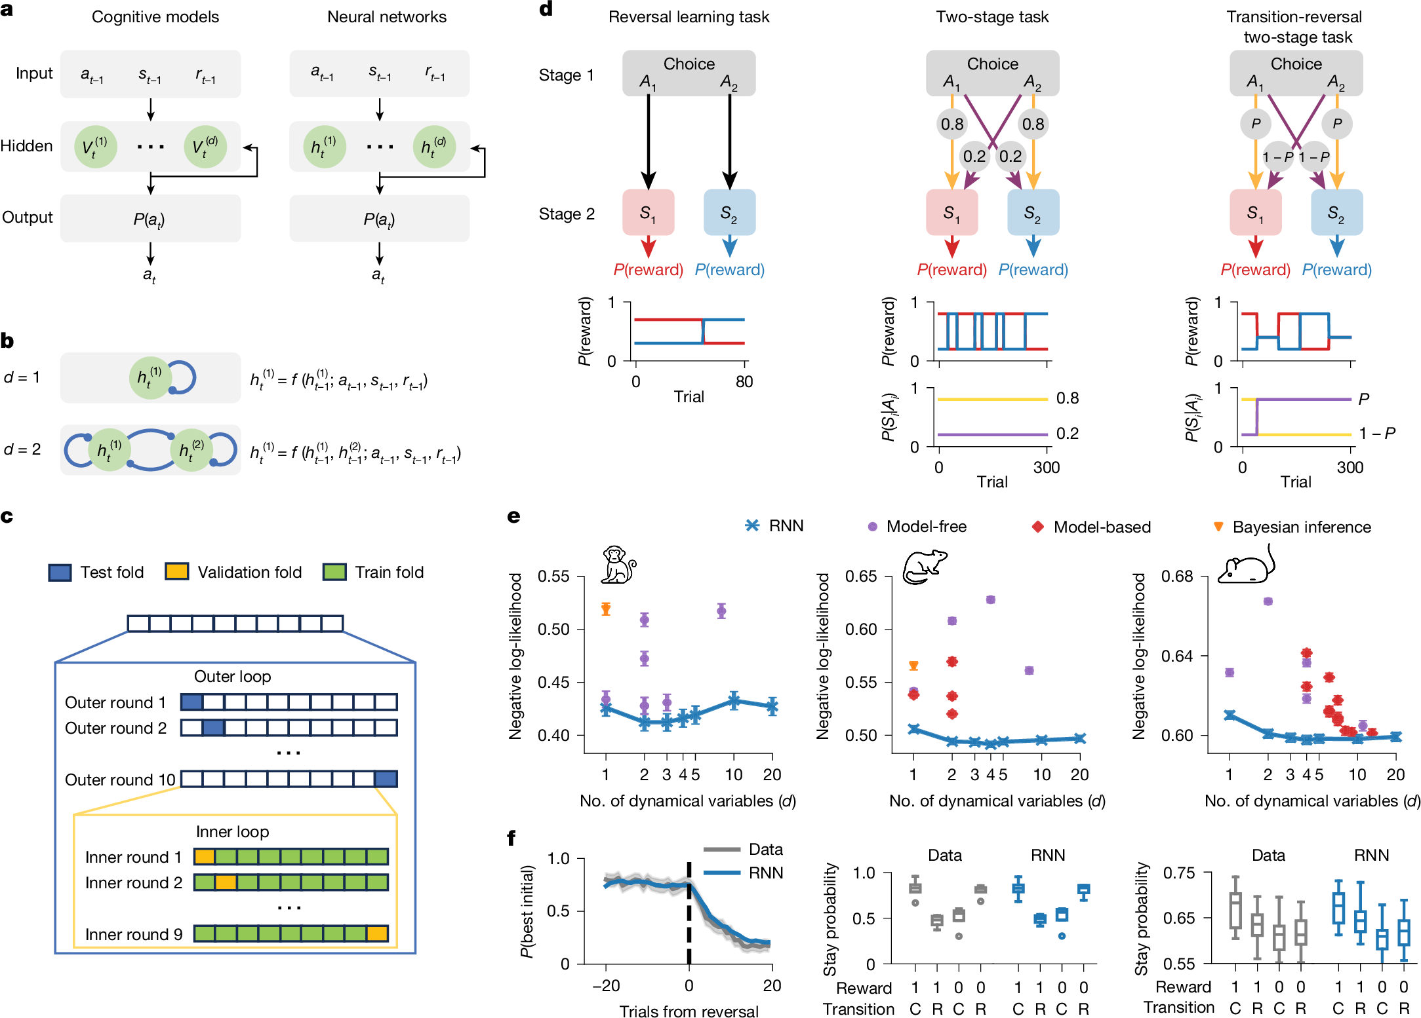
Why are brains so good at flexible generalization?
Why can‘t we explain it?
Top-down approach
Recent studies on CTRNNs & minimal cognition
E.g.
Ji-An, L., Benna, M.K. & Mattar, M.G. Discovering cognitive strategies with tiny recurrent neural networks. Nature 644, 993–1001 (2025). https://doi.org/10.1038/s41586-025-09142-4
Minimal models have a long and productive history in neuroscience. we‘re applying that logic to the question of adaptive flexibility.
Bottom-up approach

Slide 8
Selection and investigation of unsupervised adaptive learners with minmal neuronal architecture
→ Minimum viable brain

Slide 9
Selection and investigation of unsupervised adaptive learners with minmal neuronal architecture
~ 15 neurons
Details about the model an implementation with citations (e.g. Candadai et. al)
Details about the wiring-based plasticity including the weight update formula

Slide 10
Selection and investigation of unsupervised adaptive learners with minmal neuronal architecture
Grid foraging taks (with citations)
Unsupervised learning
Evolutionary algorithm (citation)
Two-level non-stationary EA
run-time adaptability & plasticity
Ablation to prohibit multiple static strategies
Testing on previously unseen tasks

Slide 11
Current Results – Unsupervised leraning on static tasks
Show EA results, wiring of lookup solution
EA solution beats lookup – why?

Slide 12
Current Results – Unsupervised leraning on static tasks
Reason: local exhaustion – exploitation vs exploration not optimal in lookup solution
Show how EA solutions solve it
Calculate exploitation vs exploration and show comparison

Slide 13
Outlook
Build minimal networks that can adapt to tasks they were never explicitly trained on, and characterize what structural properties make that possible.
Candidate wiring motifs for targeted investigation in biological circuits / networks
Model for interpretation of data from complex circuits and brains

