Slide 1

Jana elmorsy
Joice Hany
Mohamed Ahmed
Ali saber
Essam Ashraf
Mostafa Yasser
Fares Ashraf

Slide 2







Overview
Create, save, and manage your study notes with an intuitive interface
Get instant definitions and example sentences for any word
Ai Study Assistant
Get concise summaries of long texts powered by AI in seconds
Generate Q&A flashcards automatically from your study material
Create custom quizzes with 1-20 questions from any content
Track all your AI interactions and review past queries

Slide 3
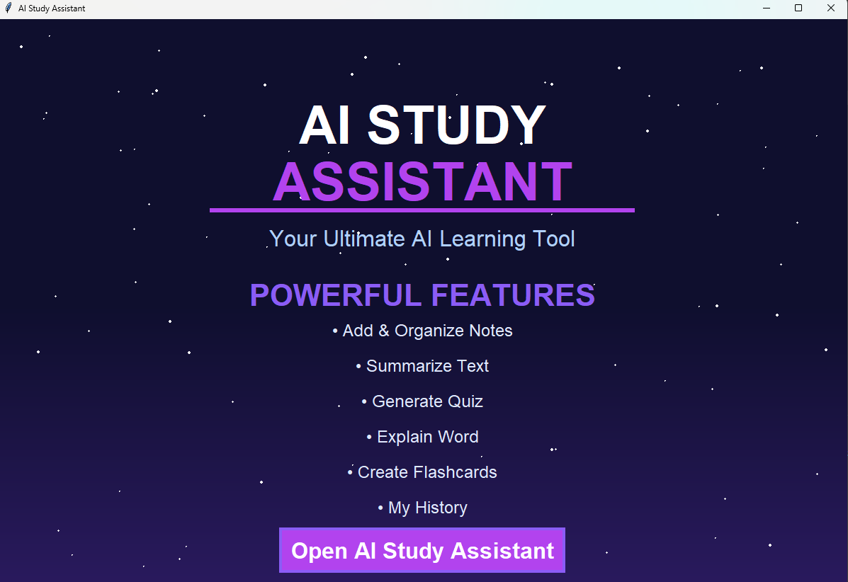

Slide 4
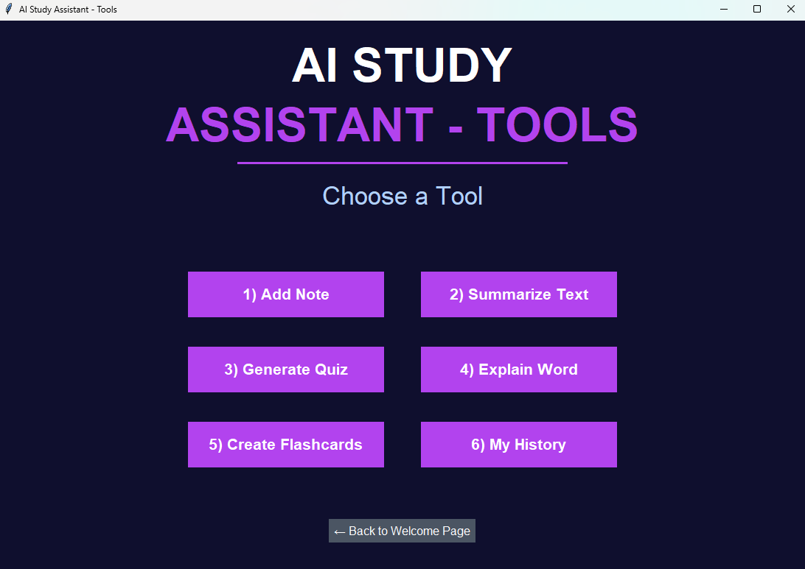

Slide 5





Agenda
My History
Summarize Text
Explain Word
Generate Quiz
Create Flashcards
Add & Organize Notes

Slide 6
Add Notes
Summarize Text
Graphical user interface(GUI)
Generate Quiz
Explain Word
Create Flashcards
My History

Slide 7
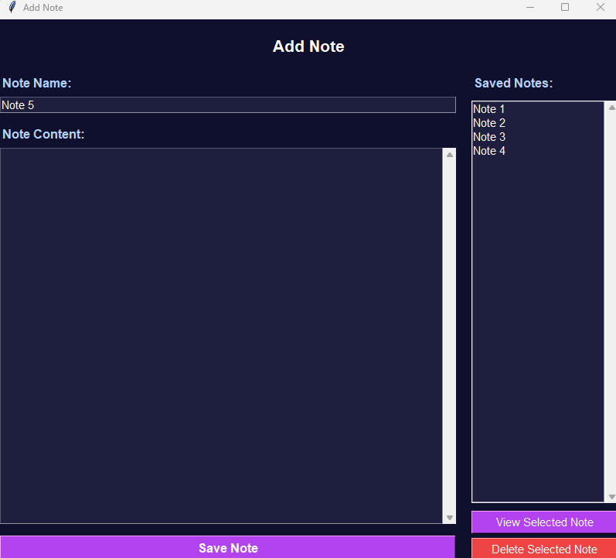
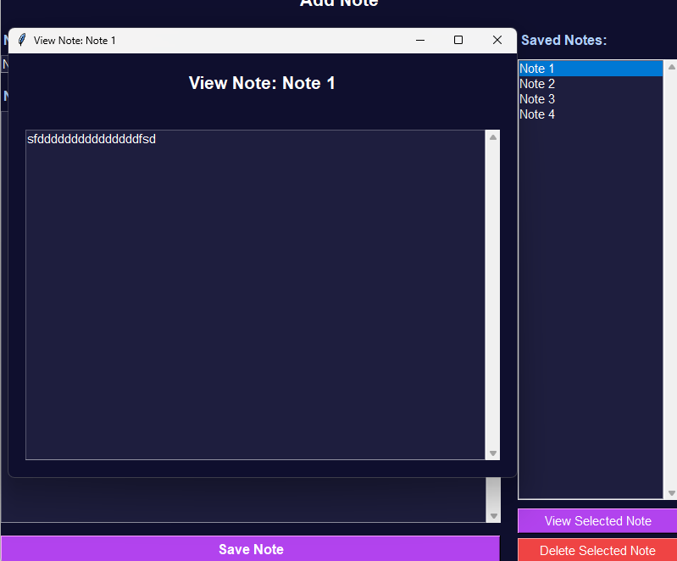
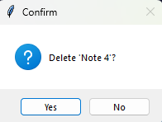
Add Notes
Summarize Text
Generate Quiz
Explain Word
Create Flashcards
My History

Slide 8
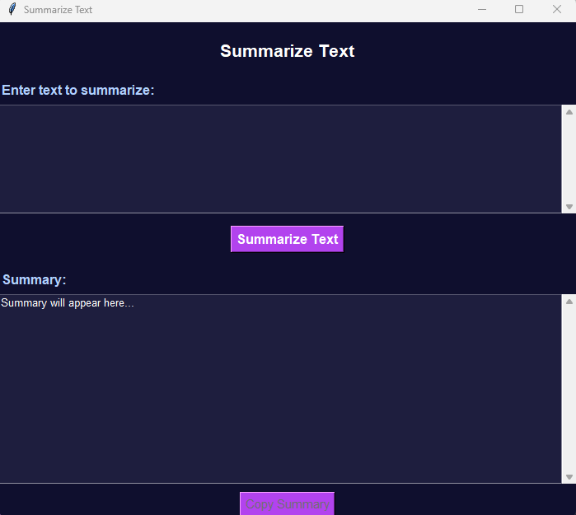
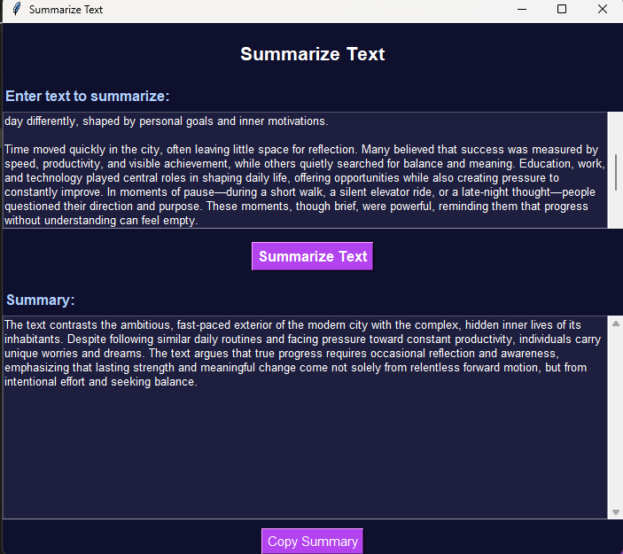
Add Notes
Summarize Text
Generate Quiz
Explain Word
Create Flashcards
My History

Slide 9
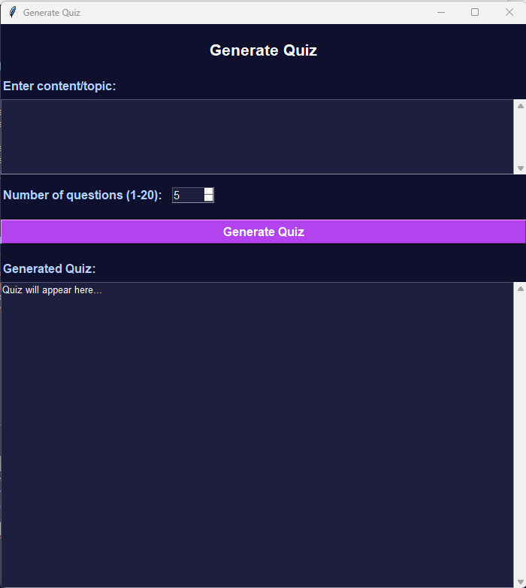
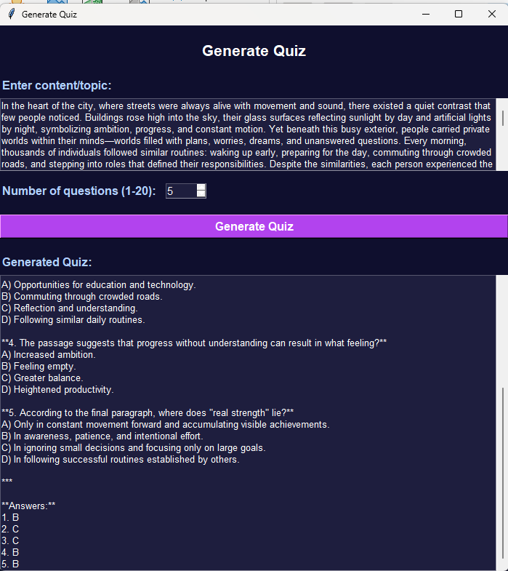
Add Notes
Summarize Text
Generate Quiz
Explain Word
Create Flashcards
My History

Slide 10
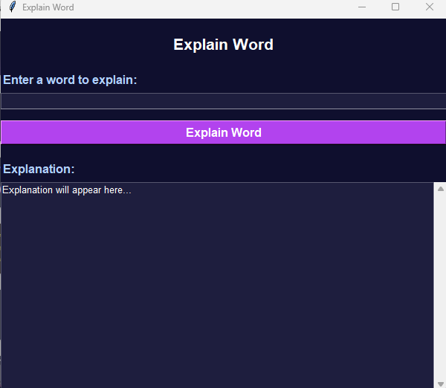
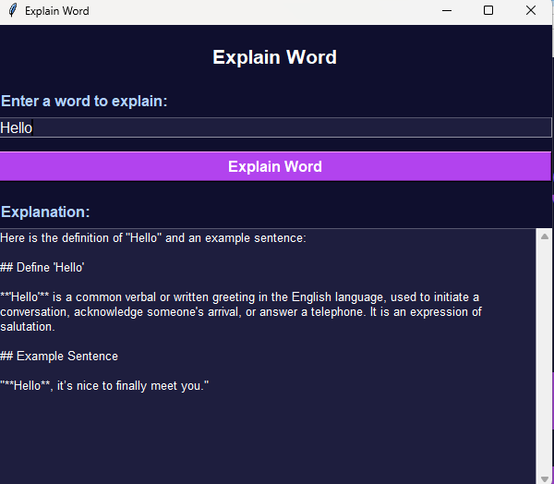
Add Notes
Summarize Text
Generate Quiz
Explain Word
Create Flashcards
My History

Slide 11
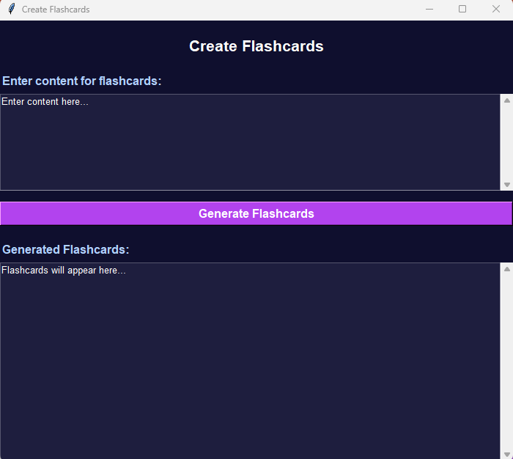
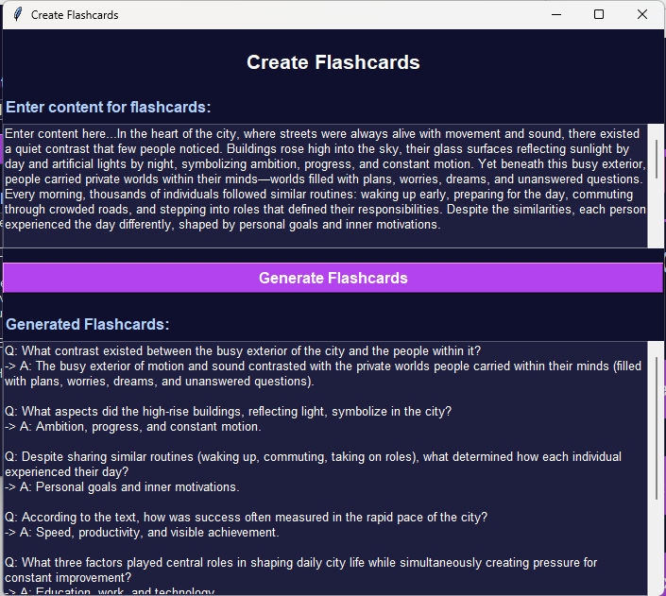
Add Notes
Summarize Text
Generate Quiz
Explain Word
Create Flashcards
My History

Slide 12
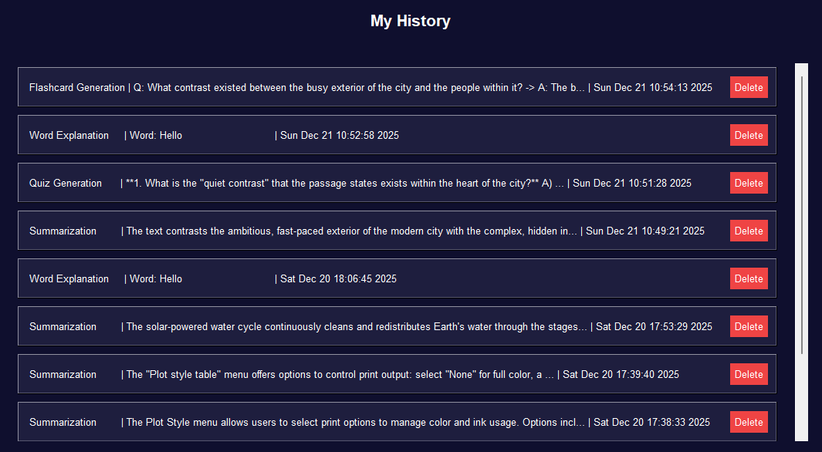
Add Notes
Summarize Text
Generate Quiz
Explain Word
Create Flashcards
My History

Slide 13
Conclusion
01
Traditional Studying
• Manual note organization
• Time-consuming quiz creation
• Limited access to explanations
• No automated summaries
• Difficult to track progress
With AI Study Assistant
• Automated note management
• Instant quiz generation (1-20 questions)
• AI-powered word explanations
• Smart text summarization
• Complete history tracking
02
03
System Architecture
Tkinter GUI(User Interface)
API Layer(Requests)
Gemini AI(Processing)
Response(Result)
Who Can Benefit?
Students
Prepare for exams, create study materials, and understand complex topics.
Researchers
Organize research notes and create summaries of academic papers
Educators
Create teaching materials and assessment tools quickly
04

Slide 14
Jana elmorsy
Joice Hany
Mohamed Ahmed
Ali saber
Essam Ashraf
Mostafa Yasser
Fares Ashraf

