Slide 1
Choosing Infrastructure That Won't Need a Rewrite at 10x Users
One of the most common questions teams ask is:
"How do we build infrastructure that can scale?"
The answer isn't to prepare for millions of users on day one.
It's to make decisions today that won't force you to rebuild everything when your application grows ten times larger.
Scalable infrastructure isn't about using the most advanced technologies—it's about avoiding architectural decisions that become expensive bottlenecks later.

Slide 2
Don't Optimize for a Million Users on Day One
Many startups overcomplicate their infrastructure before they have real users.
They deploy Kubernetes clusters, multiple databases, dozens of microservices, and complex networking—all to support an application that receives a few hundred visits a day.
In many cases, that's unnecessary.
A well-configured virtual server running Docker containers can comfortably support thousands of users before more advanced infrastructure becomes necessary.
The goal isn't to build for infinite scale today. It's to build so scaling later is straightforward.

Slide 3
Keep Your Architecture Modular
Applications that separate responsibilities are much easier to grow.
Instead of building everything into one tightly coupled system, separate concerns such as:
Frontend
Backend API
Database
File storage
Background jobs
Caching
This doesn't mean every component needs its own server immediately. It means your architecture should allow components to move independently as demand increases.

Slide 4
Containers Make Growth Easier
Using containers from the beginning provides consistency across development, testing, and production.
Whether you're deploying to a single VPS or a cloud platform, containerized applications are easier to:
Deploy
Update
Roll back
Scale
Migrate between environments
You don't need Kubernetes on day one, but using Docker early can save significant effort later.

Slide 5
Design Your Database Carefully
Many scaling problems begin with poor database design rather than insufficient hardware.
Before worrying about distributed databases, focus on:
Proper indexing
Efficient queries
Normalized data where appropriate
Connection pooling
Regular backups
A well-designed relational database can handle far more traffic than many developers expect.

Slide 6
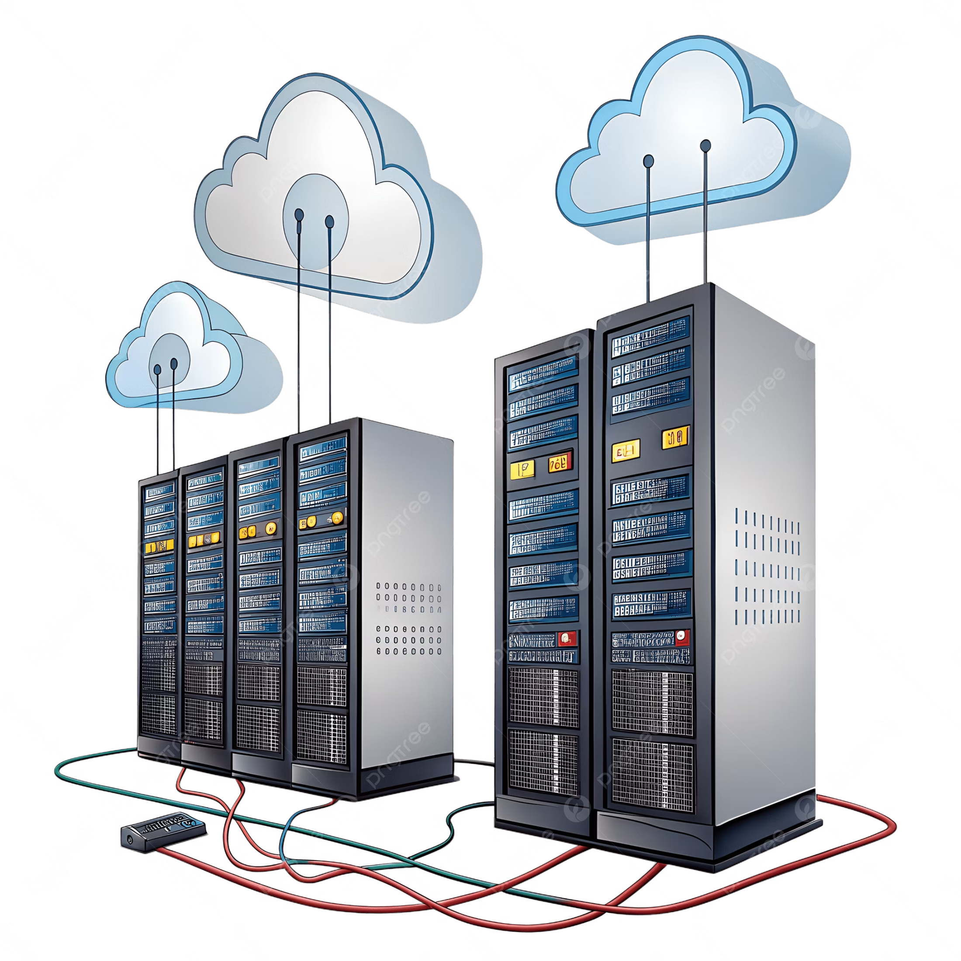
Separate Storage From Compute
Avoid storing important files directly on the application server.
Instead, use dedicated object storage or network storage for:
User uploads
Images
Documents
Backups
Generated files
This makes replacing or scaling application servers much simpler because your data isn't tied to a single machine.

Slide 7





Add Caching Where It Matters
Not every request needs to hit the database.
Caching frequently accessed data can dramatically improve performance while reducing server load.
Common examples include:
Homepage content
Product catalogs
API responses
User sessions
Frequently requested configuration data
The right caching strategy often provides greater performance gains than simply upgrading server hardware.

Slide 8
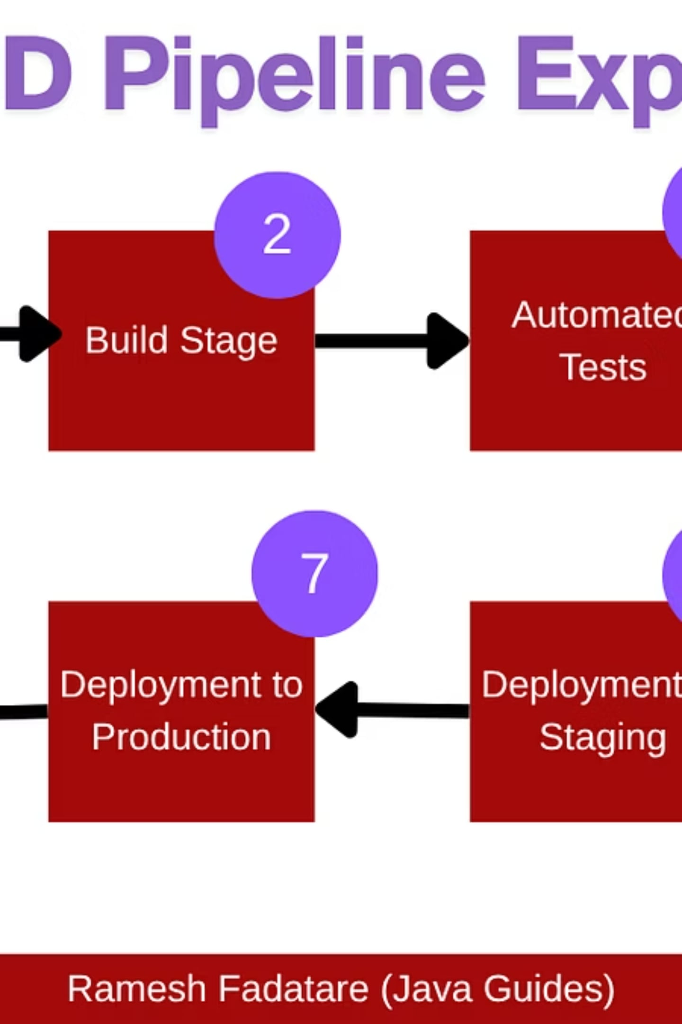
Build Reliable Deployment Pipelines
Scaling isn't just about handling more users.
It's also about delivering updates safely.
Automated deployments reduce downtime, minimize human error, and make rolling back failed releases much easier.
Even a small team benefits from having a repeatable deployment process.

Slide 9
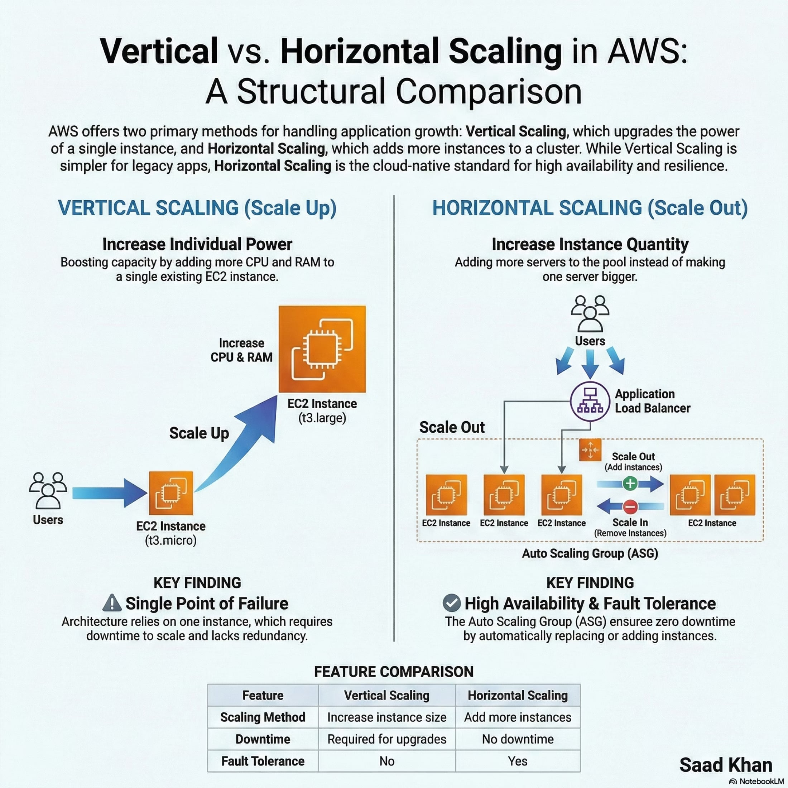
Plan for Horizontal Scaling
Eventually, one server may no longer be enough.
When that happens, your application should be able to run on multiple servers behind a load balancer.
Applications designed to be as stateless as possible are much easier to scale horizontally.
Keep user sessions and shared data in centralized services rather than storing them on individual application servers.

Slide 10

Monitor Before Problems Appear
You can't improve what you can't measure.
Track metrics such as:
CPU usage
Memory consumption
Disk space
Response times
Error rates
Database performance
Monitoring helps you identify bottlenecks before users notice them.
Scaling decisions should be driven by real data—not guesswork.

