Slide 1
How to Scope an MVP So It Doesn't Become the Whole Product
One of the biggest mistakes startups make isn't building too little—it's building too much.
An idea starts with a simple goal:
"Let's build an MVP in two months."
A few weeks later, someone suggests adding user profiles. Then notifications. Then analytics. Then a payment system. Before long, the MVP has quietly become the entire product.
So how do you avoid that?
The key is understanding what an MVP is actually meant to achieve.

Slide 2
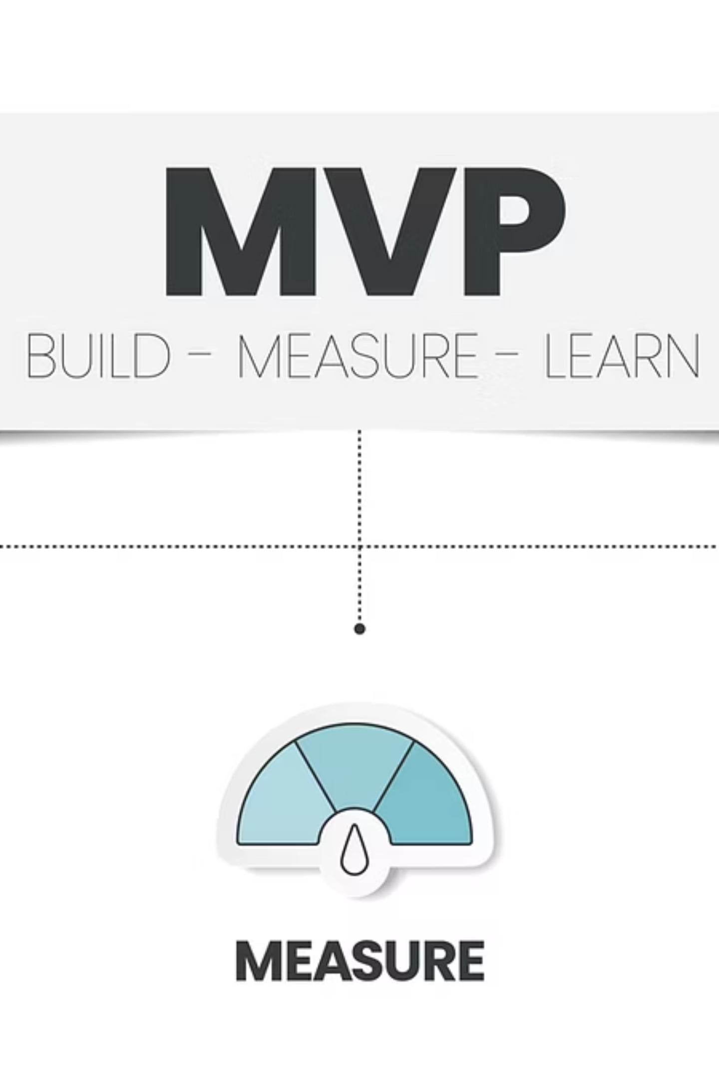
What Is an MVP?
MVP stands for Minimum Viable Product.
Notice the emphasis on minimum.
An MVP isn't an unfinished product or a low-quality version of your idea. It's the smallest version of your product that solves one real problem for one specific group of users.
Its purpose isn't to impress everyone—it's to validate your assumptions as quickly as possible.

Slide 3
Start With One Core Problem
Before writing a single line of code, answer this question:
What is the one problem we're trying to solve?
If your product tries to solve five different problems from day one, your MVP is already too large.
A focused MVP has one clear objective.
For example:
Food Delivery MVP
Project Management MVP
Booking Platform MVP
A food delivery MVP helps users order food.
A project management MVP helps teams track tasks.
A booking platform MVP allows customers to reserve appointments.
Everything else is secondary.

Slide 4
Separate "Need" From "Nice to Have"
Every feature request should face a simple test:
Can users achieve the main goal without this feature?
If the answer is yes, it probably doesn't belong in the first release.
Examples of features that are often postponed:
Dark mode
Push notifications
Advanced analytics
Social login
Referral programs
Multiple user roles
AI-powered recommendations
These features can add value, but they rarely determine whether the core idea succeeds.

Slide 5

Define Success Before Development Starts
Many teams build without knowing what success looks like.
Instead, decide what you want to learn.
For example:
Will users sign up?
Will they complete a purchase?
Will they return after a week?
Are they willing to pay?
Your MVP should be designed to answer these questions—not to include every feature on your roadmap.

Slide 6
Build for Early Users, Not Everyone
Trying to satisfy every possible customer is one of the fastest ways to delay a launch.
Instead, identify a specific audience.
Ask yourself:
Who has this problem today?
Who needs a solution the most?
Who is most likely to provide useful feedback?
A focused audience leads to a more focused product.

Slide 7




Expect Manual Work
Many founders try to automate everything before launch.
But automation takes time.
For an MVP, it's often perfectly acceptable to handle certain processes manually behind the scenes.
Examples include:
Sending emails manually
Reviewing submissions yourself
Processing payments manually
Managing customer support directly
If manual work helps you validate your idea faster, it's often the right trade-off.

Slide 8
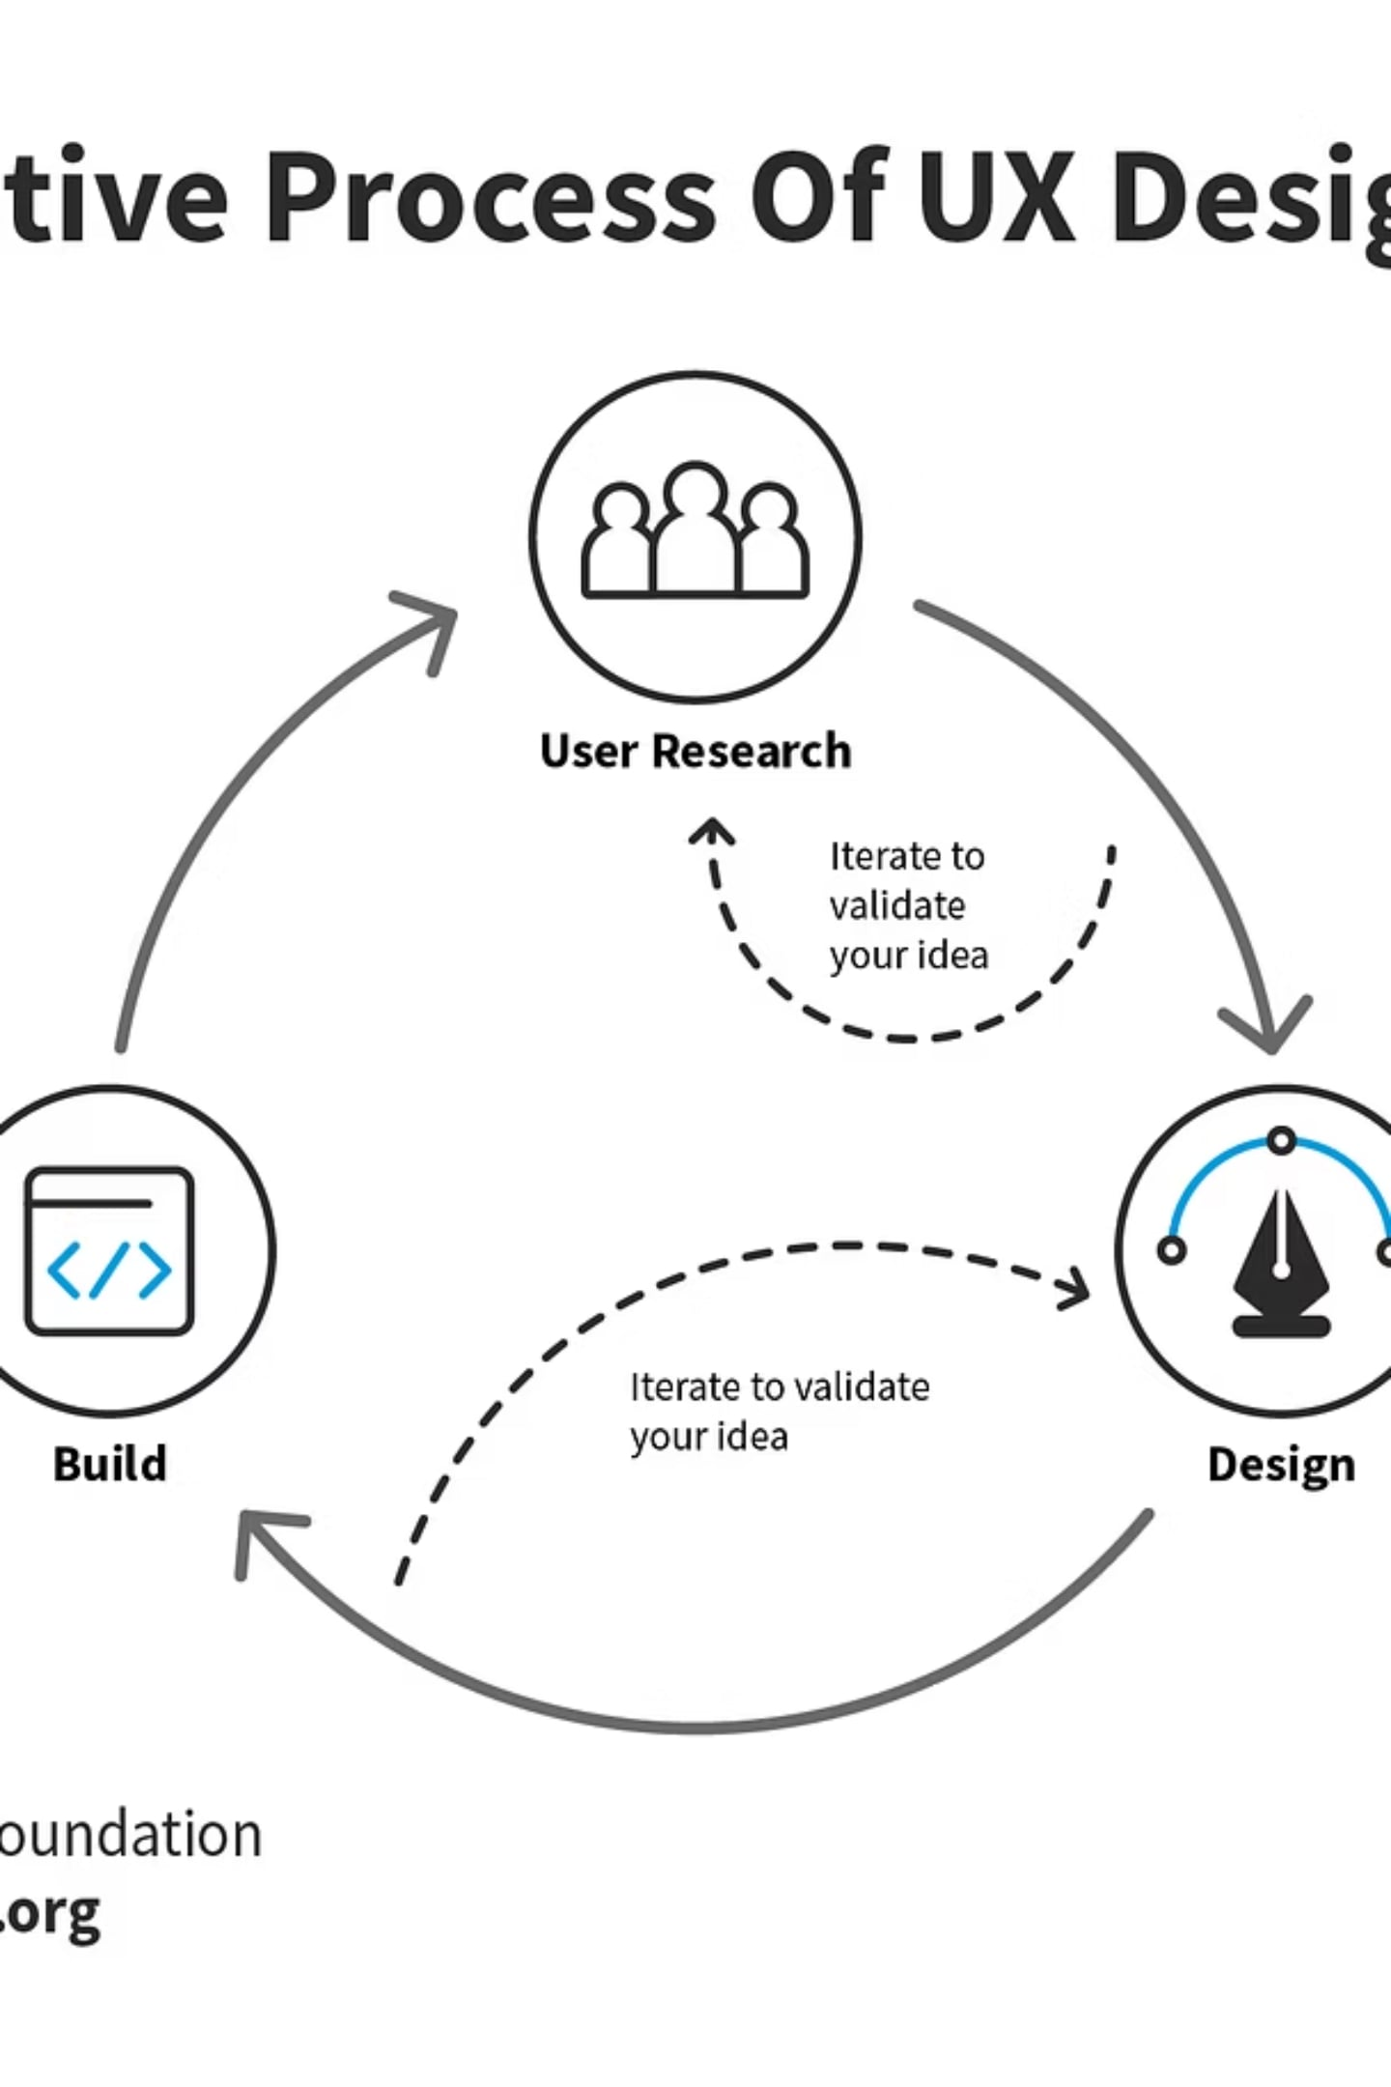
Leave Room for Feedback
The first version of your product isn't supposed to be perfect.
It's supposed to teach you something.
Real users will reveal problems you never anticipated and suggest improvements you hadn't considered.
Launching earlier gives you the opportunity to build what users actually need—not what you assume they want.

Slide 9

A Simple MVP Checklist
Before adding a feature, ask:
Does it solve the core problem?
Will users fail without it?
Does it help validate our main assumption?
Can it wait until after launch?
If most answers are "no," save it for a future release.

Slide 10
Common MVP Mistakes
Many teams delay their launch because they keep adding features like:
User achievements
Complex dashboards
Advanced reporting
AI features that aren't essential
Extensive customization options
Multiple payment methods from day one
These improvements can come later. They shouldn't prevent users from experiencing the product's core value.

