Slide 1
What "Production-Ready" Actually Means for a Web App
Many developers finish building a web application and immediately say:
"It's production-ready."
But is it?
A web app isn't production-ready simply because it works on your local machine. Production readiness means the application can reliably handle real users, failures, updates, and growth.
Here's what that actually looks like.

Slide 2
1. Security Comes First
Before anything else, your application should be secure.
That means:
HTTPS enabled
Strong authentication and authorization
Passwords securely hashed
Input validation and sanitization
Protection against common attacks like SQL Injection and XSS
Environment variables used for secrets instead of hardcoding them
A feature-rich application isn't useful if it's vulnerable.

Slide 3

2. Proper Error Handling
Things will go wrong.
Databases disconnect. Third-party APIs fail. Users submit unexpected data.
A production-ready application handles these situations gracefully instead of crashing or exposing technical errors to users.
Users should see helpful messages, while developers should receive detailed logs to investigate the issue.

Slide 4
3. Logging and Monitoring
If your application goes down at 2 AM, how will you know?
Production systems need visibility.
This includes:
Centralized application logs
Server monitoring
Performance metrics
Error tracking
Resource usage monitoring
Alerts for critical failures
If you can't monitor it, you can't reliably maintain it.

Slide 5

4. Automated Backups
Every production application stores valuable data.
That data should be backed up automatically and tested regularly.
A backup strategy should answer:
How often are backups created?
Where are they stored?
How long are they retained?
How quickly can the application recover?
Backups are only useful if they can actually be restored.

Slide 6
5. Deployment Without Downtime
Uploading files directly to a server isn't a deployment strategy.
Production applications should support predictable deployments that minimize downtime and reduce risk.
This often includes:
CI/CD pipelines
Automated testing before deployment
Rollback capability
Version control
Staging environments
Reliable deployments make updates less stressful for both developers and users.

Slide 7
6. Performance Optimization
A production-ready application should provide a smooth experience under real-world conditions.
This includes:
Fast page loads
Database query optimization
Caching
Image optimization
Asset compression
Lazy loading where appropriate
Performance isn't just about speed—it directly affects user experience.

Slide 8
7. Scalability
Your application may serve 10 users today and 10,000 tomorrow.
A production-ready architecture should be able to grow without requiring a complete rebuild.
Consider:
Horizontal scaling
Load balancing
Stateless application design
Efficient database architecture
CDN support for static assets
Planning for growth early prevents major problems later.

Slide 9
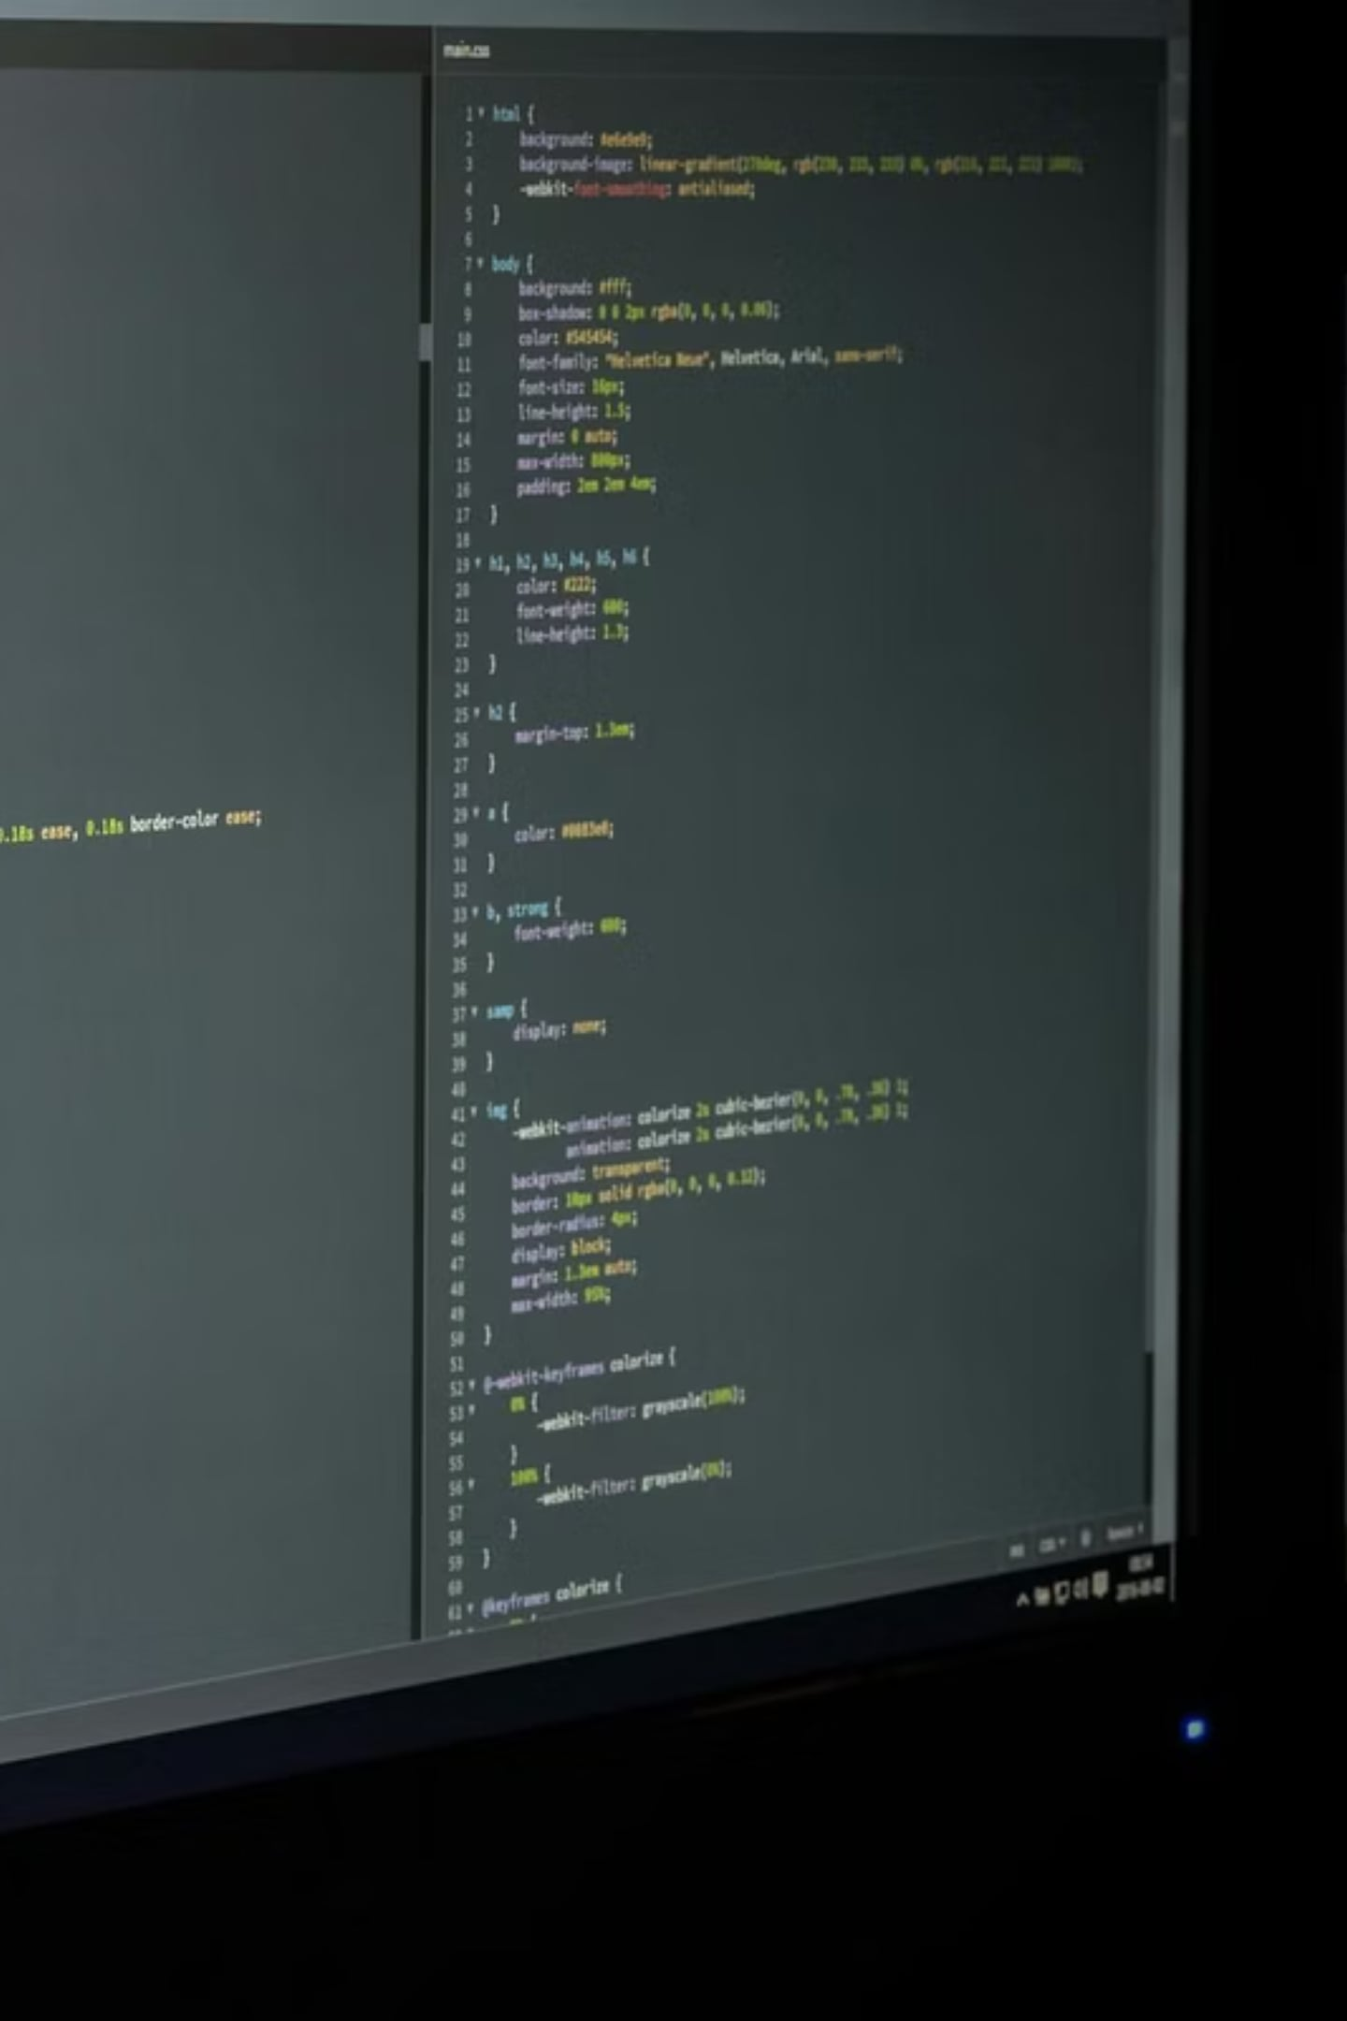
8. Configuration Management
Every environment should have its own configuration.
Development, staging, and production should never share the same credentials or settings.
Configuration should be managed through environment variables or secure configuration systems—not edited directly in the source code.

Slide 10
9. Documentation
Production readiness isn't just about code.
Good documentation helps teams maintain the application over time.
Useful documentation includes:
Installation steps
Deployment process
Environment variables
System architecture
API documentation
Backup and recovery procedures
If only one developer understands the system, it's not truly production-ready.

