Slide 1

CRM Analysis Janaina Figueira Marchesi
12/12/2020

Slide 2




Contextualization
Solid revenues and healthy bottom line
- 3 years
+ 3 years
Not promising perspectives for profit growth
How to prevent from that?
Improve performance of the marketing activities
Focus on marketing campaing

Slide 3
Problem Description
What Marketing Needs
How
Spend annual budget more wisely
Data-driven marketing activities
Goals
Understand the characteristics of respondents
Produce the highest profit for the next campaing
Segment the customers
Create a predictive model to classify the customers

Slide 4





Methodology
Data Exploratory Analysis
Descriptive Statistic
Data Visualization
Features Importance
Analysis – t statistics
Data
Driven
RFM Segmentation Technique
R - Recency
F - Frequency
M - Monetary
The freshness of customer activity
The frequency of accepted offers
The amount spent
Predictive Classification Models
Classification Techniques
Balancing Techniques
Cross -Validation

Slide 5







Data Exploratory Analysis
28%
is the difference between the median of the respondents and non respondents incomes
32%
Respondents have bigger time enrollments with the company
of respondents are single
56%
67%
of respondents have already responded to previous campaigns
Respondents have expenses considerably bigger for all products
of non respondents are married or live together with someone else
86%
of non respondents have never responded to previous campaigns

Slide 6
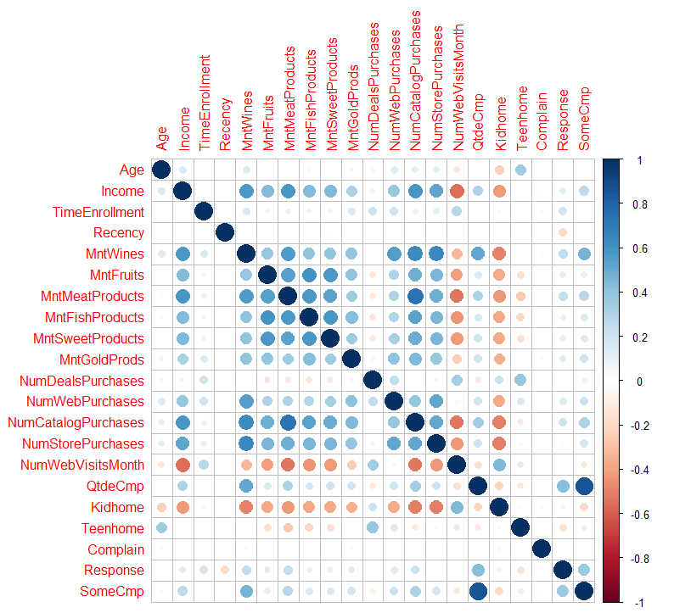
Data Exploratory Analysis
Income x Number of accepted campaings
Income x Spent with any product
Income x Number of Web Visits
Income x Numbers of Kids at home
Purchase from Catalog/Store x Number of Web Visits
Spent with Wine x Accepted offers in previous campaign
Purchase with discount x Number of Web Visits
Positive correlation
High correlation
Purchase with discount x Kids/Teenagers at home
Negative correlation
Low correlation

Slide 7
Data Exploratory Analysis
Ranking of Feature Importance to Response
Worth mentioning
Recency
Response for others campaigns
Marital Status
Enrollment Time
Purchases from Store
Response for 1st campaing
Purchases with discount
2º
1º
3º
Spent with Fruits and Meat and Gold Products

Slide 8






RFM Segmentation Technique
Core
Respondents have expenses considerably bigger for all products
Loyal
Customers who buy the most often from your company
Whales
Customers who have generated the most revenue for your
Customers who return often, but do not spend a lot
Promising
First time buyers on your site
Rookies
Great past customers who haven't bought in awhile.
Slipping

Slide 9
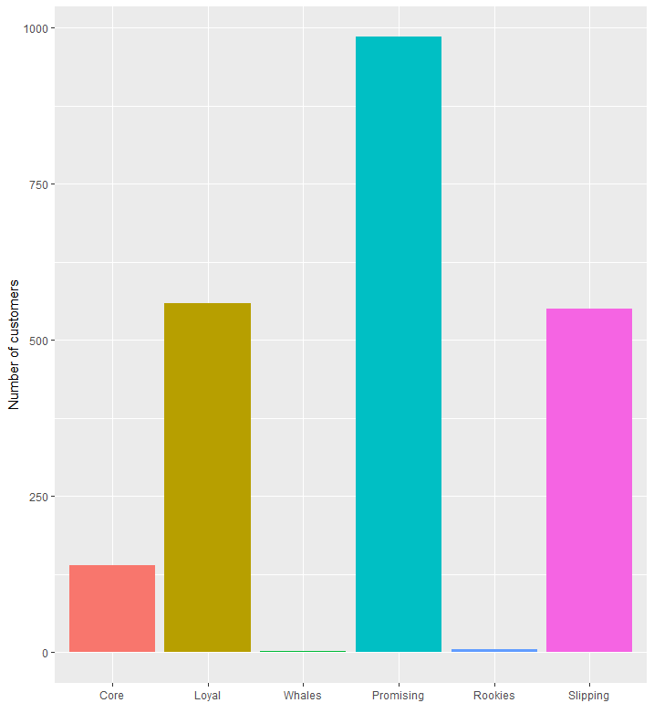
RFM Segmentation Technique
For Promising Customers
Product recommendations
Incentives tied to spending thresholds
For Slipping Customers
Focus on retention strategies
Deal offers

Slide 10
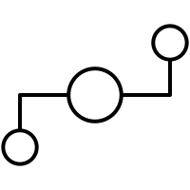


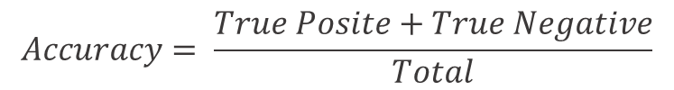
Predictive Classification Model
Classification Technique
Balancing Technique
Cross
Validation
Logistic Regression
Naïve Bayes
Downsampling
Upsampling
K-fold cross validation with k = 10
5 repetitions
Metric used to chose the best model
$$Accuracy= \frac{True Posite+True Negative}{Total}$$

Slide 11

Predictive Classification Model
88%
Chosen model
of Accuracy
for Logistic Regression model without balacing technique
Final model
Prediction = + 2E+1 - 2E-2 x Age+ 1E+0 x EducationBasic- 6E-1 x EducationGraduation- 1E+0 x EducationMaster- 2E+0 x EducationPhD+ 1E+0 x Marital_StatusMarried- 2E-1 x Marital_StatusOther+ 1E-2 x Marital_StatusSingle+ 1E+0 x Marital_StatusTogether+ 7E-1 x Marital_StatusWidow+ 6E-7 x Income- 5E-3 x TimeEnrollment- 7E-1 x Kidhome1+ 1E+1 x Kidhome2+ 1E+0 x Teenhome1+ 1E+0 x Teenhome2+ 3E-2 x Recency+ 8E-4 x MntWines- 6E-3 x MntFruits- 2E-3 x MntMeatProducts+ 3E-3 x MntFishProducts- 1E-5 x MntSweetProducts- 4E-3 x MntGoldProds- 1E-1 x NumDealsPurchases- 7E-2 x NumWebPurchases- 7E-2 x NumCatalogPurchases+ 2E-1 x NumStorePurchases- 5E-2 x NumWebVisitsMonth- 2E+0 x AcceptedCmp1Sim- 2E+0 x AcceptedCmp2Sim- 2E+0 x AcceptedCmp3Sim- 1E+0 x AcceptedCmp4Sim- 2E+0 x AcceptedCmp5Sim- 5E-1 x SomeCmpSim+ 2E-1 x ComplainSim
Probability = e^Prediction / (1 + e^Predicition)
Probability > 0.5
Accepted the offer

Slide 12
Next Steps
Apply the final model to the rest of the customers base
Identify the customers with the greatest potential to accept the offer in the campaign
Create product recommendation strategies for the Promising Customers
Create retention strategies for the Slipping Customers
Thank you!
Janaina Figueira Marchesi
janainamarchesi@gmail.com
27 99826-1648

