Slide 1
JS

Slide 2
Data Types Loop
number
string
boolean
undefined
object
function

Slide 3
Higher Order Functions
A Function that does at least one of the following:
takes one or more functions as arguments,
returns a function as its result.

Slide 4
Higher Order Functions
Example
function twice(f, value) {
return f(f(value))
}

Slide 5
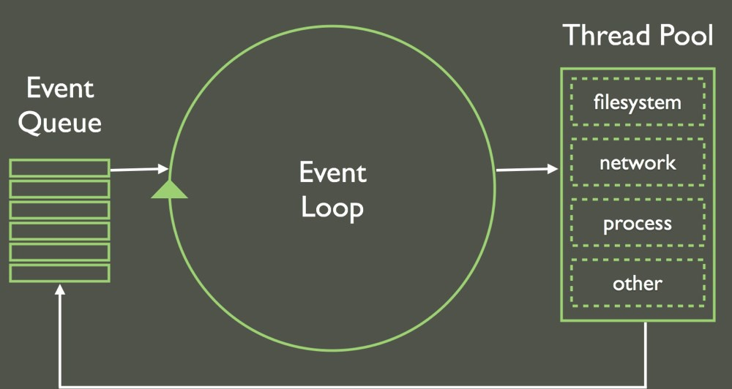
Event Loop

Slide 6
Async
Example: Do later
setTimeout( () => console.log(“Hi”), 2000)

Slide 7
Do something after that
Use callbacks
  Callback is an argument given to the function,
  Which is expected to be executed at the function completion.
function doSomthing(callback) {
// Do something
// … .. somewhere in the code call the callback
callback()
}

Slide 8
Higher Order Functions
Example
function twice(f, value) {
return f(f(value))
}

Slide 9
Callbacks
function twice(f, value) {
return f(f(value))
}

Slide 10
Callback Hell
function twice(f, value) {
return f(f(value))
}

