Slide 1
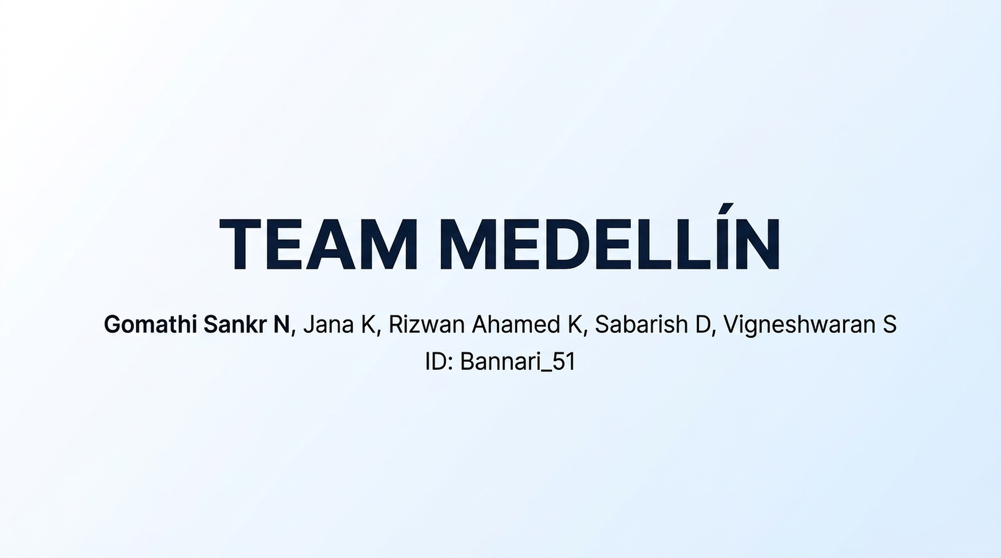
Notes:
Introduce Team Medellín and SENTINEL, our evidence-grounded AI disaster intelligence and relief coordination system for TCS Hackathon Theme 3, Challenge 11.

Slide 2
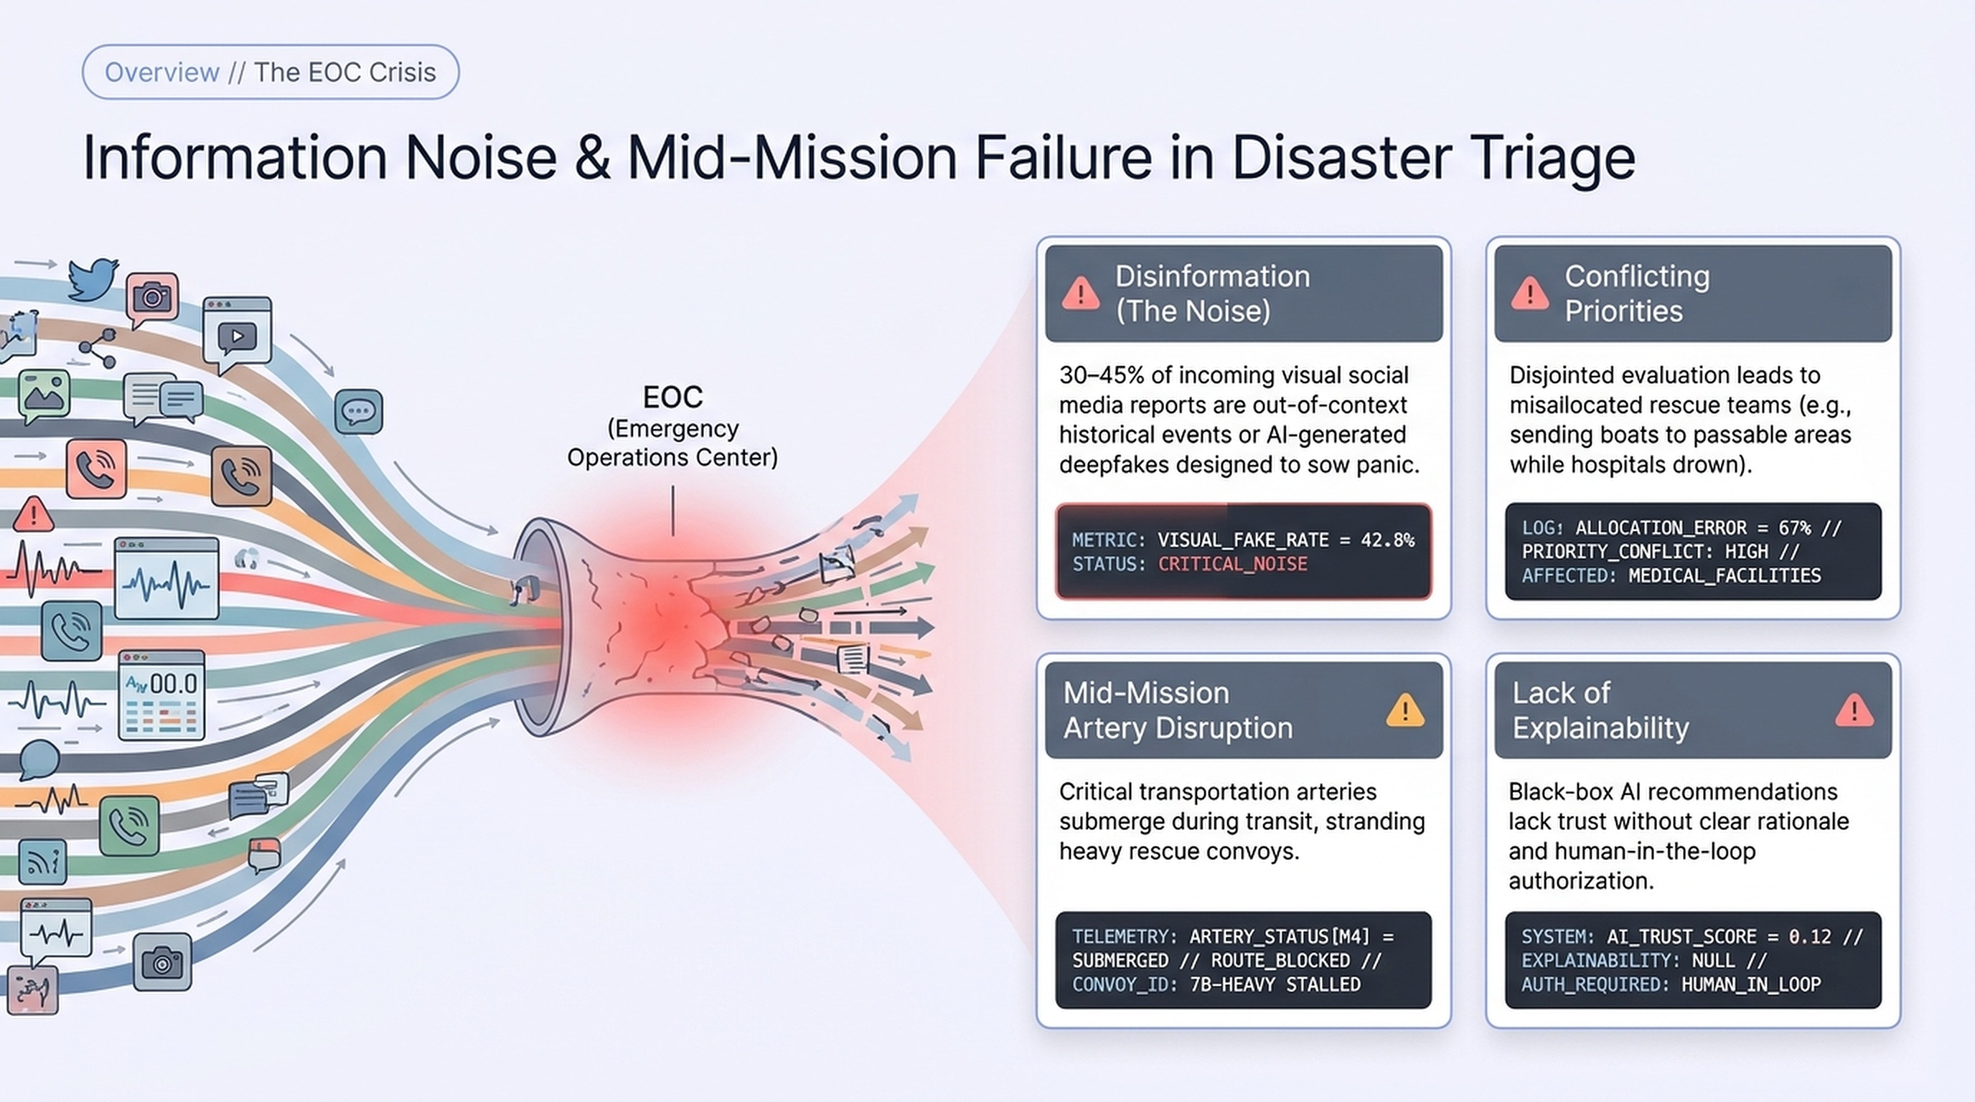
2
Notes:
Emergency control rooms are flooded with raw reports. 30–45% of visual social media reports are out of context or AI-generated. Four bottlenecks: disinformation, conflicting priorities, mid-mission artery disruption, and lack of explainability.

Slide 3
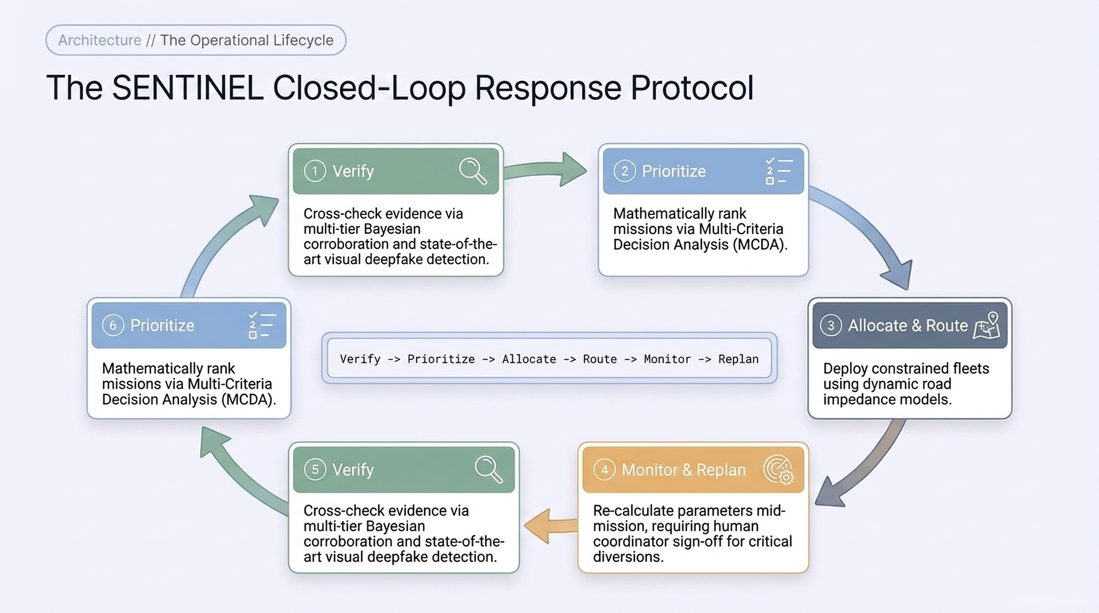
3
Notes:
SENTINEL runs a closed loop: Verify, Prioritize, Allocate, Route, Monitor, Replan. Each stage feeds the next, and a human coordinator signs off on critical decisions.

Slide 4
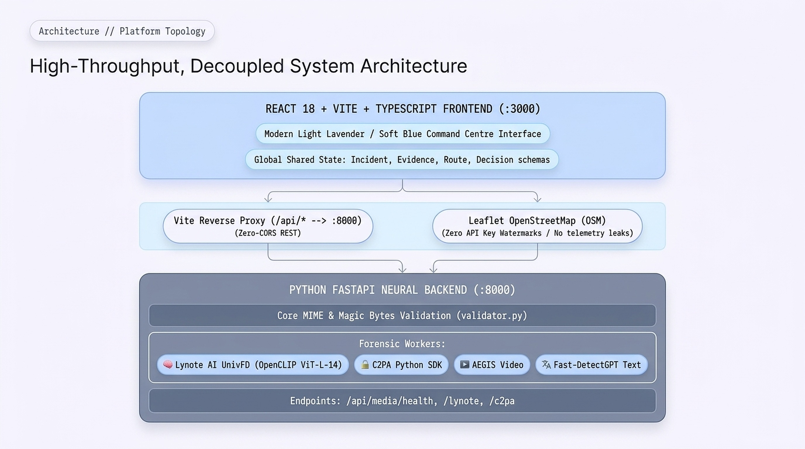
4
Notes:
Architecture: React 18 + Vite + TypeScript frontend on port 3000, proxied to a FastAPI backend on port 8000 with payload validation and forensic workers. Leaflet with OpenStreetMap needs no API keys.

Slide 5
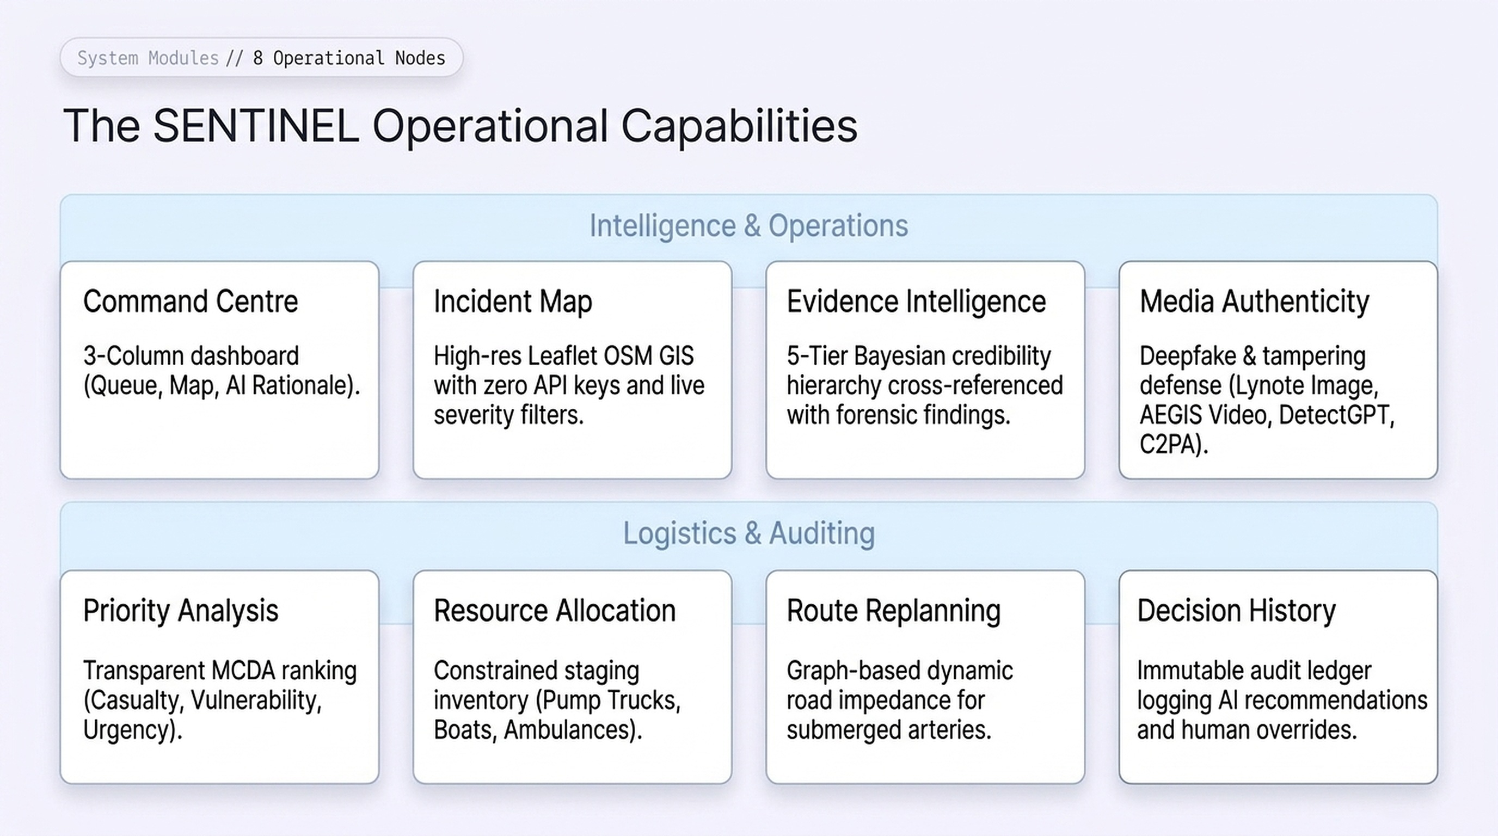
5
Notes:
Eight operational modules across Intelligence & Operations and Logistics & Auditing: Command Centre, Incident Map, Evidence Intelligence, Media Authenticity, Priority Analysis, Resource Allocation, Route Replanning, Decision History.

Slide 6
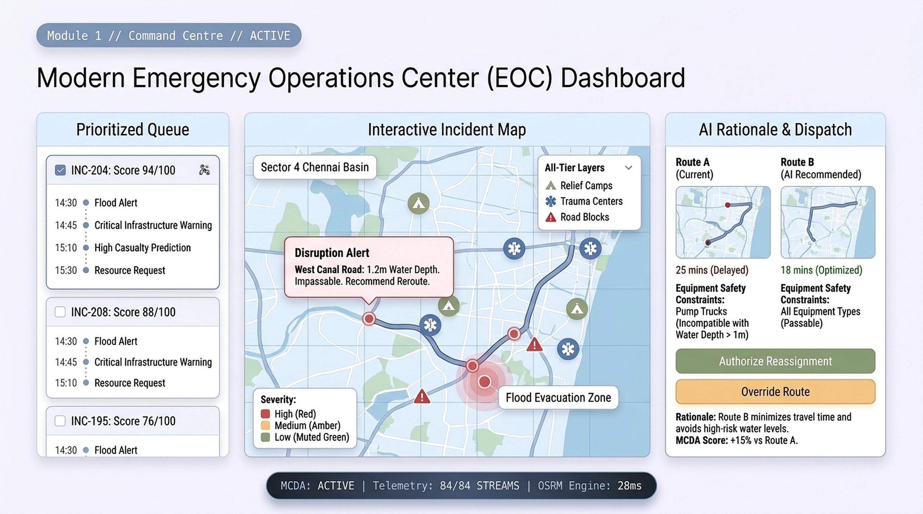
6
Notes:
The Command Centre: prioritized queue on the left, interactive incident map in the middle, AI rationale and dispatch on the right. Show the West Canal Road disruption and the recommended bypass, with Authorize and Override buttons for the operator.

Slide 7
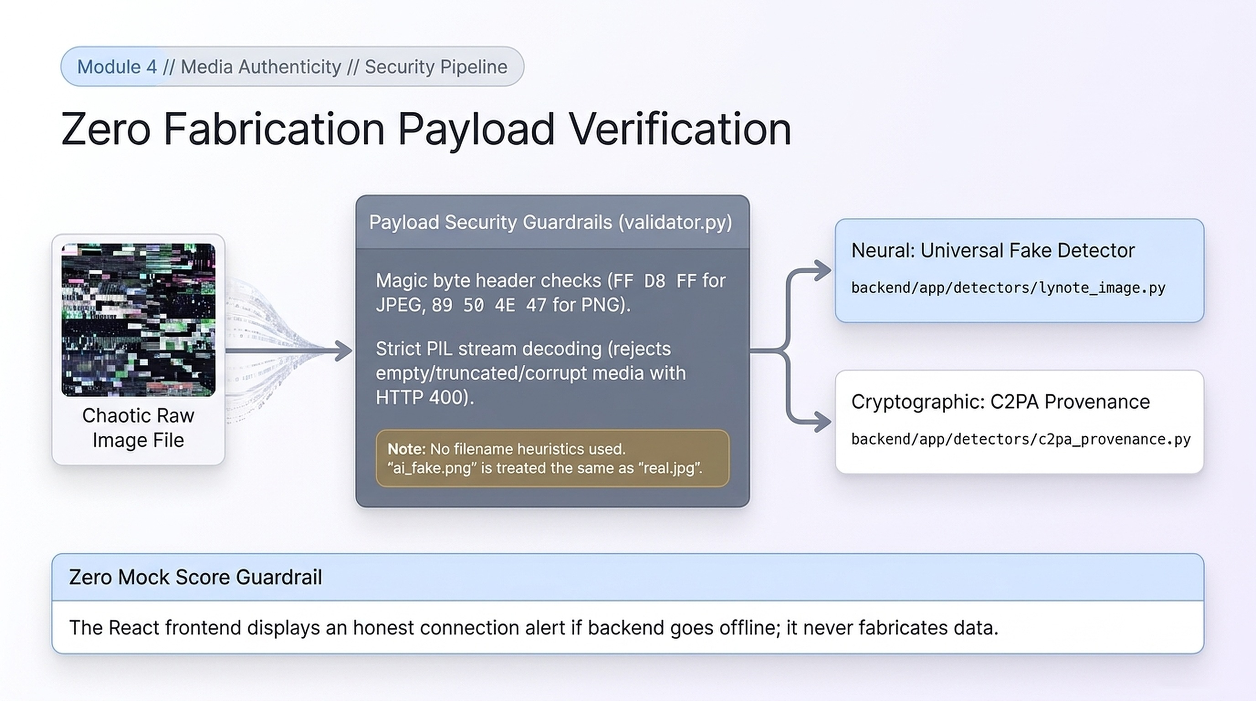
7
Notes:
Zero-fabrication payload verification. Uploads pass magic-byte and PIL decoding checks, then go to the neural detector and the C2PA worker. Corrupt files are rejected with HTTP 400, and the UI never invents scores if the backend is offline.

Slide 8
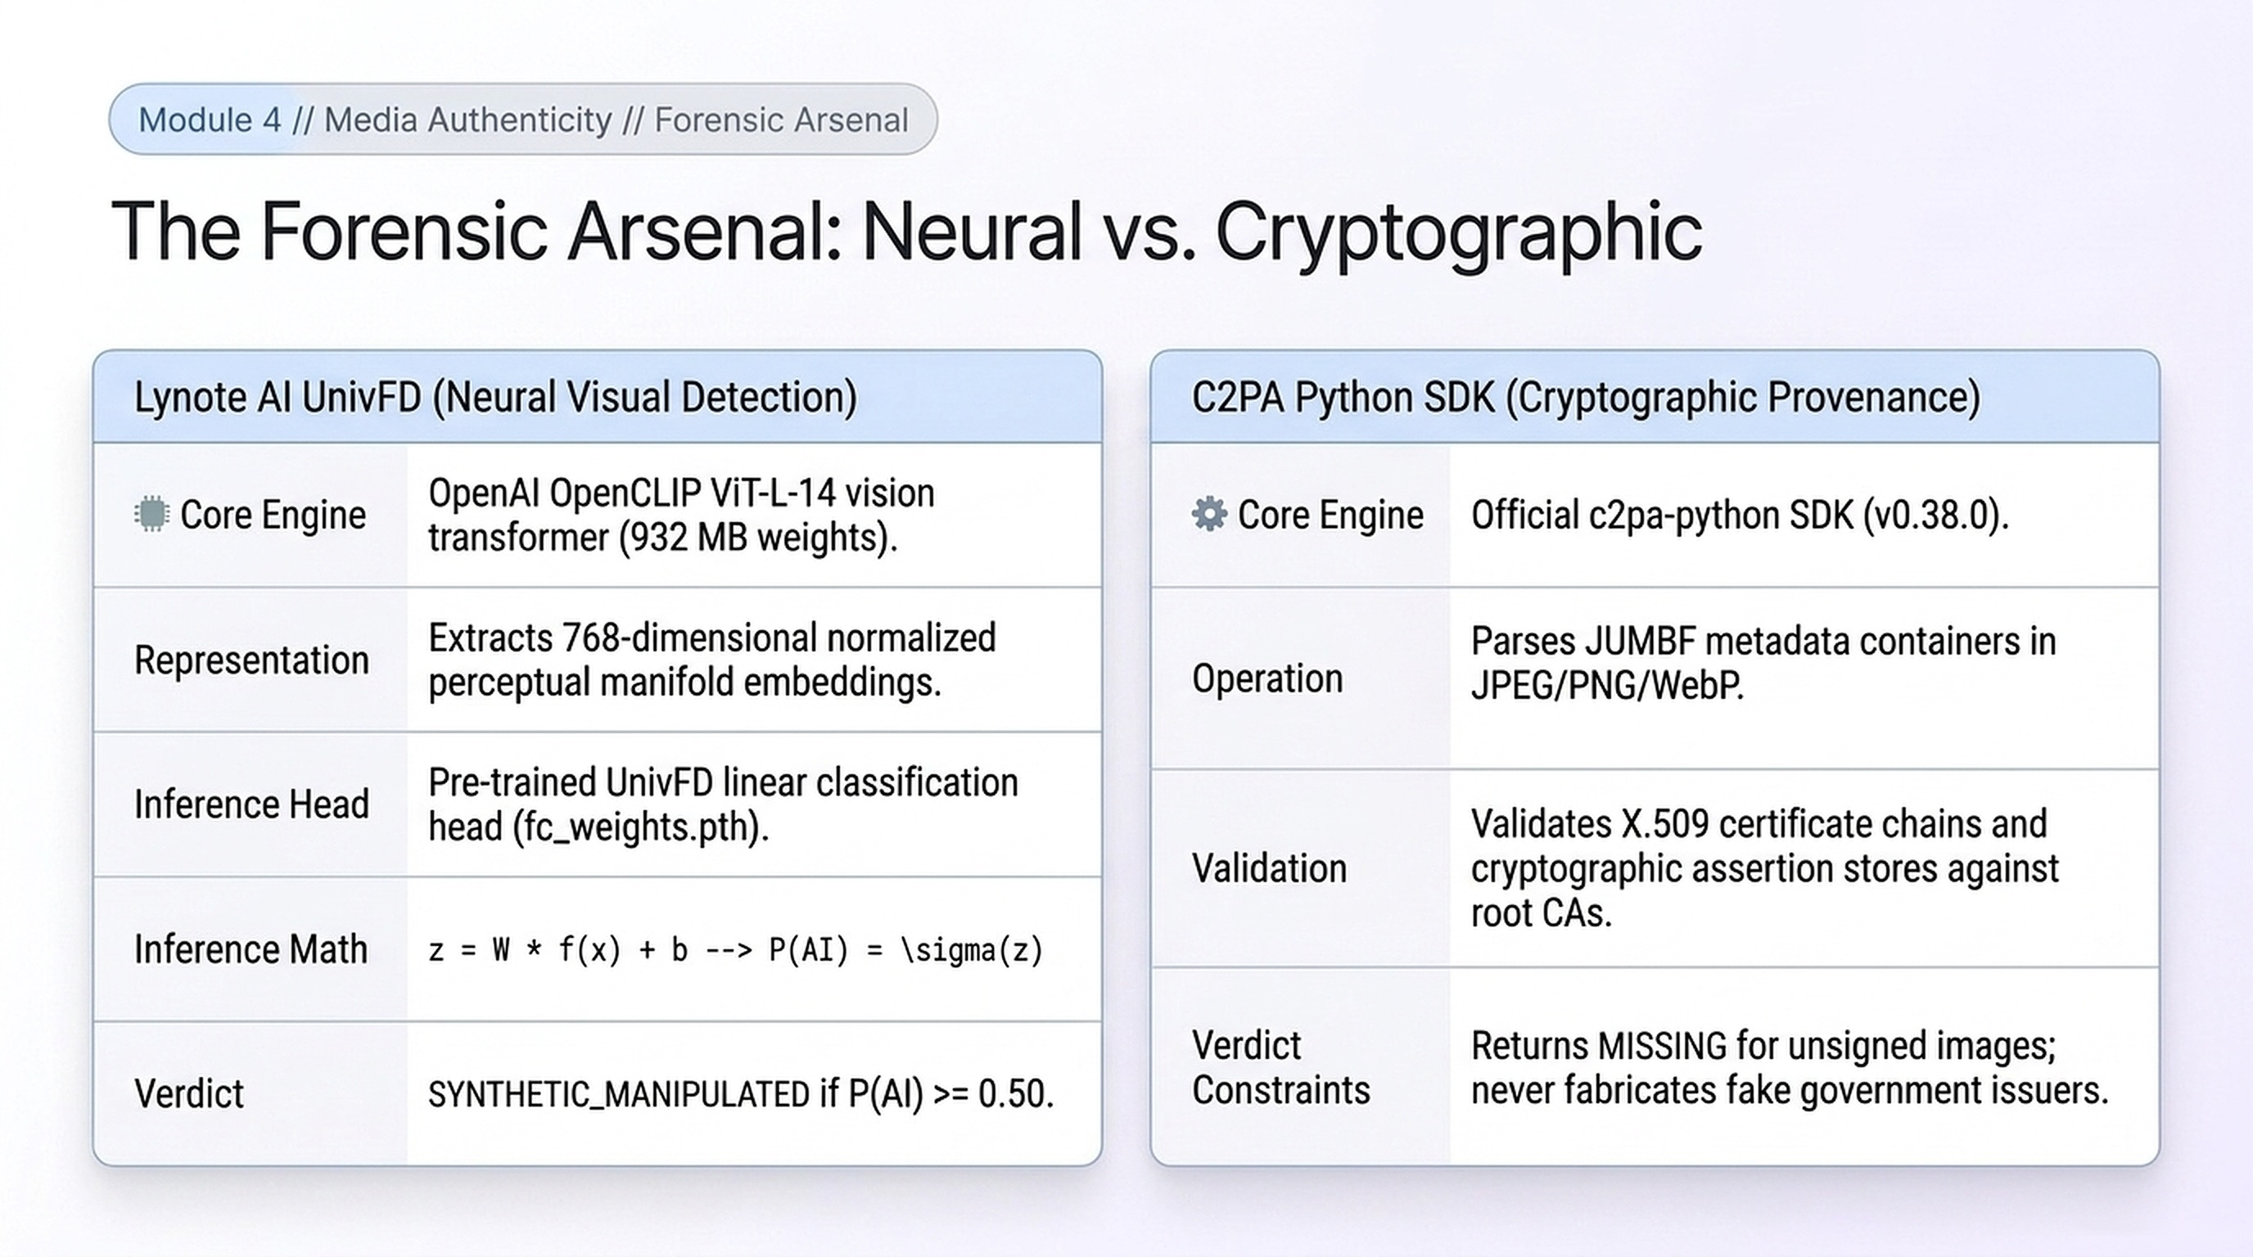
8
Notes:
Neural versus cryptographic: Lynote AI UnivFD on OpenCLIP ViT-L-14 gives P(AI) from a linear head over 768-D embeddings; the C2PA SDK validates X.509 manifests and returns MISSING for unsigned media.

Slide 9
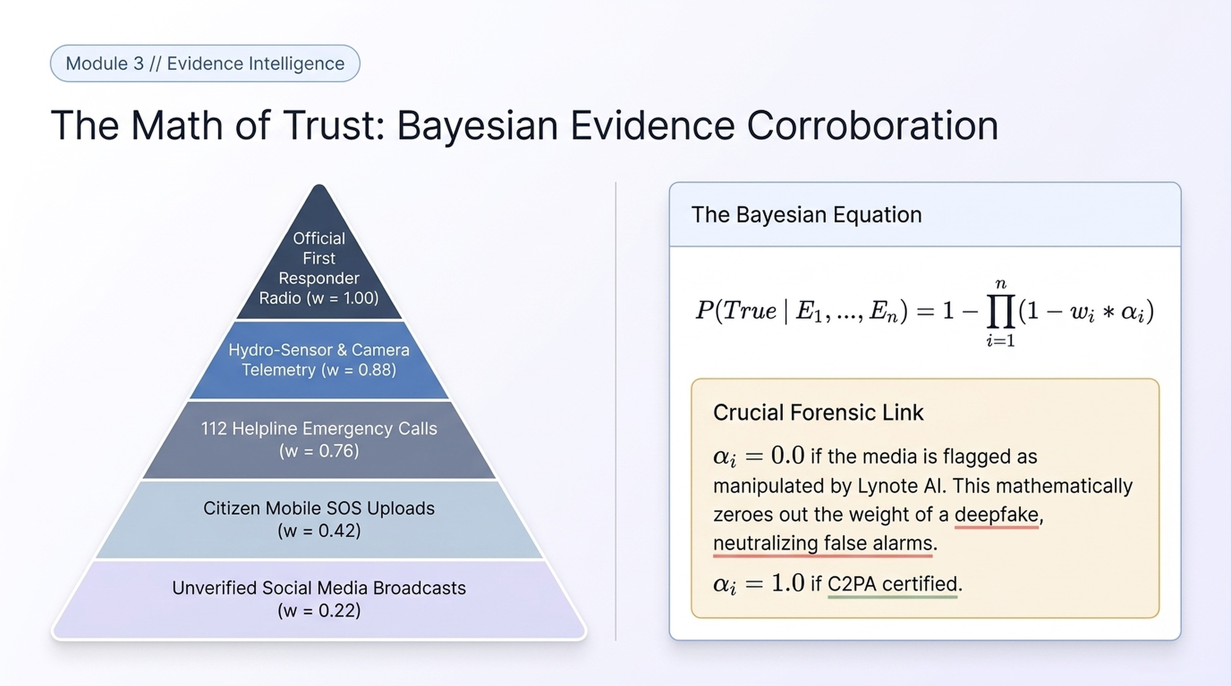
9
Notes:
Evidence is weighted by a five-tier source hierarchy, from first-responder radio at w=1.00 to social media at w=0.22. The Bayesian equation combines sources, and a deepfake flag sets the media factor to zero.

Slide 10
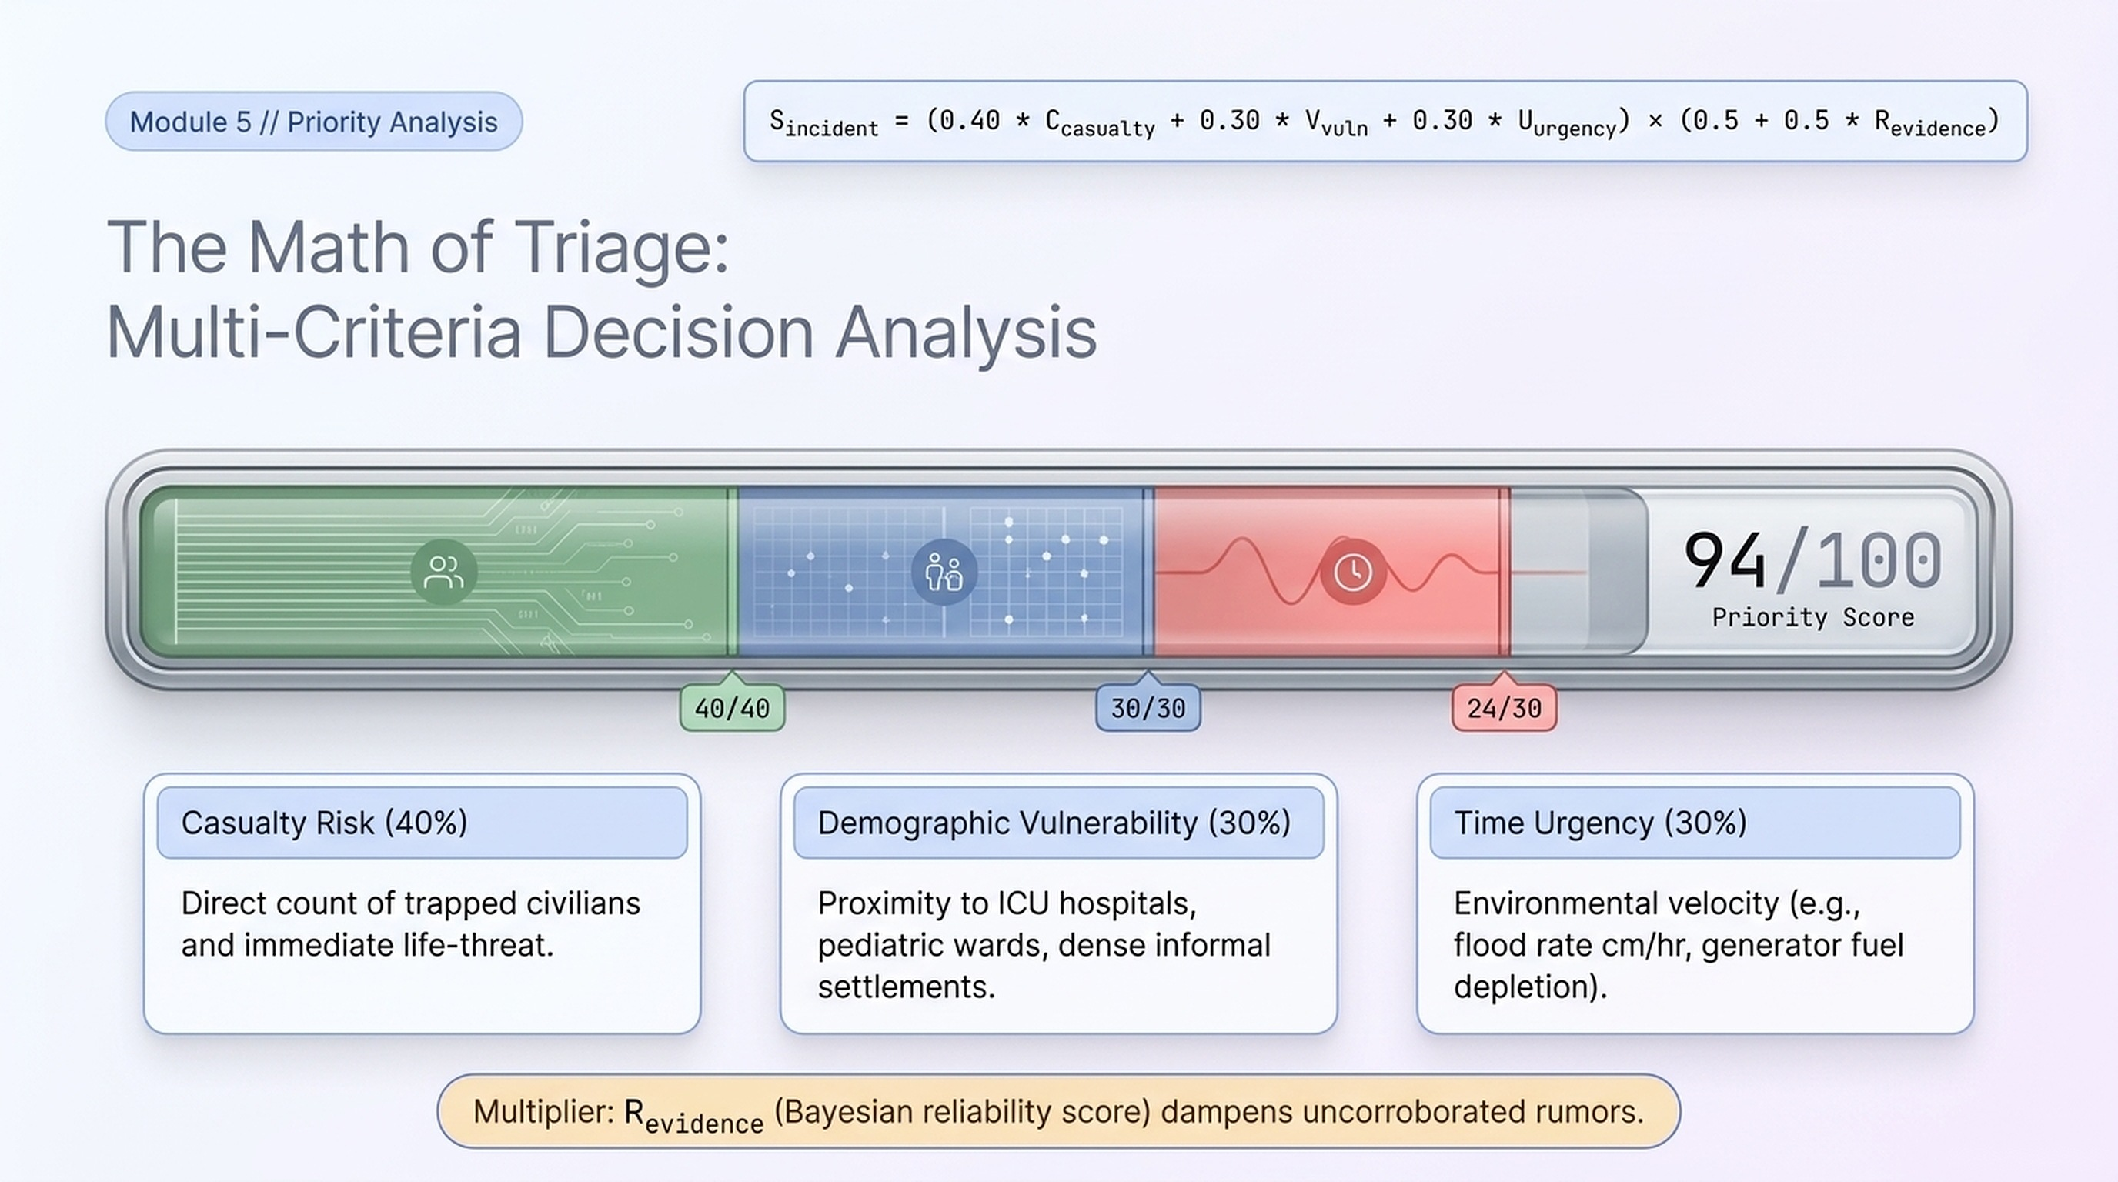
10
Notes:
Priority is a transparent MCDA score: casualty risk 40%, demographic vulnerability 30%, time urgency 30%, multiplied by an evidence-confidence factor so uncorroborated rumors are damped.

Slide 11
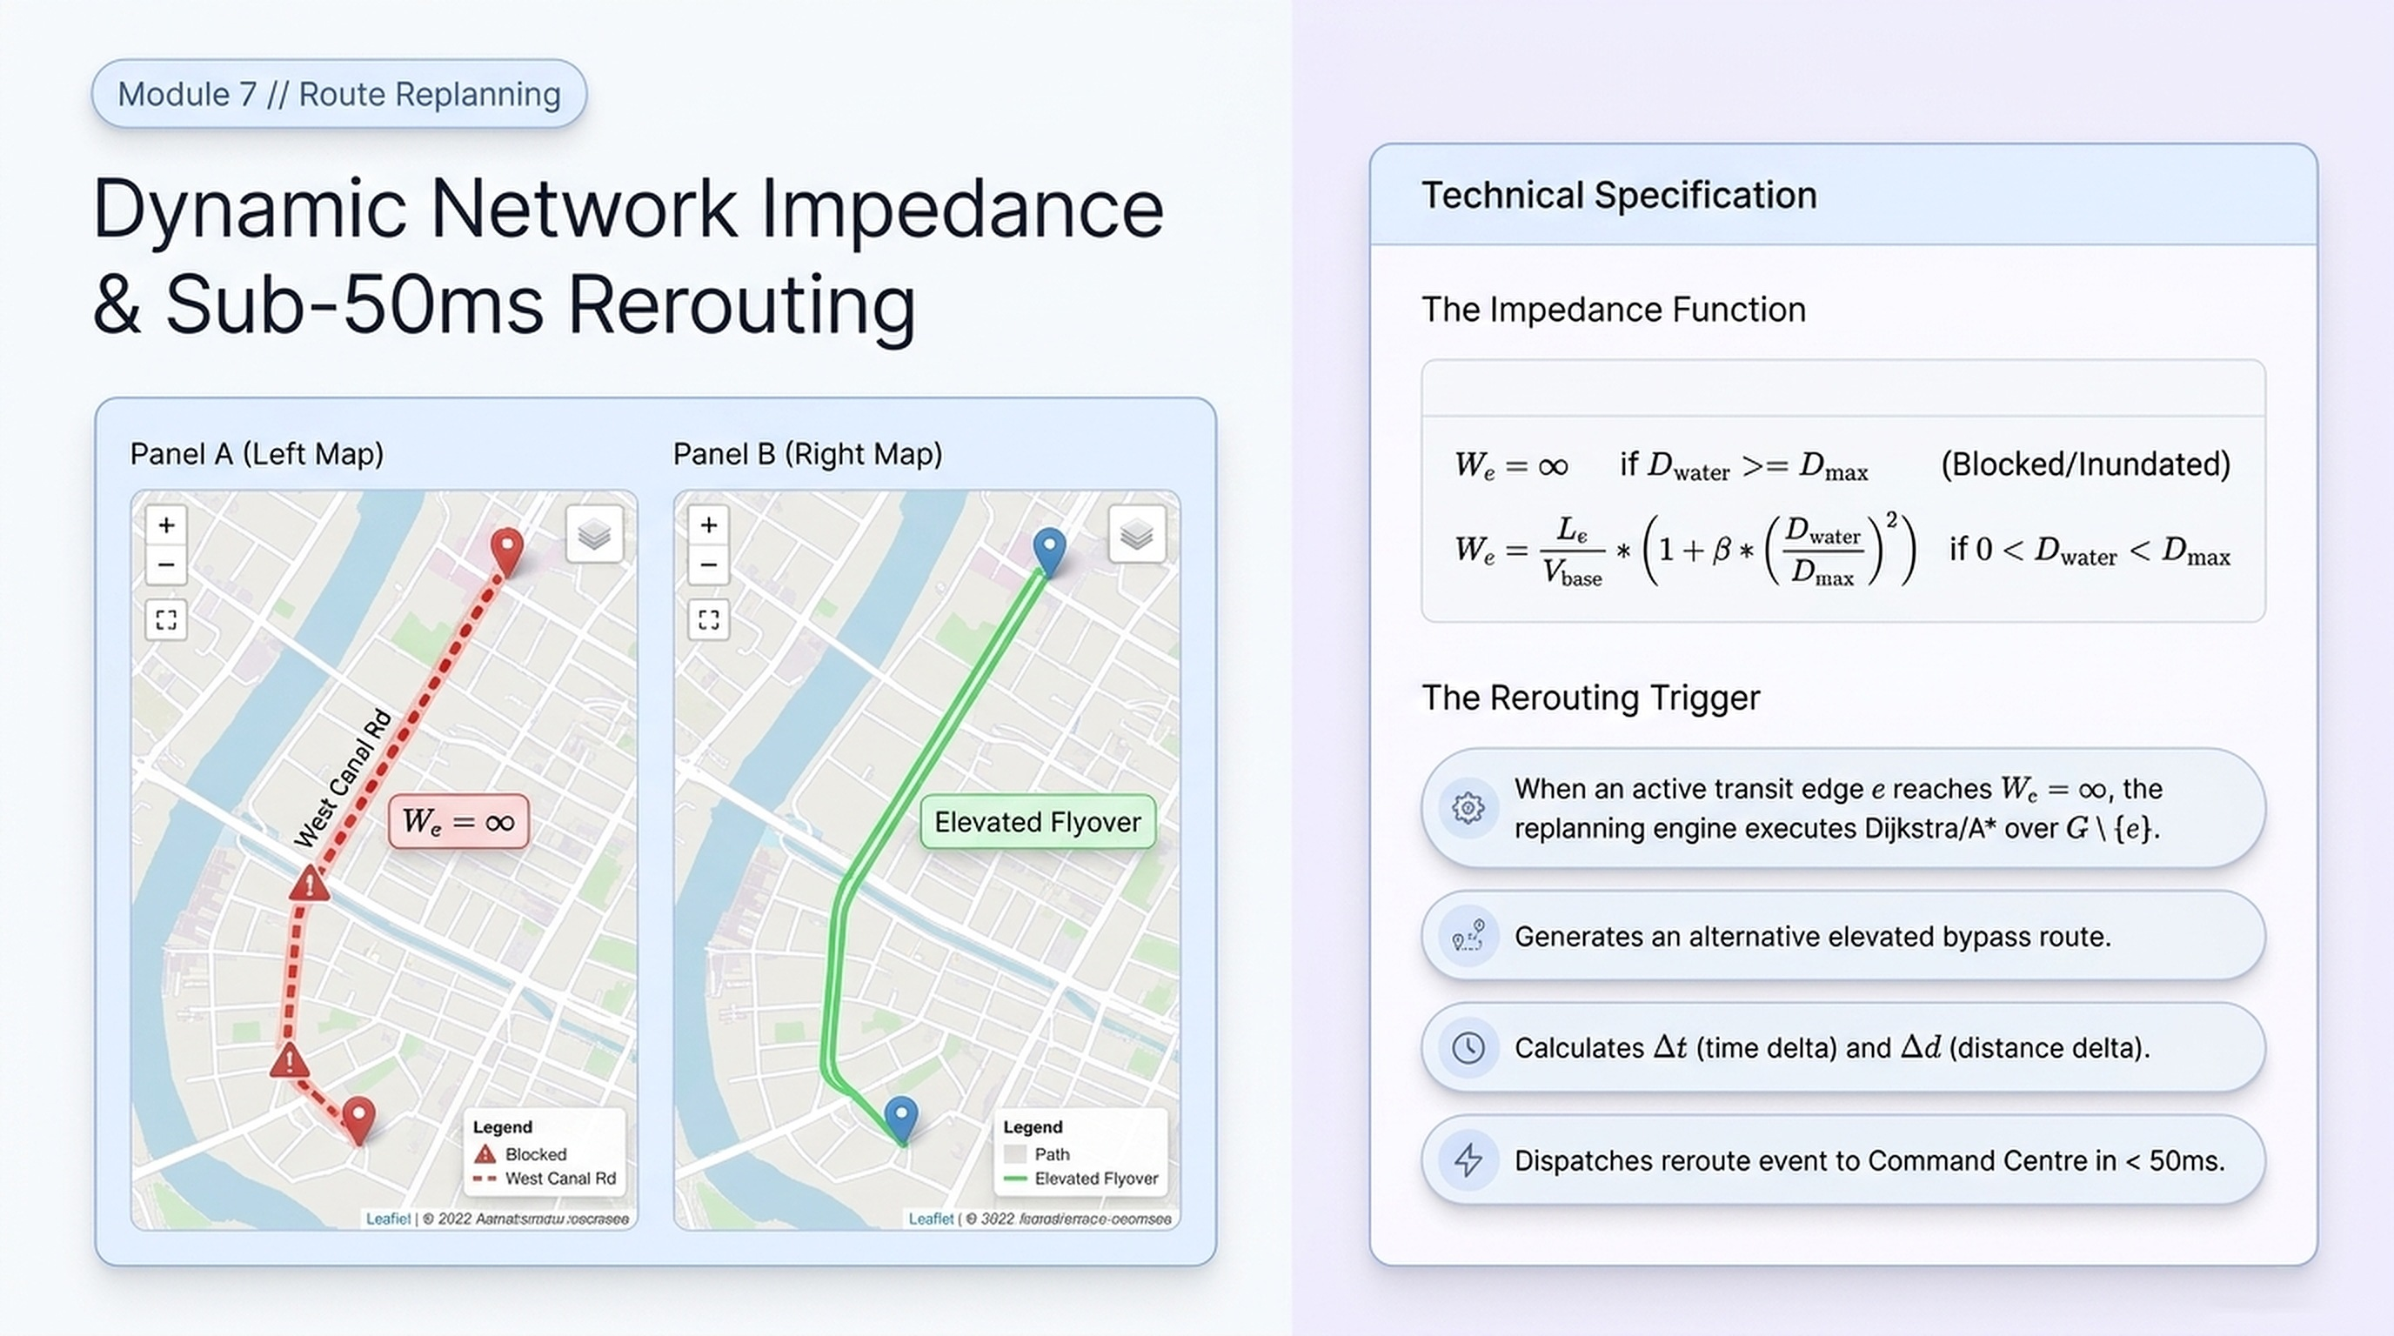
11
Notes:
Dynamic road impedance: when water depth reaches the maximum, the edge weight becomes infinite and Dijkstra/A* reroutes over the remaining graph, sending the event to the Command Centre in under 50 ms.

Slide 12
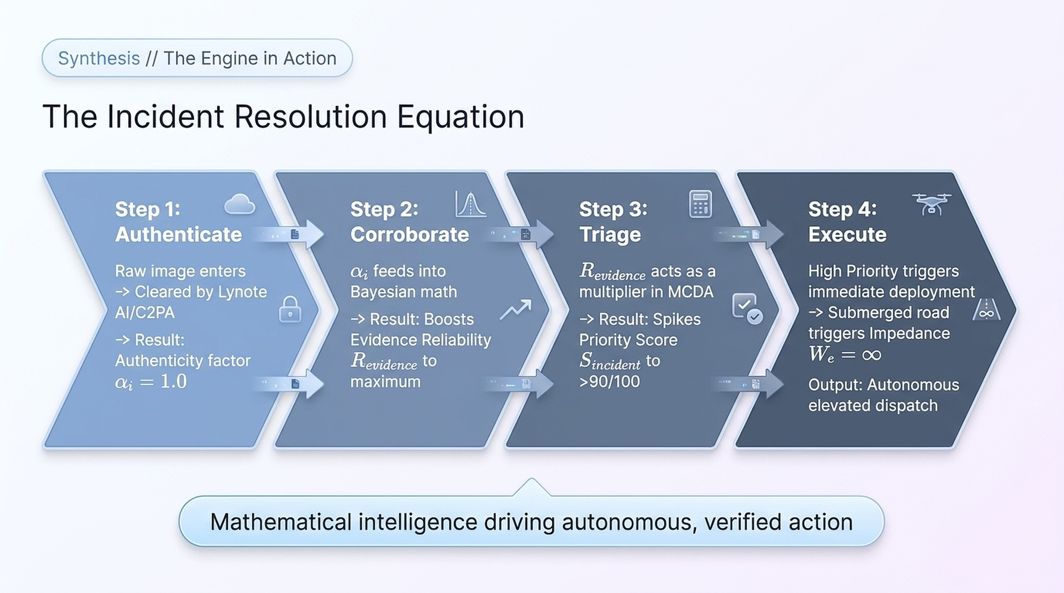
12
Notes:
The engine in action: authenticate, corroborate, triage, execute. Verified evidence feeds MCDA priority, which triggers dispatch and replanning.

Slide 13
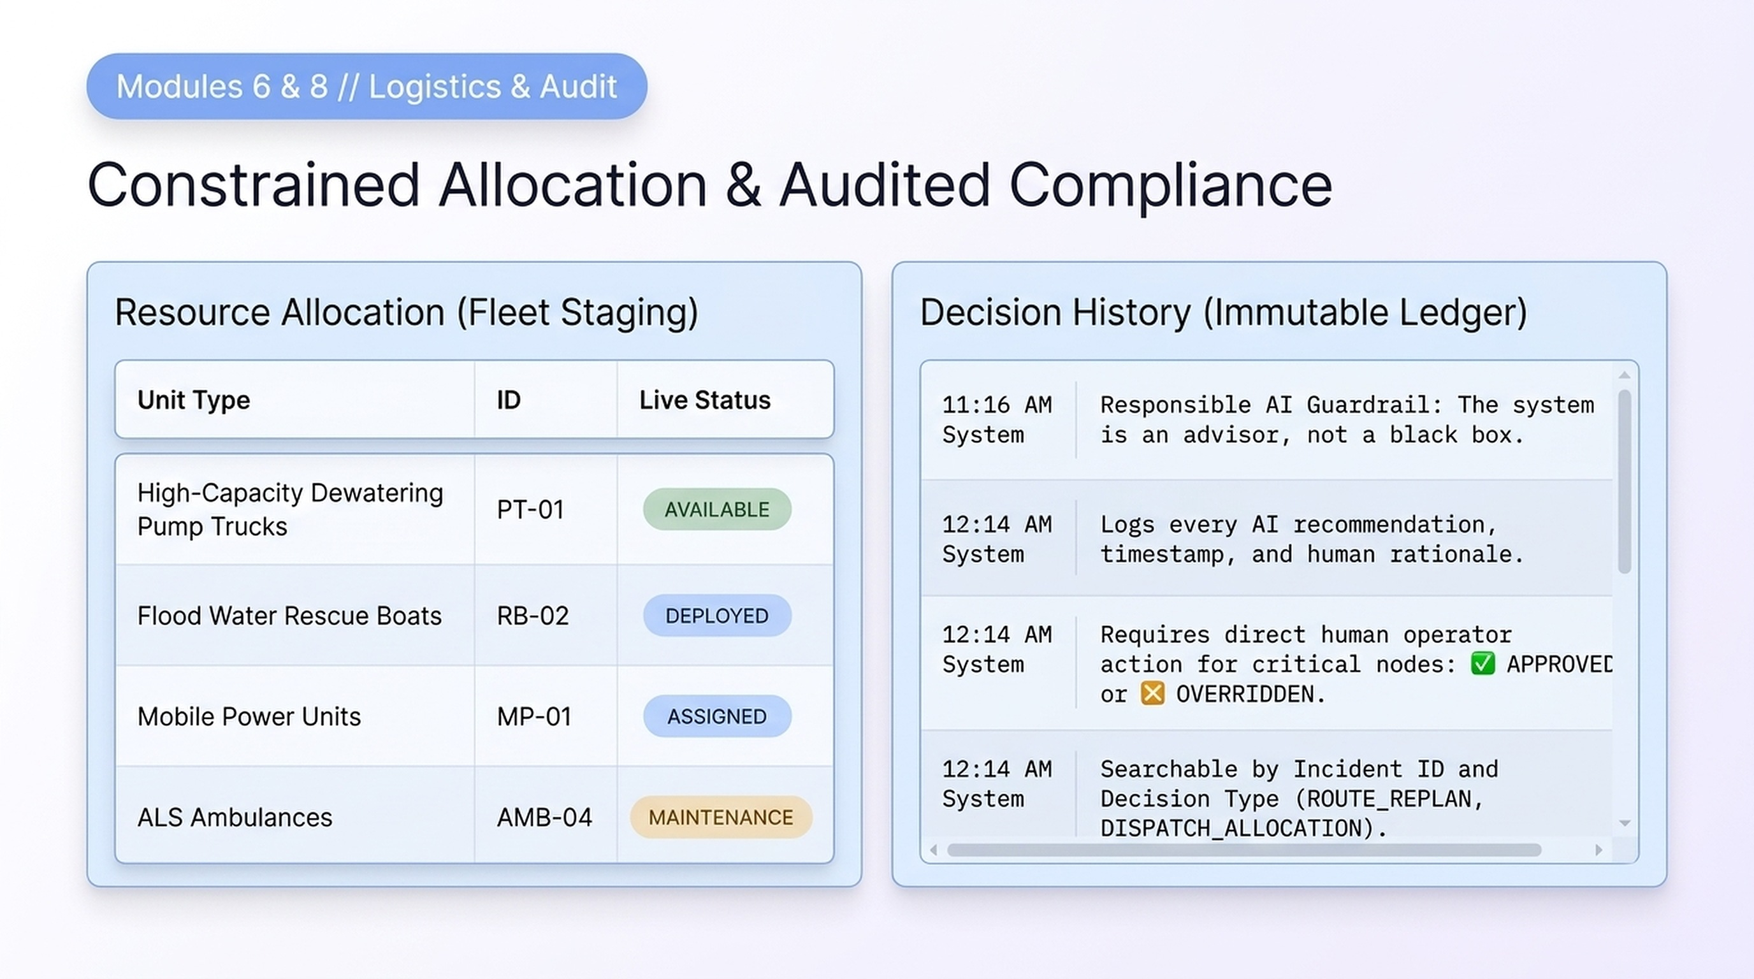
13
Notes:
Resource allocation tracks pump trucks, rescue boats, power units and ALS ambulances. Decision History is an immutable ledger of each AI recommendation and each human approval or override.

Slide 14
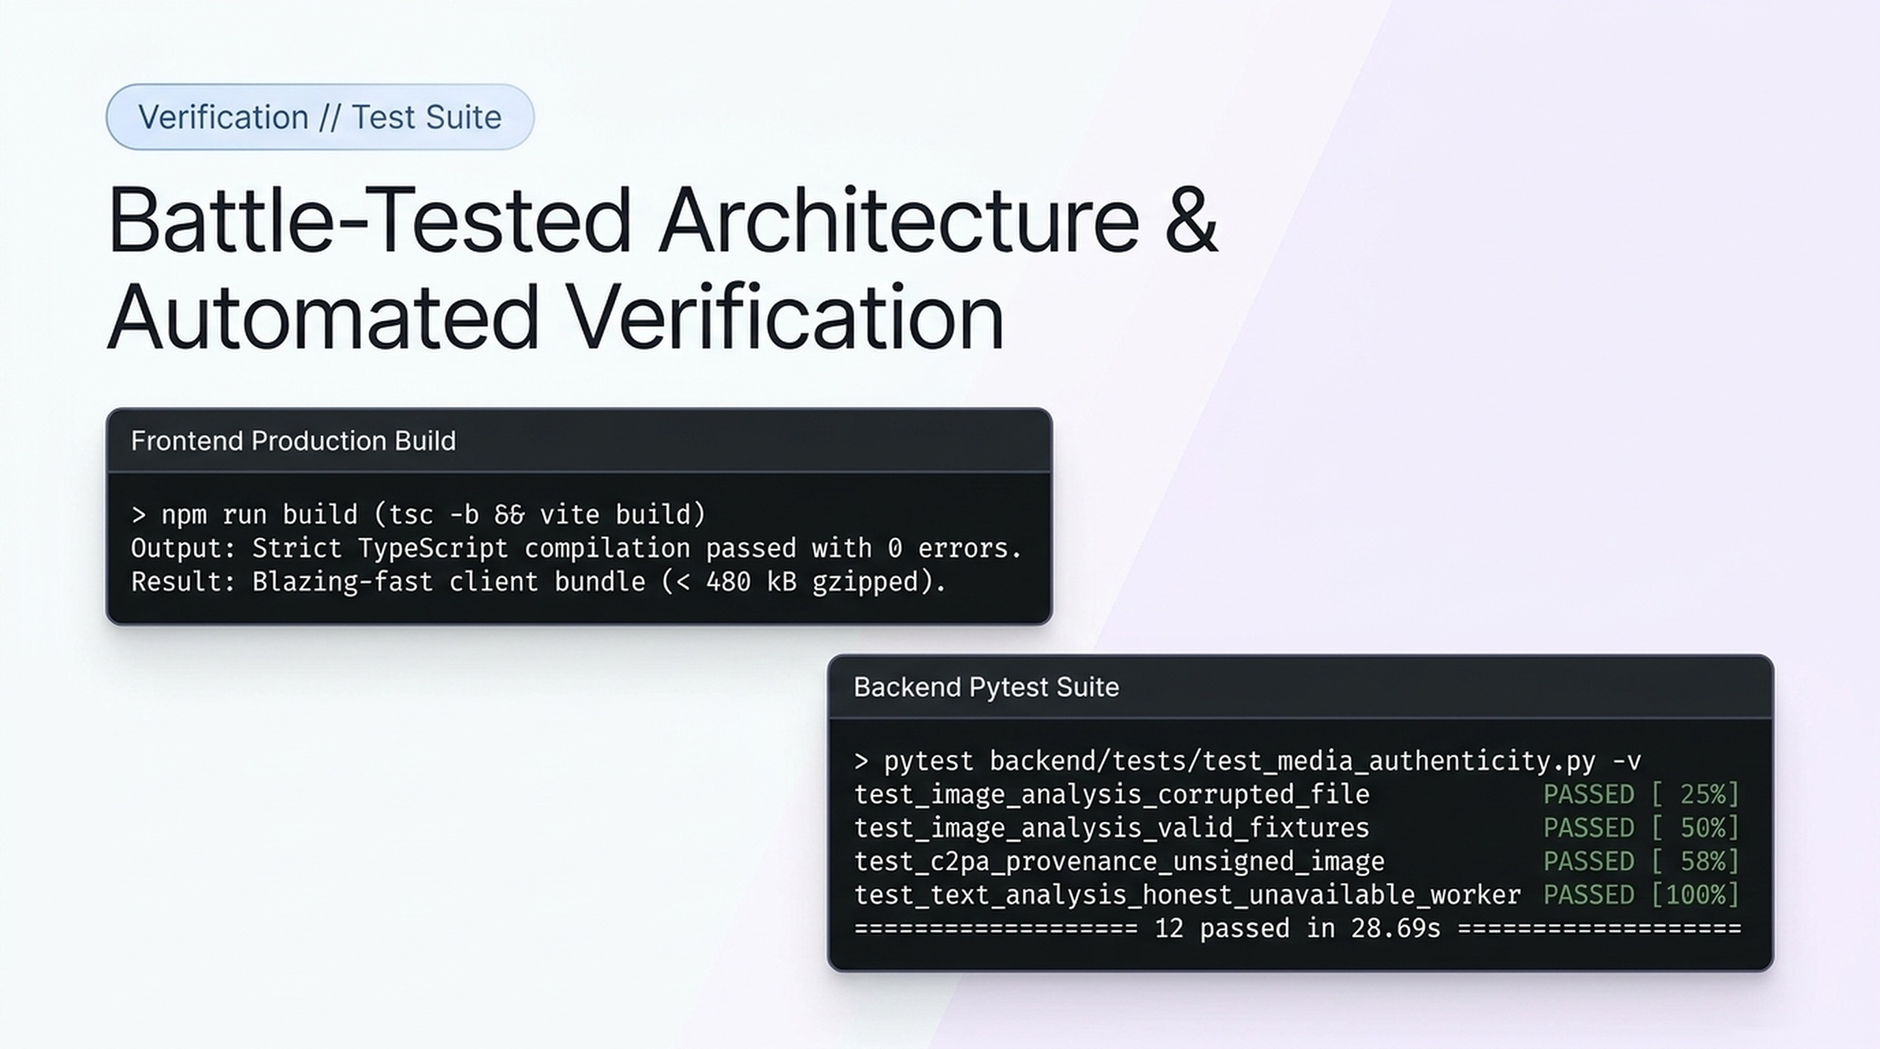
14
Notes:
Verification: the frontend production build passes with 0 TypeScript errors, and 12 of 12 backend tests pass.

Slide 15
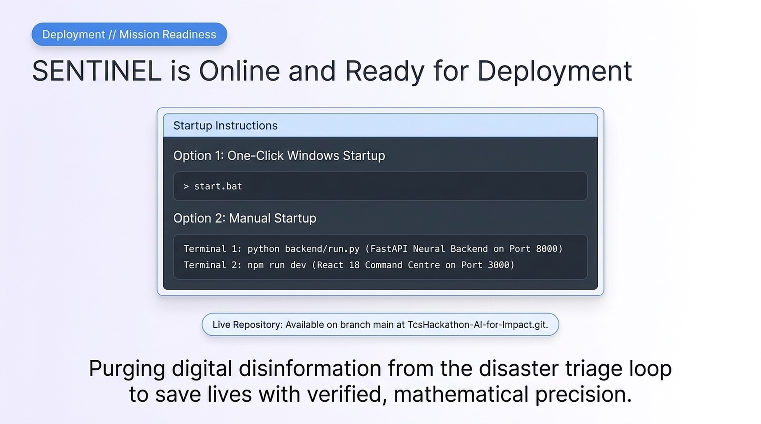
15
Notes:
SENTINEL is ready to run: start.bat on Windows, or backend and frontend in two terminals. The code is in the TcsHackathon-AI-for-Impact GitHub repository. Purging digital disinformation to save lives with verified, mathematical precision.

Slide 16
Thank you
Questions & live demo
Team Medellín
Gomathi Sankr N · Jana K · Rizwan Ahamed K · Sabarish D · Vigneshwaran S
Notes:
Close, invite questions, and offer a live demo of the dashboard.

