Slide 1
Digital Portfolio
STUDENT NAME: B.JANAKI
REGISTER NO AND NMID: asanm20124132010500122040,
DEPARTMENT: BCA
COLLEGE: ARIGNAR ANNA GOVERNMENT ARTS COLLEGE IN VILLUPURAM / UNIVERSITY : ANNAMALAI UNIVERSITY

Slide 2
PROJECT TITLE
student portfolio or personal portfolio website

Slide 3


AGENDA
Problem Statement
Project Overview
End Users
Tools and Technologies
Portfolio design and Layout
Features and Functionality
Results and Screenshots
Conclusion
Github Link
3/21/2024 Annual Review

Slide 4

PROBLEM STATEMENT
The traditional resumes alone are not enough to showcase skills and projects effetively. Many students and professionals lack a structured online presence to highlight their work, A digtal portfolio provides an interactive and accessible platform to present achievements, skills, and
devoleped coding skills.

Slide 5

PROJECT OVERVIEW
HTML establishes the page's structure, including sections for the hero intro, skills, projects, and contact form. CSS is used for all the styling, from the clean navigation bar and gradient hero section to the responsive skill and project cards. Finally, JavaScript adds interactivity, enabling the website.

Slide 6

WHO ARE THE END USERS?
* developer
*friends
* professor
*Network connection
*Examiners and etc.....

Slide 7

TOOLS AND TECHNIQUES
*Html : <header>, <section>, and <footer>
*Css :navigation bar and skill/project sections.
*Javascript: button to smoothly scroll the user to the contact form, and an event listener

Slide 8
POTFOLIO DESIGN AND LAYOUT
*HTML ->skills ,navigation bar, project content, etc...
*CSS->visual ,fonts,colors,desgin and etc....
* JAVASCRIPT -> smooth scrolling and etc...
8

Slide 9
FEATURES AND FUNCTIONALITY
*structure and content
*headings
*paragraph
*color
*styling
*smooth scrolling
*layout

Slide 10

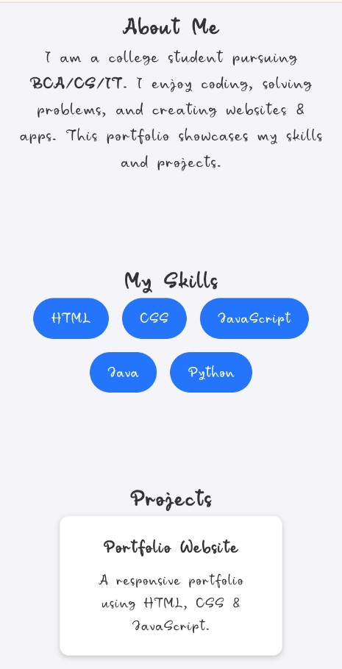
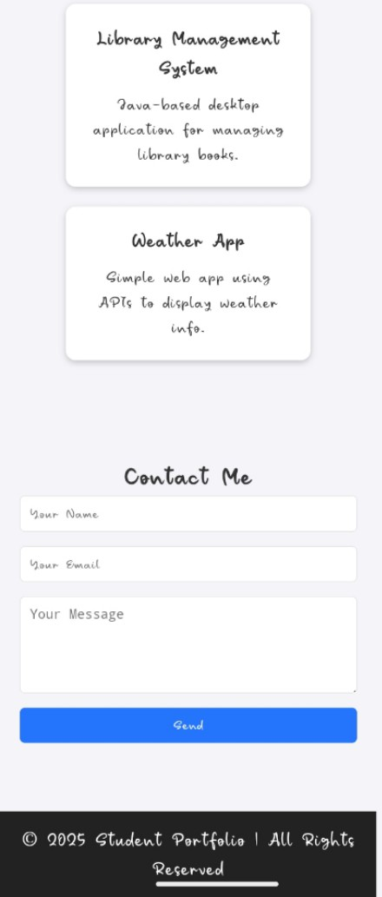

RESULTS AND SCREENSHOTS
3/21/2024 Annual Review
10

Slide 11
CONCLUSION
The HTML provides the fundamental structure and content, including the navigation bar, hero section, and dedicated sections for "About Me," "Skills," "Projects," and "Contact." The CSS handles all the styling, transforming the raw HTML into a visually appealing and responsive layout with specific colors, fonts, and box styles for each section.
11

