Slide 1
Deep learning for text processing using RNN and LSTM
Dr M Janaki Meena

Slide 2
Deep Learning Algorithms for Sequence Processing
Recurrent neural networks
1D convnets

Slide 3
Application of these Algorithms
Document and timeseries classification - Identifying topic of an article or the author of a book
Document and Timeseries comparisons - Estimating how closely related two documents or two stock tickers are
Sequence-to-sequence learning - Decoding an English sentence into French
Sentiment analysis - Classifying the sentiment of tweets or movie reviews as positive or negative
Timeseries forecasting - predicting future weather at a certain location, given recent weather data

Slide 4
Working with text data
Most widespread forms of sequence data
can be understood as either a sequence of characters or a sequence of words
Most common to work at the level of words
The models discssed here map the statistical structure of written language, which is sufficient to solve many simple textual tasks
Don’t take as input raw text: they only work with numeric tensors

Slide 5
Vectorizing text
Process of transforming text into numeric tensors
Segment text into words, and transform each word into a vector
Segment text into characters, and transform each character into a vector
Extract n-grams of words or characters, and transform each n-gram into a vector
N -grams are overlapping groups of multiple consecutive words or characters.

Slide 6
Understanding n-grams
Sentence “The cat sat on the mat.”
Shall be decomposed into the following set of 2-grams:
{"The", "The cat", "cat", "cat sat", "sat", "sat on", "on", "on the", "the", "the mat", "mat"}
Shall be decomposed into the following set of 3-grams:
{"The", "The cat", "cat", "cat sat", "The cat sat", "sat", "sat on", "on", "cat sat on", "on the", "the", "sat on the", "the mat", "mat", "on the mat"}

Slide 7
Drawbacks of n-grams
Not order-preserving tokenization method - general structure of the sentences is lost
Therefore preferred to be used in shallow language-processing models rather than in deep-learning models

Slide 8
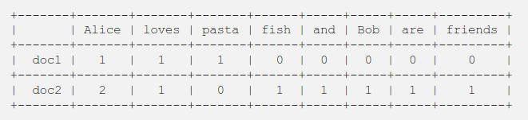
One Hot Encoding of Words
Assume our corpus has two documents
First one contains “Alice loves pasta”
Second document contains “Alice loves fish. Alice and Bob are friends”.

Slide 9
Keras
has built-in utilities for doing one-hot encoding of text at the word level and character level from raw text data
These utilities take care of a number of important features such as stripping special characters from strings and only taking into account the N most common words in your dataset

Slide 10
One-hot Hashing Trick
Variant of one-hot encoding
When number of unique tokens in your vocabulary is too large
hash words into vectors of fixed size with a very lightweight hashing function
Advantage - Does away with maintaining an explicit word index, which saves memory
Drawback - Susceptible to hash collisions

Slide 11
Word Embeddings
Meant to map human language into a geometric space
A word is associated to a dense floating-point word vectors
Learned from data
Common to see word embeddings that are 256-dimensional, 512-dimensional, or 1,024-dimensional when dealing with very large vocabularies

Slide 12
Ways to Learn Word Embeddings
Start with a random vector and jointly learn with the main task you care about (such as document classification or sentiment prediction)
Load pretrained word embeddings that were precomputed using a different machine-learning into your model

Slide 13
Learning Word Embeddings
Start with a random vector
Get geometric relationships between word vectors that should reflect the semantic relationships between these words
Synonyms will be embedded into similar word vectors;
Geometric distance (such as L2 distance) between any two word vectors will relate to the semantic distance between the associated words

Slide 14
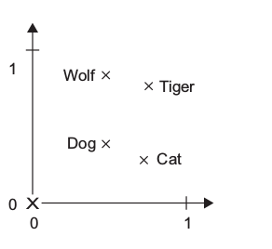
Learning Word Embeddings
Four words are embedded on a 2D plane: cat, dog, wolf, and tiger.
For instance, the same vector allows us to go from cat to tiger and from dog to wolf: this vector could be interpreted as the “from pet to wild animal” vector

Slide 15
Learning Word Embeddings
Similarly, another vector lets us go from dog to cat and from wolf to tiger, which could be interpreted as a “from canine to feline” vector
In real-world word-embedding spaces, common examples of meaningful geometric transformations are “gender” vectors and “plural” vectors.

Slide 16
Learning Word Embeddings
For instance, by adding a “female” vector to the vector “king,” we obtain the vector “queen.”
By adding a “plural” vector, we obtain “kings.”
Word-embedding spaces (WES) typically feature thousands of such interpretable and potentially useful vectors.
WES of movie-review sentiment-analysis may look different from WES for a legal document-classification model, because the importance of certain semantic relationships varies from task to task.

Slide 17
Learning Word Embeddings
It’s thus reasonable to learn a new embedding space with every new task
backpropagation makes this easy, and Keras makes it even easier
It’s about learning the weights of a layer: the Embedding layer.

Slide 18
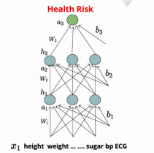
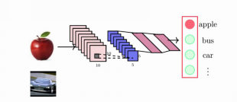
Problems Solved Till Now
Output depends on previous inputs
inputs are of fixed length

Slide 19
ConvNet and Deep Neural Networks
Densely connected networks and convnets, is that they have no memory
Each input shown to them is processed independently, with no state kept in between inputs

Slide 20
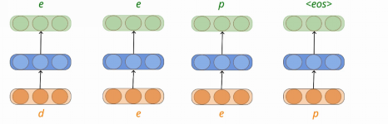
Typing Text in a Mobile Phone
Output depends on more than one previous inputs
inputs are of variable length

Slide 21
Recurrent Neural Networks
Biological intelligence processes information incrementally while maintaining an internal model of what it’s processing, built from past information and constantly updated as new information comes in.
RNN adopts same principle - Processes sequences by iterating through the sequence elements and maintaining a state containing information relative Output to what it has seen so far

Slide 22
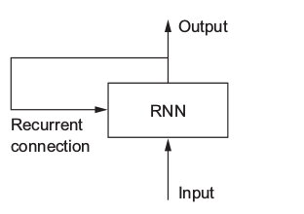
Components of Recurrent Neural Networks
State - containing information relative to what it has seen so far
Loop - Iterate over elements of the sequence

Slide 23
Steps in RNN
takes as input a sequence of vectors
Loops over timesteps, and at each timestep, it considers its current state at t and the input at t to give output at t
For the first timestep - no previous output so initialize the state as an all-zero vector and call it as initial state of the network

Slide 24
Pseudocode of RNN
state_t = 0
for input_t in input_sequence:
output_t = f(input_t, state_t)
state_t = output_t

Slide 25
More detailed Pseudocode of RNN
state_t = 0
for input_t in input_sequence:
output_t = activation(dot(W, input_t) + dot(U, state_t) + b)
state_t = output_t

Slide 26
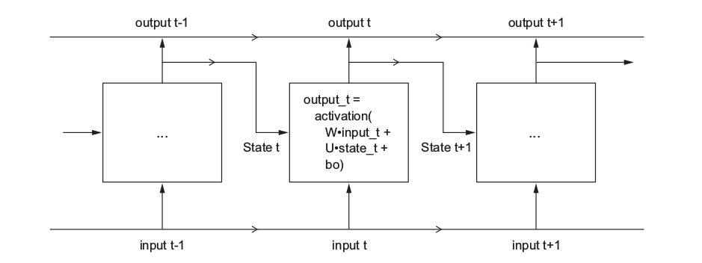
Simple RNN Unrolled Over Time

Slide 27
More detailed Pseudocode of RNN
state_t = 0
for input_t in input_sequence:
output_t = activation(dot(W, input_t) + dot(U, state_t) + b)
state_t = output_t

Slide 28
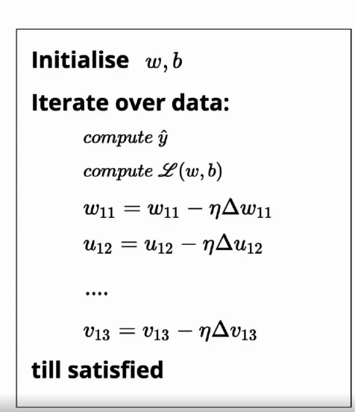
Gradient Descent Learning Algorithm

Slide 29
Backpropagation Through Time (BPTT)
Application of the Backpropagation training algorithm to recurrent neural network applied to sequence data like a time series
Conceptually, BPTT works by unrolling all input timesteps.
Each timestep has one input timestep, one copy of the network, and one output.
Errors are then calculated and accumulated for each timestep.
The network is rolled back up and the weights are updated

Slide 30
Backpropagation Through Time (BPTT)
Each timestep of unrolled recurrent neural network may be seen as an additional layer given the order dependence of the problem and the internal state from the previous timestep is taken as an input on the subsequent timestep.
We can summarize the algorithm as follows:
Present a sequence of timesteps of input and output pairs to network.
Unroll network then calculate and accumulate errors across each timestep
Roll-up the network and update weights.
Repeat.

Slide 31
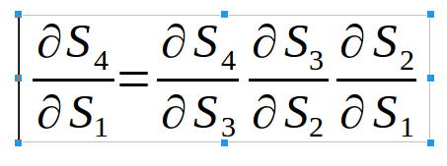
Gradient Descent Learning Algorithm
Applying Chain rule
Exploding or vanishing gradient Problem

Slide 32
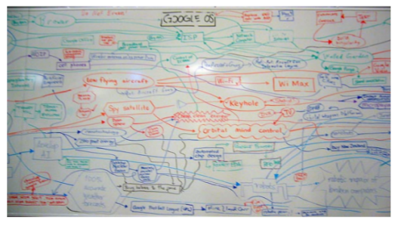
Whiteboard Analogy
Think state as a fixed memory
Compare to a fixed size white board
At each time step, we keep writing something on board and morph the information recorded till that time point
After many timesteps, it would be impossible to know how the information at time step t-k contributed to state at timestep k

Slide 33
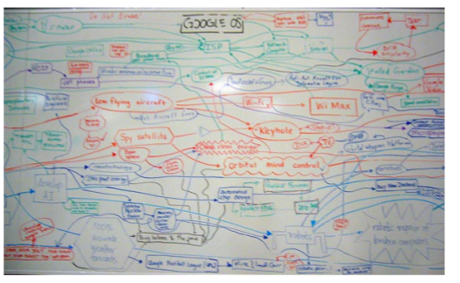
Operations made in the Whiteboard
Selective read
Selective write
Selective forget

Slide 34
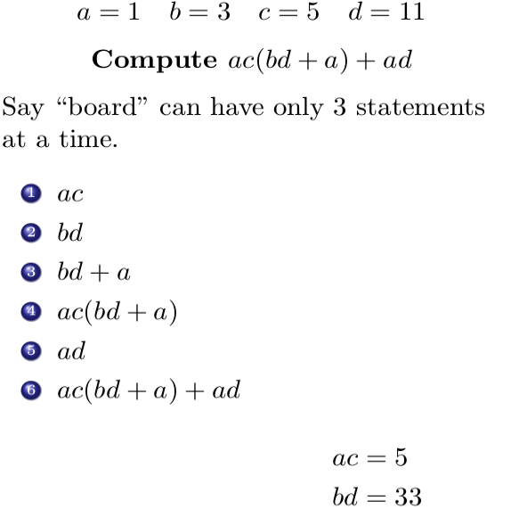
Selective Write in Whiteboard Analogy
There are many steps in the derivation but some are skipped

Slide 35
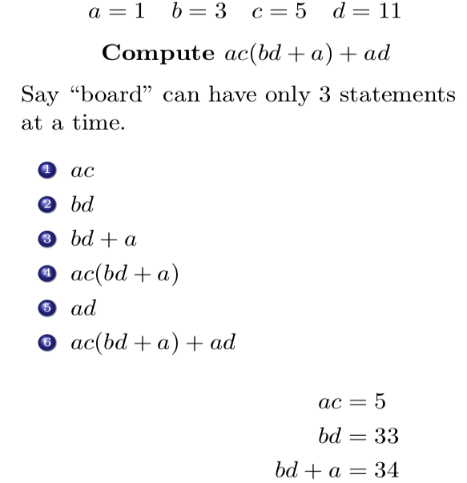
Selective Read in Whiteboard Analogy
While writing one step, we read some of the previous steps already written to decide what to write
For step 3, step 2 is important
We select what to read

Slide 36
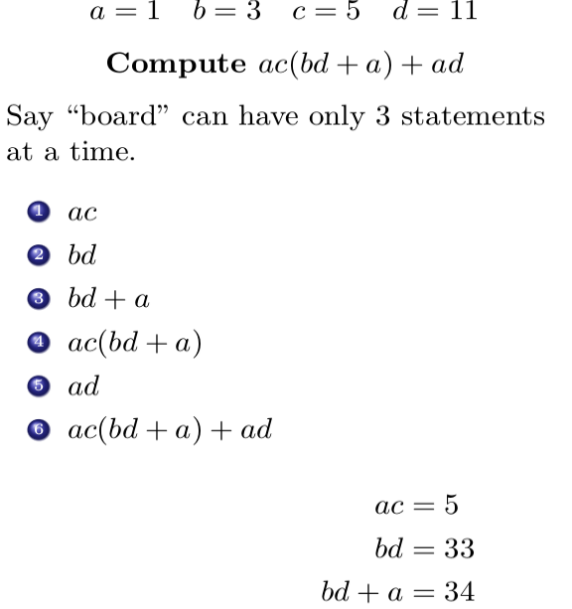
Selective Forget in Whiteboard Analogy
Once board is full, we delete some obsolete information
Delete least useful information
We select what to forget

Slide 37
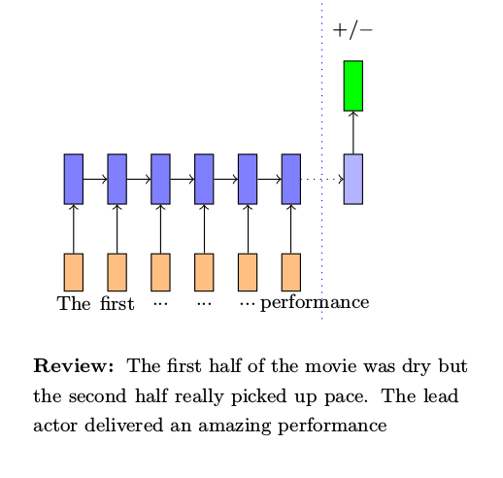
Concrete Examples for Selective Read, Write & Forget
Task of predicting senitment (positive/negative) of a review
RNN reads document from left to right
By the time, we reach end of document the information obtained from first few words is completely lost

Slide 38
Selective operations in LSTM
Forget information added by stop words such as a, the, is, was etc
Selectively read information added by sentiment words such as awesome, amazing, wonderful etc
Selectively write new information from the current word to the state

Slide 39
Gated Recurrent Unit (GRU)
Variant of LSTM
No explicit forget gate
Instead selective read and selective write is modified to pick the required information only

Slide 40
LSTMs Avoid Vanishing Gradient Problem
During forward propagation, gates control flow of information
They prevent irrelevant information from being written to the state
During back propagation, gates control flow of gradients
Keras provide options for LSTM and GRU also

Slide 41
Thank You

