Slide 1

X-rays Project1 COVID-19 Detection Using Chest X-rays
By:
Janaki Obillaneni
Susroonya Koduru
Varshitha Challa
Mentored By:
Theodoros Tavoulareas
Notes:
Line spacing + Page numbers

Slide 2
Overview
1. Problem Statement
2. Objectives
3. Dataset
4. Architecture & Methodology
5. Evaluation & Results

Slide 3
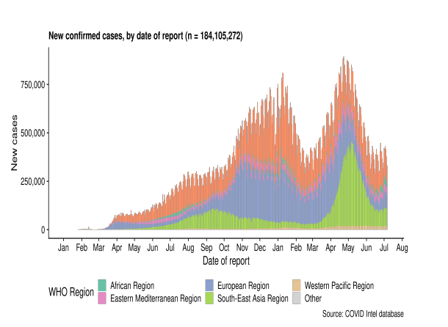
1. Problem Statement
COVID-19 disease abruptly spread all across the globe affecting millions of people and created global tension across all countries.
With an exponential increase in COVID-19 cases, there is a high demand for rapid testing.
This calls for the need of deep learning and computer vision techniques to help identify COVID-19 patients with minimum time consumption and maximum efficiency.
[1] WHO COVID. Explorer. Geneva: World Health Organization. 2020. 19
Distribution of COVID-19 cases across the globe

Slide 4
Cont..
Artificial Intelligence and Machine learning/Deep learning are currently the state of the art in predicting results in almost all fields. These systems are showing massive results in healthcare domain too.
Our goal is to develop a model which would be helpful in mitigating the time delay for COVID -19 virus identification, without any specialist guidance.
In this project, we will classify chest x-ray images as COVID-19 or Normal.
This would be really beneficial to Physicians, as they could spend more time on treating the virus(if positive) rather than identifying it.
Also, a reliable and accurate approach for everyone to rely upon.

Slide 5
2.Objectives
Identifying the most suitable machine learning technique for prediction, to perform on chest x-rays of patients.
Implementing a machine learning model that could make accurate predictions of COVID-19 in patients.
Evaluating different machine learning models used and reporting their performances.
4/28/2022
5

Slide 6
Project Timeline
Implementing ResNet50, EfficientNet
Also using Vision Transformers
Evaluating the performances
Dataset Collection
Choosing the pre-trained models
Till Mid-Term presentation
After Progress

Slide 7
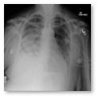
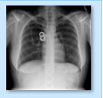
Flow Graph
Data preprocessing
Training Model
Model validation
Fine tuning
Classification
COVID-19 Positive
COVID-19 Negative

Slide 8
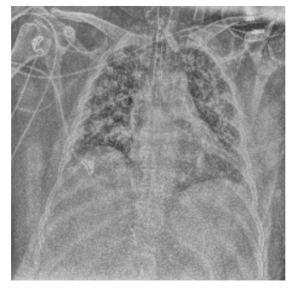
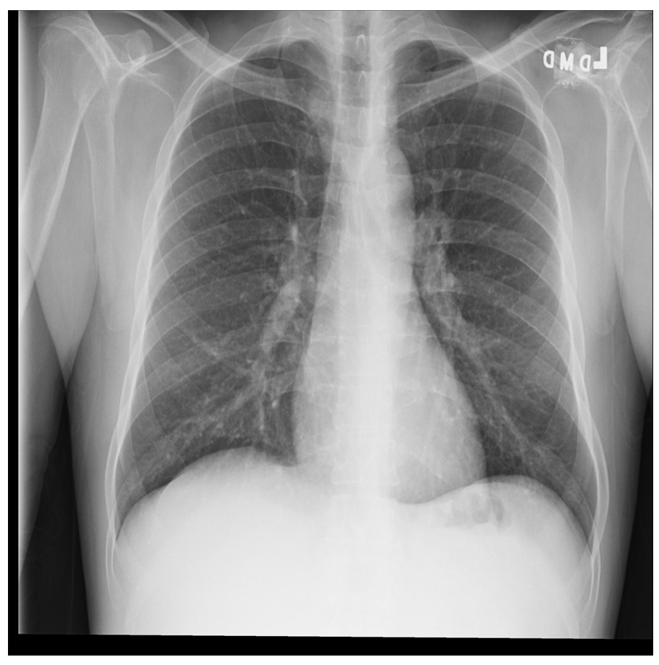
3.Dataset
COVID-19 Positive Sample [3]
We have used a COVIDx CXR-2, a public dataset.
It has two sub folders named train and test.
The train and test folders contains 30,092 and 400 images respectively.
Classified the images into two classes which are predominantly [‘positive’:1, ‘negative’:0]
[3] “COVIDx CXR-2.” https://kaggle.com/andyczhao/covidx-cxr2
COVID-19 Negative Sample [3]
4/28/2022
8

Slide 9
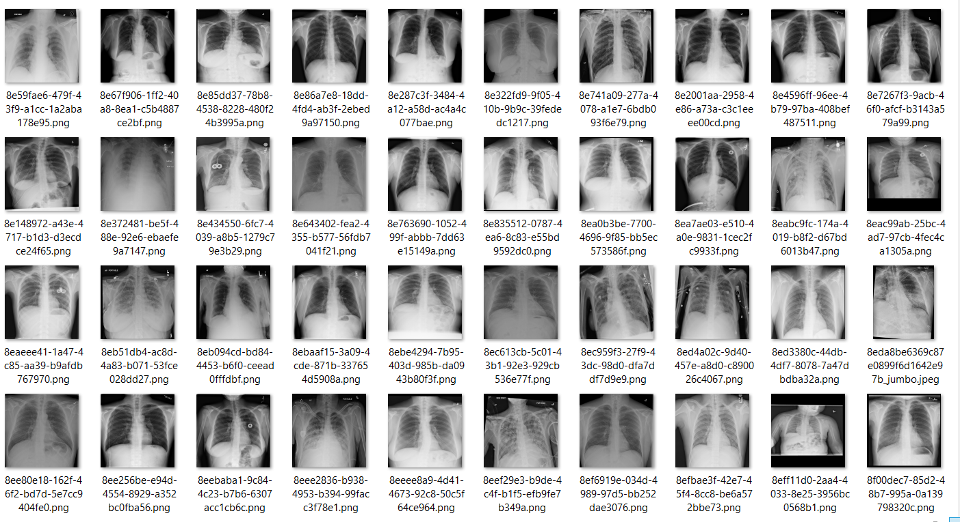
[3] “COVIDx CXR-2.” https://kaggle.com/andyczhao/covidx-cxr2

Slide 10
3.Data Preprocessing
Split the train and test data into train, validation and test sets.
As COVIDx CXR-2 dataset doesn’t have any validation data.
Applied few data augmentation techniques such as,
Image Resizing
Image rotation
Normalization

Slide 11
4.Methodology & Architecture
Models used for the detection of COVID-19 from chest x-rays are
ResNet50 : A CNN which is 50 layers deep, we have used a pre-trained version of network which is already trained in ImageNet database.
EfficientNet : EfficientNetB0 surpasses CNN in gaining better accuracy while significantly reducing the number of parameters.
Vision Transformers : It employs a Transformer-like architecture over patches of the image. An image is split into fixed-size patches, each of them are then linearly embedded, position embeddings are added, and the resulting sequence of vectors is fed to a standard Transformer encoder.
4/28/2022
11

Slide 12
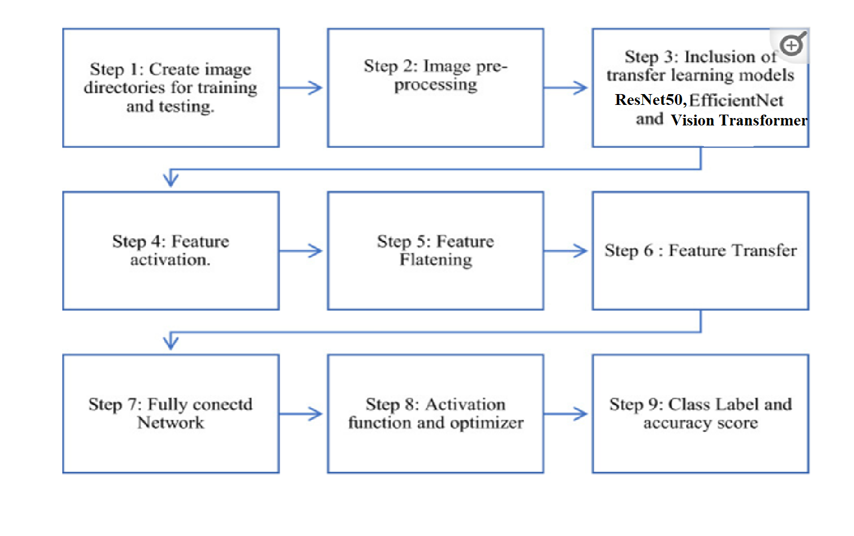
Steps to implement the model
Positive
Negative
[4] Medical image-based detection of COVID-19 using Deep Convolution Neural Networks
Loveleen Gaur,¹ Ujwal Bhatia,¹ N. Z. Jhanjhi,² Ghulam Muhammad, ^{3,4} and Mehedi Masud⁵

Slide 13
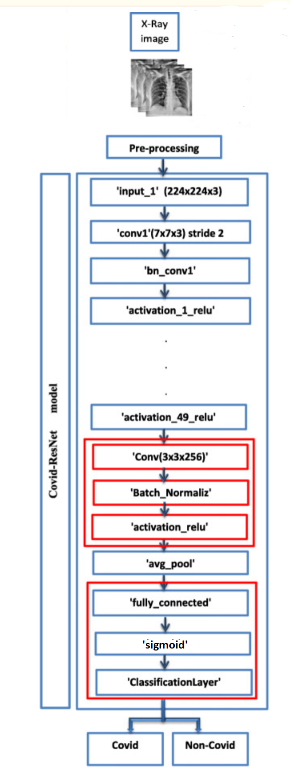
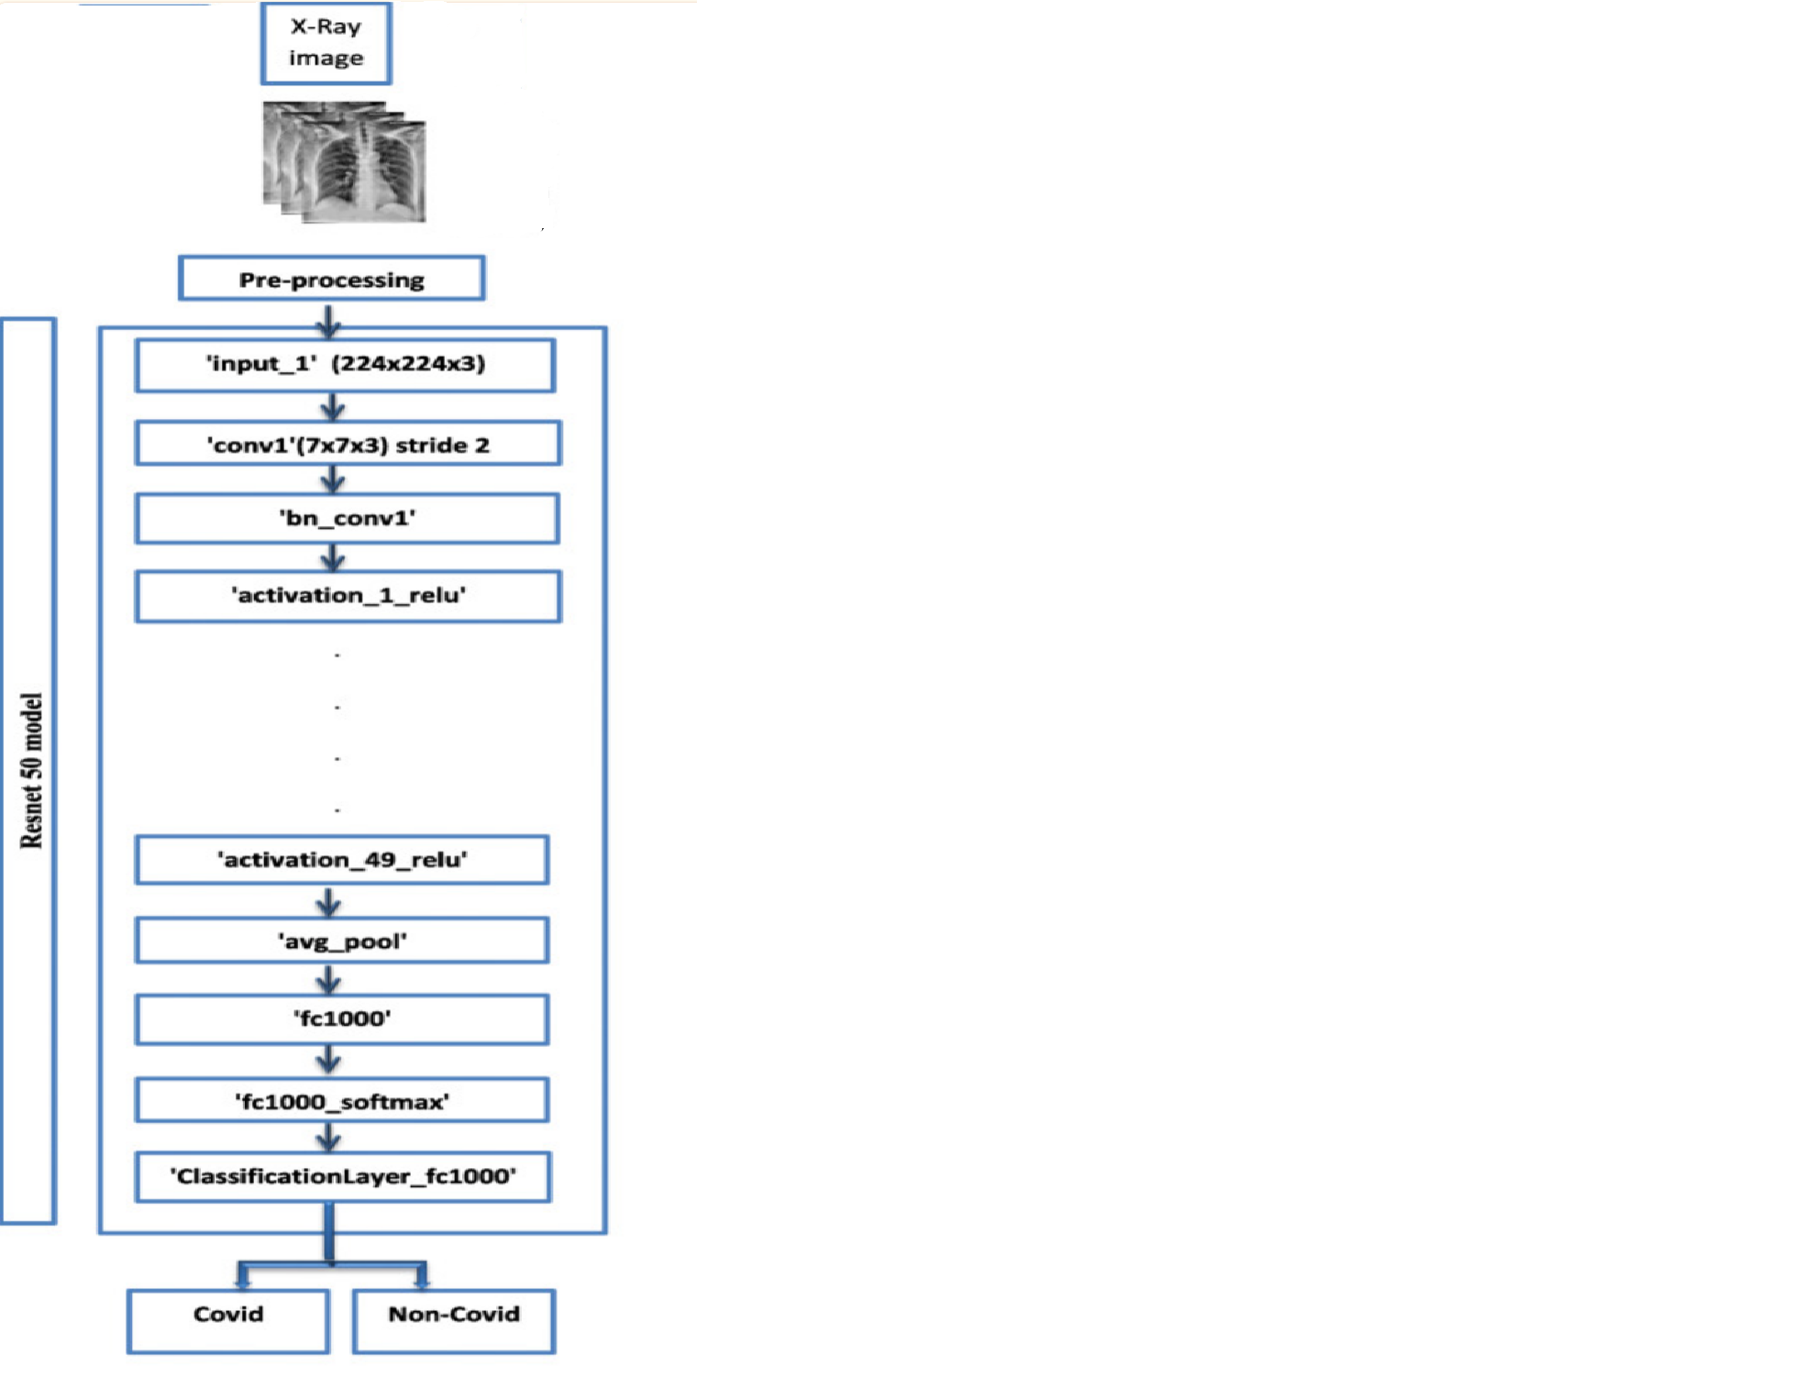
Architecture of ResNet50
[5] Automatic prediction of COVID− 19 from chest images using modified ResNet50
Marwa Elpeltagy ¹ and Hany Sallam²

Slide 14
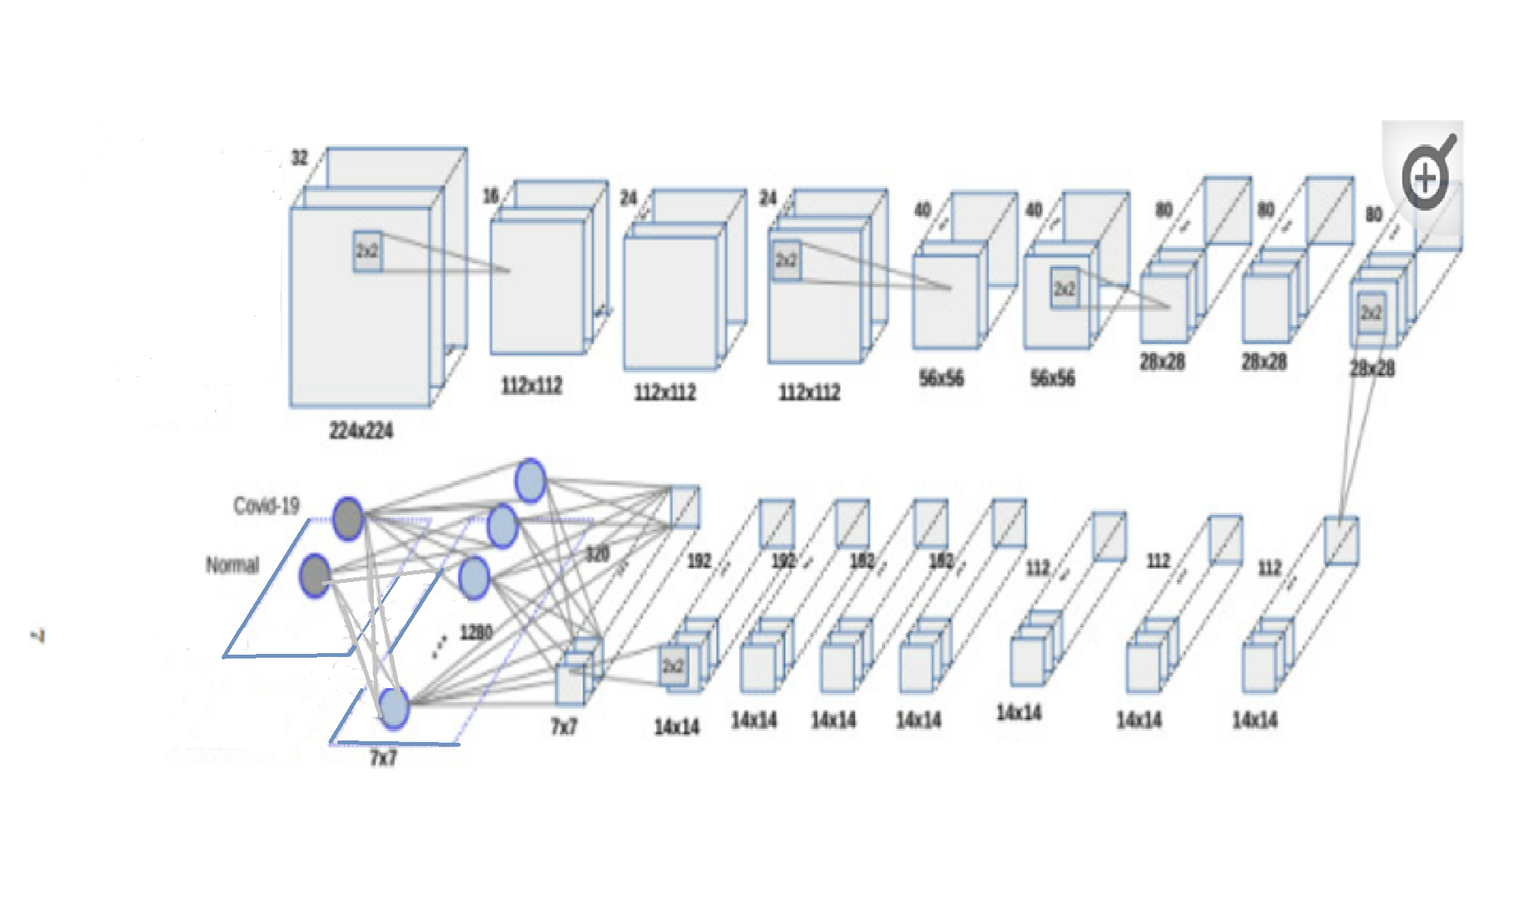
Architecture of EfficientNetB0
[4] Medical image-based detection of COVID-19 using Deep Convolution Neural Networks
Loveleen Gaur,¹ Ujwal Bhatia,¹ N. Z. Jhanjhi,² Ghulam Muhammad,^{3,4} and Mehedi Masud⁵

Slide 15
Vision Transformer(ViT)
In the academic paper An Image is Worth 16x16 Words: Transformers for Image Recognition at Scale, the authors mention that Vision Transformers (ViT) are data-hungry. Therefore, pretraining a ViT on a large-sized dataset like JFT300M and fine-tuning it on medium-sized datasets (like ImageNet) is the only way to beat state-of-the-art Convolutional Neural Network models.
The self-attention layer of ViT lacks locality inductive bias This is the reason why ViT’s need more data. On the other hand, CNNs look at images through spatial sliding windows, which helps them get better results with smaller datasets.
In the academic paper Vision Transformer for Small-Size Datasets, the authors set out to tackle the problem of locality inductive bias in ViT’s.
The main ideas are:
Shifted Patch Tokenization
Locality Self Attention
[6] Vision Transformer for Small-Size Datasets Seung Hoon Lee, Seunghyun Lee, Byung Cheol Song
[7] An Image is Worth 16x16 Words: Transformers for Image Recognition at Scale
Alexey Dosovitskiy, Lucas Beyer, Alexander Kolesnikov, Dirk Weissenborn, Xiaohua Zhai, Thomas Unterthiner, Mostafa Dehghani, Matthias Minderer, Georg Heigold, Sylvain Gelly, Jakob Uszkoreit, Neil Houlsby
4/28/2022
15

Slide 16
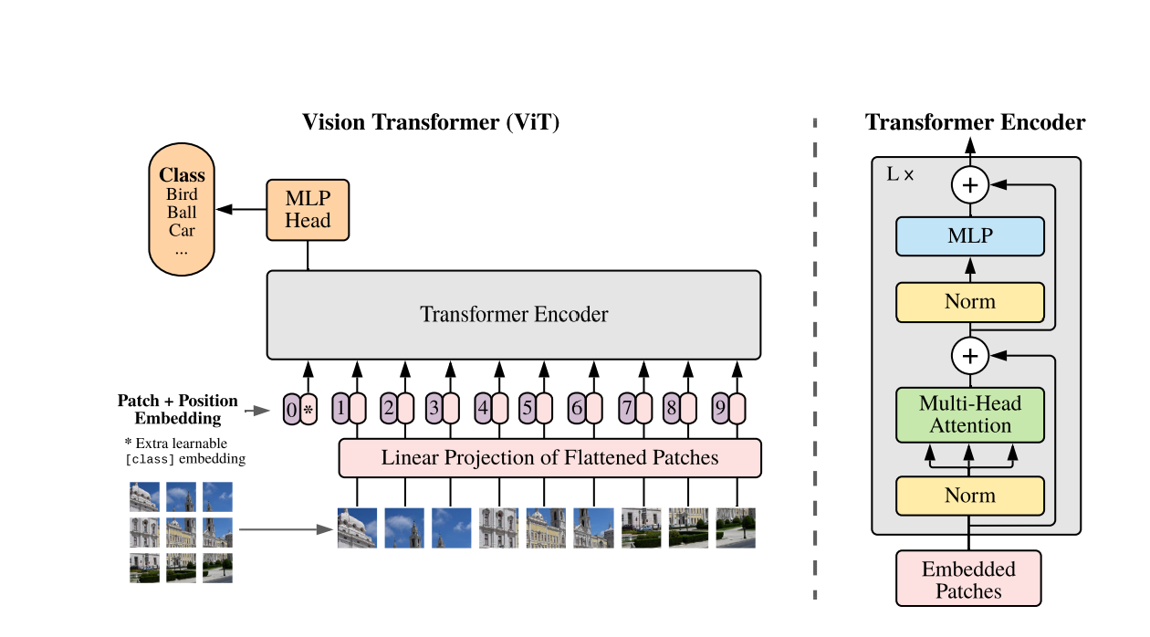
Vanilla Patch Maker
Here we split an image into fixed-size patches, linearly embed each of them, add position embeddings, and feed the resulting sequence of vectors to a standard Transformer encoder.
In order to perform classification, we use the standard approach of adding an extra learnable “classification token” to the sequence.
The illustration of the Transformer encoder was inspired by Vaswani et al. (2017).
[7] An Image is Worth 16x16 Words: Transformers for Image Recognition at Scale
Alexey Dosovitskiy, Lucas Beyer, Alexander Kolesnikov, Dirk Weissenborn, Xiaohua Zhai, Thomas Unterthiner, Mostafa Dehghani, Matthias Minderer, Georg Heigold, Sylvain Gelly, Jakob Uszkoreit, Neil Houlsby

Slide 17
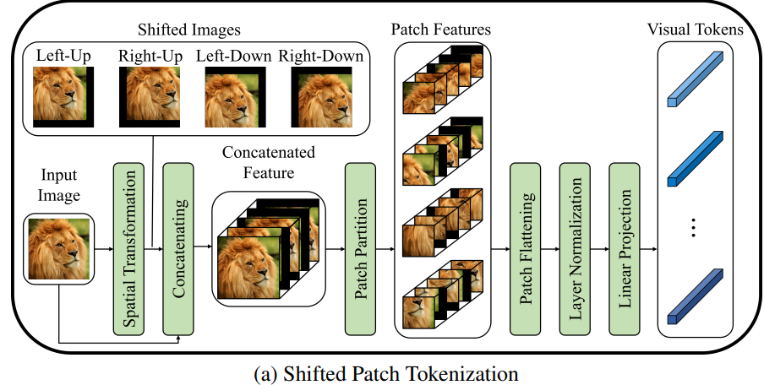
Shifted Patch Tokenization
In a ViT pipeline, the input images are divided into patches that are then linearly projected into tokens. Shifted patch tokenization (STP) is introduced to combat the low receptive field of ViT’s. The steps for Shifted Patch Tokenization are as follows:
Start with an image.
Shift the image in diagonal directions.
Concatinate the diagonally shifted images with the original image.
Extract patches of the concatenated images.
Flatten the spatial dimension of all patches.
Layer normalize the flattened patches and then project it.
[6] Vision Transformer for Small-Size Datasets Seung Hoon Lee, Seunghyun Lee, Byung Cheol Song

Slide 18
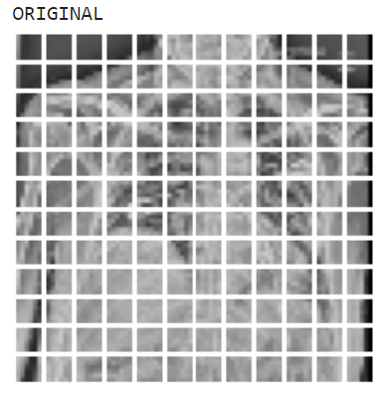
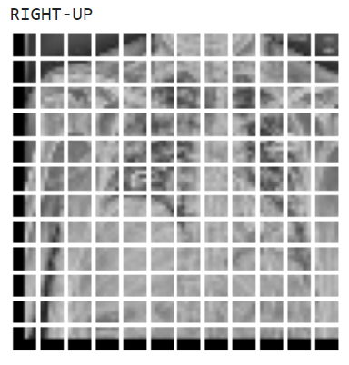
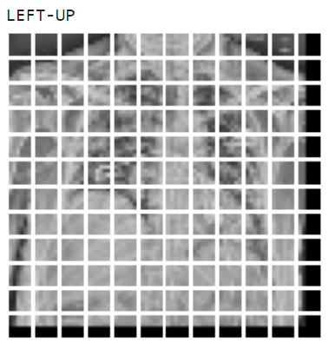
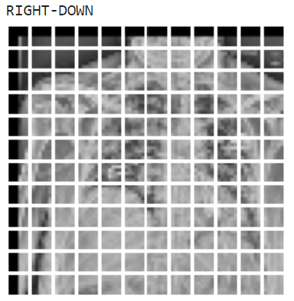
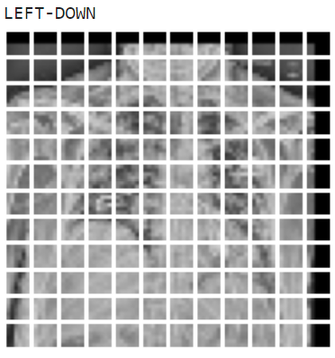
Few Examples of COVIDx CXR-2

Slide 19
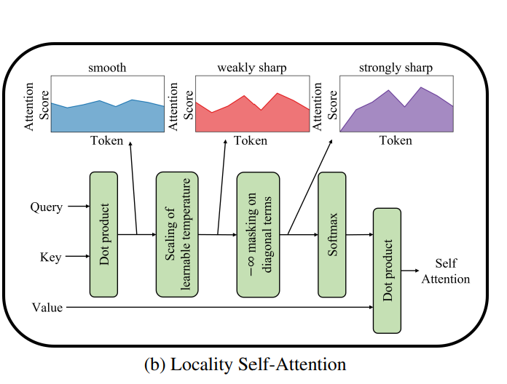
Locality Self Attention(LSA)
In general, a SoftMax function can control the smoothness of the output distribution through temperature scaling .
LSA primarily sharpens the distribution of attention scores by learning the temperature parameters of the SoftMax function.
Additionally, the self-token relation is removed by applying the so-called diagonal masking, which forcibly suppresses the diagonal components of the similarity matrix computed by Query and Key.
This masking relatively increases the attention scores between different tokens, making the distribution of attention scores sharper.
As a result, LSA increases the locality inductive bias by making ViT’s attention locally focused.
[6] Vision Transformer for Small-Size Datasets Seung Hoon Lee, Seunghyun Lee, Byung Cheol Song

Slide 20
5.Evaluation
For evaluation we have proportioned our dataset into
80% for training, 15% for testing , 5% for validation.
And for the others
Activation Function : ReLu, Sigmoid, GeLu
Loss function: Binary Cross Entropy
Optimizer : Adam

Slide 21
5.Results
Model | Train Accuracy | Test Accuracy | Validation Accuracy
ResNet50 | 99.69% | 92.25% | 98.29%
EfficientNet | 97.50% | 98.75% | 97.64%
ViT’s(Vanilla patch maker) | 95.28% | 91.27% | 96.96%
ViT’s(Shift Patch tokenization) | 94.77% | 85.61% | 97.20%

Slide 22
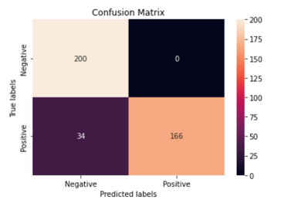
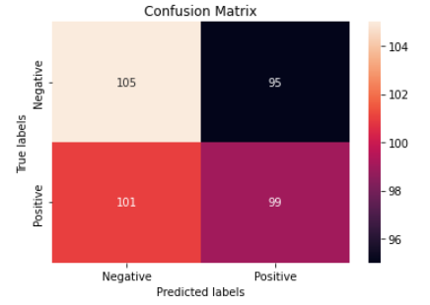
Confusion Matrix
Using ResNet50
Using EfficientNet

Slide 23
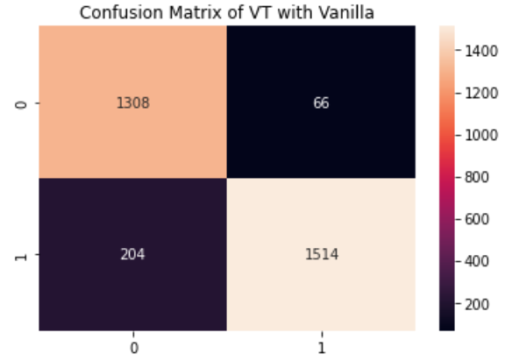
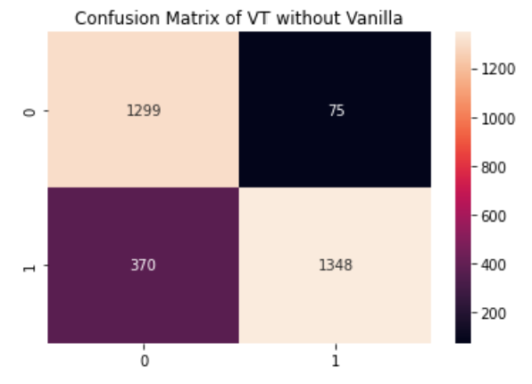
Confusion Matrix
Using Vanilla Patch Maker
Using Shift Patch tokenization
4/28/2022
2123

Slide 24
Next steps
To identify all the False negatives, True negatives among the images in the test set which our models has identified.
To use pre-trained model in Vision Transformers and compare the results with the present.
04/28/2022
24

Slide 25
Thank You

