Slide 1
COVID-19 Detection Using Deep Learning
By
Susroonya Koduru
Varshitha Challa
Mentored By : Theodoros Tavoulareas

Slide 2
Agenda
Project
Overview
1
Objectives
2
Data Representation& Methodology
3
Challenges
4

Slide 3


Project Overview
What is Covid-19?
Why do we need a computer vision model to detect it?

Slide 4
Objectives
Design and develop a model
Evaluate the performance
Detect Covid-19
4

Slide 5

Data Requirements
Used a public dataset COVIDx-CXR-2
5

Slide 6
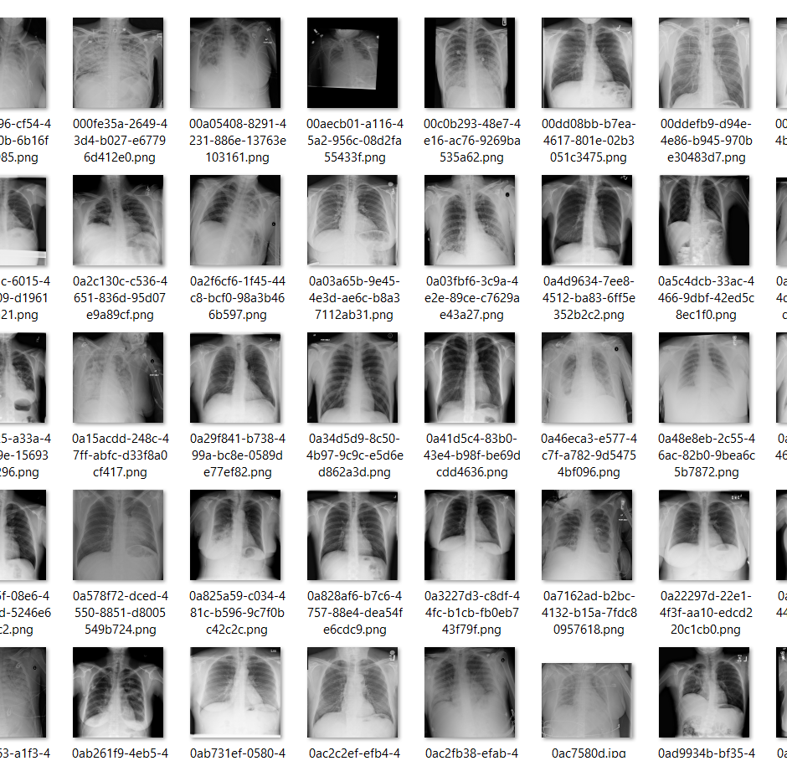
Covidx-CXR-2 Dataset Sample Reference:“COVIDx CXR-2.” https://kaggle.com/andyczhao/covidx-cxr2

Slide 7
Methodology
ResNet50
EfficientNet
COVID-Net(To be Implemented)

Slide 8
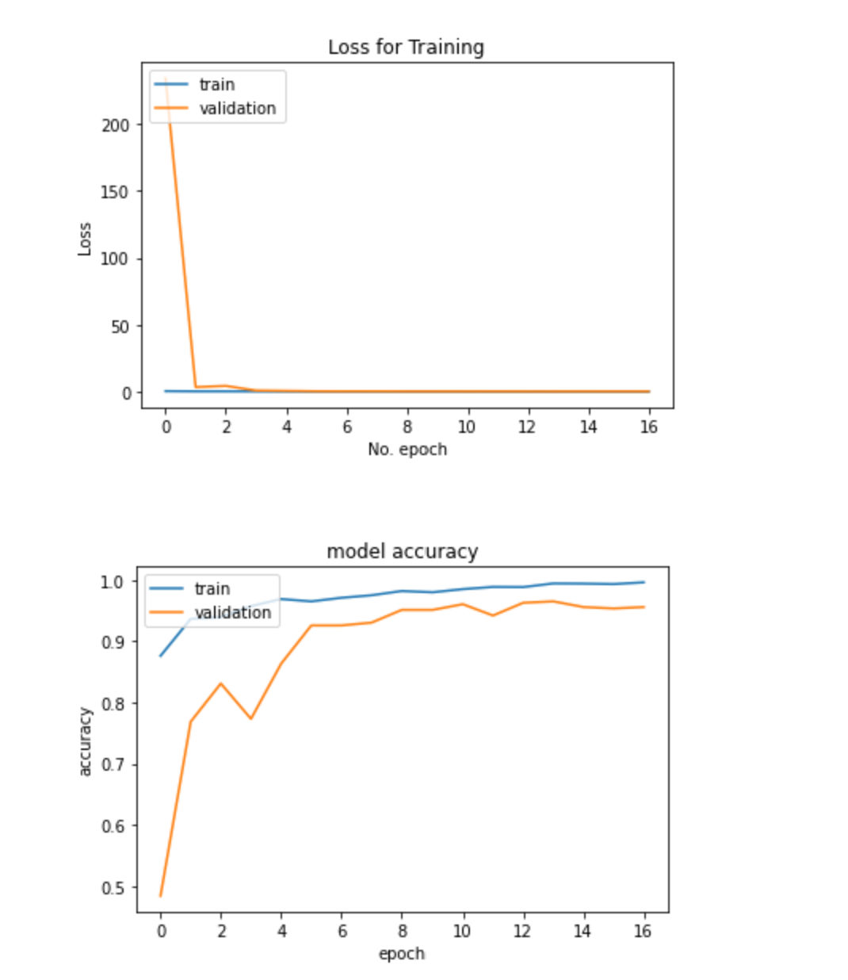
Test & Train Accuracy, Loss
(For ResNet50)

Slide 9
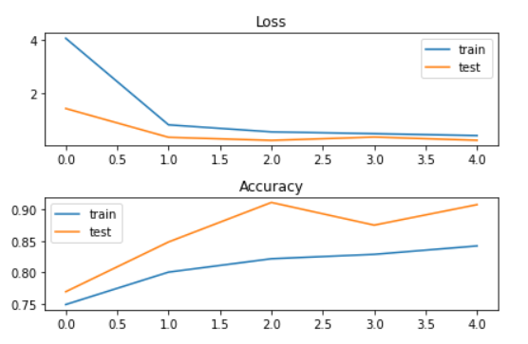
Accuracy, Loss for Test and Train data (For EfficientNet)

Slide 10
Challenges
1.Train huge amount of data
2. Time consuming

Slide 11
Thank you

