Slide 1
Mondrian Multidimensional k-Anonymity
By,
Sai Krishna Kasarapu
Sai Chaitanya Kollipara
Janaki Ram Chimata
Murali Venkateswara Gopi Krishna Ponnada

Slide 2
Introduction
Brief Introduction to k-Anonymity
K-anonymity is a critical concept in data privacy, ensuring that individual records in a dataset cannot be uniquely identified. It's a cornerstone in safeguarding sensitive information.
This concept has applications in various fields where preserving individual privacy is crucial like Healthcare data sharing, Social science research, Employee data protection, etc.
Main goal is to hold privacy of data by partitioning with various attributes.
Importance of Privacy in Data Publishing
In today's data-centric landscape, where sharing and analyzing data is ubiquitous, privacy becomes paramount. Implementing robust techniques like k-anonymity is essential to protect individual privacy during data publishing.

Slide 3
Multidimensional k-Anonymity Model
Explanation of the Multidimensional k-Anonymity Model
Our paper introduces a sophisticated multidimensional k-anonymity model. Despite the NP-hardness of the problem, we provide an efficient and practical greedy approximation algorithm to tackle it.
Greedy Approach in Multidimensional k-Anonymity
The greedy approach allows us to approximate optimal solutions efficiently. It involves making locally optimal choices at each stage with the hope of finding a global optimum.
Strict Multidimensional Partitioning and Relaxed Multidimensional Partitioning
We explore both strict and relaxed multidimensional partitioning. Strict partitioning imposes more constraints, while relaxed partitioning allows for more flexibility, contributing to the adaptability of the model.
Relaxed : Data can be overlapped. Flexible to use when there is complex scenarios.
Strict : No Overlapping. Used when there is more precise control over data.

Slide 4
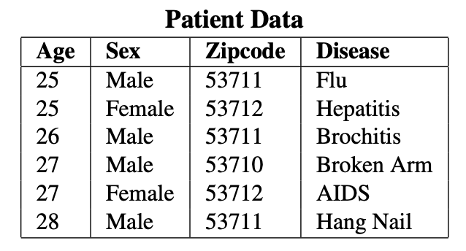
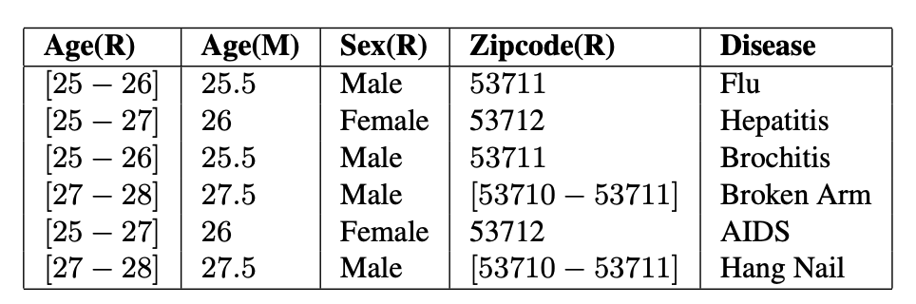
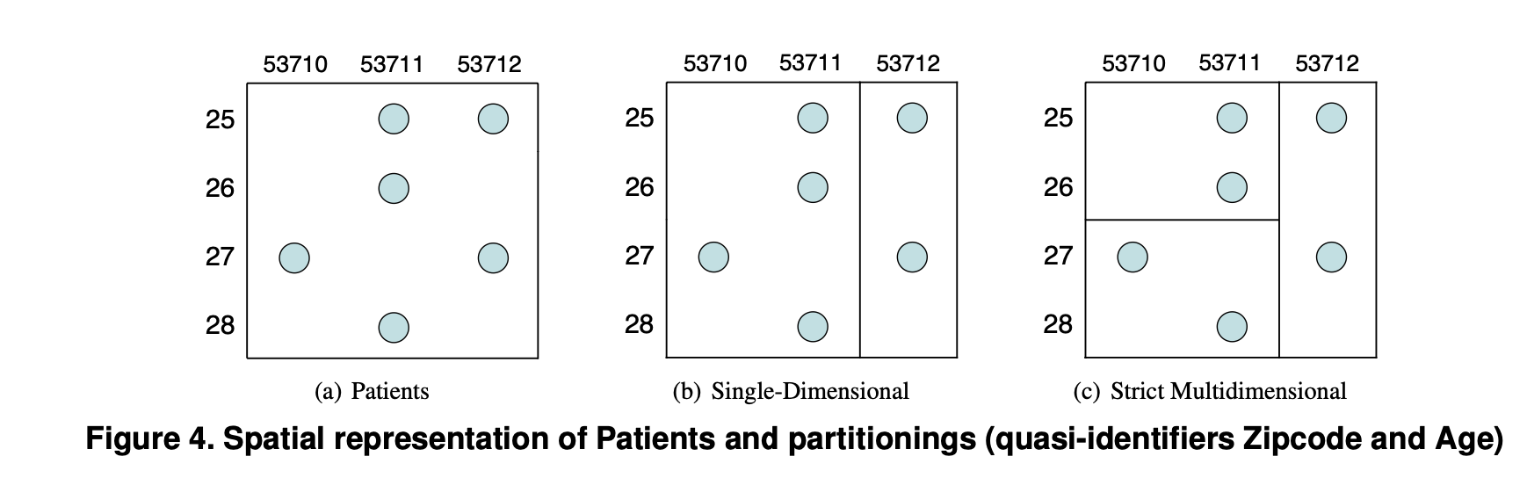
How are we gonna anonymize?
Single dimensional _ one attribute
# improves performance by distributing into multiple servers and allowing parallel processing.
Multi _ multiple attributes
# used for managing large scale datasets.
#optimizes query execution.

Slide 5
Quasi-Identifier
Quasi Identifier: A quasi-identifer is a minimal set of attributes X1 , ..., Xd in table T that can be joined with external information to re-identify individual records. We assume that the quasi-identifier is understood based on specific knowledge of the domain.
(5-digit ZIP code , Age, gender) uniquely identify 87% of the population in the U.S.
Can be used for linking anonymized datasets with other datasets

Slide 6
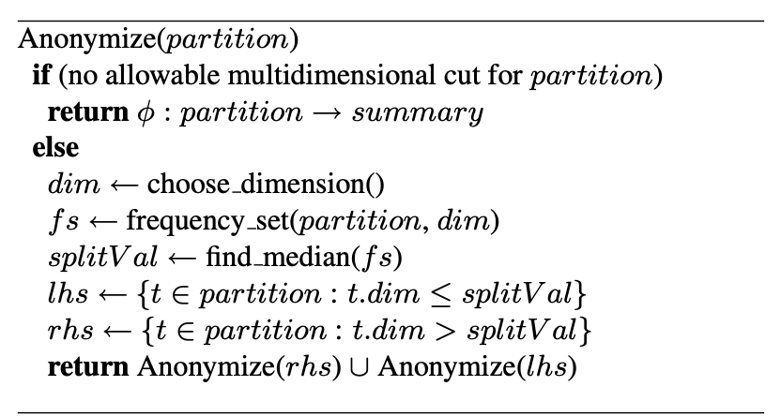
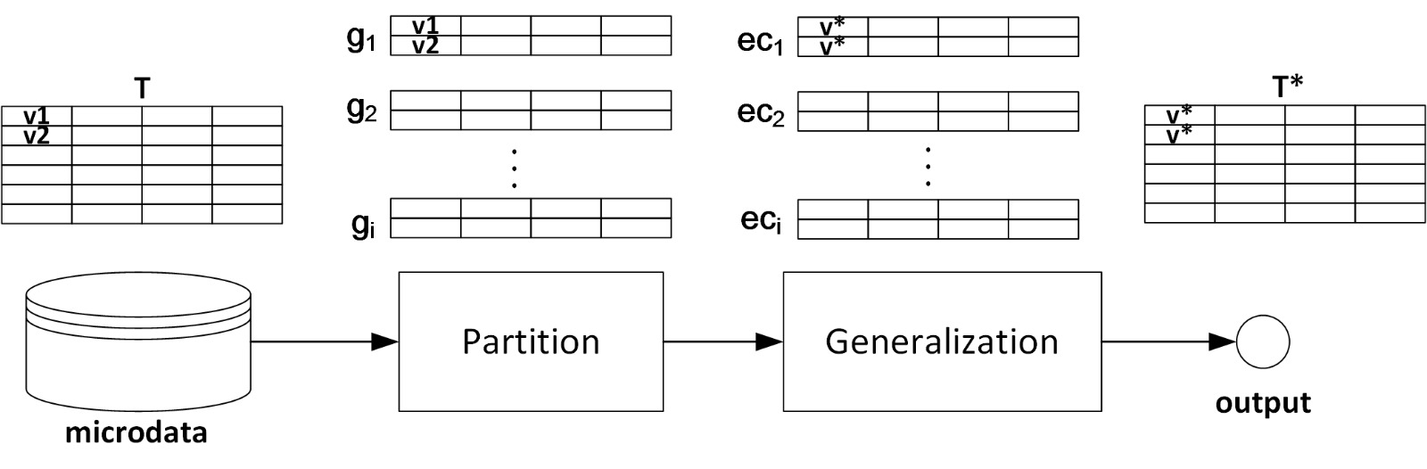
Top-Down greedy algorithm for strict multidimensional partitioning

Slide 7
Experimental Evaluation
Summary of Experiments with Synthetic and Real-World Data
We'll present the results of our experiments, covering synthetic and real-world data. Comparative analyses will showcase the effectiveness of multidimensional k-anonymity against other existing models.
Comparison of Multidimensional k-Anonymity with Other Models
How does multidimensional k-anonymity compare to varying k values ? Our experiments provide insights into how model data is transformed based on strict or relaxed partitioning.

Slide 8
Results and Conclusion
It is an np- hard problem. Using greedy approach shows more eﬃciency for proposed optimal k‐anonymization algorithms for single‐dimensional models; complexity O(n log n), compared to exponential.
The greedy multidimensional algorithm produces higher‐quality results than existing k-anonymity optimal algorithms.
Our implementation and evaluation will align with the pragmatic approach of the greedy multidimensional partitioning.

Slide 9
Thank You …

