Slide 1
Network Intrusion Detection System using Deep Learning
C.Janaki Ram 20071A0426
K.Karthik 20071A0433
V.Anemesh Chandra 20071A0457
Project Mentor: G. Sahitya, Assistant Professor, Dept. of ECE

Slide 2
Introduction
Network Intrusion Detection System
A Network Intrusion Detection System (NIDS) is an application that can detect and report network security problems by monitoring network or system activities for malicious or anomalous behavior.
NIDS works by examining a variety of data points from different sources within the network.

Slide 3
Types of Attacks
Denial Of Service (DoS): This type of attack aims to make a machine or network resource unavailable to its intended users by temporarily or indefinitely disrupting services of a host connected to the Internet.
Probe: Probing is an attack in which the attacker scans a machine or a networking device to determine weaknesses or vulnerabilities that may later be exploited to compromise the system.
User to Root (U2R): These attacks are exploitations in which the attacker starts off on the system with a normal user account and attempts to abuse vulnerabilities in the system in order to gain super user privileges.
Remote to Local (R2L): A remote to user attack is an attack in which a user sends packets to a machine over the internet, which they do not have access to, in order to expose the machine’s vulnerabilities and exploit privileges which a local user would have on the computer.

Slide 4
Motivation
Motivation
The motivation for the work is to develop a security system capable of detecting harmful behavior. The IDS employs data mining techniques such as Multi Layer Perceptron, Auto Encoders, and SVM. The machine learning system learns about the attack features.
Contributions of suggested work are:
Machine learning algorithms are used to identify attack classes.
Determine which algorithm is most suited for an IDS situation in order to effectively resist insider attacks.
The intrusion detection system employs classification techniques to determine if a packet passing over the network is normal or an attack.

Slide 5
Literature Survey
SI. No | Title of the Paper | Content
1 | A Deep Learning Approach for Intrusion Detection Using Recurrent Neural Networks - November 7, 2017 | 1. Improved Representations: Deep learning has the potential to extract better representations from the data, leading to the creation of more effective models. 2. Application Flexibility: Recurrent neural networks have played an important role in various fields such as computer vision, natural language processing, speech recognition, and human action recognition. 3. Computational Resources: Deep learning models often require significant computational resources for training and inference. 4. Data Requirements: Deep learning models may require large amounts of labelled data for effective training, which can be a challenge in certain domains.
2 | Applying Big Data Based Deep Learning System to Intrusion Detection - 2020 | 1. Utilization of big data techniques: BDHDLS leverages big data techniques, such as Apache Spark, for feature selection and clustering, enabling efficient processing of large-scale network traffic data. 2. Computational intensity: The process of feature selection and clustering in BDHDLS requires the utilization of big data techniques to speed up the time and space intensive computational process, which may require significant computational resources.
3 | A deep learning approach for effective intrusion detection in wireless networks using CNN - 2020 | High overall detection accuracy, the use of a deep learning approach, and the incorporation of a feature selection algorithm to improve the efficiency and effectiveness of the system. Need for significant computational resources to implement the deep learning approach, the potential for false positives or false negatives in the detection process, and the possibility of the system being vulnerable to new or unknown types of attacks that it has not been trained to detect.
4 | Using Deep Learning Techniques for Network Intrusion Detection - 2020 | 1. Utilization of Deep Learning Techniques: The paper leverages CNN and RNN architectures for network intrusion detection, showcasing the application of advanced deep learning techniques in the field of cybersecurity 2.Limited Computational Resources: The paper acknowledges the challenge of limited computational resources, which resulted in longer training times for the models. This limitation may impact the scalability and practical implementation of the proposed system.

Slide 6
Literature Survey
SI. No | Title of the Paper | Content
5, | A Novel Network Intrusion Detection System Based on CNN - 2020 | The document explores the application of deep learning, specifically Convolutional Neural Networks (CNN) and Recurrent Neural Networks (RNN), in network intrusion detection to combat the rising complexity of cyber-security threats. It presents a comprehensive review of utilizing deep neural networks for intrusion detection, evaluating their efficacy through experiments with the NSL-KDD dataset. Results indicate CNN's superiority over RNN variants, achieving over 97% accuracy. Despite promising results, challenges like lengthy training times due to resource constraints are noted. Future research aims to optimize deep learning models' performance, considering computational requirements and hyperparameters. Overall, the document underscores the potential of deep learning in enhancing Network Intrusion Detection Systems (NIDS), while also highlighting the need for further investigation to overcome implementation hurdles and improve efficacy.
6, | An Intrusion Detection System for Multi-Class Classification based on Deep Neural Networks - 2019 | The document outlines a study on intrusion detection employing deep learning, specifically focusing on recurrent neural networks (RNN-IDS). It addresses the challenge of accurately identifying various network attacks by proposing an RNN-based model and assessing its performance in binary and multiclass classification scenarios. Through experimentation and analysis of factors like neuron count and learning rates, the document demonstrates the RNN-IDS model's superiority over traditional machine learning methods, showcasing its potential to enhance intrusion detection accuracy. Emphasizing the escalating severity of security threats and the limitations of conventional methodologies, the study underscores the relevance of deep learning, particularly RNNs, in effectively addressing the challenges of intrusion detection. Detailed descriptions of the dataset, preprocessing steps, methodology, and evaluation metrics are provided, alongside discussions on the implications of the research findings and future research directions, indicating the promise of the RNN-IDS model in advancing intrusion detection technology.
7, | Performance evaluation of deep learning techniques for DoS attacks detection in wireless sensor network - 2023 | The document introduces a novel intrusion detection system tailored for identifying and detecting intruders within wireless networks by combining a newly proposed feature selection algorithm, Conditional Random Field and Linear Correlation Coefficient-Based Feature Selection (CRF-LCFS), with Convolutional Neural Network (CNN) classification. This system aims to bolster data communication security by effectively pinpointing intruders in wireless networks. Leveraging the KDD 99 Cup dataset, the CRF-LCFS algorithm selects the most relevant features, employing Euclidean distance measurement and CRF to group features based on correlation coefficient values. Experimental results showcase the system's efficacy, achieving an impressive detection accuracy of 98.8% when integrated with CNN, outperforming existing intrusion detection systems across various attack types.

Slide 7
Objectives
To create a Network Intrusion Detection System using Deep Learning models.
To increase the accuracy of NIDS using the models.

Slide 8
Dataset: NSL-KDD
Methodology
The dataset used for intrusion detection research is an improved version of the KDD Cup 99 data set, which was widely used as one of the few publicly available data sets for evaluating intrusion detection systems (IDSs) until the release of the NSL-KDD data set.
The NSL-KDD data set has been preprocessed to eliminate redundancy and inconsistency in the original KDDCup 99 data set.
It contains 41 features and a class label indicating whether a network connection is normal or an attack.

Slide 9
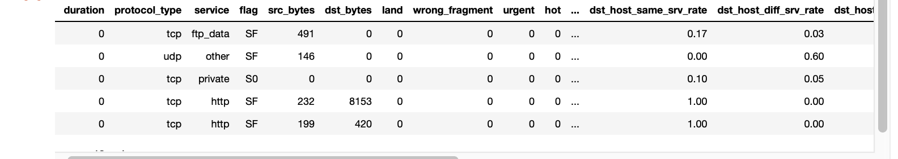

The data set consists of a training set of 125,973 instances and a test set of 22,544 instances.

Slide 10
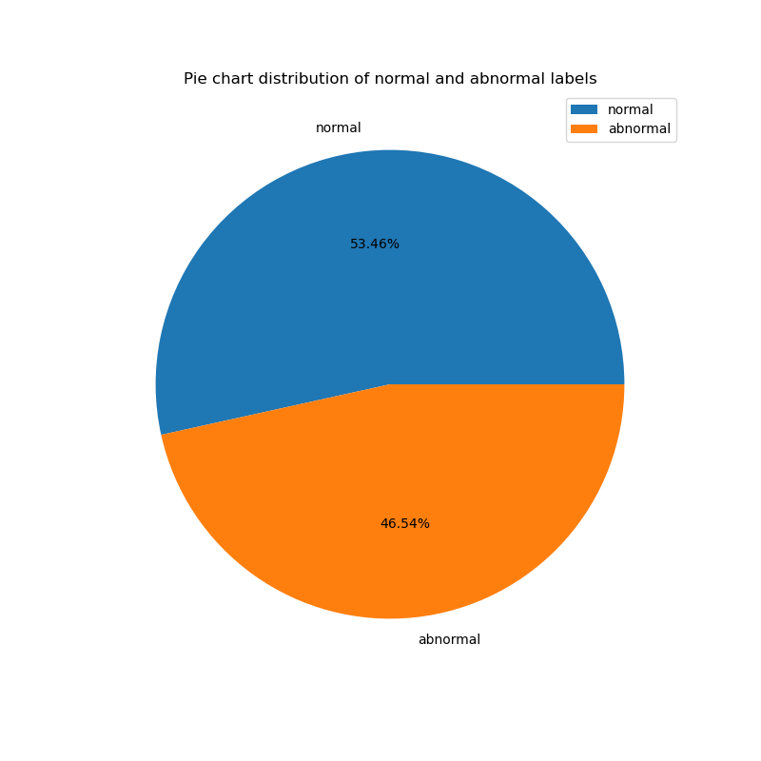
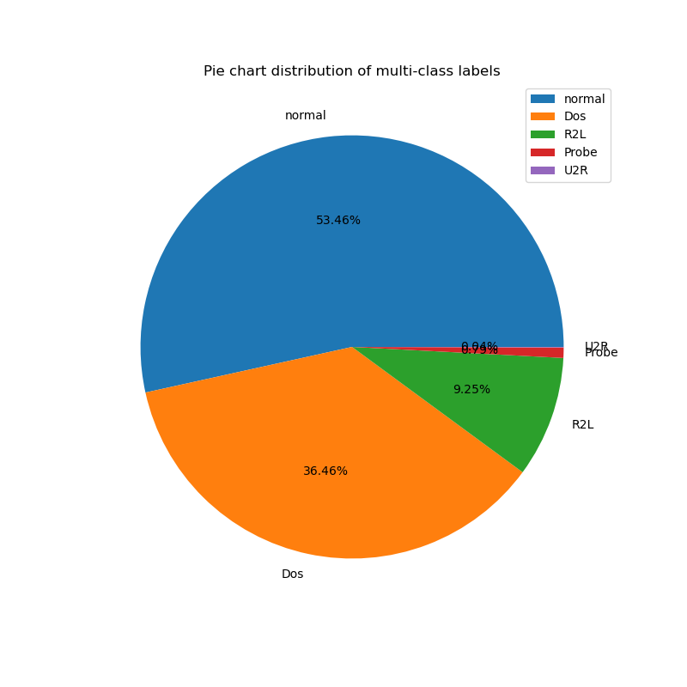
Binary and Multi-class Classification of attacks

Slide 11
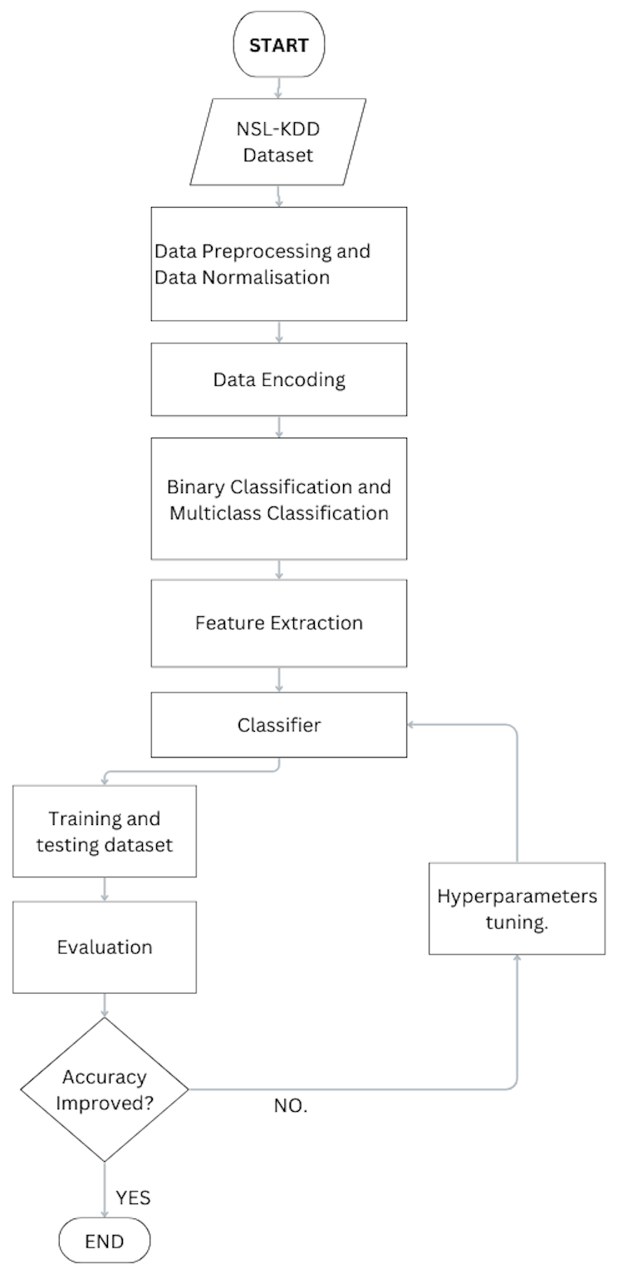
Workflow

Slide 12
Multi-Layer Perceptron
MLP is a type of artificial neural network that consists of multiple layers of interconnected neurons, where each neuron takes the weighted sum of its inputs, applies an activation function, and passes its output to the next layer.
﻿﻿MLP can be tuned by adjusting various hyper-parameters such as the number of hidden layers, the number of neurons per layer, the activation function, the optimizer, the learning rate, and the regularization strength.
﻿﻿MLP can be regularized using various techniques such as dropout, weight decay, or early stopping to prevent overfitting and improve generalization performance.

Slide 13
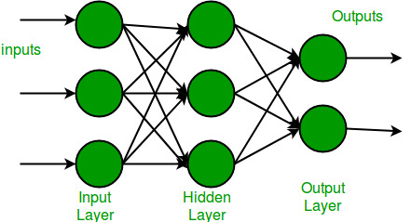

Slide 14
Auto Encoders
Autoencoders are a specialized class of algorithms that can learn efficient representations of input data with no need for labels. It is a class of artificial neural networks designed for unsupervised learning.
Learning to compress and effectively represent input data without specific labels is the essential principle of an automatic decoder. This is accomplished using a two-fold structure that consists of an encoder and a decoder.
The encoder transforms the input data into a reduced-dimensional representation, which is often referred to as “latent space” or “encoding”. From that representation, a decoder rebuilds the initial input.

Slide 15
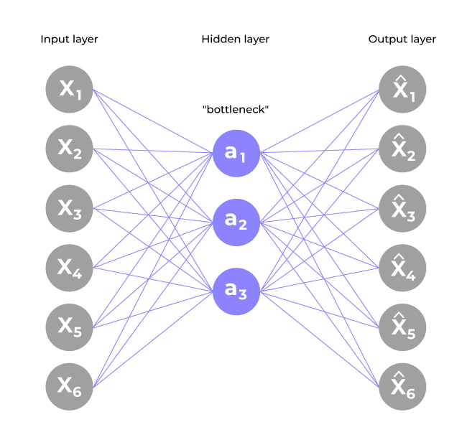

Slide 16
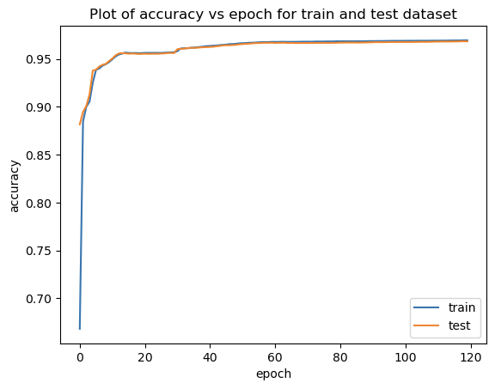
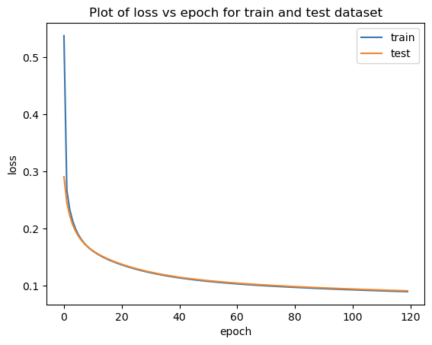
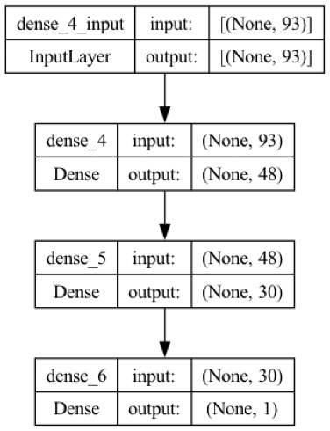
Results of Multi-Layer Perceptron

Slide 17
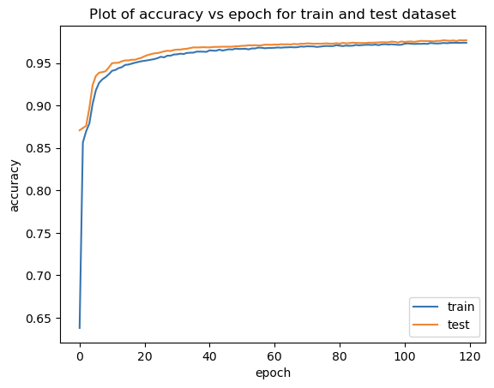
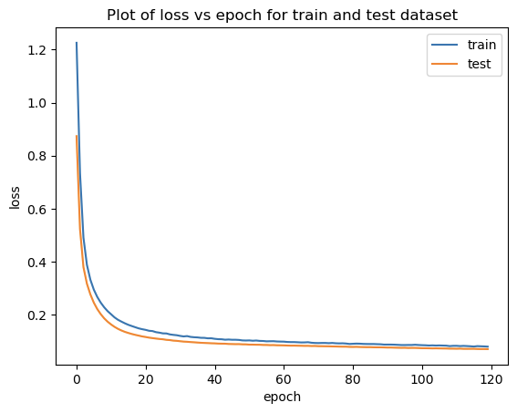
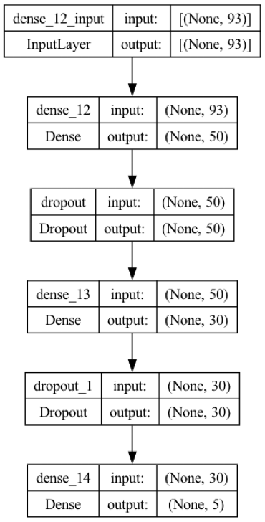
Results of Multi-Layer Perceptron

Slide 18
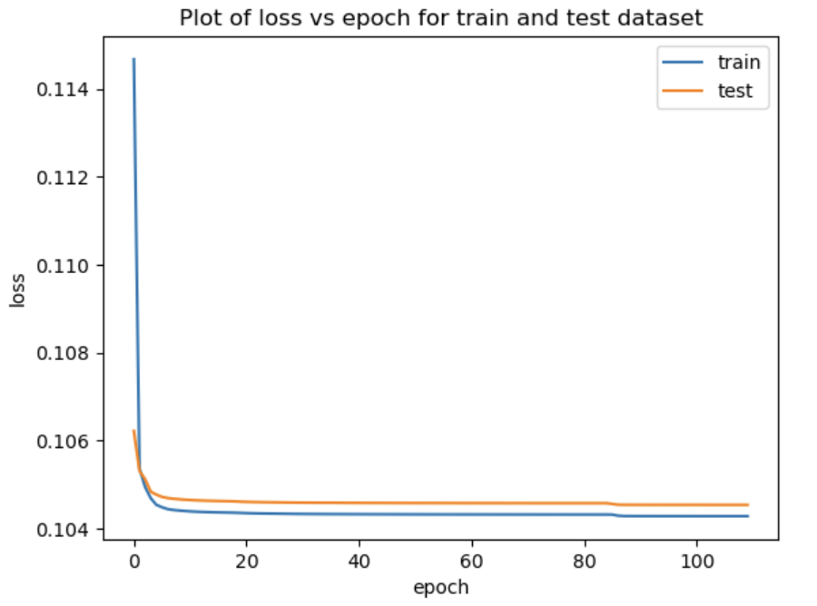
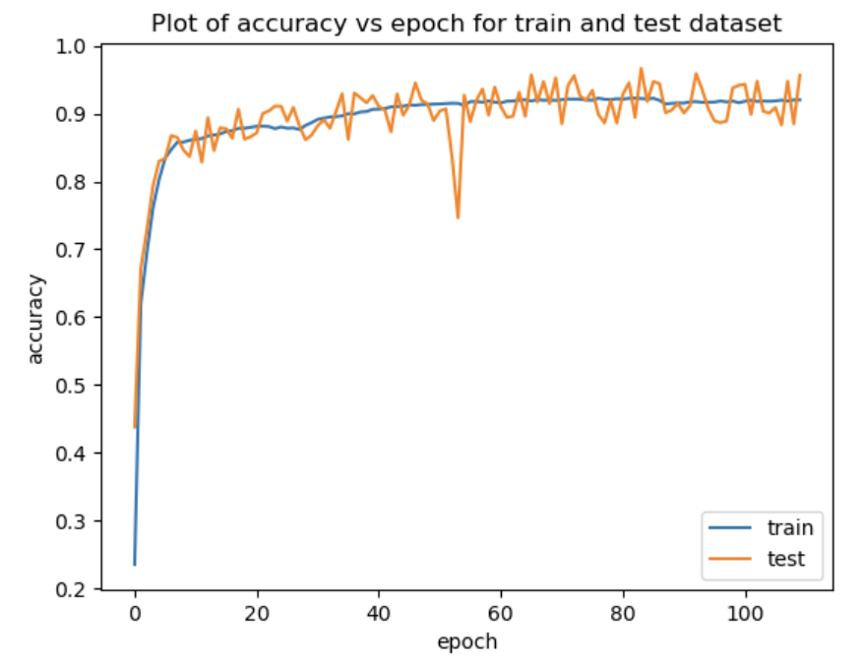
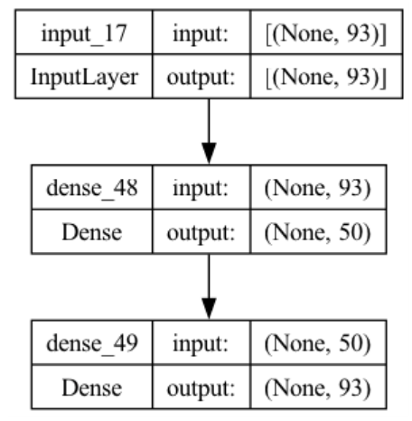
Results of Autoencoder

Slide 19
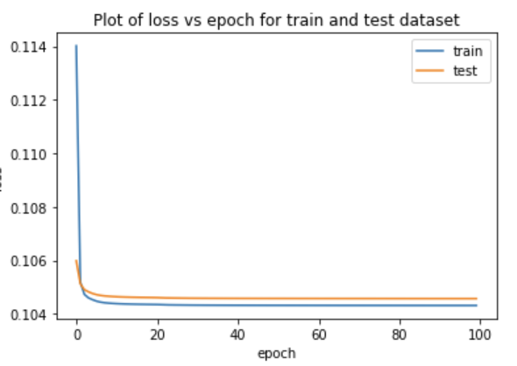
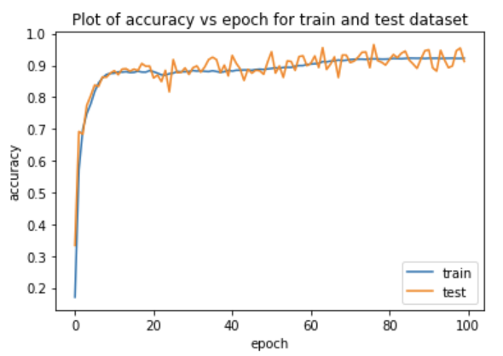
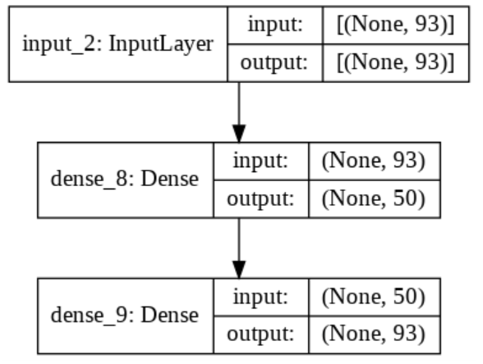
Results of Autoencoder

Slide 20
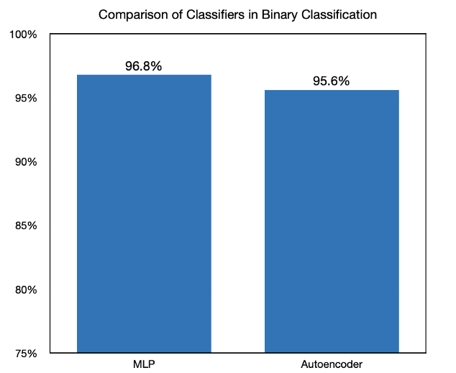
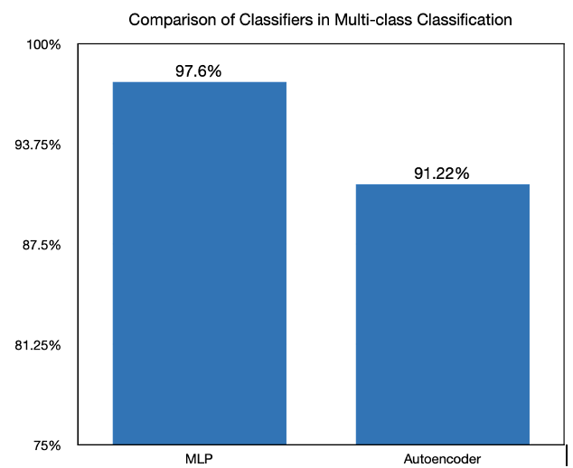
Conclusion
The accuracy of Multi-layer perceptron and Autoencoder has been improved for the Network Intrusion Detection System (NIDS).

Slide 21
Future Scope
To implement more Deep Learning models and improve the accuracies of the models.
To implement the classifiers on other datasets.
To implement on real time network traffic.

Slide 22
References
S. Al-Emadi, A. Al-Mohannadi and F. Al-Senaid, "Using Deep Learning Techniques for Network Intrusion Detection," 2020 IEEE International Conference on Informatics, IoT, and Enabling Technologies (ICIoT), Doha, Qatar, 2020, pp. 171-176.
C. Yin, Y. Zhu, J. Fei and X. He, "A Deep Learning Approach for Intrusion Detection Using Recurrent Neural Networks," in IEEE Access, vol. 5, pp. 21954-21961, 2017.
Riyaz, B., Ganapathy, S. A deep learning approach for effective intrusion detection in wireless networks using CNN. Soft Comput 24, 17265–17278 (2020).
Yin, C., Zhu, Y., Liu, S. et al. Enhancing network intrusion detection classifiers using supervised adversarial training. J Supercomput 76, 6690–6719 (2020).

Slide 23
References
P. Toupas, D. Chamou, K. M. Giannoutakis, A. Drosou and D. Tzovaras, "An Intrusion Detection System for Multi-class Classification Based on Deep Neural Networks," 2019 18th IEEE International Conference On Machine Learning And Applications (ICMLA), Boca Raton, FL, USA, 2019, pp. 1253-1258.
Ahmad Z, Shahid Khan A, Wai Shiang C, Abdullah J, Ahmad F. Network intrusion detection system: A systematic study of machine learning and deep learning approaches. Trans Emerging Tel Tech. 2021; 32: e4150.
Lirim Ashiku, Cihan Dagli, Network Intrusion Detection System using Deep Learning, Procedia Computer Science, Volume 185, 2021, Pages 239-247, ISSN 1877-0509.
Panda, Mrutyunjaya & Abraham, Ajith & Das, Swagatam & Patra, Manas. (2011). Network intrusion detection system: A machine learning approach. Intelligent Decision Technologies (IDT) Journal, IOS Press. 5. 347-356. 10.3233/IDT-2011-0117.

Slide 24
Thank You.

