Slide 1
Properties of triangle
Subash Regmi

Slide 2
Introduction
Perimeter of triangle = sum of all sides
semi perimeter= sum of all sides / 2
∆ = abc/ 4R

Slide 3
Results of conditional identity
If A+B+C = Π
sin2A+ sin2B+ sin2C = 4sinA sinB sinC
sinA+ sinB+ sinC = 4 cos A/2 cosB/2 cosC/2
cos A + cosB + cosC = 1+ 4 sinA/2 sinB/2 sinC/2
sin²A + sin²B + sin² C = 2 + 2 cosA cosB cosC
cos²A + cos²B + cos² C = 1 – 2 cos A cosB cosC
cos²A /2+ cos²B/2 + cos² C/2 = 2 + 2 sinA/2 sinB/2 sinC/2
tanA + tanB+ tanC = tanA tanB tanC
tanA/2. tanB/2 + tanB/2. tanC/2 + tanC/2 tanA/2 = 1

Slide 4
Results of conditional identity
cotA. cotB+ cotB. cotC + cotC . cotA =1

Slide 8
Sine law
In any triangle,
a/sinA = b/sinB = c/ sinC = 2R
a = 2R sinA , sinA = a/2R
∆ = ½ bc sinA = ½ ca sinB = ½ ab sinC

Slide 9
Cosine law
cosA = b² + c² - a²/ 2bc
cosB = a² + c² - b²/ 2ac
cosC = b² + a² - c²/2ab

Slide 10
Projection law
a cosB+ b cos A = c
c cosA + a cosC = b
b cos C + c cos B = a

Slide 11
Tangent law
tan ( B – C)/2 = ( b-c/b+ c) cot A/2
tan (C-A)/2 = ( c-a/c+ a) cot B/2
tan (A-B) /2 = ( a-b/a+b) cot C/2

Slide 12
Circles associated to a triangle
circum circle : circle passing through the vertices of a triangle is circum circle and its radius is circum radius
circum center : point of intersection of the right bisector of sides of a triangle.
in- circle : circle which is inscribed in a triangle and which touches the sides of a triangle internally and the point of intersection of the internal bisector of the angles of a triangle is in center.

Slide 13
Formula of in -radius
r = ∆/(s-a)
r = 4R sinA/2 sinB/2 sinC/2
r = (s-a) tanA/2 = (s-b) tanB/2 = (s-c) tanC/2

Slide 14
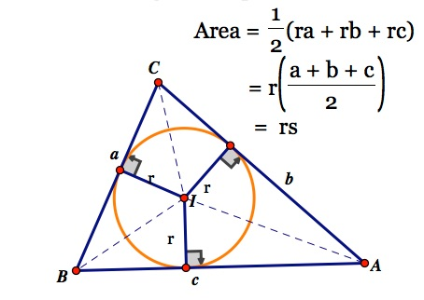

Slide 15
EX- CRIBED CIRCLE
The circle which touches only one side of a triangle and other two produced sides of a triangle is ex- cribed circle.

Slide 16
Formula of ex- radius r₁- radius opposite to angle A
r₁ = ∆/(s-a)
r₁ = 4R sinA/2 sinB/2 sinC/2
r₁ = s tanA/2
r₁ = a secA/2 cosB/2 cosC/2

Slide 17
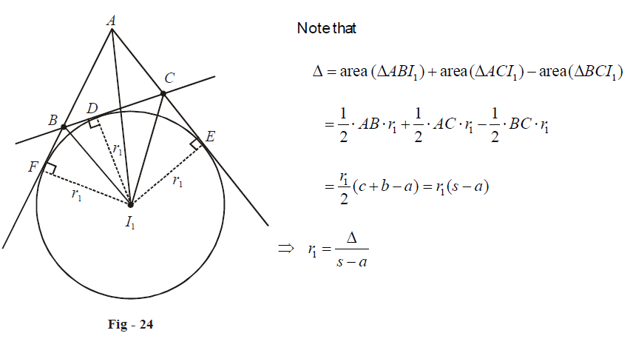

Slide 18
Now, let us consider the second set of relations. In ΔAFI , we’ll have r₁=AFtanA/2 . We need to prove that AF = s. To that end;
AF = ½ ( AF + AE) = ½ (AB+BF+AC+CE)
=1/2 (AB+BD+AC+DC)
= ½ (AB+ BC+ CA) = s
So, r₁ = s tanA/2

Slide 19
we note from ΔI₁BD and ΔI₁CD that
BD=r₁tanB/2,DC=r₁tanC/2
BD+DC=BC=a
= acosB/2 cosC/2 /{cosA/2}
=4RsinA/2sinB/2sinC/2

Slide 20
Formula of ex- radius r₂- radius opposite to angle B
r₂ = ∆/(s-b)
r₂ = 4R cosA/2 sinB/2 cosC/2
r₂ = s tanB/2
r₂ = b cosA/2 secB/2 cosC/2

Slide 21
Formula of ex- radius r₃- radius opposite to angle C
r₃ = ∆/(s-c)
r₃ = 4R cosA/2 cosB/2 sinC/2
r₃ = s tanC/2
r₃ = c cosA/2 cosB/2 secC/2

Slide 22
Half angle formulae

Slide 23
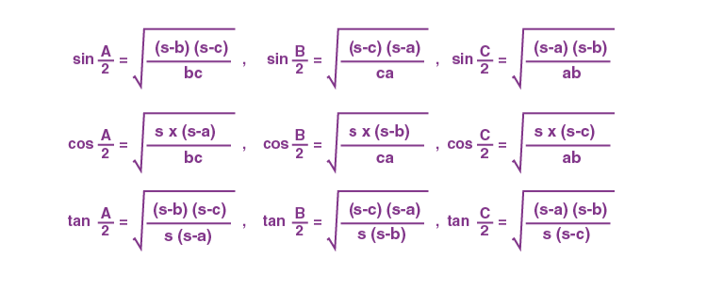

Slide 24
Important notes
If sinA, sinB, sinC are in A.P./G.P./H.P., then A,B,C are in A.P./G.P./H.P. respectrively
if a,b,c are in A.P., then r₁,r₂ ,r₃ are in H.P
if cot A/2 , cot B/2, cot C/2 are in A.P., then a,b,c are in A.P.
if cot A,cot B,cot C are in A.P., then a²,b²,c² are in A.P.
if sin A,sin B ,sinC are in H.P., then (1-cosA), (1-cosB), (1-cosC) are in H.P.

Slide 25
Important notes
r₁ + r₂ + r₃ - r = 4R
rr₁ r₂ r₃ = ∆²
1/ r₁ + 1/ r₂ + 1/ r₃ = 1/r
sinA + SinB + sinC = s/R
cosA+ cosB +cosC = 1+ r/R
cosecA = bc/ 2∆
tanA = 4∆/ b² + c² - a²

Slide 27
Tricks for problem solving
Assume equilateral triangle A = B= C = 60°, a= b= c = 2
∆ = √3/4 (a)² = √3
R = abc/ 4∆ = 2/√3
s = a+ b + c /2 = 3
r = ∆/ s = 1/√3
r₁= r₂= r₃= √ 3

