Slide 1
DIGITAL E-COMMERCE WEBSITE (FIRST REVIEW)
DONE BY-
SOMASKANDAN RA2111003020525
SIVESH KUMAR RA2111003020547
JANARTHANAN RA2111003020531

Slide 2
TABLE CONTENT
LITERATURE SURVEY
ARCHITECTURE DIAGRAM
MODULE

Slide 3
LITERATURE SURVEY:
*"Electronic Commerce 2020: A Managerial and Social Networks Perspective"* by Turban, E., King, D., Liang, T. P., & Turban, D.: - Discusses the managerial and social network aspects of electronic commerce, emphasizing the role of technology and networks in shaping e-commerce strategies.
2. *"E-commerce: Business, Technology, Society"* by Laudon, K. C., & Traver, C. G.: - Explores the interconnectedness of e-commerce, business, and technology, highlighting the impact of e-commerce on society and business practices.
3. *"Customer perceptions of e-service quality in online shopping"* by Lee, J., & Lin, H. F.: - Investigates how customers perceive the quality of e-services in online shopping, examining factors such as website design, information quality, and responsiveness.

Slide 4
4. *"Trust and TAM in online shopping: An integrated model"* by Gefen, D., Karahanna, E., & Straub, D. W.: - Proposes an integrated model that highlights the role of trust and the Technology Acceptance Model (TAM) in influencing consumers' adoption of online shopping.
5. *"Digital Marketing Excellence: Planning, Optimizing and Integrating Online Marketing"* by Chaffey, D., & Smith, P. R.: - Provides insights into planning, optimizing, and integrating online marketing strategies, emphasizing the importance of digital marketing excellence for businesses.
6. *"E-commerce success factors: An analysis of retail companies in China"* by Li, H., & Suomi, R.: - Analyzes success factors for e-commerce in the context of retail companies in China, identifying key elements that contribute to successful e-commerce ventures.

Slide 5
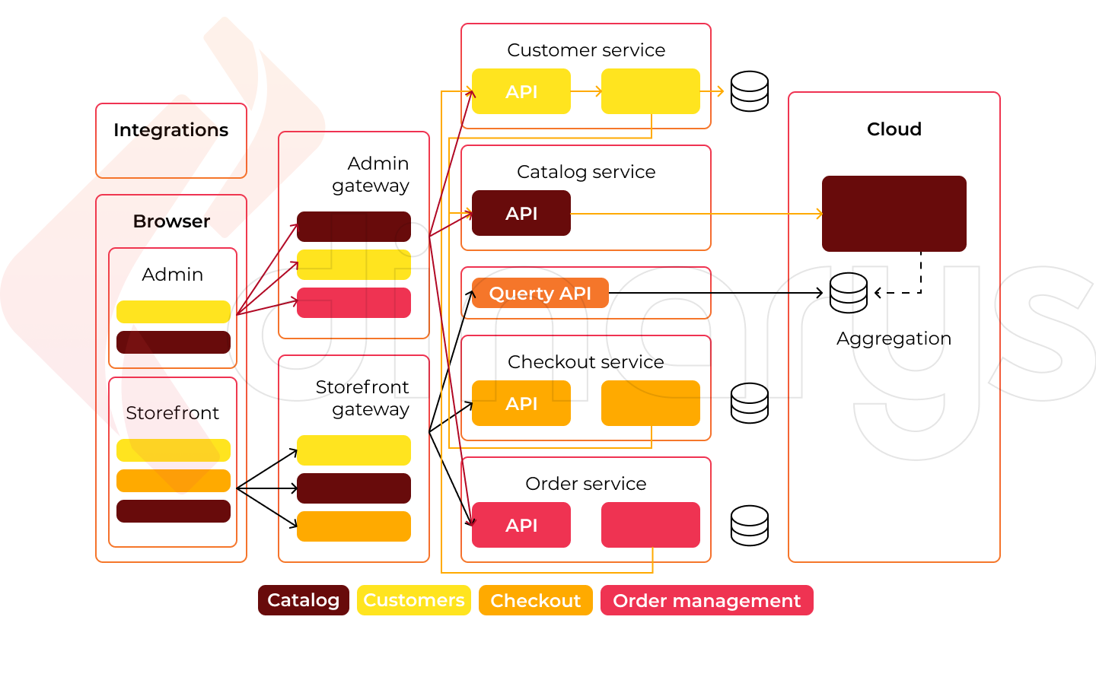
ARCHITECTURE DIAGRAM:

Slide 6
MODULE:
1. Product Management Module: This module handles product listings, categorization, descriptions, images, and pricing. It allows administrators to easily add, edit, or remove products.
2. Shopping Cart Module: The shopping cart module enables users to add products, view the cart, update quantities, and proceed to checkout. It should calculate the total cost and handle any discounts or promotions.
3. User Authentication and Account Management: This module provides user registration, login, and account management features. Users can track orders, manage personal information, and access their order history.
4. Payment Gateway Integration: The payment module integrates with various payment gateways to securely process transactions. It ensures that customer payment information is encrypted and processed smoothly.

Slide 7
5. mail delivery module: an e-commerce website would be a system that manages the process of shipping and delivering products to customers. It typically includes features such as selecting shipping options, calculating shipping costs, generating shipping labels, tracking shipments, and updating customers about their order's status. This module would integrate with various shipping carriers' APIs to facilitate seamless delivery and provide a positive customer experience.
6.Social Media Integration: Integrating social media sharing buttons and tools to enable customers to share products and reviews on their social platforms.
7. Return and Refund Management: This module provides guidelines and processes for customers to initiate returns and refunds.
8. Responsive Design: Ensuring that the website is responsive and works well on various devices, such as smartphones, tablets, and desktops.

