Slide 1
Anton Stråhle, Jan Alexandersson, Fredrika Lundahl
Group 118
The mechanisms, powers and limitations of some Data Augmentation Techniques

Slide 2
Anton Stråhle, Jan Alexandersson, Fredrika Lundahl
Group 118
BIRDS dataset
The mechanisms, powers and limitations of some Data Augmentation Techniques

Slide 3
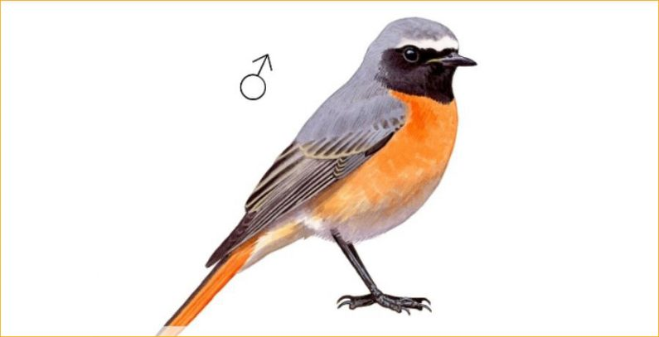
Anton Stråhle, Jan Alexandersson, Fredrika Lundahl
Group 118
BIRDS dataset

Slide 4
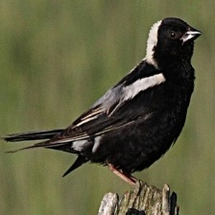
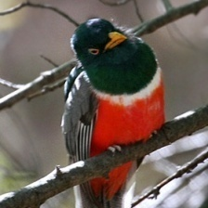
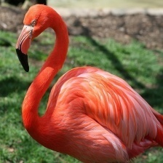
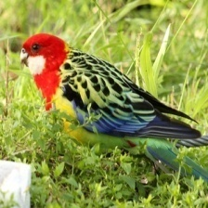
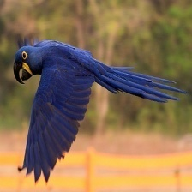
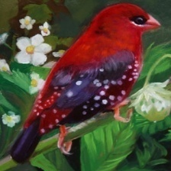
Anton Stråhle, Jan Alexandersson, Fredrika Lundahl
Group 118
- 200 bird species
- 25 000 images
BIRDS dataset

Slide 5
Anton Stråhle, Jan Alexandersson, Fredrika Lundahl
Group 118
BIRDS dataset
- 200 bird species
TASK
- 25 000 images
Investigate the performance of different data augmentation techniques on 2 CNNs

Slide 6
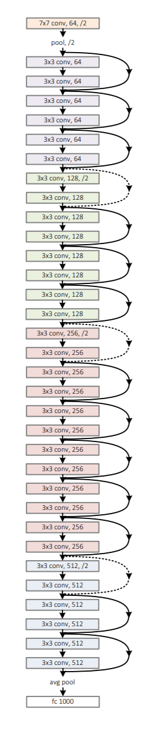
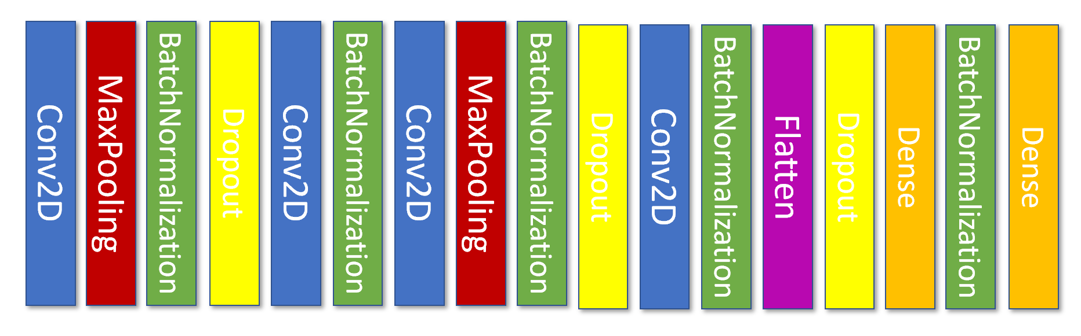
Basic CNN
Baseline accuracy on the whole dataset(no augmentations): 65% & 95%
CNN NETWORKS
ResNet50

Slide 7
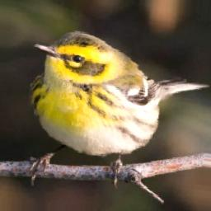
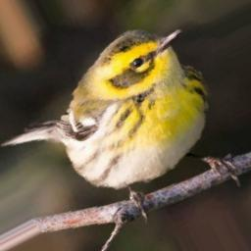
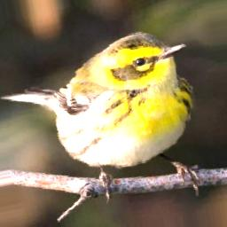
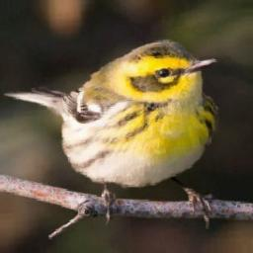
Basic Data Augmentations:
Increase the number of relevant pictures e.g. by
- flipping
- rotating
AUGMENTATIONS
- brightness adjustments
-horizontal flips
-horizontal flips

Slide 8
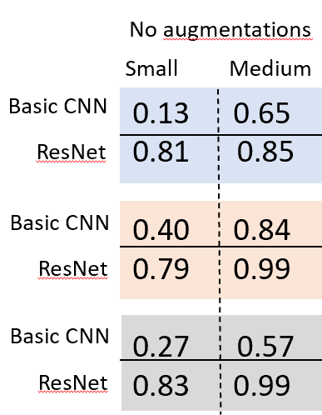
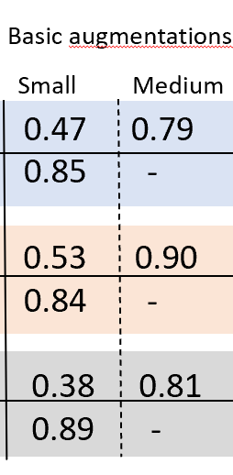

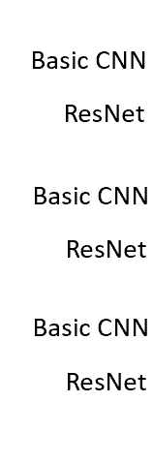

15 species per
subset
Small = 5 training images
EXPERIMENTS
- Basic Augmentations always good ☺
Medium = 50 training images

Slide 9
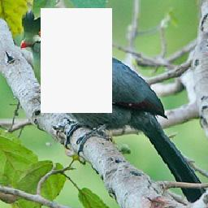
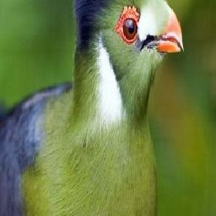
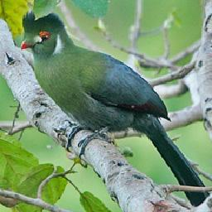
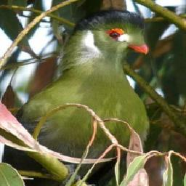
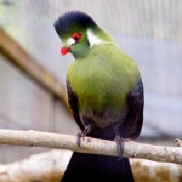
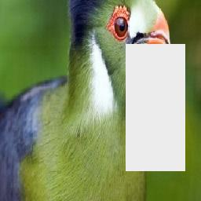
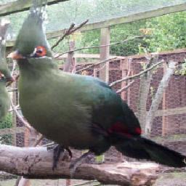
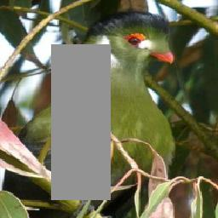
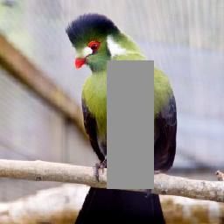
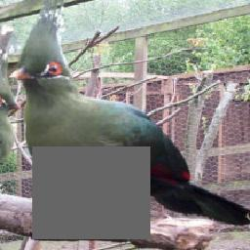
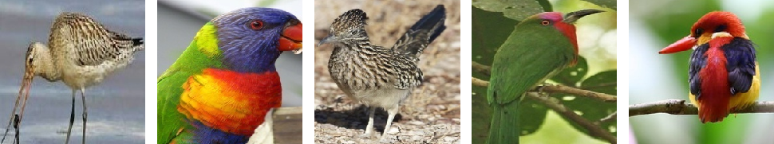
Photometric Data Augmentations:
Confuse the network enough for it to memorize less and be more general by
Random Erasing: removing random rectangles of the pictures
AUGMENTATIONS

Slide 10
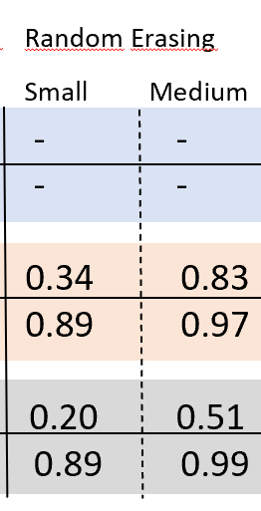

15 species per
subset
Small = 5 training images
EXPERIMENTS
- Basic Augmentations always good ☺
Medium = 50 training images
- Random Erasing good for ResNet, harmful for basic CNN

Slide 11
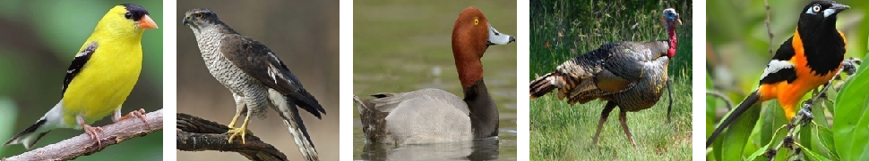
Photometric Data Augmentations:
Confuse the network enough for it to memorize less and be more general by
Random Erasing: removing random rectangles of the pictures
AUGMENTATIONS
Mixup: blending pictures

Slide 12

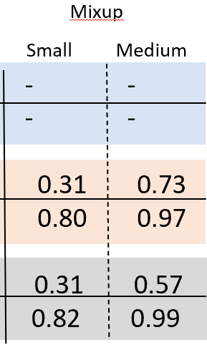
15 species per
subset
Small = 5 training images
EXPERIMENTS
- Basic Augmentations always good ☺
Medium = 50 training images
- Random Erasing good for ResNet, harmful for basic CNN
- Mixup always either does nothing or is harmful?

Slide 13
Mixup on all data
More mixup
α
Basic CNN
ResNet
0 0.1 0.2
0.64 0.51 0.54
0.95 0.98 0.82
EXPERIMENTS

Slide 14
15 species per
subset
Small = 5 training images
EXPERIMENTS
- Basic Augmentations always good ☺
Medium = 50 training images
- Random Erasing good for ResNet, harmful for basic CNN
- Mixup always either does nothing or is harmful?
- Mixup always either does nothing or is harmful? needs tuning. This does probably also apply to Random Erasing

Slide 15
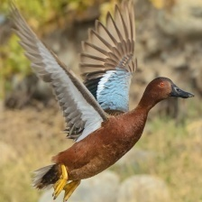
Thank you for listening!

