Slide 1
A “Hands-on” Intro to MPI Python
Sung Bae, Ph.D
New Zealand eScience Infrastructure

Slide 2
Questions
Are you a Python programmer
Advanced/Intermediate/Beginner
Frustrated by Python’s speed?

Slide 3
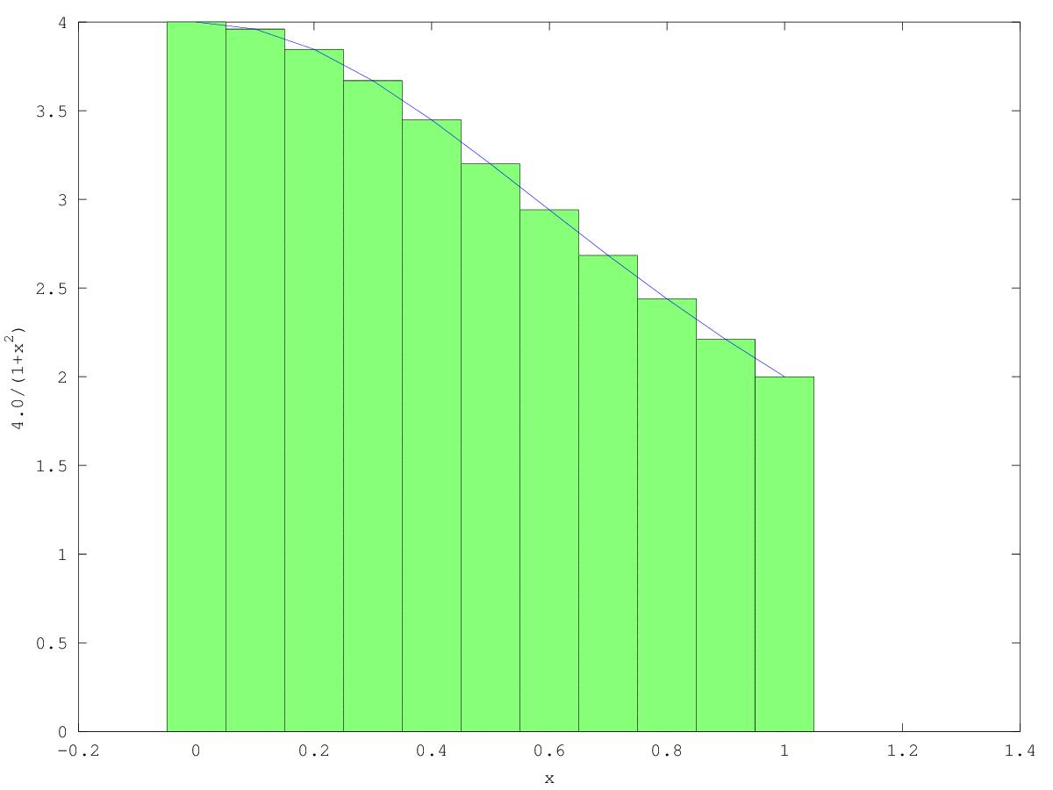
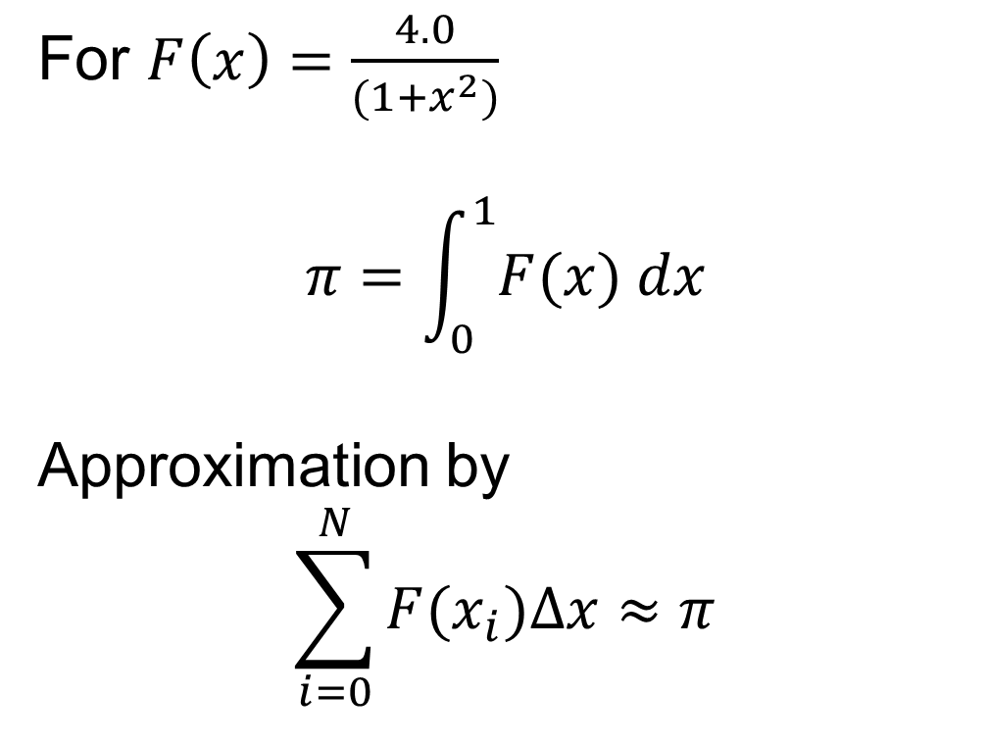
Introduction : Is Python slow?
For $F\left(x\right)=\frac{4.0}{(1+x^{2})}$
$$π=\int_{0}^{1}{F(x) dx}$$
Approximation by
$$\sum_{i=0}^{N}{F(x_{i})∆x≈π}$$

Slide 4
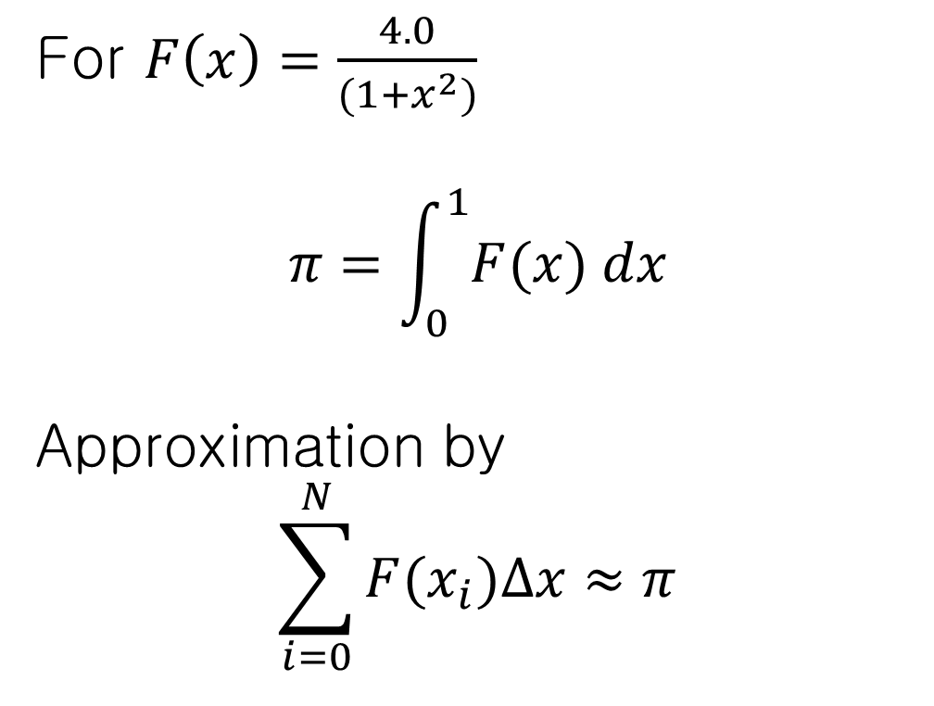
Introduction : Is Python slow?
For $F\left(x\right)=\frac{4.0}{(1+x^{2})}$
$$π=\int_{0}^{1}{F(x) dx}$$
Approximation by
$$\sum_{i=0}^{N}{F(x_{i})∆x≈π}$$
4.0/(1+x*x)
step
num_steps

Slide 5
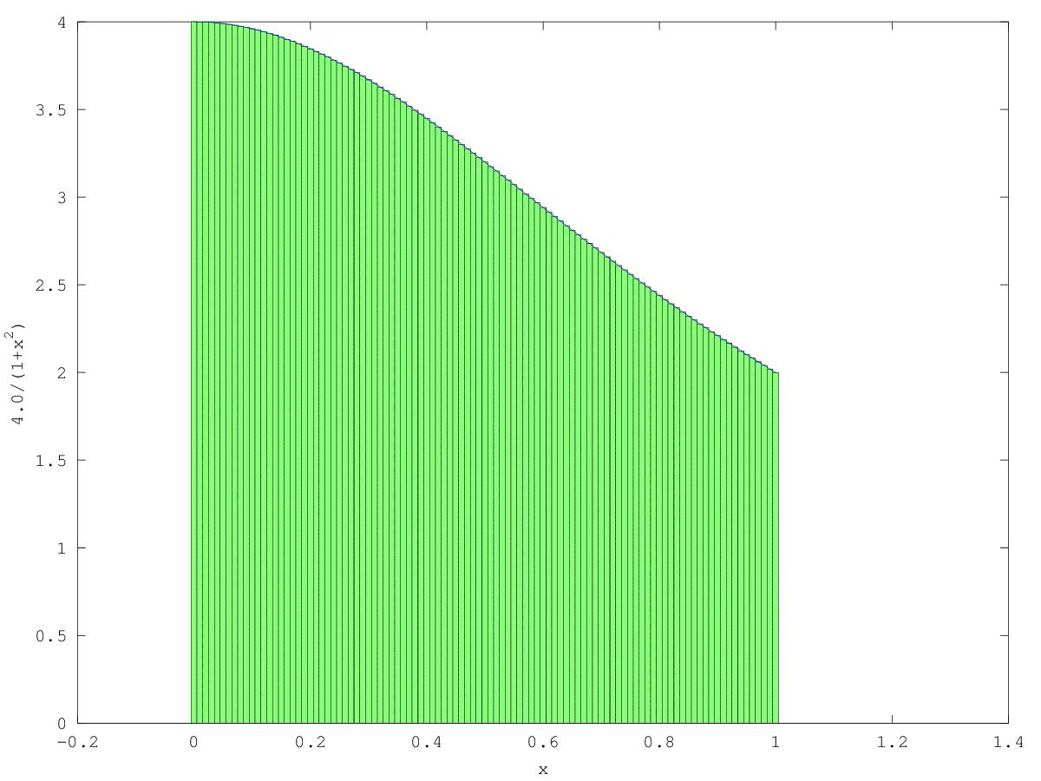
Introduction : Is Python slow?
For $F\left(x\right)=\frac{4.0}{(1+x^{2})}$
$$π=\int_{0}^{1}{F(x) dx}$$
Approximation by
$$\sum_{i=0}^{N}{F(x_{i})∆x≈π}$$

Slide 6
Introduction : Is Python slow?
import time def Pi(num_steps): start = time.time() step = 1.0/num_steps sum = 0 for i in xrange(num_steps): x= (i+0.5)*step sum = sum + 4.0/(1.0+x*x) pi = step * sum end = time.time() print "Pi with %d steps is %f in %f secs" %(num_steps, pi, end-start) if __name__ == '__main__': Pi(100000000) | #include <stdio.h> #include <time.h> void Pi(int num_steps) { double start, end, pi, step, x, sum; int i; start = clock(); step = 1.0/(double)num_steps; sum = 0; for (i=0;i<num_steps;i++) { x = (i+0.5)*step; sum = sum + 4.0/(1.0+x*x); } pi = step * sum; end= clock(); printf("Pi with %d steps is %f in %f secs\n", num_steps, pi,(float)(end-begin)/CLOCKS_PER_SEC); void main() { Pi(100000000); }

Slide 7
Before you run a program on PAN..
Log in to PAN by
Run program by
Source codes located at ~/training/otago2014-05/mpi/src
“ssh nesi.eduXX@login.uoa.nesi.org.nz”
interactive –A uoa00243 –c {num_cores} –e “{program}”
cd ~/training/otago2014-05/mpi/src

Slide 8
Recap from the last session
Run program by
interactive –A uoa00243 –c 1 –e “./pi” | interactive –A uoa00243 –c 1 –e “python pi.py”

Slide 9
Introduction : Is Python slow?
import time def Pi(num_steps): start = time.time() step = 1.0/num_steps sum = 0 for i in xrange(num_steps): x= (i+0.5)*step sum = sum + 4.0/(1.0+x*x) pi = step * sum end = time.time() print "Pi with %d steps is %f in %f secs" %(num_steps, pi, end-start) if __name__ == '__main__': Pi(100000000) | #include <stdio.h> #include <time.h> void Pi(int num_steps) { double start, end, pi, step, x, sum; int i; start = clock(); step = 1.0/(double)num_steps; sum = 0; for (i=0;i<num_steps;i++) { x = (i+0.5)*step; sum = sum + 4.0/(1.0+x*x); } pi = step * sum; end= clock(); printf("Pi with %d steps is %f in %f secs\n", num_steps, pi,(float)(end-begin)/CLOCKS_PER_SEC); void main() { Pi(100000000); }
31.95sec
0.78 sec

Slide 10




Speed-up Options
Better
Algorithm
Get your code
working
Profile
Parallel
HPC
Rewrite in C

Slide 11
Speed-up Example: Profiling
Find what is slowing you down
Put @profile above the function
Run by:
… @profile def Pi(num_steps): start = time.time() step = 1.0/num_steps sum = 0 for i in xrange(num_steps): x= (i+0.5)*step sum = sum + 4.0/(1.0+x*x) …..
interactive –A uoa00243 –c 1 –e “python kernprof.py –l –v pi.py”

Slide 12
Speed-up Example: Profiling
[sbae335@login-01 profiling]$ interactive -A uoa00243 -c 1 -e "python kernprof.py -l -v pi.py" Pi with 1000000 steps is 3.14159265358976425020 in 6.438980 secs Wrote profile results to pi.py.lprof Timer unit: 1e-06 s File: pi.py Function: Pi at line 8 Total time: 3.16501 s Line # Hits Time Per Hit % Time Line Contents ============================================================== 8 @profile 9 def Pi(num_steps): 10 1 10 10.0 0.0 start = time.time() 11 1 3 3.0 0.0 step = 1.0/num_steps 12 13 1 1 1.0 0.0 sum = 0 14 1000001 945845 0.9 29.9 for i in range(num_steps): 15 1000000 1070908 1.1 33.8 x= (i+0.5)*step 16 1000000 1148150 1.1 36.3 sum = sum + 4.0/(1.0+x*x) 17 18 1 5 5.0 0.0 pi = step * sum 19 20 1 3 3.0 0.0 end = time.time() 21 1 88 88.0 0.0 print "Pi with %d steps is %.20f in %f secs" %(num_steps, pi, end-start)
Loop is very slow

Slide 13
Speed-up Example: Compute in C
HPC
Get your code
working
Parallel
Profile
Better
Algorithm
Compute in C

Slide 14
Speed-up Example: NumPy
>>> from numpy import * >>> i=arange(10) >>> i array([0, 1, 2, 3, 4, 5, 6, 7, 8, 9]) >>> i+0.5 array([ 0.5, 1.5, 2.5, 3.5, 4.5, 5.5, 6.5, 7.5, 8.5, 9.5]) >>> x=(i+0.5)*10 >>> x array([ 5., 15., 25., 35., 45., 55., 65., 75., 85., 95.]) >>> x.sum() 500.0 >>> x*x array([ 25., 225., 625., 1225., 2025., 3025., 4225., 5625., 7225., 9025.])
import time def Pi(num_steps): start = time.time() step = 1.0/num_steps sum = 0 for i in xrange(num_steps): x= (i+0.5)*step sum = sum + 4.0/(1.0+x*x) pi = step * sum end = time.time() print "Pi with %d steps is %f in %f secs" %(num_steps, pi, end-start) if __name__ == '__main__': Pi(100000000)

Slide 15
Speed-up Example: NumPy
>>> from numpy import * >>> i=arange(10) >>> i array([0, 1, 2, 3, 4, 5, 6, 7, 8, 9]) >>> i+0.5 array([ 0.5, 1.5, 2.5, 3.5, 4.5, 5.5, 6.5, 7.5, 8.5, 9.5]) >>> x=(i+0.5)*10 >>> x array([ 5., 15., 25., 35., 45., 55., 65., 75., 85., 95.]) >>> x.sum() 500.0 >>> x*x array([ 25., 225., 625., 1225., 2025., 3025., 4225., 5625., 7225., 9025.])
import time from numpy import * def Pi(num_steps): start = time.time() step = 1.0/num_steps i=arange(num_steps) x=(i+0.5)*step sum = (4.0/(1.0+x*x)).sum() pi = step * sum end = time.time() print "Pi with %d steps is %f in %f secs" %(num_steps, pi, end-start) if __name__ == '__main__': Pi(100000000)
2.77sec
???? (3 lines)

Slide 16
Speed-up Example: Numba
import time def Pi(num_steps ): start = time.time() step = 1.0/num_steps sum = 0 for i in xrange(num_steps): x= (i+0.5)*step sum = sum + 4.0/(1.0+x*x) pi = step * sum end = time.time() print "Pi with %d steps is %f in %f secs" %(num_steps, pi, end-start) if __name__ == '__main__': Pi(100000000)
import time def loop(num_steps): step = 1.0/num_steps sum = 0 for i in xrange(num_steps): x= (i+0.5)*step sum = sum+4.0/(1.0+x*x) return sum

Slide 17
Speed-up Example: Numba
import time def Pi(num_steps ): start = time.time() step = 1.0/num_steps sum = 0 for i in xrange(num_steps): x= (i+0.5)*step sum = sum + 4.0/(1.0+x*x) pi = step * sum end = time.time() print "Pi with %d steps is %f in %f secs" %(num_steps, pi, end-start) if __name__ == '__main__': Pi(100000000)
import time def loop(num_steps): step = 1.0/num_steps sum = 0 for i in xrange(num_steps): x= (i+0.5)*step sum = sum+4.0/(1.0+x*x) return sum def Pi(num_steps): start = time.time() sum=loop(num_steps) pi = sum / num_steps end = time.time() … if __name__ == '__main__': Pi(100000000)

Slide 18
Speed-up Example: Numba
import time def Pi(num_steps ): start = time.time() step = 1.0/num_steps sum = 0 for i in xrange(num_steps): x= (i+0.5)*step sum = sum + 4.0/(1.0+x*x) pi = step * sum end = time.time() print "Pi with %d steps is %f in %f secs" %(num_steps, pi, end-start) if __name__ == '__main__': Pi(100000000)
import time from numba import jit @jit def loop(num_steps): step = 1.0/num_steps sum = 0 for i in xrange(num_steps): x= (i+0.5)*step sum = sum+4.0/(1.0+x*x) return sum def Pi(num_steps): start = time.time() sum=loop(num_steps) pi = sum / num_steps end = time.time() … if __name__ == '__main__': Pi(100000000)
0.84 sec

Slide 19
Why is Numba faster?
It is a Just-In-Time (JIT) compiler: It uses LLVM compiler infrastructure to compile Python to native code.
Can handle NumPy (unlike PyPy)

Slide 20
Pure Python vs Numba
Pure Python
Numba
31.95sec
0.84 sec
num_steps=100,000,000
Pure Python
Numba
325.60sec
7.93 sec
num_steps=1,000,000,000

Slide 21
Parallel Programming
Better
Algorithm
Get your code
working
Profile
Parallel
HPC
Rewrite in C

Slide 22
mpi4Py
Distributed Memory model - Separate sets of processor and memory. Needs “message passing” to access remote data
mpi4Py : Python wrapper for MPI (Message Passing Interface)
mem
processor
mem
processor
Message Passing
mem
processor
mem
processor

Slide 23
Example 1. MPI Hello World
#hello_mpi.py
from mpi4py import MPI
comm = MPI.COMM_WORLD
rank = comm.Get_rank()
size = comm.Get_size()
print "hello world from process %d/%d“ %(rank,size)
mem
#hello_mpi.py
from mpi4py import MPI
comm = MPI.COMM_WORLD
rank = comm.Get_rank()
size = comm.Get_size()
print "hello world from process %d/%d“ %(rank,size)
#hello_mpi.py from mpi4py import MPI comm = MPI.COMM_WORLD rank = comm.Get_rank() size = comm.Get_size() print "hello world from process %d/%d“ %(rank,size)
$interactive –A uoa00243 –c 4 –e “python ./hello_mpi.py”
#hello_mpi.py
from mpi4py import MPI
comm = MPI.COMM_WORLD
rank = comm.Get_rank()
size = comm.Get_size()
print "hello world from process %d/%d“ %(rank,size)
cpu
#hello_mpi.py
from mpi4py import MPI
comm = MPI.COMM_WORLD
rank = comm.Get_rank()
size = comm.Get_size()
print "hello world from process %d/%d“ %(rank,size)
mem
cpu
mem
cpu
mem
cpu

Slide 24
Example 1. MPI Hello World
mem
#hello_mpi.py from mpi4py import MPI comm = MPI.COMM_WORLD rank = comm.Get_rank() size = comm.Get_size() print "hello world from process %d/%d“ %(rank,size)
$interactive –A uoa00243 –c 4 –e “python ./hello_mpi.py”
#hello_mpi.py
from mpi4py import MPI
comm = MPI.COMM_WORLD
rank = comm.Get_rank()
size = comm.Get_size()
print "hello world from process %d/%d“ %(rank,size)
rank=0
size=4
cpu
mem
#hello_mpi.py
from mpi4py import MPI
comm = MPI.COMM_WORLD
rank = comm.Get_rank()
size = comm.Get_size()
print "hello world from process %d/%d“ %(rank,size)
rank=1
size=4
cpu
mem
#hello_mpi.py
from mpi4py import MPI
comm = MPI.COMM_WORLD
rank = comm.Get_rank()
size = comm.Get_size()
print "hello world from process %d/%d“ %(rank,size)
rank=2
size=4
cpu
mem
#hello_mpi.py
from mpi4py import MPI
comm = MPI.COMM_WORLD
rank = comm.Get_rank()
size = comm.Get_size()
print "hello world from process %d/%d“ %(rank,size)
rank=3
size=4
cpu

Slide 25
Example 1. MPI Hello World
mem
#hello_mpi.py from mpi4py import MPI comm = MPI.COMM_WORLD rank = comm.Get_rank() size = comm.Get_size() print "hello world from process %d/%d“ %(rank,size)
$interactive –A uoa00243 –c 4 –e “python ./hello_mpi.py” hello world from process 0/4 hello world from process 1/4 hello world from process 3/4 hello world from process 2/4
#hello_mpi.py
from mpi4py import MPI
comm = MPI.COMM_WORLD
rank = comm.Get_rank()
size = comm.Get_size()
print "hello world from process %d/%d“ %(rank,size)
rank=0
size=4
cpu
mem
#hello_mpi.py
from mpi4py import MPI
comm = MPI.COMM_WORLD
rank = comm.Get_rank()
size = comm.Get_size()
print "hello world from process %d/%d“ %(rank,size)
rank=1
size=4
cpu
mem
#hello_mpi.py
from mpi4py import MPI
comm = MPI.COMM_WORLD
rank = comm.Get_rank()
size = comm.Get_size()
print "hello world from process %d/%d“ %(rank,size)
rank=2
size=4
cpu
mem
#hello_mpi.py
from mpi4py import MPI
comm = MPI.COMM_WORLD
rank = comm.Get_rank()
size = comm.Get_size()
print "hello world from process %d/%d“ %(rank,size)
rank=3
size=4
cpu

Slide 26





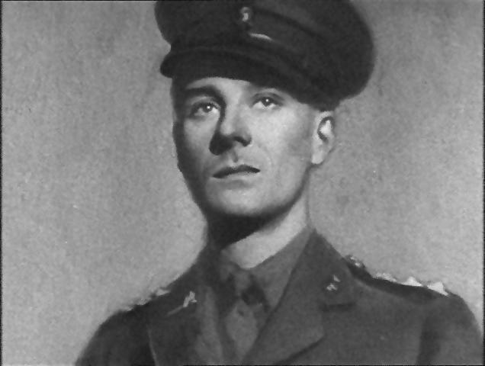
Exercise 1: Photo processing
De-noising frames of old movie (Alfred Hitchcock, Secret Agent 1936. www.hitchcockwiki.com)

Slide 27
Exercise 1: Photo processing
import numpy as np from skimage import data, img_as_float, filter, io import os.path import time curPath = os.path.abspath(os.path.curdir) inputDir = os.path.join(curPath,'noisy') outputDir = os.path.join(curPath,'denoised') def loop(imgFiles): for f in imgFiles: img = img_as_float(data.load(os.path.join(inputDir,f))) startTime = time.time() img = filter.denoise_bilateral(img, sigma_range=0.2, sigma_spatial=10), io.imsave(os.path.join(outputDir,f), img) print("Took {} seconds for {}".format(time.time() - startTime, f)) def serial(): total_start_time = time.time() numFiles = 100 imgFiles=["%.4d.jpg"%x for x in range(1,numfiles+1)] loop(imgFiles) print("Total time {} seconds".format(time.time() - total_start_time)) if __name__=='__main__': serial()

Slide 28
Exercise 1: Photo processing
size=4
Problem
100 photos to process
4 CPUs available
Solution
Data decomposition: Let each CPU handle 25 photos
Embarrassingly parallel: No interaction between two processes needed
mem
rank=0
0001.jpg…0025.jpg
cpu
rank=1
mem
0026.jpg…0050.jpg
cpu
rank=2
mem
0051.jpg…0075.jpg
cpu
rank=3
mem
0076.jpg…0100.jpg
cpu

Slide 29
Exercise 1: Photo processing
import numpy as np from skimage import data, img_as_float, filter, io import os.path import time from mpi4py import MPI ... def loop(imgFiles): for f in imgFiles: img = img_as_float(data.load(os.path.join(inputDir,f))) startTime = time.time() img = filter.denoise_bilateral(img, sigma_range=0.2, sigma_spatial=10) io.imsave(os.path.join(outputDir,f), img) print("Took %f seconds for %s“ %(time.time() - startTime, f)) def parallel(): comm = MPI.COMM_WORLD rank = comm.Get_rank() size = comm.Get_size() #size must be 4!! total_start_time = time.time() numFiles = 100/size imgFiles=["%.4d.jpg"%x for x in range(rank*numFiles+1,(rank+1)*numFiles+1)] loop(imgFiles) print("Total time %f seconds“ %(time.time() - total_start_time)) if __name__=='__main__': parallel()
????

Slide 30
Example 2. Point-to-point comm.
from mpi4py import MPI
comm = MPI.COMM_WORLD
rank = comm.Get_rank()
size = comm.Get_size()
if rank == 0:
for i in range(1, size):
sendMsg = “Hello, Rank %d“ %i
comm.send(sendMsg, dest=i)
else:
recvMsg = comm.recv(source=0)
print recvMsg
mem
from mpi4py import MPI
comm = MPI.COMM_WORLD
rank = comm.Get_rank()
size = comm.Get_size()
if rank == 0:
for i in range(1, size):
sendMsg = “Hello, Rank %d“ %i
comm.send(sendMsg, dest=i)
else:
recvMsg = comm.recv(source=0)
print recvMsg
from mpi4py import MPI
comm = MPI.COMM_WORLD
rank = comm.Get_rank()
size = comm.Get_size()
if rank == 0:
for i in range(1, size):
sendMsg = “Hello, Rank %d“ %i
comm.send(sendMsg, dest=i)
else:
recvMsg = comm.recv(source=0)
print recvMsg
#hello_p2p.py from mpi4py import MPI comm = MPI.COMM_WORLD rank = comm.Get_rank() size = comm.Get_size() if rank == 0: for i in range(1, size): sendMsg = “Hello, Rank %d“ %i comm.send(sendMsg, dest=i) else: recvMsg = comm.recv(source=0) print recvMsg
$interactive –A uoa00243 –c 4 –e “python ./hello_p2p.py”
from mpi4py import MPI
comm = MPI.COMM_WORLD
rank = comm.Get_rank()
size = comm.Get_size()
if rank == 0:
for i in range(1, size):
sendMsg = “Hello, Rank %d“ %i
comm.send(sendMsg, dest=i)
else:
recvMsg = comm.recv(source=0)
print recvMsg
cpu
mem
cpu
mem
cpu
mem
cpu

Slide 31
Example 2. Point-to-point comm.
rank=0
size=4
from mpi4py import MPI
comm = MPI.COMM_WORLD
rank = comm.Get_rank()
size = comm.Get_size()
if rank == 0:
for i in range(1, size):
sendMsg = “Hello, Rank %d“ %i
comm.send(sendMsg, dest=i)
else:
recvMsg = comm.recv(source=0)
print recvMsg
mem
#hello_p2p.py from mpi4py import MPI comm = MPI.COMM_WORLD rank = comm.Get_rank() size = comm.Get_size() if rank == 0: for i in range(1, size): sendMsg = “Hello, Rank %d“ %i comm.send(sendMsg, dest=i) else: recvMsg = comm.recv(source=0) print recvMsg
$interactive –A uoa00243 –c 4 –e “python ./hello_p2p.py”
send(dest=1)
cpu
send(dest=2)
send(dest=3)
rank=1
size=4
from mpi4py import MPI
comm = MPI.COMM_WORLD
rank = comm.Get_rank()
size = comm.Get_size()
if rank == 0:
for i in range(1, size):
sendMsg = “Hello, Rank %d“ %i
comm.send(sendMsg, dest=i)
else:
recvMsg = comm.recv(source=0)
print recvMsg
mem
Hello, Rank 1
cpu
recv(source=0)
rank=2
size=4
from mpi4py import MPI
comm = MPI.COMM_WORLD
rank = comm.Get_rank()
size = comm.Get_size()
if rank == 0:
for i in range(1, size):
sendMsg = “Hello, Rank %d“ %i
comm.send(sendMsg, dest=i)
else:
recvMsg = comm.recv(source=0)
print recvMsg
mem
Hello, Rank 2
cpu
recv(source=0)
rank=3
size=4
from mpi4py import MPI
comm = MPI.COMM_WORLD
rank = comm.Get_rank()
size = comm.Get_size()
if rank == 0:
for i in range(1, size):
sendMsg = “Hello, Rank %d“ %i
comm.send(sendMsg, dest=i)
else:
recvMsg = comm.recv(source=0)
print recvMsg
mem
cpu
Hello, Rank 3
recv(source=0)

Slide 32
Example 2. Point-to-point comm.
rank=0
size=4
from mpi4py import MPI
comm = MPI.COMM_WORLD
rank = comm.Get_rank()
size = comm.Get_size()
if rank == 0:
for i in range(1, size):
sendMsg = “Hello, Rank %d“ %i
comm.send(sendMsg, dest=i)
else:
recvMsg = comm.recv(source=0)
print recvMsg
mem
#hello_p2p.py from mpi4py import MPI comm = MPI.COMM_WORLD rank = comm.Get_rank() size = comm.Get_size() if rank == 0: for i in range(1, size): sendMsg = “Hello, Rank %d“ %i comm.send(sendMsg, dest=i) else: recvMsg = comm.recv(source=0) print recvMsg
$interactive –A uoa00243 –c 4 –e “python ./hello_p2p.py” Hello, Rank 1 Hello, Rank 2 Hello, Rank 3
send(dest=1)
cpu
send(dest=2)
send(dest=3)
rank=1
size=4
from mpi4py import MPI
comm = MPI.COMM_WORLD
rank = comm.Get_rank()
size = comm.Get_size()
if rank == 0:
for i in range(1, size):
sendMsg = “Hello, Rank %d“ %i
comm.send(sendMsg, dest=i)
else:
recvMsg = comm.recv(source=0)
print recvMsg
mem
Hello, Rank 1
cpu
recv(source=0)
rank=2
size=4
from mpi4py import MPI
comm = MPI.COMM_WORLD
rank = comm.Get_rank()
size = comm.Get_size()
if rank == 0:
for i in range(1, size):
sendMsg = “Hello, Rank %d“ %i
comm.send(sendMsg, dest=i)
else:
recvMsg = comm.recv(source=0)
print recvMsg
mem
Hello, Rank 2
cpu
recv(source=0)
rank=3
size=4
from mpi4py import MPI
comm = MPI.COMM_WORLD
rank = comm.Get_rank()
size = comm.Get_size()
if rank == 0:
for i in range(1, size):
sendMsg = “Hello, Rank %d“ %i
comm.send(sendMsg, dest=i)
else:
recvMsg = comm.recv(source=0)
print recvMsg
mem
cpu
Hello, Rank 3
recv(source=0)

Slide 33
MPI: Point-to-point communication
send(self, obj, dest=0, tag=0) recv(self, obj, source=0, tag=0, status=None)
comm.send([1,2,3], dest=2, tag=0)
Send a list of [1,2,3] to rank 2, with message tag 0
x=comm.recv(source=0,tag=0)
Receive a message from rank 0 with tag 0 and store it to x
st=MPI.Status()
x=comm.recv(source=0,tag=0, status=st)
Additionally stores status into “st” variable

Slide 34
Example 3. Collective comm.: Broadcast
from mpi4py import MPI
comm = MPI.COMM_WORLD
rank = comm.Get_rank()
size = comm.Get_size()
if rank == 0:
comm.bcast("Hello from Rank 0", root=0)
else:
msg=comm.bcast(root=0)
print "Rank %d received: %s"%(rank, msg)
mem
from mpi4py import MPI
comm = MPI.COMM_WORLD
rank = comm.Get_rank()
size = comm.Get_size()
if rank == 0:
comm.bcast("Hello from Rank 0", root=0)
else:
msg=comm.bcast(root=0)
print "Rank %d received: %s"%(rank, msg)
from mpi4py import MPI
comm = MPI.COMM_WORLD
rank = comm.Get_rank()
size = comm.Get_size()
if rank == 0:
comm.bcast("Hello from Rank 0", root=0)
else:
msg=comm.bcast(root=0)
print "Rank %d received: %s"%(rank, msg)
#hello_bcast.py from mpi4py import MPI comm = MPI.COMM_WORLD rank = comm.Get_rank() size = comm.Get_size() if rank == 0: comm.bcast("Hello from Rank 0", root=0) else: msg=comm.bcast(root=0) print "Rank %d received: %s"%(rank, msg)
$interactive –A uoa00243 –c 4 –e “python hello_bcast.py”
from mpi4py import MPI
comm = MPI.COMM_WORLD
rank = comm.Get_rank()
size = comm.Get_size()
if rank == 0:
comm.bcast("Hello from Rank 0", root=0)
else:
msg=comm.bcast(root=0)
print "Rank %d received: %s"%(rank, msg)
cpu
mem
cpu
mem
cpu
mem
cpu

Slide 35
Example 3. Collective comm.: Broadcast
rank=0
size=4
from mpi4py import MPI
comm = MPI.COMM_WORLD
rank = comm.Get_rank()
size = comm.Get_size()
if rank == 0:
comm.bcast("Hello from Rank 0", root=0)
else:
msg=comm.bcast(root=0)
print "Rank %d received: %s"%(rank, msg)
mem
#hello_bcast.py from mpi4py import MPI comm = MPI.COMM_WORLD rank = comm.Get_rank() size = comm.Get_size() if rank == 0: comm.bcast("Hello from Rank 0", root=0) else: msg=comm.bcast(root=0) print "Rank %d received: %s"%(rank, msg)
$interactive –A uoa00243 –c 4 –e “python hello_bcast.py”
bcast(“Hello from Rank 0”, root=0)
cpu
rank=1
size=4
from mpi4py import MPI
comm = MPI.COMM_WORLD
rank = comm.Get_rank()
size = comm.Get_size()
if rank == 0:
comm.bcast("Hello from Rank 0", root=0)
else:
msg=comm.bcast(root=0)
print "Rank %d received: %s"%(rank, msg)
mem
Hello from Rank 0
cpu
bcast(root=0)
rank=2
size=4
from mpi4py import MPI
comm = MPI.COMM_WORLD
rank = comm.Get_rank()
size = comm.Get_size()
if rank == 0:
comm.bcast("Hello from Rank 0", root=0)
else:
msg=comm.bcast(root=0)
print "Rank %d received: %s"%(rank, msg)
mem
Hello from Rank 0
cpu
bcast(root=0)
rank=3
size=4
from mpi4py import MPI
comm = MPI.COMM_WORLD
rank = comm.Get_rank()
size = comm.Get_size()
if rank == 0:
comm.bcast("Hello from Rank 0", root=0)
else:
msg=comm.bcast(root=0)
print "Rank %d received: %s"%(rank, msg)
mem
cpu
Hello from Rank 0
bcast(root=0)

Slide 36
Example 3. Collective comm.: Broadcast
rank=0
size=4
from mpi4py import MPI
comm = MPI.COMM_WORLD
rank = comm.Get_rank()
size = comm.Get_size()
if rank == 0:
comm.bcast("Hello from Rank 0", root=0)
else:
msg=comm.bcast(root=0)
print "Rank %d received: %s"%(rank, msg)
mem
#hello_bcast.py from mpi4py import MPI comm = MPI.COMM_WORLD rank = comm.Get_rank() size = comm.Get_size() if rank == 0: comm.bcast("Hello from Rank 0", root=0) else: msg=comm.bcast(root=0) print "Rank %d received: %s"%(rank, msg)
$interactive –A uoa00243 –c 4 –e “python hello_bcast.py” Rank 2 received: Hello from Rank 0 Rank 1 received: Hello from Rank 0 Rank 3 received: Hello from Rank 0
bcast(“Hello from Rank 0”, root=0)
cpu
rank=1
size=4
from mpi4py import MPI
comm = MPI.COMM_WORLD
rank = comm.Get_rank()
size = comm.Get_size()
if rank == 0:
comm.bcast("Hello from Rank 0", root=0)
else:
msg=comm.bcast(root=0)
print "Rank %d received: %s"%(rank, msg)
mem
Hello from Rank 0
cpu
bcast(root=0)
rank=2
size=4
from mpi4py import MPI
comm = MPI.COMM_WORLD
rank = comm.Get_rank()
size = comm.Get_size()
if rank == 0:
comm.bcast("Hello from Rank 0", root=0)
else:
msg=comm.bcast(root=0)
print "Rank %d received: %s"%(rank, msg)
mem
Hello from Rank 0
cpu
bcast(root=0)
rank=3
size=4
from mpi4py import MPI
comm = MPI.COMM_WORLD
rank = comm.Get_rank()
size = comm.Get_size()
if rank == 0:
comm.bcast("Hello from Rank 0", root=0)
else:
msg=comm.bcast(root=0)
print "Rank %d received: %s"%(rank, msg)
mem
cpu
Hello from Rank 0
bcast(root=0)

Slide 37
Example 4. Point-to-point comm.
#sum_p2p.py
from mpi4py import MPI
comm = MPI.COMM_WORLD
rank = comm.Get_rank()
size = comm.Get_size()
val = (rank+1)*10
print "Rank %d has value %d" %(rank, val)
if rank ==0:
sum = val
for i in range(1,size):
sum += comm.recv(source=i)
print "Rank 0 worked out the total %d" %sum
else:
comm.send(val, dest=0)
mem
#sum_p2p.py
from mpi4py import MPI
comm = MPI.COMM_WORLD
rank = comm.Get_rank()
size = comm.Get_size()
val = (rank+1)*10
print "Rank %d has value %d" %(rank, val)
if rank ==0:
sum = val
for i in range(1,size):
sum += comm.recv(source=i)
print "Rank 0 worked out the total %d" %sum
else:
comm.send(val, dest=0)
from mpi4py import MPI comm = MPI.COMM_WORLD rank = comm.Get_rank() size = comm.Get_size() val = (rank+1)*10 print "Rank %d has value %d" %(rank, val) if rank ==0: sum = val for i in range(1,size): sum += comm.recv(source=i) print "Rank 0 worked out the total %d" %sum else: comm.send(val, dest=0)
$interactive –A uoa00243 –c 4 –e “python sum_p2p.py”
#sum_p2p.py
from mpi4py import MPI
comm = MPI.COMM_WORLD
rank = comm.Get_rank()
size = comm.Get_size()
val = (rank+1)*10
print "Rank %d has value %d" %(rank, val)
if rank ==0:
sum = val
for i in range(1,size):
sum += comm.recv(source=i)
print "Rank 0 worked out the total %d" %sum
else:
comm.send(val, dest=0)
#sum_p2p.py
from mpi4py import MPI
comm = MPI.COMM_WORLD
rank = comm.Get_rank()
size = comm.Get_size()
val = (rank+1)*10
print "Rank %d has value %d" %(rank, val)
if rank ==0:
sum = val
for i in range(1,size):
sum += comm.recv(source=i)
print "Rank 0 worked out the total %d" %sum
else:
comm.send(val, dest=0)
cpu
mem
cpu
mem
cpu
mem
cpu

Slide 38
Example 4. Point-to-point comm.
sum
=10
+20
+30
+40
#sum_p2p.py
from mpi4py import MPI
comm = MPI.COMM_WORLD
rank = comm.Get_rank()
size = comm.Get_size()
val = (rank+1)*10
print "Rank %d has value %d" %(rank, val)
if rank ==0:
sum = val
for i in range(1,size):
sum += comm.recv(source=i)
print "Rank 0 worked out the total %d" %sum
else:
comm.send(val, dest=0)
rank=0
size=4
val=10
mem
from mpi4py import MPI comm = MPI.COMM_WORLD rank = comm.Get_rank() size = comm.Get_size() val = (rank+1)*10 print "Rank %d has value %d" %(rank, val) if rank ==0: sum = val for i in range(1,size): sum += comm.recv(source=i) print "Rank 0 worked out the total %d" %sum else: comm.send(val, dest=0)
$interactive –A uoa00243 –c 4 –e “python sum_p2p.py”
recv(source=1)
cpu
recv(source=2)
recv(source=3)
#sum_p2p.py
from mpi4py import MPI
comm = MPI.COMM_WORLD
rank = comm.Get_rank()
size = comm.Get_size()
val = (rank+1)*10
print "Rank %d has value %d" %(rank, val)
if rank ==0:
sum = val
for i in range(1,size):
sum += comm.recv(source=i)
print "Rank 0 worked out the total %d" %sum
else:
comm.send(val, dest=0)
rank=1
size=4
val=20
mem
cpu
send(20,dest=0)
#sum_p2p.py
from mpi4py import MPI
comm = MPI.COMM_WORLD
rank = comm.Get_rank()
size = comm.Get_size()
val = (rank+1)*10
print "Rank %d has value %d" %(rank, val)
if rank ==0:
sum = val
for i in range(1,size):
sum += comm.recv(source=i)
print "Rank 0 worked out the total %d" %sum
else:
comm.send(val, dest=0)
rank=2
size=4
val=30
mem
cpu
send(30,dest=0)
#sum_p2p.py
from mpi4py import MPI
comm = MPI.COMM_WORLD
rank = comm.Get_rank()
size = comm.Get_size()
val = (rank+1)*10
print "Rank %d has value %d" %(rank, val)
if rank ==0:
sum = val
for i in range(1,size):
sum += comm.recv(source=i)
print "Rank 0 worked out the total %d" %sum
else:
comm.send(val, dest=0)
rank=3
size=4
val=40
mem
cpu
send(40,dest=0)

Slide 39
Example 4. Point-to-point comm.
sum
=10
+20
+30
+40
#sum_p2p.py
from mpi4py import MPI
comm = MPI.COMM_WORLD
rank = comm.Get_rank()
size = comm.Get_size()
val = (rank+1)*10
print "Rank %d has value %d" %(rank, val)
if rank ==0:
sum = val
for i in range(1,size):
sum += comm.recv(source=i)
print "Rank 0 worked out the total %d" %sum
else:
comm.send(val, dest=0)
rank=0
size=4
val=10
mem
from mpi4py import MPI comm = MPI.COMM_WORLD rank = comm.Get_rank() size = comm.Get_size() val = (rank+1)*10 print "Rank %d has value %d" %(rank, val) if rank ==0: sum = val for i in range(1,size): sum += comm.recv(source=i) print "Rank 0 worked out the total %d" %sum else: comm.send(val, dest=0)
$interactive –A uoa00243 –c 4 –e “python sum_p2p.py” Rank 0 has value 10 Rank 2 has value 30 Rank 1 has value 20 Rank 3 has value 40 Rank 0 worked out the total 100
recv(source=1)
cpu
recv(source=2)
recv(source=3)
#sum_p2p.py
from mpi4py import MPI
comm = MPI.COMM_WORLD
rank = comm.Get_rank()
size = comm.Get_size()
val = (rank+1)*10
print "Rank %d has value %d" %(rank, val)
if rank ==0:
sum = val
for i in range(1,size):
sum += comm.recv(source=i)
print "Rank 0 worked out the total %d" %sum
else:
comm.send(val, dest=0)
rank=1
size=4
val=20
mem
cpu
send(20,dest=0)
#sum_p2p.py
from mpi4py import MPI
comm = MPI.COMM_WORLD
rank = comm.Get_rank()
size = comm.Get_size()
val = (rank+1)*10
print "Rank %d has value %d" %(rank, val)
if rank ==0:
sum = val
for i in range(1,size):
sum += comm.recv(source=i)
print "Rank 0 worked out the total %d" %sum
else:
comm.send(val, dest=0)
rank=2
size=4
val=30
mem
cpu
send(30,dest=0)
#sum_p2p.py
from mpi4py import MPI
comm = MPI.COMM_WORLD
rank = comm.Get_rank()
size = comm.Get_size()
val = (rank+1)*10
print "Rank %d has value %d" %(rank, val)
if rank ==0:
sum = val
for i in range(1,size):
sum += comm.recv(source=i)
print "Rank 0 worked out the total %d" %sum
else:
comm.send(val, dest=0)
rank=3
size=4
val=40
mem
cpu
send(40,dest=0)

Slide 40
Example 4. Collective Comm.: Reduce
from mpi4py import MPI
comm = MPI.COMM_WORLD
rank = comm.Get_rank()
size = comm.Get_size()
val = (rank+1)*10
print "Rank %d has value %d" %(rank, val)
sum = comm.reduce(val, op=MPI.SUM, root=0)
if rank==0:
print "Rank 0 worked out the total %d" %sum
mem
from mpi4py import MPI
comm = MPI.COMM_WORLD
rank = comm.Get_rank()
size = comm.Get_size()
val = (rank+1)*10
print "Rank %d has value %d" %(rank, val)
sum = comm.reduce(val, op=MPI.SUM, root=0)
if rank==0:
print "Rank 0 worked out the total %d" %sum
from mpi4py import MPI
comm = MPI.COMM_WORLD
rank = comm.Get_rank()
size = comm.Get_size()
val = (rank+1)*10
print "Rank %d has value %d" %(rank, val)
sum = comm.reduce(val, op=MPI.SUM, root=0)
if rank==0:
print "Rank 0 worked out the total %d" %sum
from mpi4py import MPI comm = MPI.COMM_WORLD rank = comm.Get_rank() size = comm.Get_size() val = (rank+1)*10 print "Rank %d has value %d" %(rank, val) sum = comm.reduce(val, op=MPI.SUM, root=0) if rank==0: print "Rank 0 worked out the total %d" %sum
$interactive –A uoa00243 –c 4 –e “python sum_reduce.py”
from mpi4py import MPI
comm = MPI.COMM_WORLD
rank = comm.Get_rank()
size = comm.Get_size()
val = (rank+1)*10
print "Rank %d has value %d" %(rank, val)
sum = comm.reduce(val, op=MPI.SUM, root=0)
if rank==0:
print "Rank 0 worked out the total %d" %sum
cpu
mem
cpu
mem
cpu
mem
cpu

Slide 41
Example 4. Collective Comm.: Reduce
sum
=10
+20
+30
+40
rank=0
size=4
val=10
mem
from mpi4py import MPI
comm = MPI.COMM_WORLD
rank = comm.Get_rank()
size = comm.Get_size()
val = (rank+1)*10
print "Rank %d has value %d" %(rank, val)
sum = comm.reduce(val, op=MPI.SUM, root=0)
if rank==0:
print "Rank 0 worked out the total %d" %sum
from mpi4py import MPI comm = MPI.COMM_WORLD rank = comm.Get_rank() size = comm.Get_size() val = (rank+1)*10 print "Rank %d has value %d" %(rank, val) sum = comm.reduce(val, op=MPI.SUM, root=0) if rank==0: print "Rank 0 worked out the total %d" %sum
$interactive –A uoa00243 –c 4 –e “python sum_reduce.py”
sum=
reduce(10,MPI.SUM, root=0)
cpu
rank=1
size=4
val=20
mem
from mpi4py import MPI
comm = MPI.COMM_WORLD
rank = comm.Get_rank()
size = comm.Get_size()
val = (rank+1)*10
print "Rank %d has value %d" %(rank, val)
sum = comm.reduce(val, op=MPI.SUM, root=0)
if rank==0:
print "Rank 0 worked out the total %d" %sum
reduce(20,MPI.SUM, root=0)
cpu
rank=2
size=4
val=30
mem
from mpi4py import MPI
comm = MPI.COMM_WORLD
rank = comm.Get_rank()
size = comm.Get_size()
val = (rank+1)*10
print "Rank %d has value %d" %(rank, val)
sum = comm.reduce(val, op=MPI.SUM, root=0)
if rank==0:
print "Rank 0 worked out the total %d" %sum
cpu
reduce(30,MPI.SUM, root=0)
rank=3
size=4
val=40
mem
from mpi4py import MPI
comm = MPI.COMM_WORLD
rank = comm.Get_rank()
size = comm.Get_size()
val = (rank+1)*10
print "Rank %d has value %d" %(rank, val)
sum = comm.reduce(val, op=MPI.SUM, root=0)
if rank==0:
print "Rank 0 worked out the total %d" %sum
cpu
reduce(40,MPI.SUM, root=0)

Slide 42
Example 4. Collective Comm.: Reduce
sum
=10
+20
+30
+40
rank=0
size=4
val=10
mem
from mpi4py import MPI
comm = MPI.COMM_WORLD
rank = comm.Get_rank()
size = comm.Get_size()
val = (rank+1)*10
print "Rank %d has value %d" %(rank, val)
sum = comm.reduce(val, op=MPI.SUM, root=0)
if rank==0:
print "Rank 0 worked out the total %d" %sum
from mpi4py import MPI comm = MPI.COMM_WORLD rank = comm.Get_rank() size = comm.Get_size() val = (rank+1)*10 print "Rank %d has value %d" %(rank, val) sum = comm.reduce(val, op=MPI.SUM, root=0) if rank==0: print "Rank 0 worked out the total %d" %sum
$interactive –A uoa00243 –c 4 –e “python sum_reduce.py” Rank 0 has value 10 Rank 2 has value 30 Rank 1 has value 20 Rank 3 has value 40 Rank 0 worked out the total 100
sum=
reduce(10,MPI.SUM, root=0)
cpu
rank=1
size=4
val=20
mem
from mpi4py import MPI
comm = MPI.COMM_WORLD
rank = comm.Get_rank()
size = comm.Get_size()
val = (rank+1)*10
print "Rank %d has value %d" %(rank, val)
sum = comm.reduce(val, op=MPI.SUM, root=0)
if rank==0:
print "Rank 0 worked out the total %d" %sum
reduce(20,MPI.SUM, root=0)
cpu
rank=2
size=4
val=30
mem
from mpi4py import MPI
comm = MPI.COMM_WORLD
rank = comm.Get_rank()
size = comm.Get_size()
val = (rank+1)*10
print "Rank %d has value %d" %(rank, val)
sum = comm.reduce(val, op=MPI.SUM, root=0)
if rank==0:
print "Rank 0 worked out the total %d" %sum
cpu
reduce(30,MPI.SUM, root=0)
rank=3
size=4
val=40
mem
from mpi4py import MPI
comm = MPI.COMM_WORLD
rank = comm.Get_rank()
size = comm.Get_size()
val = (rank+1)*10
print "Rank %d has value %d" %(rank, val)
sum = comm.reduce(val, op=MPI.SUM, root=0)
if rank==0:
print "Rank 0 worked out the total %d" %sum
cpu
reduce(40,MPI.SUM, root=0)

Slide 43
Example 4. P2P vs Collective - Reduce
Sum
=10
+20
+30
+40
Sum = 100
rank 0
rank 0
recv(1)
recv(2)
recv(3)
reduce(MPI.SUM)
send(20,0)
send(30,0)
send(40,0)
20
30
40
10
20
30
40
rank 1
rank 2
rank 3
rank 0
rank 1
rank 2
rank 3
#sum_p2p.py from mpi4py import MPI comm = MPI.COMM_WORLD rank = comm.Get_rank() size = comm.Get_size() val = (rank+1)*10 print "Rank %d has value %d" %(rank, val) if rank ==0: sum = val for i in range(1,size): sum += comm.recv(source=i) print "Rank 0 worked out the total %d" %sum else: comm.send(val, dest=0 | #sum_reduce.py from mpi4py import MPI comm = MPI.COMM_WORLD rank = comm.Get_rank() size = comm.Get_size() val = (rank+1)*10 print "Rank %d has value %d" %(rank, val) sum = comm.reduce(val, op=MPI.SUM, root=0) if rank==0: print "Rank 0 worked out the total %d" %sum

Slide 44
MPI: Collective communication
bcast(self, obj, root=0) barrier(self) reduce(self, obj, op=SUM, root=0) scatter(self, obj, root=0) gather(self, obj, root=0)
sum = comm.reduce(val, op=MPI.SUM, root=0)
Each process send its “val” variable to rank 0 and rank 0 does “SUM” operation with all collected “val”s, and stores into “sum”
Op : MAX, MIN, LOR, LXOR, LAND BOR, BXOR, BAND,MAXLOC,MINLOC

Slide 45
Exercise 2. Parallel computation of Pi
import time def Pi(num_steps ): start = time.time() step = 1.0/num_steps sum = 0 for i in xrange(num_steps): x= (i+0.5)*step sum = sum + 4.0/(1.0+x*x) pi = step * sum end = time.time() print "Pi with %d steps is %f in %f secs" %(num_steps, pi, end-start) if __name__ == '__main__': Pi(1000000000)
from numba import jit @jit def loop(num_steps): step = 1.0/num_steps sum = 0 for i in xrange(num_steps): x= (i+0.5)*step sum = sum+4.0/(1.0+x*x) return sum def Pi(num_steps): start = time.time() sum=loop(num_steps) pi = sum / num_steps end = time.time() … if __name__ == '__main__': Pi(1000000000)
7.93 sec

Slide 46
Exercise 2. Parallel computation of Pi
from numba import jit @jit def loop(num_steps): step = 1.0/num_steps sum = 0 for i in xrange(num_steps): x= (i+0.5)*step sum = sum+4.0/(1.0+x*x) return sum def Pi(num_steps): start = time.time() sum=loop(num_steps) pi = sum / num_steps end = time.time() … if __name__ == '__main__': Pi(1000000000)
num_steps

Slide 47
Exercise 2. Parallel computation of Pi
from numba import jit @jit def loop(num_steps): step = 1.0/num_steps sum = 0 for i in xrange(num_steps): x= (i+0.5)*step sum = sum+4.0/(1.0+x*x) return sum def Pi(num_steps): start = time.time() sum=loop(num_steps) pi = sum / num_steps end = time.time() … if __name__ == '__main__': Pi(1000000000)
0
num_steps/4
3*num_steps/4
2*num_steps/4
num_steps
num_steps/4 each

Slide 48
Exercise 2. Parallel computation of Pi
from numba import jit @jit def loop(num_steps,begin,end): step = 1.0/num_steps sum = 0 for i in xrange(begin,end): x= (i+0.5)*step sum = sum+4.0/(1.0+x*x) return sum ...
rank 0: loop(num_steps, 0, num_steps/4)
rank 1: loop(num_steps, num_steps/4, 2*num_steps/4)
rank 2: loop(num_steps, 2*num_steps/4, 3*num_steps/4)
rank 3: loop(num_steps, 3*num_steps/4, num_steps)
0
Rank 0
Rank 1
Rank 2
Rank 3
num_steps/4
3*num_steps/4
2*num_steps/4
num_steps
num_steps/4 each

Slide 49
Exercise 2. Parallel computation of Pi
from mpi4py import MPI from numba import jit @jit def loop(num_steps,begin,end): step = 1.0/num_steps sum = 0 for i in xrange(begin,end): x= (i+0.5)*step sum = sum+4.0/(1.0+x*x) return sum def Pi(num_steps): comm = MPI.COMM_WORLD rank = comm.Get_rank() size = comm.Get_size() … if __name__ == '__main__': Pi(1000000000)
0
Rank 0
Rank 1
Rank 2
Rank 3
num_steps/4
3*num_steps/4
2*num_steps/4
num_steps
num_steps/4 each

Slide 50
Exercise 2. Parallel computation of Pi
from mpi4py import MPI from numba import jit @jit def loop(num_steps,begin,end): step = 1.0/num_steps sum = 0 for i in xrange(begin,end): x= (i+0.5)*step sum = sum+4.0/(1.0+x*x) return sum def Pi(num_steps): comm = MPI.COMM_WORLD rank = comm.Get_rank() size = comm.Get_size() num_steps2 = num_steps/size local_sum=loop(num_steps,\ rank*num_steps2, \ (rank+1)*num_steps2) …
local_sum
local_sum
local_sum
local_sum
Rank 0
Rank 1
Rank 2
Rank 3
????
????
num_steps/4 each

Slide 51
Exercise 2. Parallel computation of Pi
from mpi4py import MPI from numba import jit @jit def loop(num_steps,begin,end): step = 1.0/num_steps sum = 0 for i in xrange(begin,end): x= (i+0.5)*step sum = sum+4.0/(1.0+x*x) return sum def Pi(num_steps): comm = MPI.COMM_WORLD rank = comm.Get_rank() size = comm.Get_size() num_steps2 = num_steps/size local_sum=loop(num_steps,\ rank*num_steps2, \ (rank+1)*num_steps2) …
local_sum
local_sum
local_sum
local_sum
rank 0: loop(num_steps, 0, num_steps/4)
rank 1: loop(num_steps, num_steps/4, 2*num_steps/4)
rank 2: loop(num_steps, 2*num_steps/4, 3*num_steps/4)
rank 3: loop(num_steps, 3*num_steps/4, num_steps)
????
Rank 0
Rank 1
Rank 2
Rank 3
????
num_steps/4 each

Slide 52
Exercise 2. Parallel computation of Pi
sum
from mpi4py import MPI from numba import jit … def Pi(num_steps): comm = MPI.COMM_WORLD rank = comm.Get_rank() size = comm.Get_size() num_steps2 = num_steps/size local_sum=loop(num_steps,\ rank*num_steps2, \ (rank+1)*num_steps2) sum = comm.reduce(local_sum, root=0) end = time.time() if rank == 0: pi = sum / num_steps print "Pi with %d steps is %.20f in %f secs" %(num_steps, pi, end-start) if __name__ == '__main__': Pi(1000000000)
local_sum
local_sum
local_sum
local_sum
????
Rank 0
Rank 1
Rank 2
Rank 3
num_steps/4 each

Slide 53
Exercise 2. Parallel computation of Pi
from mpi4py import MPI from numba import jit … def Pi(num_steps): comm = MPI.COMM_WORLD rank = comm.Get_rank() size = comm.Get_size() num_steps2 = num_steps/size local_sum=loop(num_steps,\ rank*num_steps2, \ (rank+1)*num_steps2) sum = comm.reduce(local_sum, root=0) end = time.time() if rank == 0: pi = sum / num_steps print "Pi with %d steps is %.20f in %f secs" %(num_steps, pi, end-start) if __name__ == '__main__': Pi(1000000000)
Sum = 100
rank 0
reduce(MPI.SUM)
????
10
20
30
40
rank 0
rank 1
rank 2
rank 3

Slide 54
Exercise 2. Parallel computation of Pi
from mpi4py import MPI from numba import jit … def Pi(num_steps): comm = MPI.COMM_WORLD rank = comm.Get_rank() size = comm.Get_size() num_steps2 = num_steps/size local_sum=loop(num_steps,\ rank*num_steps2, \ (rank+1)*num_steps2) sum = comm.reduce(local_sum, root=0) end = time.time() if rank == 0: pi = sum / num_steps print "Pi with %d steps is %.20f in %f secs" %(num_steps, pi, end-start) if __name__ == '__main__': Pi(1000000000)
2.03 sec

Slide 55
Conclusion: Pure Python vs Numba+MPI
Numba+MPI (n=2)
num_steps=1,000,000,000
4.05 sec
Pure Python
Numba
325.60sec
7.93 sec
2.03 sec
(n=4)
1.09 sec
(n=8)

