Slide 1
DECORARTE Online art gallery platform
Business Plan for web portal
Jana Milutinovic – jana_milutinovic@yahoo.com
1/10

Slide 2
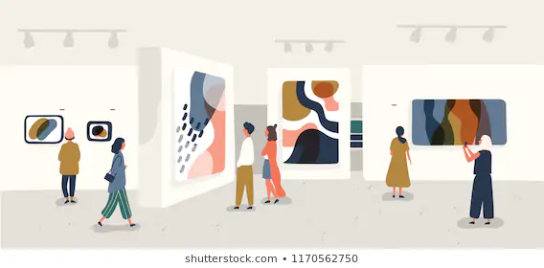
Did you just move in a new apartment or want to spice up your space?
Are you an artist? Do you need more jobs?
Are you having difficulties to sell your artwork and to find customers?
How often do you buy art? Do you know where to buy it?
2/10

Slide 3
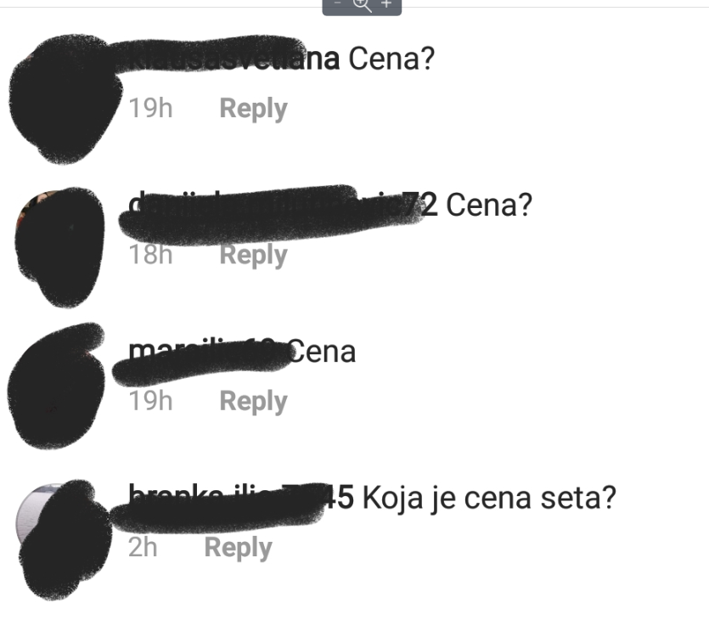


In Serbia, online gallery system does not exist
Search for artworks is limited to galleries who resale and take big commissions
Foreign sites are available but taxes and shipping costs are high, but also - act locally!
Instagram searches are exhausting
3/10

Slide 4
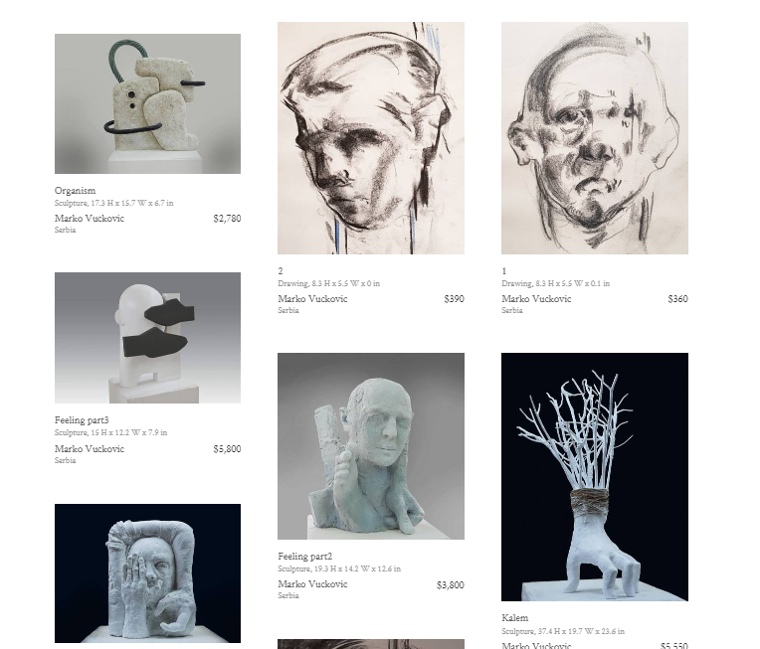
We provide you a solution
Unique place with wide range of artwork, artist and their skills
Custom art requests
Insight into other customers satisfaction and result
Artist on a plate ☺
4/10

Slide 5
Artists can create their profiles, fill their resumes, occupation, skills and portfolio
Items will be categorized in few types:
Painting
Sculptures-installations
House supplies
Decorations
tbd
Services will be categorized in few types:
Painting
Carving
Making plaster decorations and elements
Sewing
Textile processing
etc
Web shop will constantly been updated with new creations. Customers are free to ask for art service they need.
5/10

Slide 6
Management and organization
2 developers
Web designer
Customer service representative
Payments to artists via portal
Artist will be in charge for sending art to customer
As the business grows, more employees will be necessary
6/10

Slide 7
Marketing and sales plan
Social networks promotion via Instagram, Facebook, Google and YouTube ads
Portal will be regularly updated with products, artist and performed works
‘How it looks’ page where people can insert pictures of bought artwork or services
On first year only 5% commission to artists
After the first year 10% commission
7/10

Slide 8
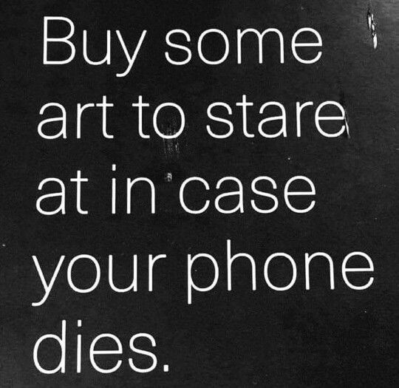

Impact
local global
8/10

Slide 9
Financial plan
Budget | Average per unit | Number of units | Risk | Total
Developers | 1 500 EUR | 2 | 0.00% | 3000 EUR
Web designer | 1 500 EUR | 1 | 0.00% | 1000 EUR
Customer service | 600 EUR | 1 | 0.00% | 600 EUR
Advertisement | 500 EUR |  | 20.00% | 500 EUR
Total |  |  |  | 4100 EUR
9/10

Slide 10
Thank you for your attention! Any questions or feedback? Ask now or reach me on jana_milutinovic@yahoo.com
10/10

