Slide 1
Mobile application for blood transfusion alert calls
Small or medium scale focused research project (STREP) proposal
Jana Milutinovic – jana_milutinovic@yahoo.com
1/10

Slide 2
Abstract
How often do you donate blood?
Do you know where you can donate it?
Provide health centers support in blood transfusion process by:
simplifying creation of an instant alert for donors about low blood supplies
Provide donors support in blood transfusion process by:
providing access to the database of health centers in need for blood
providing useful information and guidance through transfusion process
2/10

Slide 3
Participants
MATF - Faculty of Mathematics, University of Belgrade
ITDM – IT Company from Serbia
RCS – Red Cross of Serbia
3/10

Slide 4
Strategy of the work plan
The project is organized in 7 work packages as follows:
WP0 - Concept development and planning (Project management)
WP1 - Requirements analysis
WP2 - Design
WP3 - Database architecture, Implementing basic functionalities
WP4 – Development of admin user rights and actions and test
WP5 - Development of donor user rights and actions and test
WP6 - Development of form for entering data about used blood by admin and notification for donor user
4/10

Slide 5
Project management
1/3/2020 – 30/6/2020
Requirements analysis
01/3/2020 – 15/3/2020
Database architecture,
initial implementation
16/3/2020-31/3/2020
Design
16/3/2020-31/3/2020
Alert Donor – Gantt chart
Development of admin user rights and actions
1/4/2020-30/4/2020
Development of donor user rights and actions
1/5/2020-31/5/2020
Post development
1/6/2020-30/6/2020
5/10

Slide 6
Resource plan
Partic. no. | Partic. short name | WP0 | WP1 | WP2 | WP3 | WP4 | WP5 | WP6 | Total person months
1 | MATF | 0.5 | 0.5 | 0.5 | 1 | 1 | 1 | 1 | 5.5
2 | RCS | 0.5 | 0 | 0 | 0 | 0.5 | 0.5 | 0.5 | 2
3 | IDTM | 0.5 | 0.5 | 0.5 | 1 | 1 | 1 | 1 | 5.5
Total |  | 0.5 | 1 | 1 | 2 | 2.5 | 2.5 | 2.5 | 13
6/10

Slide 7
Impact
Saving lives
7/10

Slide 8
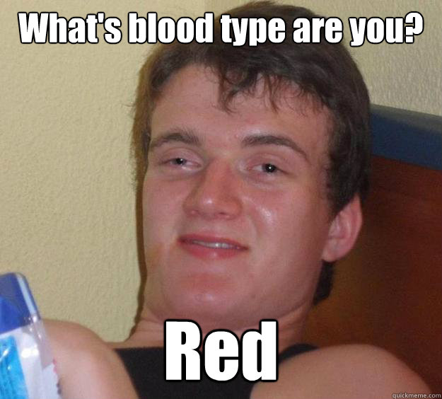
8/10

Slide 9
References:
http://home.etf.rs/~vm/os/uspi/how_fp7.html
http://poincare.matf.bg.ac.rs/~aleksandar/files/upin.html
http://home.etf.rs/~vm/os/osuspi.html
https://eucalls.net/dashboard/call?id=35806
8/10

Slide 10

Thank you for your attention!
Questions?
10/10

