Slide 1
Clinical Decision Making & Pattern Recognition in Health Care
Auditable Agentic AI for Treatment, Payment & Operations
Janam Ajay Patel
M.S. Computer Science, North Carolina State University
Cotiviti Intern Screening — Topic 2
Notes:
Hi, I'm Janam from NC State. For the Cotiviti screening I chose Topic 2 and built a working prototype to prove a point about trustworthy AI.

Slide 2
THE PROBLEM
Generative AI is powerful but untrustworthy for decisions
• LLMs hallucinate — they invent justifications that sound right
• In healthcare, every decision can be audited, appealed, or regulated
• A black-box "the AI said so" answer is unusable in payment integrity
• The need: pattern recognition that is auditable by construction
Notes:
The more capable these models get, the less we can trust them to decide. That's the wrong property for an audit-heavy business.

Slide 3
THE CONCEPT — TOPIC 2
Pattern recognition across Treatment, Payment & Operations
• Classification · Prediction · Inference · Clustering · Anomaly detection
• Agentic chain reasoning: retrieve -> generate -> filter -> rank -> explain
• Key insight: treatment appropriateness and claims appropriateness are the same problem from two ends of care
• The frontier isn't more power — it's grounded, explainable reasoning
Notes:
The engine that decides if a drug fits a patient is the same engine that decides if a claim fits a policy.

Slide 4
TRENDS
Where the field is heading (2024–2026)
• Retrieval-grounded reasoning replaces free-form generation
• Separation of decision from explanation — deterministic model decides, LLM only describes
• Synthetic + open data (Synthea, DDInter) enable safe, PHI-free prototyping
• Regulation (FDA SaMD) pushes explainability from nice-to-have to mandatory
Notes:
These three trends set up why my architecture is the right bet.

Slide 5
THE POC — ARCHITECTURE
A "decision-deterministic, explanation-only" pipeline
Stage | What it does
1. Retrieve | Embed patient -> similar patients + guideline chunks
2. Generate | Assemble candidate therapies
3. Safety filter | Remove contraindications + drug interactions (DDInter)
4. Rank | LightGBM scores survivors on 5 clinical features
5. Explain | LLM writes a CITED rationale — cannot change the ranking
A grounding guard suppresses any recommendation without a citation.
Notes:
The LLM never decides. It receives an already-ranked answer and may only explain it. That's the whole trust argument in one design choice.

Slide 6
POC DEMO — THE RECOMMENDATION
Live: patient in -> ranked, cited recommendation out
• Real synthetic cohort: 107 T2D patients from Synthea, parsed from FHIR
• Recommendation carries a guideline citation + per-feature score breakdown
• The rationale is explicitly labeled "LLM — explanation only"
Notes:
Walk through one recommendation end to end. Every number here is inspectable.

Slide 7
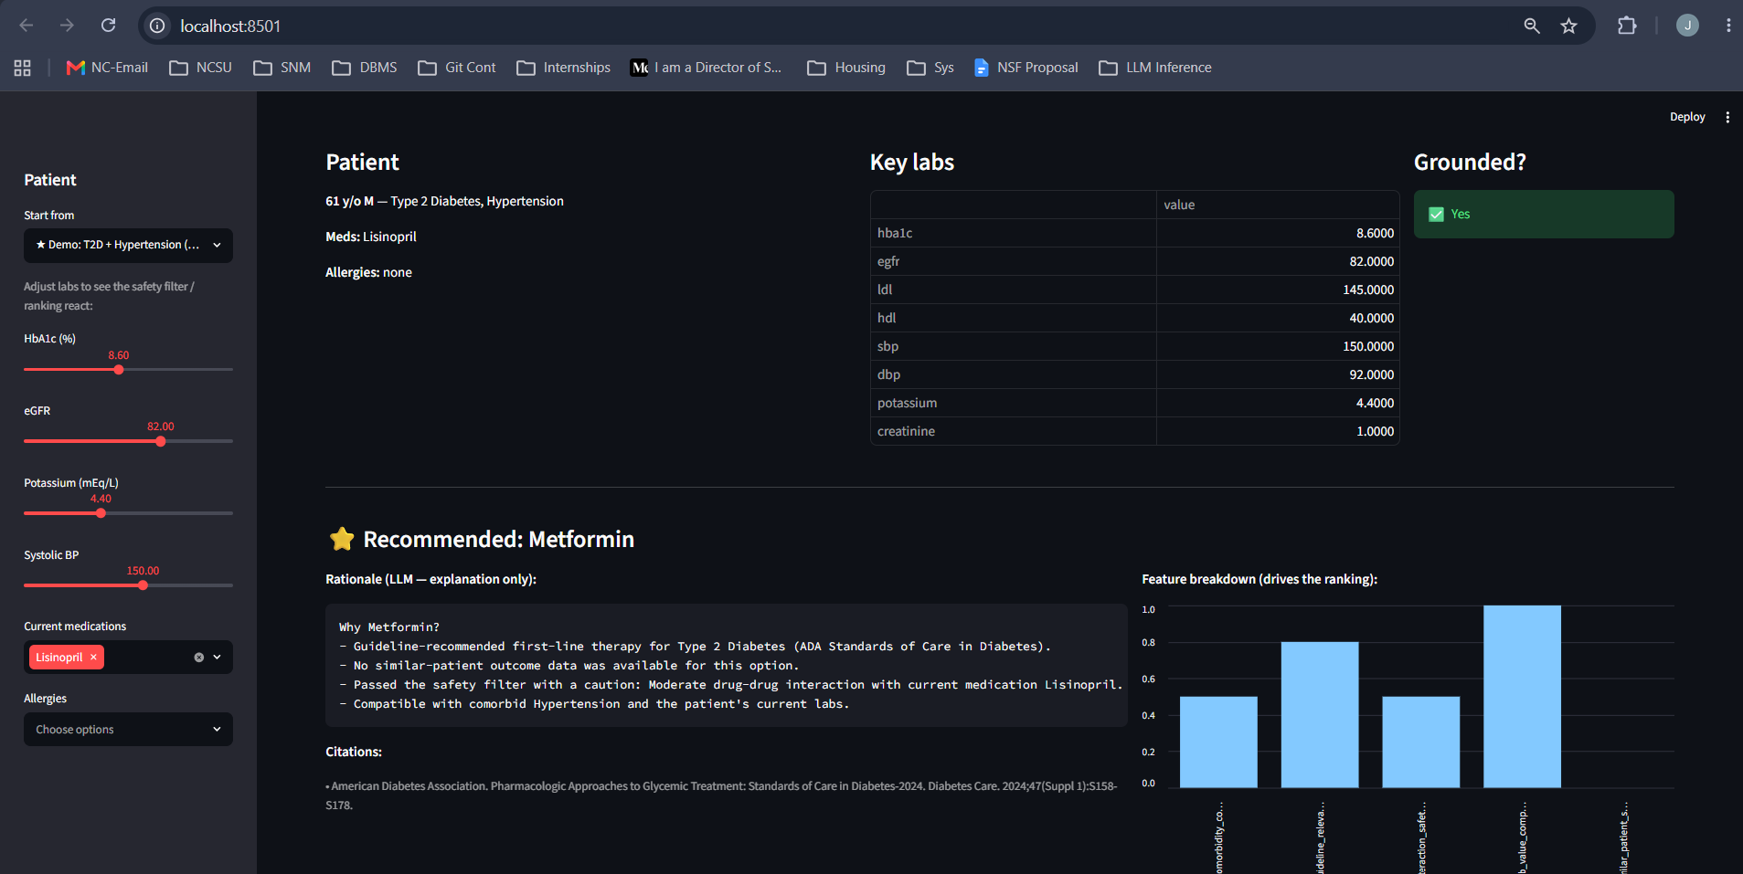
The Recommendation — recommended drug, rationale, citations, feature bar chart
Notes:
Point at the citation and the feature bars: every number here is inspectable.

Slide 8
POC DEMO — SAFETY IN ACTION
The safety filter catches what a naive model would miss
• Drag eGFR below 30 -> metformin is removed, with the contraindication cited
• Backed by DDInter 2.0 (~300k severity-graded drug interactions)
• Removed drugs are shown WITH reasons — the audit trail an appeal needs
Notes:
The system doesn't just say no — it says no, because eGFR 24 contraindicates metformin per the guideline.

Slide 9
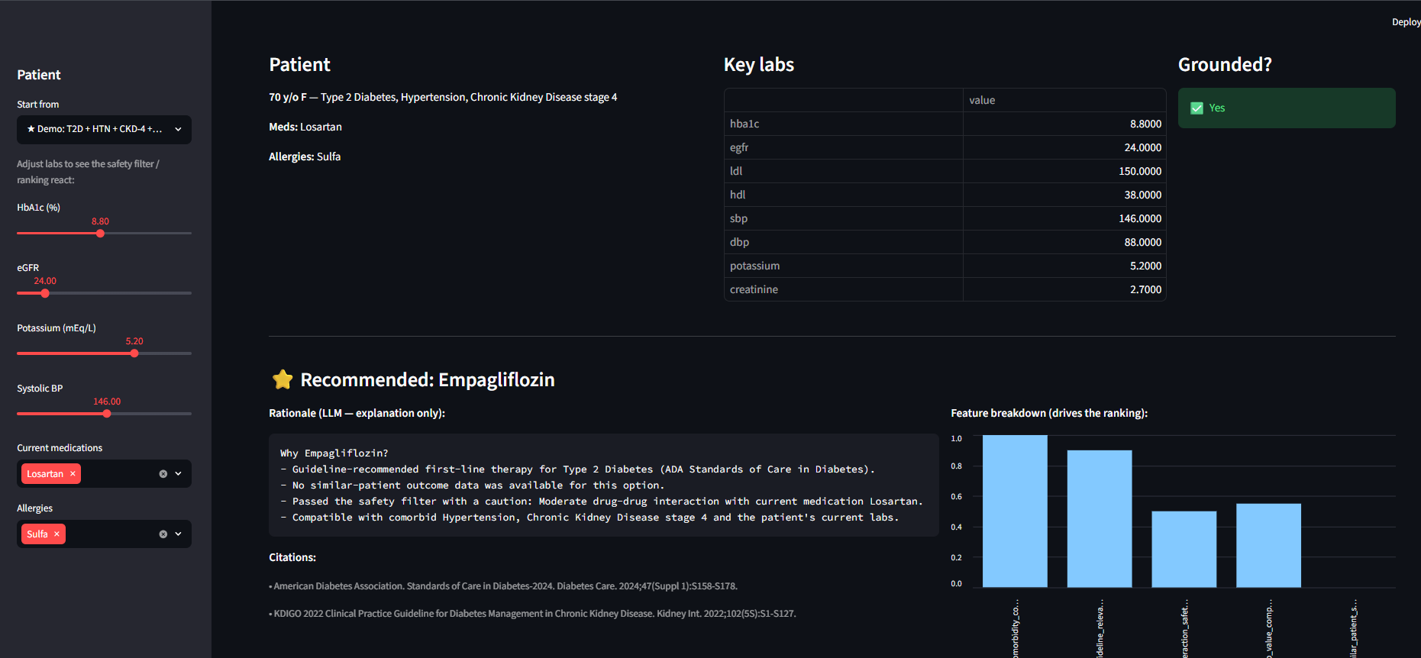
Safety Filter (1 of 2) — candidates assembled + start of the removed-drugs table (CKD-4 patient)

Slide 10
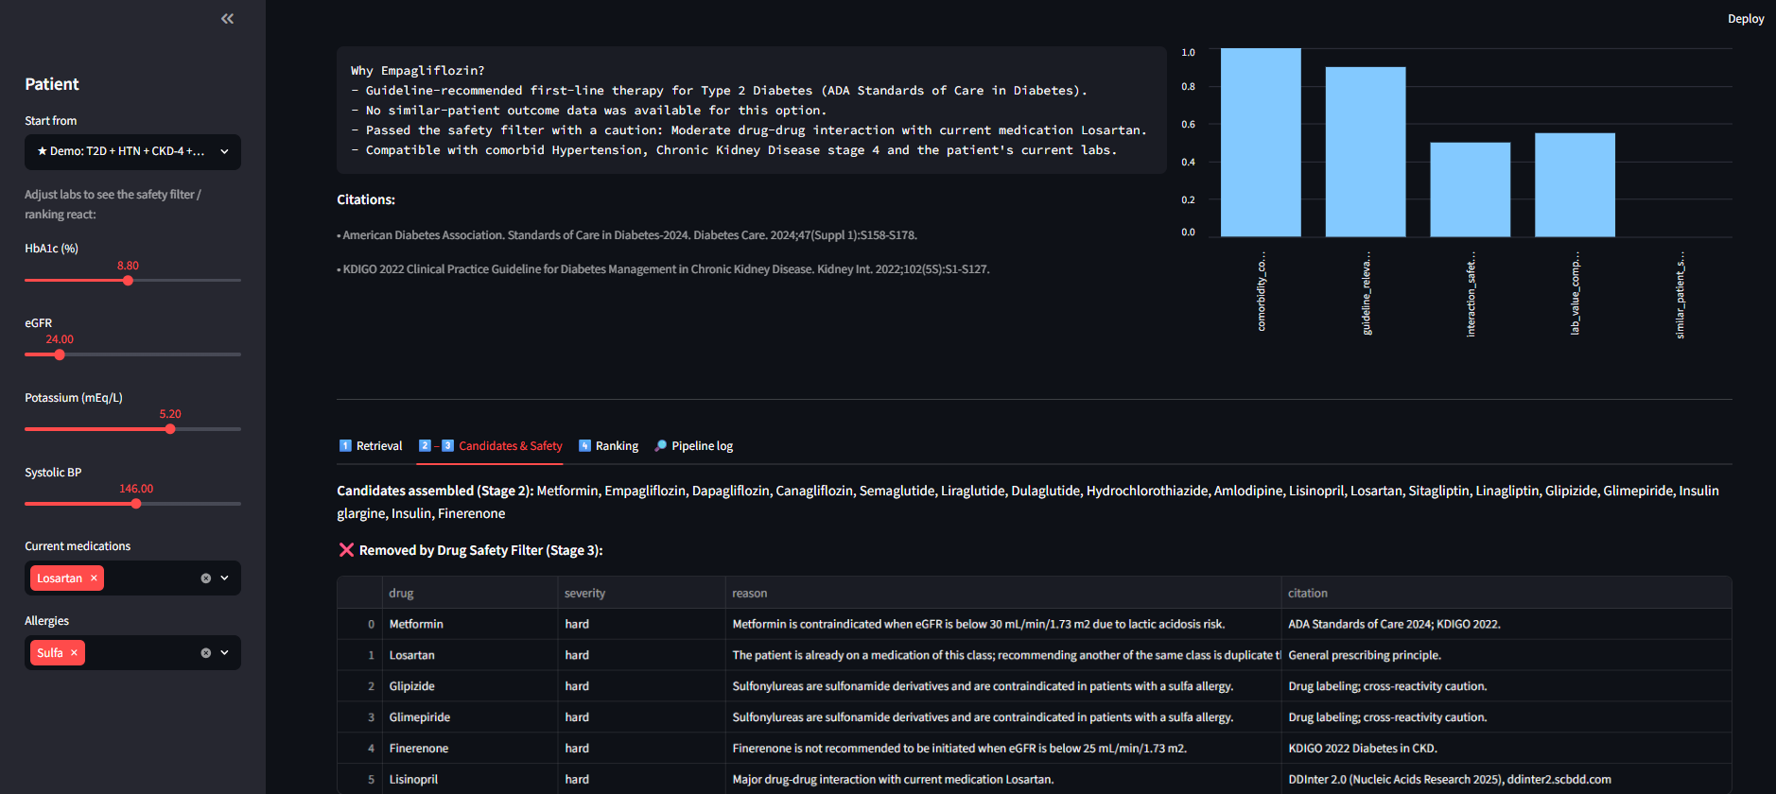
Safety Filter (2 of 2) — removed-drugs table: drug, severity, reason, citation

Slide 11
POC DEMO — TRANSPARENT RANKING
Deterministic ranking on 5 explainable features
• guideline_relevance · similar_patient_success · interaction_safety
• comorbidity_compatibility · lab_value_compatibility
• A LightGBM LambdaRank model — no opaque scoring, every feature in [0,1]
Notes:
If a reviewer disagrees, they can see which feature drove the score. That's debuggable. A neural black box is not.

Slide 12
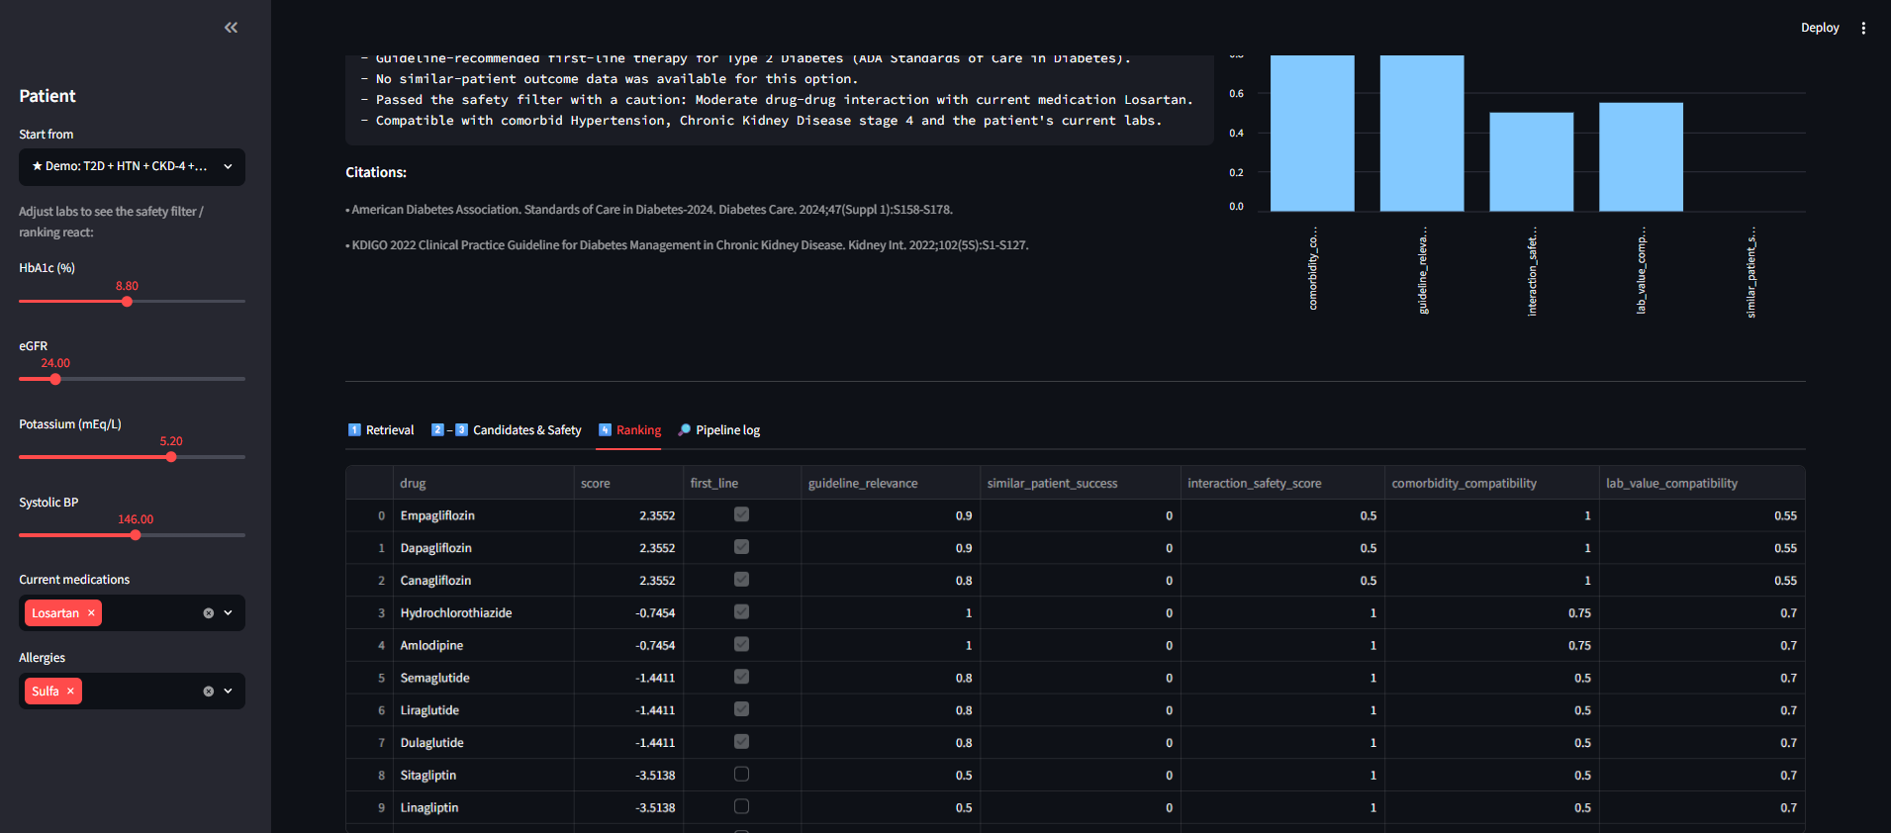
Transparent Ranking — ranked drugs with per-feature scores and first_line flags

Slide 13
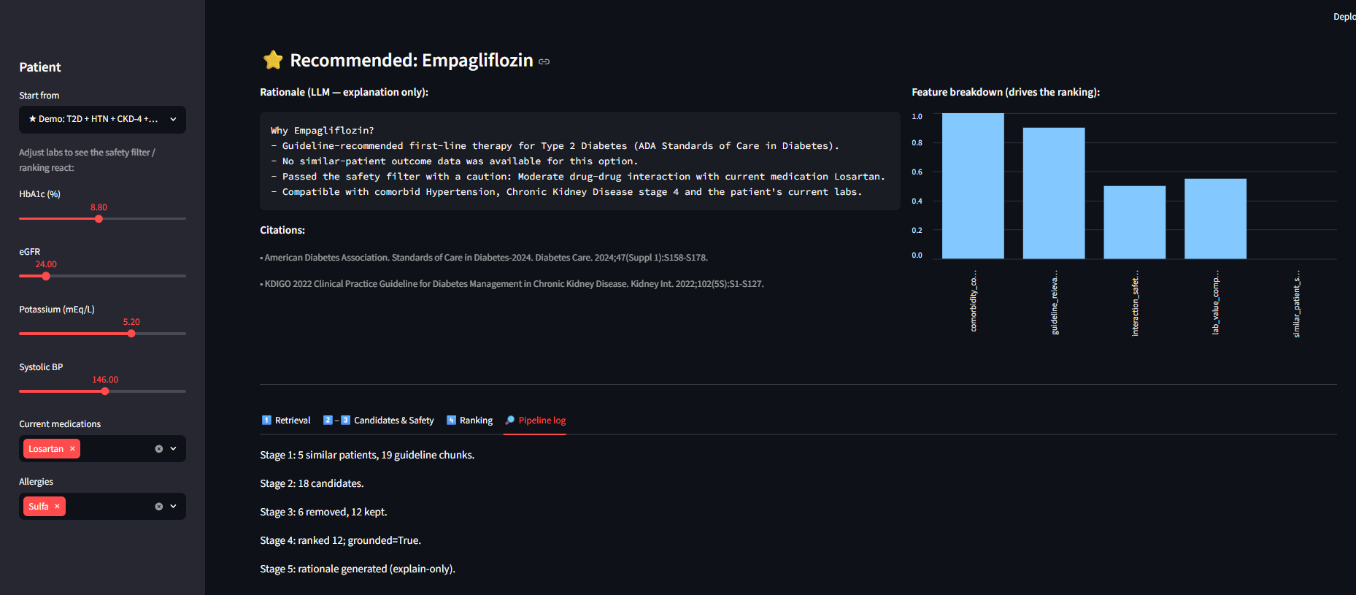
Pipeline Log — agent trace: retrieve -> generate -> filter -> rank -> explain -> grounding check
Notes:
Optional. Delete this slide if you don't use the pipeline-log screenshot.

Slide 14
OPPORTUNITIES & THREATS FOR COTIVITI
Why this architecture matters to the business
OPPORTUNITY: Extend payment integrity upstream into clinical-appropriateness & quality review — same retrieve-rank-explain machinery
OPPORTUNITY: Make every determination audit-ready by construction -> faster reviewers, defensible appeals
THREAT: Unaudited generative AI — hallucinated justifications create legal, regulatory & reputational risk
THREAT: Competitive — if Cotiviti doesn't own the explainable layer, others set a lower trust bar
Notes:
The cost of a wrong, unexplained answer in this industry is measured in audits and appeals.

Slide 15
Adopt "decision-deterministic, explanation-only" as a reference pattern
1. Standardize the pattern for any LLM-assisted determination — clinical or payment
2. Build a versioned "policy-as-evidence" corpus so retrieval grounds in Cotiviti's own authoritative rules
3. Differentiate in market: sell auditable AI to payers/providers who must defend every decision
Notes:
In a domain where every decision can be contested, the company that makes auditable AI cheaper than opaque AI wins. My POC is a working blueprint.

