Slide 1
COMBINATIONAL SHIFTER TO IMPLEMENT LOGICAL,CIRCULAR AND ARTHEMATIC SHIFT OPERATIONS IN BOTH DIRECTIONS
PRESENTED BY: 21BCE194,21BCE195,21BCE196,21BCE197

Slide 2
INDEX
INTRODUCTION
TYPES OF SHIFTERS
ARITHMATIC SHIFTER
CIRCULAR SHIFTER
LOGICAL SHIFTER

Slide 3
INTRODUCTION TO SHIFTERS
A group of flip flops which is used to store multiple bits of data and the data is moved from one flip flop to another is known as Shift Register. The bits stored in registers shifted when the clock pulse is applied within and inside or outside the registers. A Shift Register can shift the bits either to the left or to the right. A Shift Register, which shifts the bit to the left, is known as "Shift left register", and it shifts the bit to the right, known as "Right left register".

Slide 4
TYPES OF SHIFTERS
THIS PROJECT CONSISTS OF THREE TYPES OF SHIFTERS:
ARTHEMATIC SHIFTERS
LOGICAL SHIFTERS
CIRCULAR SHIFTERS

Slide 5
ARTHEMATIC SHIFTERS
Arithmetic shifter—is the same as a logical shifter, but on right shifts fills the most significant bits with a copy of the old most significant bit (msb). This is useful for multiplying and dividing signed numbers. Arithmetic shift left is the same as logical shift left.
Example: 11001 >>> 2 = 11110; 11001 << 2 = 00100. The operators <<, >>, and >>> typically indicate shift left, logical shift right, and arithmetic shift right, respectively.

Slide 6
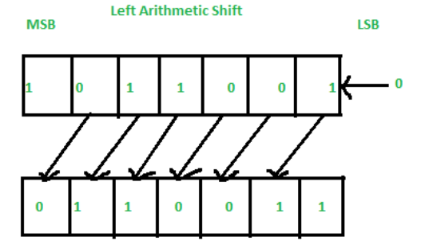
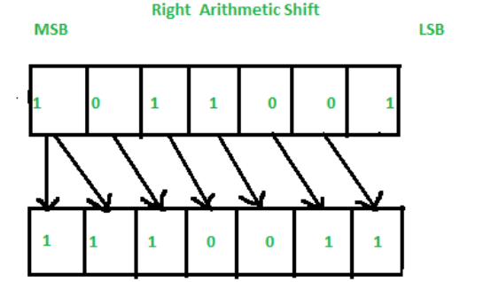

Slide 7
CIRCULAR SHIFTERS
It have the ability to shift data work in a single operation over standard shift left or right registers that utilize more than one cycle
Rotates numbers in a cycle such that empty spots are filled with bits shifted off the other end.

Slide 8
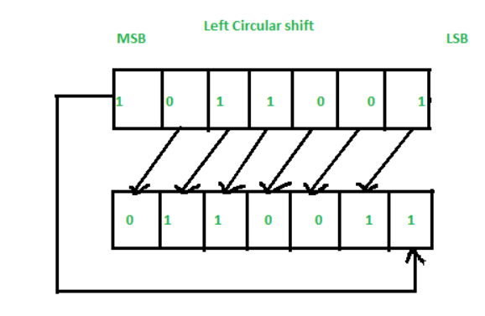
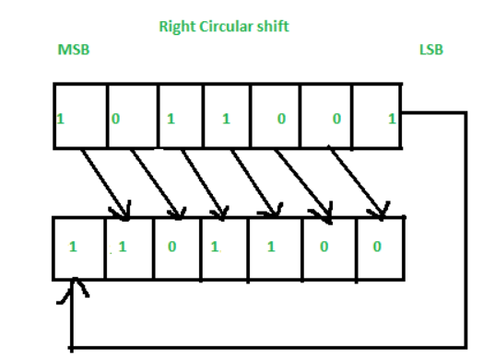

Slide 9
LOGICAL SHIFTERS
A binary shift is a binary operation that consists of shifting all the digit of a binary number either to the left or to the right by a fixed amount. Binary shifts can be used to multiply a number by a power of 2 (left shift) or to divide a number by a power of 2 (right shift).

Slide 10
