Slide 1

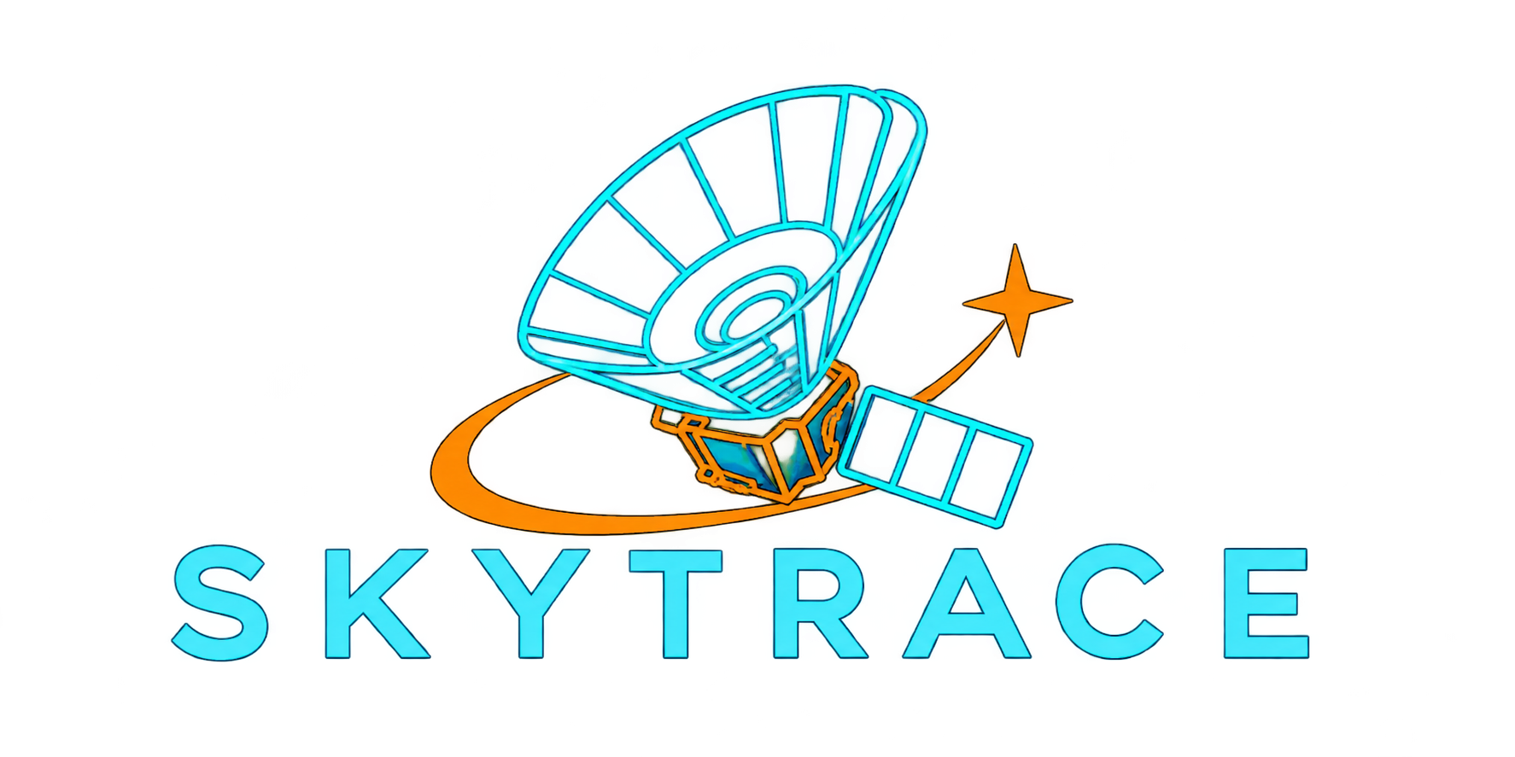
NASA SPACE APPS 2026
SKYTRACE
A new way
to look closer.
Real NASA SPHEREx infrared images,
guided: see what moves in the sky,
then check the evidence.
For students and citizen scientists.
Jana · Sadeel · Batool · Yazan · Taqwa · Haneen
Challenge: Planet X and SPHEREx
Team SKYTRACE · Ramallah local event
Notes:
[0:00-0:15] Speaker 1
"We are Team SKYTRACE from the Ramallah local event, and our challenge is Planet X and SPHEREx.
SKYTRACE is a guided explorer of real NASA SPHEREx infrared images: you see what moves in the sky, and then you check the evidence."
Tip: say the tagline slowly. Every team member must be able to say it in one breath.

Slide 2
THE PROBLEM | ONE PERSON, ONE NUMBER, WHY NOW
Lina has the data, not the answer.
358
Lina, Ramallah
Physics student · illustrative user
She wants to know: did anything in this patch of sky move?
The archive gives her raw FITS files, not a picture.
SPHEREx images of one point in the sky
(Barnard's Star) in 13 months, on 6 detectors
Count: SKYTRACE search on NASA/IPAC IRSA (DR1 + QR3), Nov 2026
Why now: SPHEREx data go public within 60 days, and in 2025 the interstellar comet 3I/ATLAS crossed its sky.
MOVING OBJECTS HIDE IN ARCHIVES | HUBBLE ASTEROID HUNTER, PEOPLE + MACHINE LEARNING
37,000
11,482
1,701
1,031
archival images
volunteers
asteroid trails
previously uncatalogued
Sources: IRSA SPHEREx search via SKYTRACE API (RA 269.446, Dec 4.768); NASA Science, SPHEREx; NASA Hubble Mission Team, 18 Apr 2024.
02
Notes:
[0:15-0:45] Speaker 1
"Meet Lina, a physics student in Ramallah. She is an illustrative user, but her problem is real.
She hears NASA's SPHEREx is mapping the whole sky, and she wants to know one thing: did anything here move?
She opens the archive. For one single point, Barnard's Star, there are 358 SPHEREx images in 13 months, on six detectors. Raw FITS files, not a picture.
Why now: SPHEREx data become public within 60 days, and in 2025 the interstellar comet 3I/ATLAS crossed its sky.
And moving objects really do hide in archives: Hubble Asteroid Hunter found 1,031 uncatalogued asteroids in old images."
Facts: 358 = live SKYTRACE search on IRSA (spherex_dr1 + spherex_qr3), 2025-08-15 to 2026-09-22, detectors D1-D6.
Hubble: https://science.nasa.gov/missions/hubble/hubble-goes-hunting-for-small-main-belt-asteroids/

Slide 3
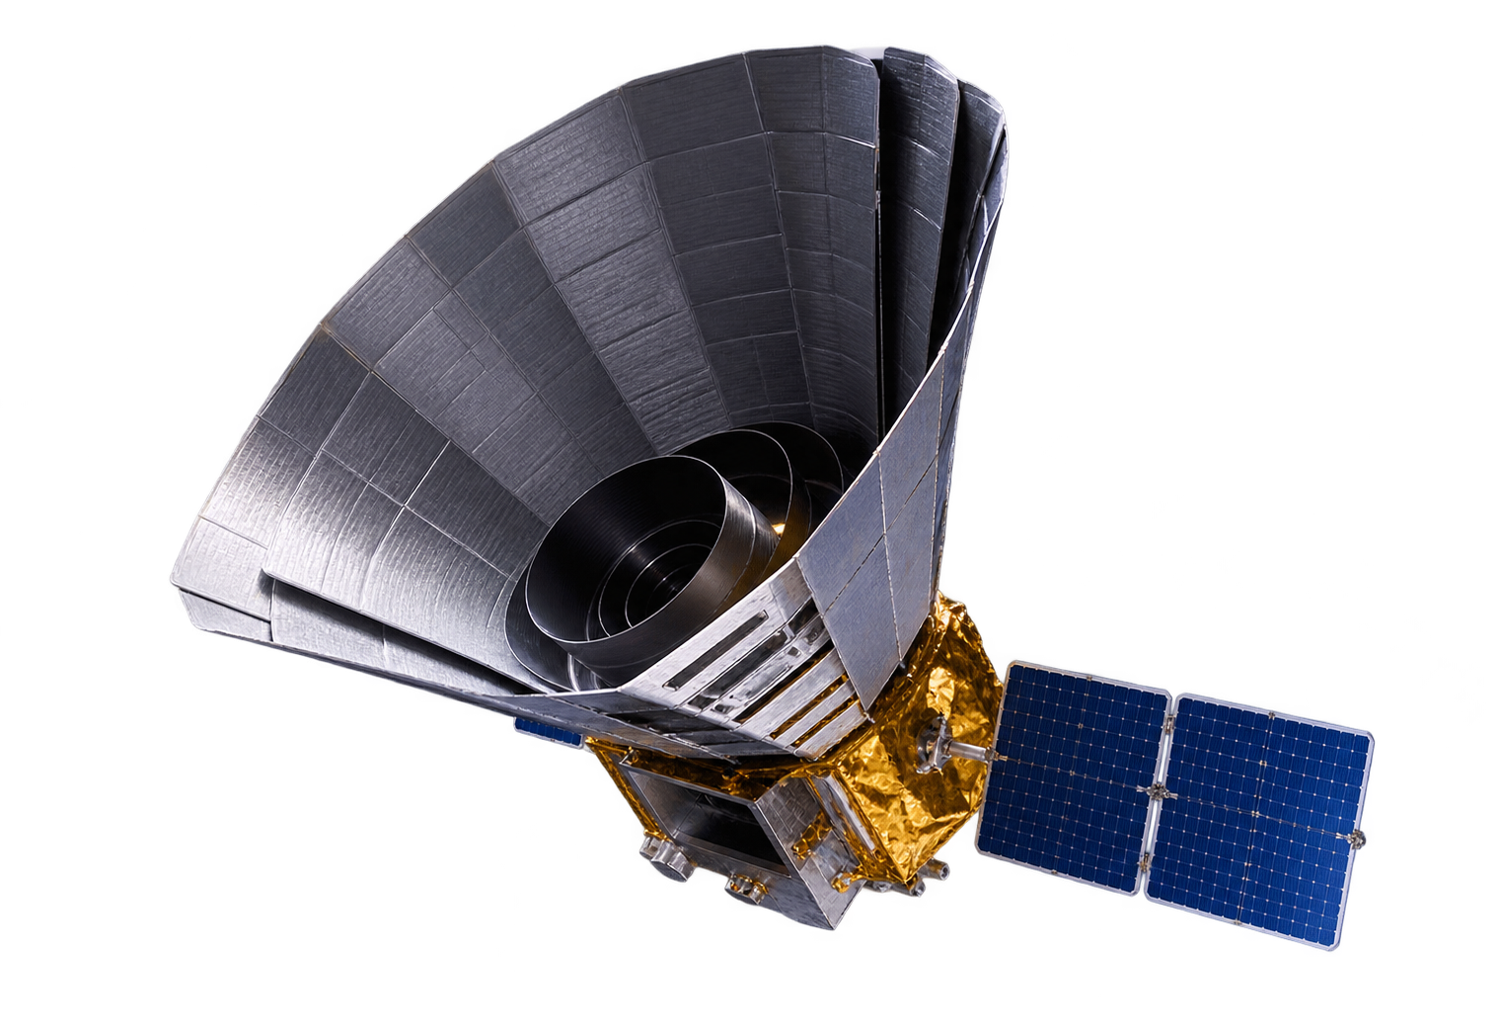
OUR SOLUTION | WHAT IS NEW
See it move.
Then see the evidence.
01
Choose a place or an object
Sky map, coordinates, or guided targets like Vesta
02
Compare real SPHEREx images
Blink, slide and difference, with time, band and file
03
Understand what you see
Its real orbit, and a year-by-year night-sky story
What is new: unlike research tools that start from a catalogue, SKYTRACE starts from a question, “did anything move here?”, and walks anyone to the answer and its evidence.
Challenge fit: SPHEREx data at the core, a public audience, and the Planet X question (finding moving objects) with honest limits.
03
Notes:
[0:45-1:10] Speaker 2
"SKYTRACE turns those files into an investigation in three steps.
One: choose a place or an object, from the sky map, coordinates, or guided targets like the asteroid Vesta.
Two: compare the real SPHEREx images: blink, slide, or look at the difference.
Three: understand what you see: the object's real orbit around the Sun, and its path across the night sky, year by year.
What is new: research tools start from a catalogue. We start from a question, 'did anything move here?', and walk anyone to the answer and its evidence.
That is exactly the Planet X idea: finding things that move, with SPHEREx data at the core."
Context: IRSA already offers expert tools (source discovery, spectrophotometry, mosaics). We do not claim to replace them; we guide non-experts.

Slide 4
HOW IT WORKS | THE NASA DATA INSIDE
From NASA archives to one clear view.
NASA DATA
METHOD
OUTPUT
SPHEREx spectral images: IRSA collections spherex_dr1 + spherex_qr3 (SIA2, 102 bands, detectors D1-D6)
JPL Horizons: real orbits and sky paths
AllWISE (NASA/IPAC) sky background · ESA Gaia DR3 known stars
Find every image covering RA/Dec in a time window
Cut out, read the quality FLAGS, align north-up
Engine: 3×3 pixel peaks with SNR ≥ 5, linked across frames, matched to known objects
Blink and difference views, each with time (UTC), band and file
Candidates labelled “pending validation”, never “discovered”
Orbit journey + night-sky story
SNR = peak signal / σ ≥ 5 → motion across frames → match with Gaia DR3 + Horizons
Pixels are measured in the original FITS (MJy/sr); display images are never measured.
Other data, credited: Hipparcos stars and d3-celestial constellations (sky story), Gaia DR3 (ESA).
Data credit: NASA SPHEREx via NASA/IPAC IRSA · JPL Solar System Dynamics (Horizons) · NASA/IPAC AllWISE HiPS
04
Notes:
[1:10-1:45] Speaker 3 (science)
"Here is what is inside. Our core data is NASA SPHEREx: spectral images from the IRSA archive, collections spherex_dr1 and spherex_qr3, 102 bands over six detectors. For orbits we use JPL Horizons, and for context the AllWISE sky and ESA's Gaia DR3 stars.
The method: we find every image that covers a point in a time window, cut it out, read its quality flags, and align it north-up.
Our engine looks for pixel peaks with a signal-to-noise ratio of at least 5, links them across frames to see motion, and matches them with known stars and solar-system objects.
The output: images you can blink and compare, each with its time, band and file, and candidates that stay 'pending validation'. We never say 'discovered'."
If asked 'what breaks without NASA data?': everything. No SPHEREx, no images; no Horizons, no orbit or sky path.

Slide 5
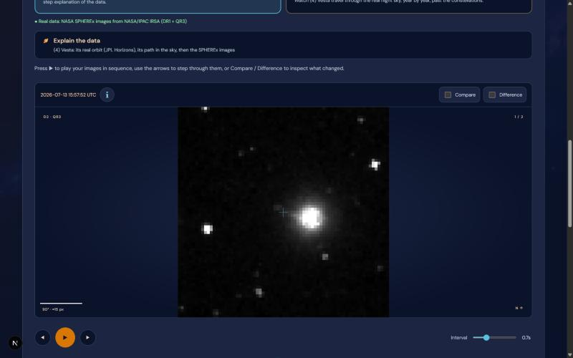
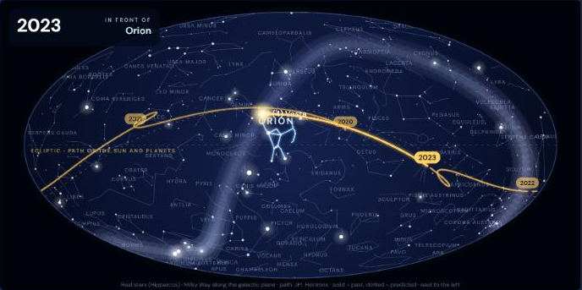
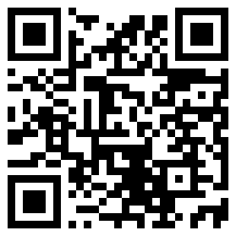
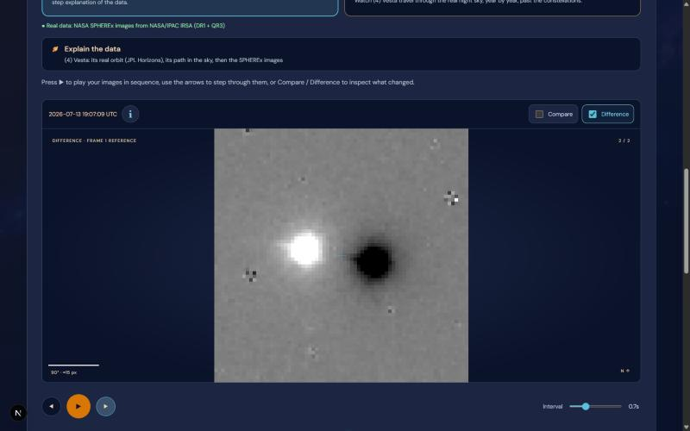
DEMO | REAL NASA DATA, LIVE PUBLIC LINK
Vesta, live from the archive.
Night-sky story: Vesta's real path (JPL Horizons) past Orion
Real SPHEREx image, 13 July 2026 · QR3, D2
Try it now, no login: skytrace-puce.vercel.app
Works today: real SPHEREx search and images, blink and difference, orbit journey, sky story, candidate engine. Next: science review of candidates.
Notes:
[1:45-2:25] Speaker 4 (demo driver)
"This is the live site, open to anyone, no login. Scan the code to try it.
We pick the asteroid Vesta. SKYTRACE finds the real SPHEREx images from 13 July 2026; here is one from detector D2, with its time, band and file.
Press 'Explain the data' and you see Vesta's real orbit from JPL Horizons. Press 'Simple explanation' and Vesta travels across the real night sky, year by year, past Orion.
What works today: real search, real images, comparison, the orbit, the sky story and the candidate engine. Next is scientific review of the candidates."
Live demo safety:
- 10 minutes before: open https://skytrace-api-pwq3.onrender.com/api/health (free server sleeps; first load takes ~1 min).
- Keep a screen recording as an offline backup.
- Path: Explorer -> Choose a suggested target -> (4) Vesta -> View selected images -> Explain the data -> Simple explanation.

Slide 6
IMPACT | WHO BENEFITS, AND HOW
Built for people who want to look.
324K
WHO BENEFITS
University students: see real NASA data move, no telescope needed
Teachers and astronomy clubs: a ready lesson with Vesta, 3I/ATLAS and Mira
Citizen scientists: a guided first look before joining NASA projects
NASA Zooniverse volunteers since 2020
120M
Local angle: made in Ramallah; free, any browser, no login.
Planned pilot: one university astronomy class, Dec 2026, measuring completion and understanding.
classifications since 2020
31 projects / 96 scientific publications
06
Source: NASA Science, 10 Jul 2026. Participation totals do not measure unmet need or people affected.
Notes:
[2:25-2:45] Speaker 5
"Who benefits? University students, who can see real NASA data move without a telescope. Teachers and astronomy clubs, who get a ready lesson with Vesta, 3I/ATLAS and Mira. And citizen scientists, who get a guided first look before joining NASA projects.
People clearly want to take part: NASA's Zooniverse projects have 324,000 volunteers and 120 million classifications since 2020.
Locally, SKYTRACE is free, works in any browser, and needs no login. Our next step is a pilot with one university astronomy class."
Be honest if asked: adoption is not measured yet; the Zooniverse numbers show interest in citizen science, not SKYTRACE users.
Source: https://science.nasa.gov/get-involved/citizen-science/nasa-volunteers-help-zooniverse-reach-1-billion-classifications/

Slide 7
NEXT STEPS AND TEAM
Next:
validation.
TEAM SKYTRACE
Jana
Backend
Sadeel
Frontend
Batool
UI/UX & visualization
Yazan
Scientific engine
Taqwa
FITS & data quality
1 Pilot with a university astronomy class (Dec 2026)
2 Validate the engine on known movers: Vesta, 3I/ATLAS
3 Partner with teachers and astronomy clubs
Haneen
Image processing
Limits today: candidates are unconfirmed; the free server sleeps (first load ~1 min); SPHEREx coverage is still filling in.
Live: skytrace-puce.vercel.app · Code: github.com/jananael/Planet-X-and-SPHEREx · AI tools assisted code and slides; the team reviewed every claim
Notes:
[2:45-3:00] Speaker 1
"Next: a pilot with a university class in December, validating our engine on known moving objects like Vesta and 3I/ATLAS, and partnering with teachers and astronomy clubs.
Our limits: candidates are not confirmed yet, and SPHEREx coverage is still filling in.
We are Team SKYTRACE: Jana, Sadeel, Batool, Yazan, Taqwa and Haneen. The sky is never still. Thank you."
AI disclosure (also on the project page): AI assistants (Claude Code, Codex) helped write code and draft these slides; the team checked every scientific claim and number.

