Slide 1


K.S.R.M. COLLEGE OF ENGINEERING (UGC-AUTONOMOUS) Kadapa, Andhra Pradesh, India– 516 003 Approved by AICTE, New Delhi & Affiliated to JNTUA, Ananthapuramu, An ISO 14001:2004 & 9001: 2015 Certified Institution
TECHNICAL SEMINAR
DEPARTMENT OF ELECTRONICS AND COMMUNICATION ENGINEERING
TITLE: NANOTECHNOLOGY AND PARALLEL COMPUTING
Under the supervision of: Reviewer-Senior Faculty:
Dr. D. ARUN KUMAR, Ph.D., P .SUBBA RAYUDU.,
ASSOCIATE PROFESSOR, ASSISTANT PROFESSOR,
DEPARTMENT OF ECE. DEPARTMENT OF ECE.
Presented by:
K.JANARDHANA (199Y1A0467),
ECE-A

Slide 2
CONTENTS
Introduction
What is Nanotechnology
Synthesis of nanomaterials
Applications of Nanotechnology
Advantages and Disadvantages
Conclusion

Slide 3
INTRODUCTION
Nanotechnology is the study of manipulating matter on an atomic scale.
Nanotechnology refers to the constructing and engineering of the functional systems at very micro level or we can say that atomic level.
It is one billionth of a meter and roughly the width of three or four atoms.The average human hair is about 25,000 nanometers wide.
The goal of nanotechnology is to control individual of atoms and molecules to create computer chips and other devices that are thousands of times smaller than current technologies limit.

Slide 4
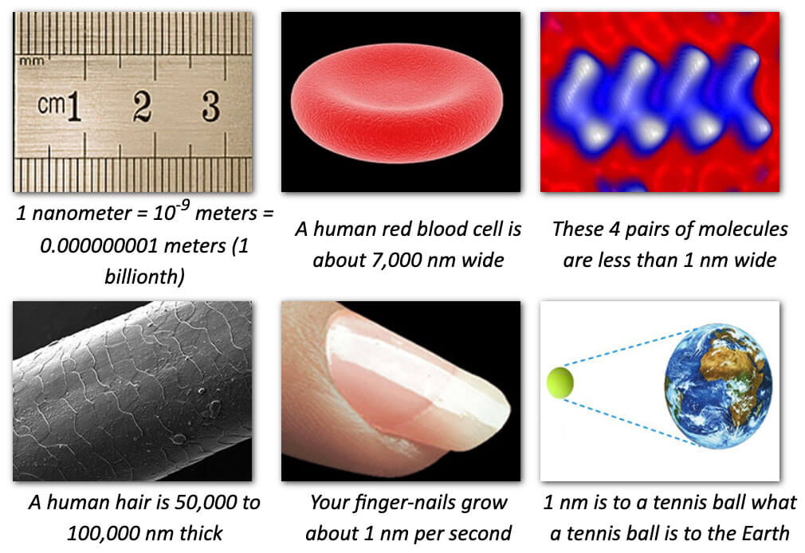
WHAT IS NANOTECHNOLOGY
The study of controlling or manipulating of matter on an atomic and molecular scale.
Nanotechnology deals with structures sized between 1-100 nanometer in at least one dimension and involves developing or modifying materials or devices within that size.

Slide 5
SYNTHESIS OF NANOMATERIALS
There are Two Approaches. They are classified by
Top-Down
Bottom-up
TOP-DOWN APPROACH
In this approach involves the breaking down of the bulk material into nanosized structures or particles.
Top-Down approach often uses the traditional workshop or microfabrication methods in which externally-controlled tools are used to cut, mill and shape materials into the described shape and order.
Attrition and milling for making nanoparticles are typical top-down processes.

Slide 6
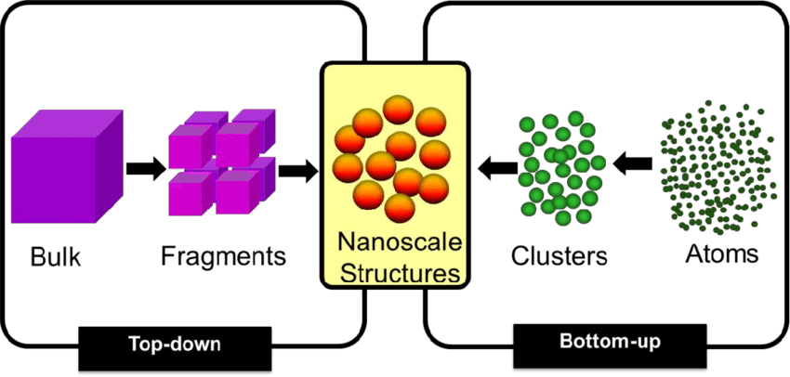
BOTTOM-UP APPROACH
This is a chemical process.
In this approach different materials and devices are constructed from molecular components on their own which do not require any external agent to assemble them.
Bottom-up approach starts by collection and combination of atoms and molecules to build complex structures.

Slide 7

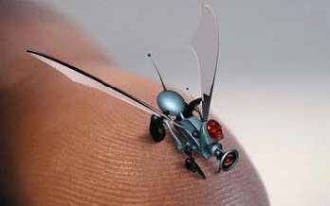
APPLICATIONS
MEDICINE:
Researchers are developing customized nanoparticles the size of molecules that can deliver drugs directly to diseased cells in your body.
A variety of nanomaterials are also being employed to improve
The efficiency of imaging systems.
ELECTRONICS:
Carbon nanotubes are close to replacing silicon as a material
for making smaller, faster and more efficient microchips and
Devices as well as lighter, more conductive and stronger quantum
Nanowires.

Slide 8
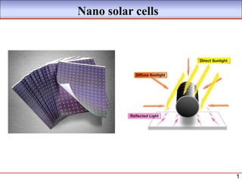
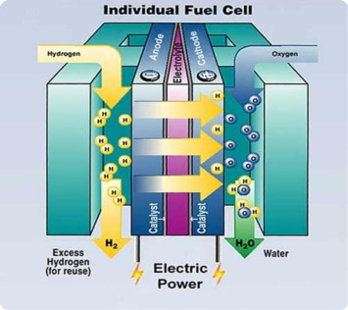
SOLAR CELLS:
Solar cells are devices that convert sunlight into electrical energy.
In nanotechnology there has been
Significant research and development focused on
Improving the efficiency and cost effectiveness of
Solar cells by utilizing nanoscale materials and structures.
FUEL CELLS:
Nanotechnology is being used to reduce the cost of catalysts used in fuel cells to produce hydrogen ions from fuel such as methanal and to improve
The efficiency of membranes used in fuel cells to
Separate hydrogen ions from other gases such as oxygen.

Slide 9
ADVANTAGES AND DISADVANTAGES
ADVANTAGES:
Increased efficiency
Improved medical treatments
Benefits for manufacturing
Automatic pollution clean up
DISADVANTAGES:
Negative environmental impact
Economic imbalance
Health problems
Costly

Slide 10
CONCLUSION
Nanotechnology with all its challenges and opportunities will become a part of our future.
The researchers are optimistic for the products based upon this technology.
Nanotechnology is slowly but steadily ushering in the new industrial revolution.

Slide 11
CONTENTS ON PARALLEL COMPUTING
Introduction
What is parallel computing
Types of parallel computing
Uses of parallel computing
Advantages and Disadvantages
Conclusion

Slide 12
INTRODUCTION
Parallel computing refers to the use of multiple processors or computer systems working together to solve a computational problem or execute a task in parallel.
Ever-growing size of data bases and increasing complexity are putting great stress on the single processor computers.
Parallel computing is the simultaneous execution of the same task split into subtasks on multiple processors in order to obtain results fast.

Slide 13
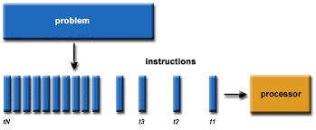
WHAT IS PARALLEL COMPUTING
Parallel computing is a form of computation in which many instructions are carried out simultaneously operating on the principle that large problems can often be divided into smaller ones ,which are they solved concurrently in parallel.

Slide 14
TYPES OF PARALLEL COMPUTING
There are different types of parallel computing. They are
Bit-level
Instructional
Data
Task
BIT-LEVEL PARALLELISM
When an 8-bit processor needs to add two 16-bit integers, its to be done in two steps.
The processor must first add the 8 lower-order bits from each integer using the standard addition instruction.
Then add the 8 higher-order bits using an add-with carry instruction and the carry bit from the lower order addition.

Slide 15
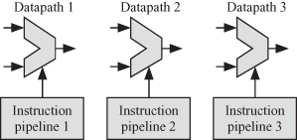
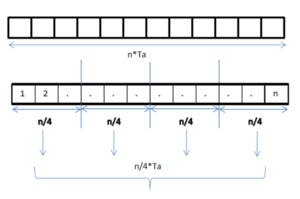
INSTRUCTION LEVEL PARALLELISM
The instructions given to a computer for processing can be divided into groups or re-ordered and then processed without changing the final list.
This is known as instructional level parallelism.
DATA LEVEL PARALLELISM
Data parallelism focuses on distributing the data across different parallel computing nodes.
It is also called as loop-level parallelism.

Slide 16
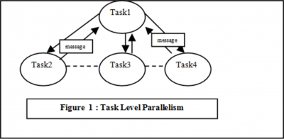
TASK LEVEL PARALLELISM
Task parallelism focuses on distribution of tasks across different processors.
It is also known as functional parallelism or control parallelism.

Slide 17
USES OF PARALLEL COMPUTING
Saves time and money.
Solves complex problems
Provides concurrency
In a natural world many complex interrelated events happen at the same time, yet within a temporal sequence.
Compared to serial computing , parallel computing is much better suited for modelling , simulating and understanding complex, real world phenomena.
Data is processed quicker.

Slide 18
ADVANTAGES AND DISADVANTAGES
ADVANTAGES
Memory is scalable with the number of processors.
Each processor can rapidly access its own memory.
Global address space provides a user friendly programming perspective to memory.
Parallel computing saves time by allowing problems to be executed in less time.
DISADVANTAGES
It may be difficult to map existing data structures.
Non-uniform memory access times.
High latency, low band width
Difficult to develop and debug.

Slide 19
CONCLUSION
The efficiency of a model in shared memory parallel computing depends on the type of the program and best use of underlaying hardware parallel processing features.
Extending MPI for high computational problems like big data mining is much more efficient than the traditional frameworks.
Shared memory models are easy to implement but MPI gives best optimal results for more complex problems.

Slide 20


