Slide 1
Relational Databases
Chapter 4
4-1

Slide 2
Learning Objectives
Explain the importance and advantages of databases, as well as the difference between database and file-based legacy systems.
Explain the difference between logical and physical views of a database.
Explain fundamental concepts of database systems such as DBMS, schemas, the data dictionary, and DBMS languages.
Describe what a relational database is and how it organizes data.
Create a set of well-structured tables to properly store data in a relational database.
Perform simple queries using the Microsoft Access database.
Design:
  To design a database, you need to have a conceptual view of the entire database. The conceptual view illustrates the different files and relationships between the files.
  The data dictionary is a “blueprint” of the structure of the database and includes data elements, field types, programs that use the data element, outputs, and so on.
4-2

Slide 3
What Is a Database?
Efficiently and centrally coordinates information for a related group of files
A file is a related group of records
A record is a related group of fields
A field is a specific attribute of
interest for the entity (record)
4-3

Slide 4
Advantages of Databases
Data is integrated and easy to share
Minimize data redundancy
Data is independent of the programs that use the data
Data is easily accessed for reporting and cross-functional analysis
4-4

Slide 5
Database Users and Designers
Different users of the database information are at an external level of the database. These users have logical views of the data.
At an internal level of the database is the physical view of the data which is how the data is actually physically stored in the system.
Designers of a database need to understand user’s needs and the conceptual level of the entire database as well as the physical view.
4-5

Slide 6
DBMS Languages
Data Definition Language (DDL)
  Builds the data dictionary
  Creates the database
  Describes logical views for each user
  Specifies record or field security constraints
Data Manipulation Language (DML)
  Changes the content in the database
    Creates, updates, insertions, and deletions
Data Query Language (DQL)
  Enables users to retrieve, sort, and display specific data from the database
4-7

Slide 7
Relational Database
Represents the conceptual and external schema as if that “data view” were truly stored in one table.
Although the conceptual view appears to the user that this information is in one big table, it really is a set of tables that relate to one another.
4-8

Slide 8
Conceptual View Example
Customer Name | Sales Invoice # | Invoice Total
D. Ainge | 101 | $1,447
G. Kite | 102 | $4,394
D. Ainge | 103 | $ 898
G. Kite | 104 | $ 789
F. Roberts | 105 | $3,994
4-9

Slide 9
Relational Data Tables
4-10

Slide 10
Relational Data Tables
Primary Keys
Foreign Key (Customer # is a Foreign key in the Sales Table because it is a Primary key that uniquely identifies Customers in the Customer Table). Because of this, the Sales Table can relate to the Customer Table (see red arrow above).
4-11

Slide 11
Why Have a Set of Related Tables?
Data stored in one large table can be redundant and inefficient causing the following problems:
  Update anomaly
  Insert anomaly
  Delete anomaly
4-12

Slide 12
Relational Database Design Rules
Every column in a row must be single valued
Primary key cannot be null (empty) also known as entity integrity
IF a foreign key is not null, it must have a value that corresponds to the value of a primary key in another table (referential integrity)
All other attributes in the table must describe characteristics of the object identified by the primary key
Following these rules allows databases to be normalized and solves the update, insert, and delete anomalies.
4-13

Slide 13
Queries
Users may want specific information found in a relational database and not have to sort through all the files to get that information. So they query (ask a question) the data.
An example of a query might be: What are the invoices of customer D. Ainge and who was the salesperson for those invoices?
4-14

Slide 14
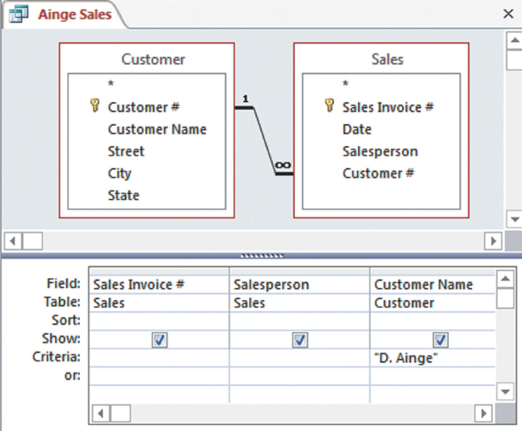
4-16
Creating the Query
4-15

Slide 15
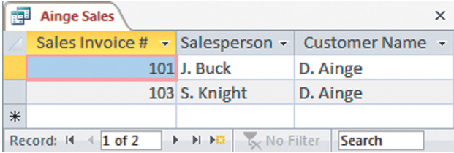
Query Answer
4-16

Slide 16
Key Terms
Database
Database management system (DBMS)
Database system
Database administrator (DBA)
Data warehouse
Business intelligence
Online analytical processing (OLAP)
Data mining
Record layout
Logical view
Physical view
Schema
Conceptual-level schema
External-level schema
Subschema
Internal-level schema
Data dictionary
Data definition language (DDL)
Data manipulation language (DML)
Data query language (DQL)
Report writer
Data model
Relational data model
Tuple
Primary key
Foreign key
4-17

Slide 17
Key Terms (continued)
Update anomaly
Insert anomaly
Delete anomaly
Relational database
Entity integrity rule
Referential integrity rule
Normalization
Semantic data modeling
4-18

