Slide 1
Windows Azure: Microsoft’s Cloud Platform
By Shahed Chowdhuri
Notes:
Windows Azure: Microsoft’s Cloud Platform
By Shahed Chowdhuri

Slide 2
Cloud Services: IaaS, PaaS and SaaS
 |  | Host | Build | Consume
 | Packaged Software | IaaS: infrastructure as a service | PaaS: Platform as a service | Saas: software as a service
Applications | Self- Managed | Self- Managed | Self- Managed | Managed By Vendor
Data
Runtime |  |  | Managed By Vendor
Middleware
O/S
Virtualization |  | Managed By Vendor
Servers
Storage
Networking
Source: Bret Stateham, Windows Azure evangelist
Notes:
Cloud Services: IaaS, PaaS and SaaS
Packaged Software
IaaS: infrastructure as a service
PaaS: Platform as a service
Saas: software as a service

Slide 3
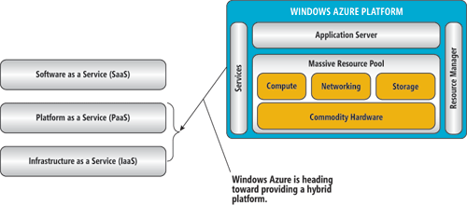
Azure as a PaaS and IaaS
Source: MSDN Magazine, http://msdn.microsoft.com/en-us/magazine/ee309870.aspx
Notes:
Azure as a PaaS and IaaS
Enables any developer to build SaaS solutions

Slide 4
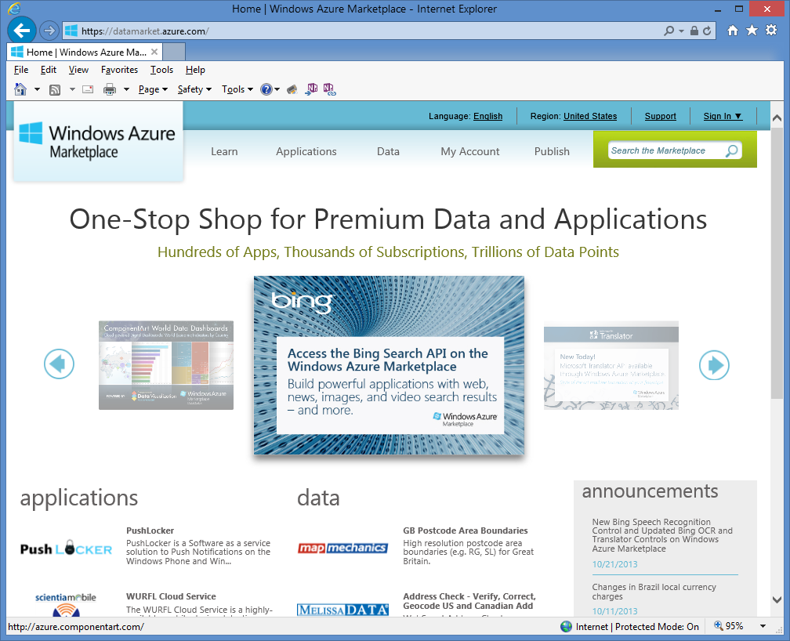
Azure Marketplace
http://datamarket.azure.com
Notes:
Azure Marketplace, for SaaS offerings
http://datamarket.azure.com

Slide 5

In Line with Microsoft’s Vision
“… mobile first, cloud first… ”
Microsoft CEO Satya Nadella
Notes:
In Line with Microsoft’s Vision
Microsoft CEO Satya Nadella:
“… mobile first, cloud first… ”

Slide 6


Things To Know
Use Microsoft environments or Linux servers
High availability (99.95% SLA)
Affordable
Pay only for what you use
Use your MSDN membership
BizSpark for Startups
Academic Benefits
Free trial available
Notes:
Things To Know
Use Microsoft environments or Linux servers
High availability (99.95% SLA)
Affordable
Pay only for what you use
Use your MSDN membership
BizSpark for Startups
Academic Benefits
Free trial available

Slide 7
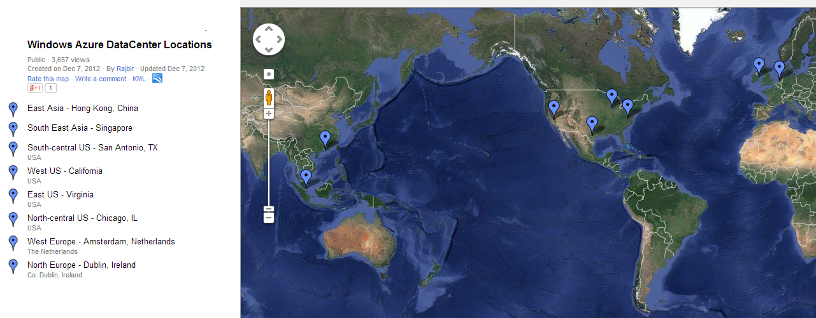
Data Centers Worldwide
Source: Google Maps, http://goo.gl/maps/dGtgJ
Notes:
Data Centers Worldwide
East Asia - Hong Kong, China
South East Asia - Singapore
South-central US - San Antonio, TX
West US - California
East US - Virginia
North-central US - Chicago, IL
West Europe - Amsterdam, Netherlands
North Europe - Dublin, Ireland

Slide 8
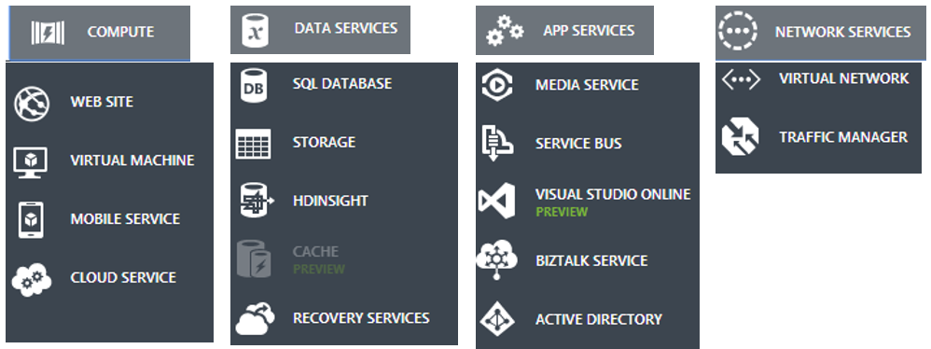
Azure offerings
Source: http://www.windowsazure.com/
Notes:
Azure offerings
Compute
Data Services
App Services
Network Services
Source: http://www.windowsazure.com/

Slide 9
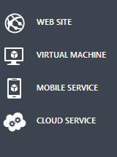
Compute
Build a new site, or publish an existing site
Create a VM, access from anywhere
Data storage, user authentication, push notifications for multiplatform mobile apps
Build, deploy and manage apps in the cloud, with web/worker roles
Notes:
Compute
Build a new site, or publish an existing site
Create a VM, access from anywhere
Data storage, user authentication, push notifications for multiplatform mobile apps
Build, deploy and manage apps in the cloud, with web/worker roles

Slide 10
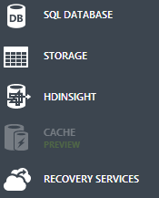
Data Services
Host a SQL database on Azure
Store non-relational data (e.g. Blobs, Tables, Queues)
Analyze “Big Data” with Azure’s Apache Hadooop-based service
In-memory, scalable, managed cache service for responsive applications
Replication and recovery of VMs and services via Hyper-V Recovery Manager
Notes:
Data Services
Host a SQL database on Azure
Store non-relational data (e.g. Blobs, Tables, Queues)
Analyze “Big Data” with Azure’s Apache Hadooop-based service
In-memory, scalable, managed cache service for responsive applications
Replication and recovery of VMs and services via Hyper-V Recovery Manager

Slide 11
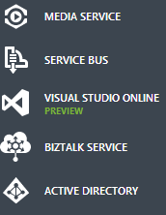
App Services
Cloud-based media services for media content and streaming
For messaging services between applications
For hosting code, planning/tracking projects, team collaboration
Integration service for B2B and EnterpriCloud-based se Application Integration (EAI) capabilities
Identity and Access Management
Notes:
App Services
Cloud-based media services for media content and streaming
For messaging services between applications
For hosting code, planning/tracking projects, team collaborationintegration service for B2B and EnterpriCloud-based se Application Integration (EAI) capabilities
Integration service for B2B and EnterpriCloud-based se Application Integration (EAI) capabilities
Identity and Access Management

Slide 12

Network Services
VPNs within Windows Azure, linked with on-premises IT infrastructure
Load-balance incoming traffic across hosted services within Azure, across datacenters
Notes:
Network Services
VPNs within Windows Azure, linked with on-premises IT infrastructure
Load-balance incoming traffic across hosted services within Azure, across datacenters

Slide 13
Tools for Developers
Web Matrix
Visual Studio
Online UI
Notes:
Tools for Developers
Web Matrix
Visual Studio
Online UI

Slide 14
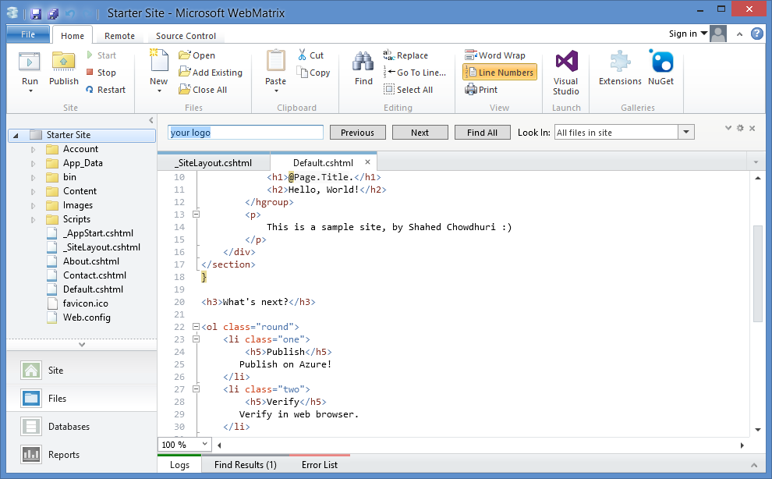
WebMatrix
Create a new ASP.NET website, publish with 1 click
Notes:
WebMatrix
Create a new ASP.NET website, publish with 1 click

Slide 15
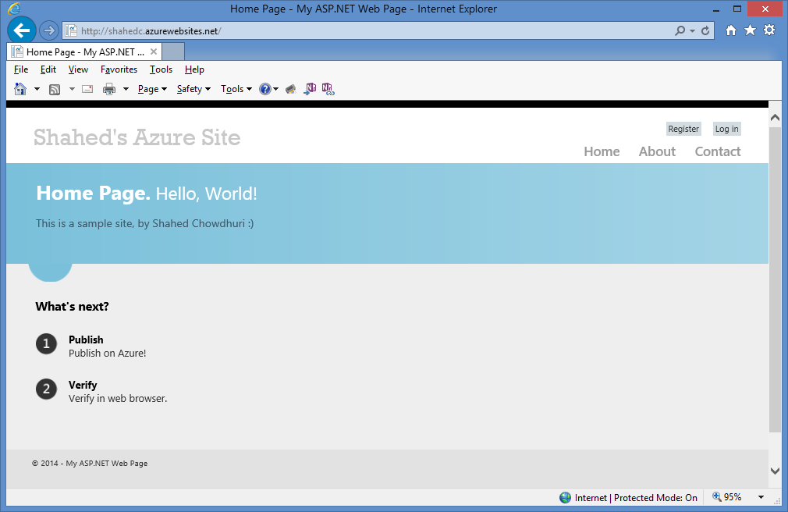
Sample Site
Sample Site URL: http://shahedc.azurewebsites.net/
Notes:
Sample Site
Sample Site URL: http://shahedc.azurewebsites.net/

Slide 16
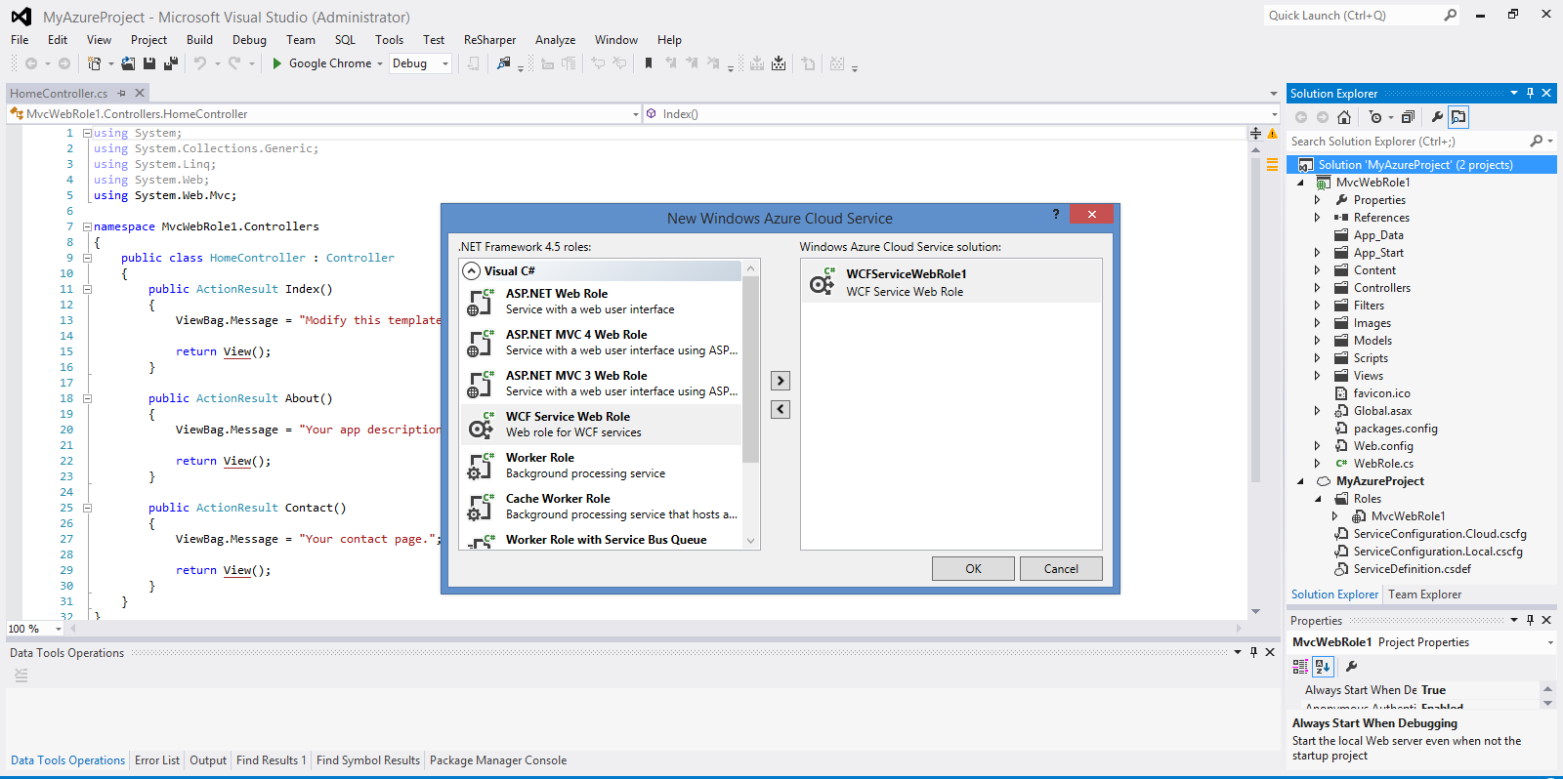
Visual Studio
Azure projects from within Visual Studio
Notes:
Visual Studio
Azure projects from within Visual Studio

Slide 17
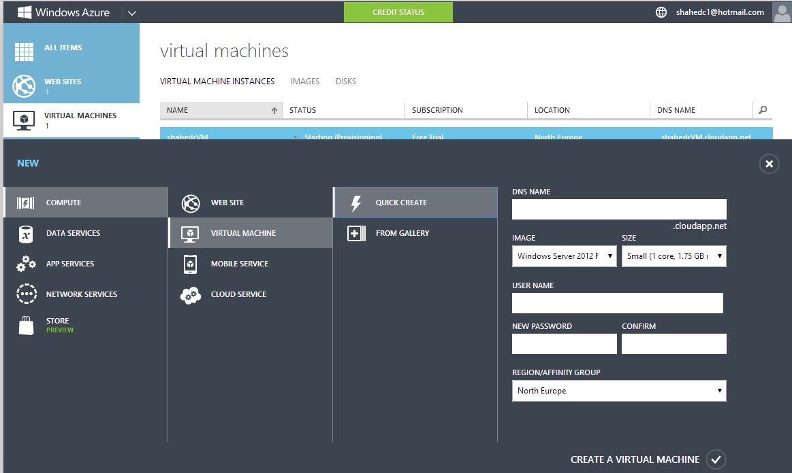
Virtual Machine: Setup
Create VM online in Windows Azure account…
Notes:
Virtual Machine: Setup
Create VM online in Windows Azure account…

Slide 18
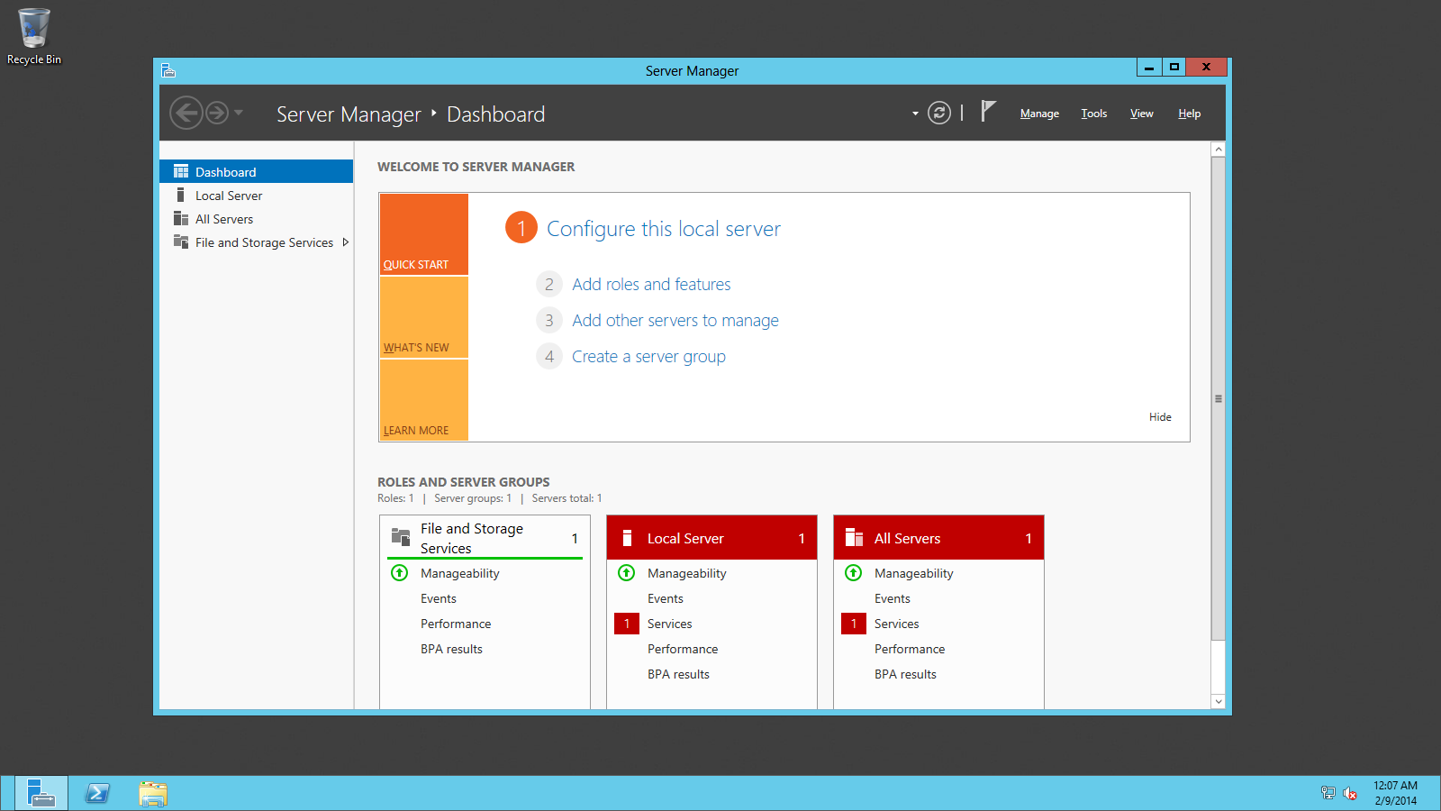
Virtual Machine: Access
… access remotely, via Remote Desktop
Notes:
Virtual Machine: Access
… access remotely, via Remote Desktop

Slide 19

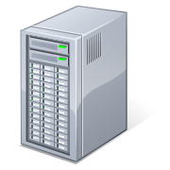
From Full Control VMs to Full Web Apps
Virtual Machines
Cloud Services
Web Sites
Notes:
From Full Control VMs to Full Web Apps
Virtual Machines -- Cloud Services -- Web Sites

Slide 20
More Information
Azure website: http://www.windowsazure.com/
Pricing Info: http://www.windowsazure.com/en-us/pricing/overview/
Contact: shahedc1@hotmail.com
Twitter: @shahedC
Blog: http://WakeUpAndCode.com
Notes:
More Information
Azure website: http://www.windowsazure.com/
Pricing Info: http://www.windowsazure.com/en-us/pricing/overview/
Contact: shahedc1@hotmail.com
Twitter: @shahedC
Blog: http://WakeUpAndCode.com

Slide 21
Questions?
Notes:
Questions?

