Slide 1


Department of Computer Science and Engineering
CS191P11 –IOT
BLIND WALK-AN IOT BASED
SMART DEVICES
JANANI V -210701087 JANANI A-210701085

Slide 2
ABSTRACT
Eyesight is a precious gift, but millions worldwide lack it. In India, 40 million are blind, 1.6 million of whom are children. To aid them, IoT-based Smart Shoe Systems for the Blind and Smart Specs for Visually Impaired have been developed. These devices, using ultrasonic sensors and offer long-term mobility solutions. Embedded with sensors, arduino, and buzzers, they detect obstacles Arduino UNO board, leverage IoT to empower the visually impaired.Smart Shoe Systems and alert wearers with auditory cues, promoting independent navigation. Similarly, Smart Specs enhance perception and navigation. Equipped with sensors and intelligent algorithms, they provide real-time audio or tactile feedback, aiding individuals with low vision in navigating various environments.Globally, an estimated 285 million people suffer from visual impairment, with 39 million being blind and 246 million experiencing low vision. By using new technologies like smart shoes and glasses connected to the internet, we can make the world more inclusive. These inventions help people who can't see well to move around better and feel more independent. They also help everyone feel like they belong and have the power to do things on their own.

Slide 3
Introduction
Smart Shoe Systems, equipped with sensors and auditory alerts, offer long-term mobility solutions, enabling users to detect obstacles and navigate surroundings with newfound confidence. Similarly, Smart Specs utilize intelligent algorithms and sensory feedback to enhance perception and facilitate seamless navigation for those with low vision.
Globally, an estimated 285 million people grapple with visual impairment, with 39 million classified as blind and 246 million experiencing low vision. By harnessing the potential of IoT-connected innovations like smart shoes and glasses, we embark on a journey towards a more inclusive world. These inventions not only improve mobility for individuals with visual impairments but also foster a sense of independence and belonging within society. They symbolize progress, breaking down barriers, and affirming the fundamental right of every individual to navigate the world with dignity and autonomy.

Slide 4
Problem Statement
The goal is to develop a novel assistive device that empowers individuals with visual impairments to navigate their surroundings independently, thereby enhancing their quality of life and fostering greater inclusion in society.

Slide 5
Proposed Work
The BLIND WALK includes two devices one is smart shoe and other one is the smart spectacle. It aims at detecting obstacles and provides auditory alerts through embedded buzzers . These empower the users to navigate their surroundings independently and safely. By providing realtime audio or tactile feedback, they assist users in navigating diverse environments with confidence and ease. By harnessing the power of the internet and cutting-edge technologies, such as smart shoes and glasses, we can create a more inclusive world.
The proposed sytstems empower users that is visually impared people to navigate their surroundings independently enhancing their sense of freedom and autonomy.

Slide 6
Implementation
Navigating environments without adequate visual cues can pose significant safety risks . By detecting the oresence of objects using these devices may help avoid accidents and navigate safely.
Accessing information about ones's surrounding is crucial for individuals with visual impairments to make informed decisions and navigate effectively.
This model reduces the reluctance of visually impared people by not socializing them. It may boost user's confidence by providing reliable navigation support and promote self reliance.
With millions of individuals worldwide experiencing visual impairment, there is a pressing need for innovative solutions that can scale and address diverse needs.

Slide 7
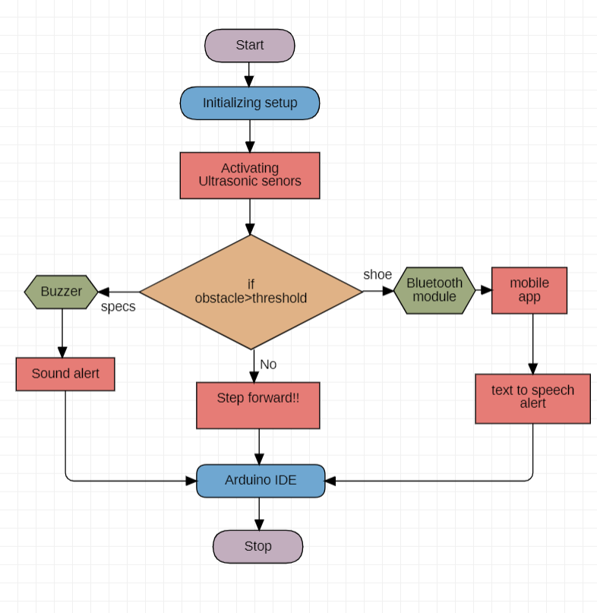
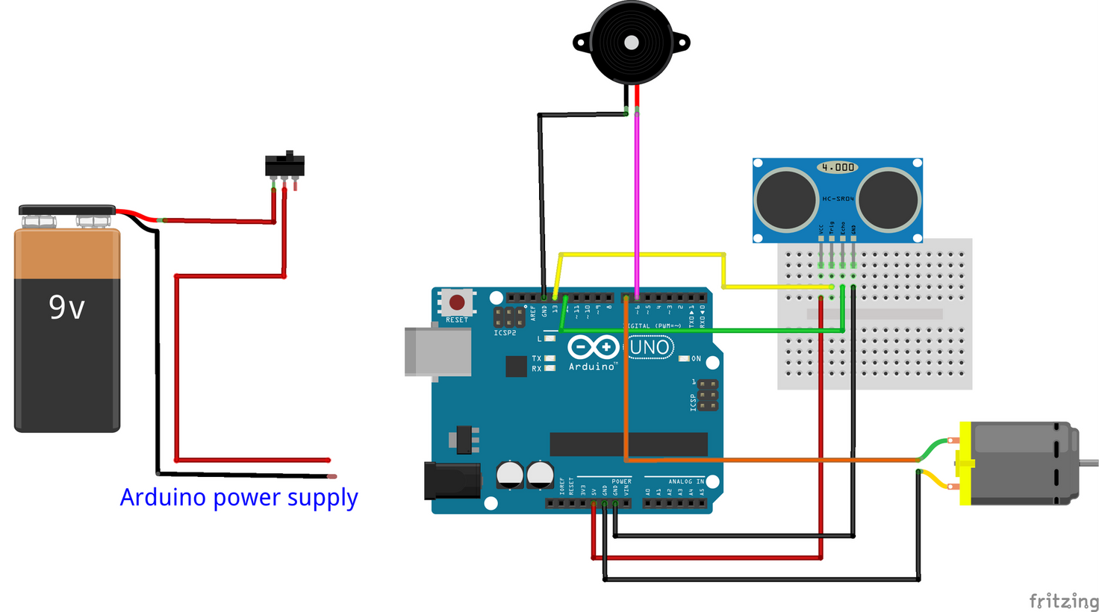
Architecture

Slide 8
System requirements
Arduino UNO software
Ultrasonic sensors
Switches
Buzzer
Bluetooth
Jumper wired

Slide 9
Advantages of the proposed system
Enables blind individuals to move without assistance.
Detects obstacles in real-time, preventing accidents.
Encourages exploration and boosts self-esteem.
Arduino platforms make devices accessible to all
Cost-effectiveness

Slide 10
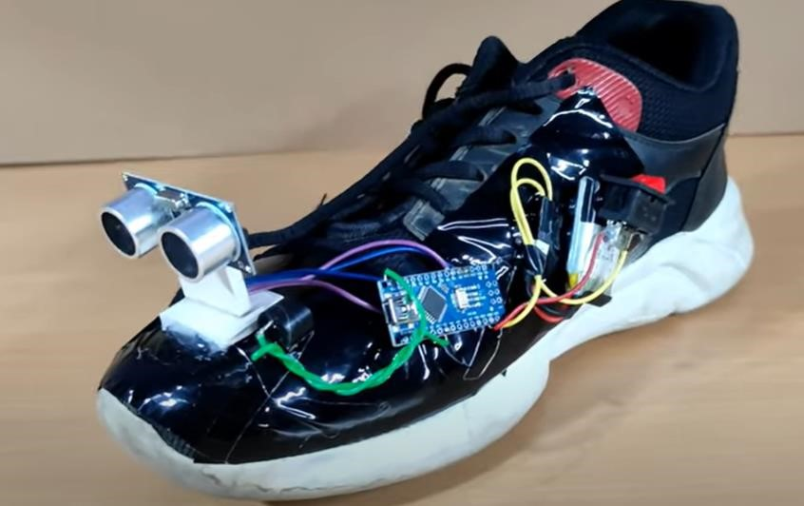
Smart Shoe

Slide 11
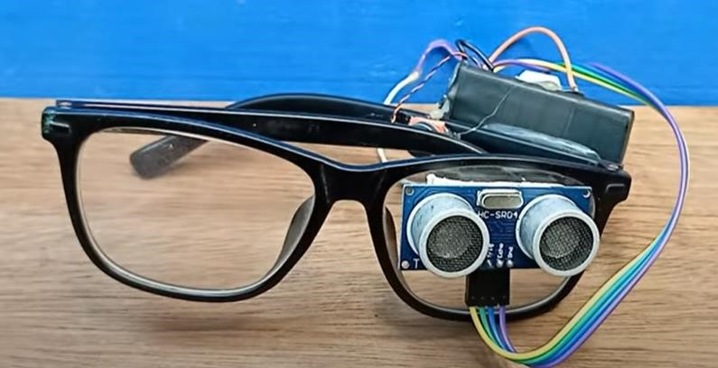
Smart Specs

Slide 12
Implementation of shoe
The ultrasonic sensor is placed on the front of the shoe and sends out sound waves that bounce back when they hit an obstacle.
The sensor then calculates the time it takes for the sound waves to return to the shoe and determines the distance to the obstacle.
This distance information is transmitted to an Arduino Uno microcontroller.
The Arduino Uno interprets the data and activates the buzzer accordingly.

Slide 13
Implementation of shoe
The shoe can talk to a smartphone app using Bluetooth technology. It's like a wireless connection that allows the shoe to share information with the app on the user's phone.
The user's phone has a special app that works together with the smart shoe. When the shoe detects an obstacle, it sends a message to the app..
The app receives the message from the shoe and can play a voice message to the user, describing what the obstacle is and where it's located.

Slide 14
Conclusion
we have proposed a system for detecting obstacles in the way of a blind or a visually impaired person, that helps them navigate independently, and alerts them through a buzzer. Also, it helps the guardian(s) to keep track of the user. We have included all the objectives we would like to use and their expected results. Possible future work is to add new available techniques to the review process, which may include edge sensitivity, Voice alerts, Object identification using AI. Regular weather forecasts can be generated in time to alert users to rain and storms in advance. The product can be used more widely by using artificial intelligence and image processing, which can help detect obstacles more accurately.

Slide 15
References
[1] Feng Lan, Guangtao Zhai, Wei Lin “Lightweight smart glass system with audio aid for visually impaired people” ,IEEE conference, 2016.
[2] Tan, Bo; Woodbridge, Karl; Chetty, Kevin "A real-time high resolution passive WiFi Doppler-radar and its applications", Radar Conference
(Radar), 2014 International, On page(s): 1 - 6
[3] Brunner, Eberhard, “Ultrasound System Considerations and their Impact on Front-End Components,” Analog Devices, Inc., 2002,
[4]A. Gopi *, M. Kameswara Rao , Survey of privacy and security issues in IoT, International Journal of Engineering & Technology, 7 (2.7) (2018) 293-296

Slide 16
Thank You

