Slide 1

GROCERY DELIVERY
WEBSITE

Slide 2
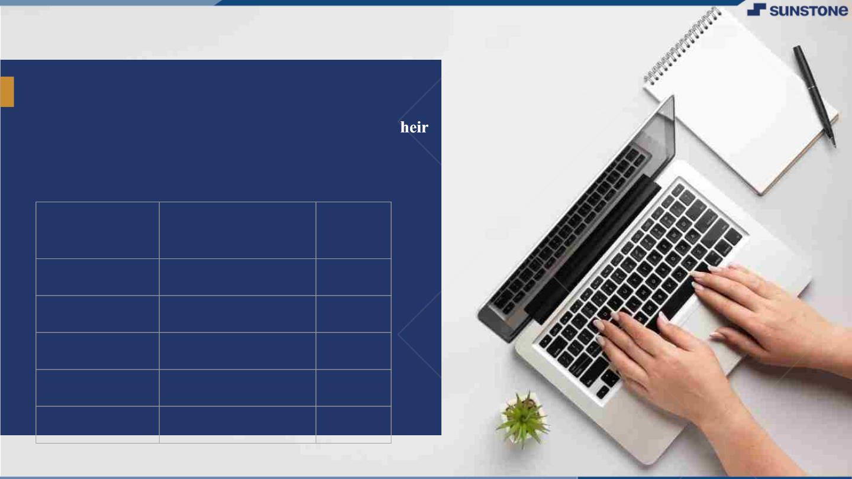
GROCERY DELIVERY WEBSITE
▪ A grocery delivery service is a platform through
which groceries can be delivered to customers at t
homes or a central pickup location. With grocery
delivery services, you can place orders and make
payments for various items online.
LMS
Name
Batch
Username
2115a917
2115a923
2115a926
2115a927
DHARANI.R
HARINI.B
JANANI.G
JANANI.G
A9
A9
A9
A9

Slide 3

Main.html
<?xml version="1.0"encoding="utf-8"?>
<!DOCTYPE html PUBLIC"-//W3C//DTD XHTML 1.0 frameset//EN"
"http://www.w3.org/1999/xhtml">
<frameset rows="20%,80%">
<frame src="logo.html">
<frameset cols="30%,70%">
<frame src="menu.html">
<frame src="contents.html">
</frameset>
</frameset>
</html>

Slide 4

MENU.HTML
<html>
<head>
<title>
MENU
</title>
</head>
<body bgcolor=“skyblue”>
<center>
<nav>
<ul>
<h2><a href=“Login.html”/>Login</h2>
<h2><a href=“Fruit.html”/>Fruit</h2>
<h2><a href=“Vegetable.html”/>Vegetable</h2>
<h2><a href=“Daily Essential.html”/>Daily Essential</h2>
<h2><a href=“Fish & Meat.html”/>Fish & Meat</h2>
<h2><a href=“Home Care.html”/>Home Care</h2>
<h2><a href=“Packaged Food.html”/>Packaged Food</h2>
</ul>
</nav>
</center>
</body>
</html>

Slide 5
CONTENTS.HTML
<html>
<head>
<title>
content
</title>
</head>
<body>
<h3><img src="grocery.jpg"/>delivery</h3>
</body>
</html>

Slide 6
LOGO.HTML
<html>
<head>
<title>
LOGO
</title>
</head>
<body bgcolor="yellow">
<center>
<h1> HDJ GROCERY DELIVERY SERVICE</h1>
<h3>why cant't the groceries travel to you</h3>
</center>
</body>
</html>

Slide 7
LOGIN.HTML
<html>
<head>
<meta name="viewport" content="width=device-width, initial-scale=1">
<title> Login Page </title>
<style>
Body {
font-family: Calibri, Helvetica, sans-serif;
background-color: pink;
} button {
background-color: #4CAF50;
width: 100%;
color: orange;
padding: 15px;
margin: 10px 0px;
border: none;
cursor: pointer;
}

Slide 8
form {
border: 3px solid #f1f1f1;
}
input[type=text], input[type=password] {
width: 100%;
margin: 8px 0;
padding: 12px 20px;
display: inline-block;
border: 2px solid green;
box-sizing: border-box;
}
button:hover {
opacity: 0.7;
}
.cancelbtn {
width: auto;
padding: 10px 18px;
margin: 10px 5px;
} .container {
padding: 25px;
background-color: lightblue;

Slide 9
}
</style>
</head>
<body>
<center> <h1> Student Login Form </h1> </center>
<form>
<div class="container">
<label>Username : </label>
<input type="text" placeholder="Enter Username" name="username" required>
<label>Password : </label>
<input type="password" placeholder="Enter Password" name="password" required>
<button type="submit">Login</button>
<input type="checkbox" checked="checked"> Remember me
<button type="button" class="cancelbtn"> Cancel</button>
Forgot <a href="#"> password? </a>
</div>
</form>
</body>
</html>

Slide 10
FRUITS.HTML
<html>
<head>
<title>GROCERY WEBSITE</title> I
</head>
<body bgcolor="white">
<h2>APPLE</h2>
<img src="https://st3.depositphotos.com/29384342/34076/i/600/depositphotos_340760842-stock-photo
-apple-isolated-white-background.jpg" alt="apple"/>
<h2>BANANA</h2>
<img src="https://media.istockphoto.com/id/1400057530/photo/bananas-
isolated.jpg?b=1&s=170667a&w=0&k=20&c=uiSdjIQkTr7S4gEdW_oB_5zfFYhpfe0LP-CryQl49w4="
alt="banana"/>
<h2>GRAPES</h2>
<img src="https://cdn.pixabay.com/photo/2017/08/18/19/48/grapes-2656259__480.jpg" alt="grapes"/>
</body>
</html>

Slide 11
VEGETABLE.HTML
<html>
<head>
<title>VEGETABLES</title>
</head>
<body>
<h2>TOMATO</h2>
<img src="tomato.jpg"/>
<h2>CARROT</h2>
<img src="carrot.jpg"/>
<h2>CAULIFLOWER</h2>
<img src="cau.jpg"/>
</body>
</html>

Slide 12
DAILY ESSENTIAL.HTML
<html>
<head><title>GROCERY WEBSITE</title></head>
<body bgcolor="white">
<h2>MILK<h2>
<img
src="https://images.hindustantimes.com/rf/image_size_630x354/HT/p2/2018/09/20/Pictures/_61433f0c-
bcb9-11e8-95ec-91800d079bb4.jpg"alt="milk"/>
<h2>CURD<h2>
<img src="https://vrindavan.farm/images/portfolio/a1-curd-bg.jpg"alt="curd"/>
<h2>BUTTER<h2>
<img src="https://encrypted-
tbn0.gstatic.com/images?q=tbn:ANd9GcQV8iAombS59_ZjFqgFI1jr5w6sW45qJE7YmA&usqp=CAU"alt="
butter"/>
<h2>GHEE<h2>
<img src="https://www.bigbasket.com/media/uploads/p/xxl/20005456_4-organic-india-desi-
ghee.jpg"alt="ghee"/>
</body></html>

Slide 13
FISH & MEAT.HTML
<html>
<head>
<title>fish and meat</title>
</head>
<body bgcolor="white">
<h2>FISH</h2>
<img src="https://encrypted-
tbn0.gstatic.com/images?q=tbn:ANd9GcSRUIvcfEsTL_nn5DJiCAfJ6-
8UwEhhXMH9cQ&usqp=CAU" alt="fish">
<h2>MEAT</h2>
<img src="meat.jpg"/>
<h2>EGG</h2>
<img src="egg.jpg"/>
</body>
</html>

Slide 14
HOMECARE.HTML
<html>
<head>
<title>HOME CARE</title>
</head>
<body bgcolor="white">
<h2>BRUSH<h2>
<img src="https://m.media-amazon.com/images/W/IMAGERENDERING_521856-
T1/images/I/51hTIwQNGyL._SL1200_.jpg"alt="brush">
<h2>DETERGENT<h2>
<img src="https://5.imimg.com/data5/XC/XB/MY-8261133/4-1000x1000.png"alt="detergent">
<h2>SOAP<h2>
<img src="https://www.littlesoapcompany.co.uk/wp-
content/uploads/2021/02/Avo_Lifestyle.jpg"alt="soap"
<h2>CLEANER<h2>
<img src="https://www.bigbasket.com/media/uploads/p/xxl/40206006-2_2-bb-home-disinfectant-floor-
surface-cleaner-floral-kills-999-germs.jpg"alt="cleaner"/>
</body></html>

Slide 15
PACKAGED FOODS.HTML
<html>
<head>
<title>PACKAGED FOODS</title>
</head>
<body bgcolor=“white”>
<h2>PICKLED VEGGIES</h2>
<img src=“Pickled.jpg”alt=“pickle”/>
<h2>CHIPS</h2>
<img src=“chips.jpg”alt=“chips”/>
<h2>OATS</h2>
<img src=“oats.jpg”alt=“oats”/>
</body>
</html>

Slide 16
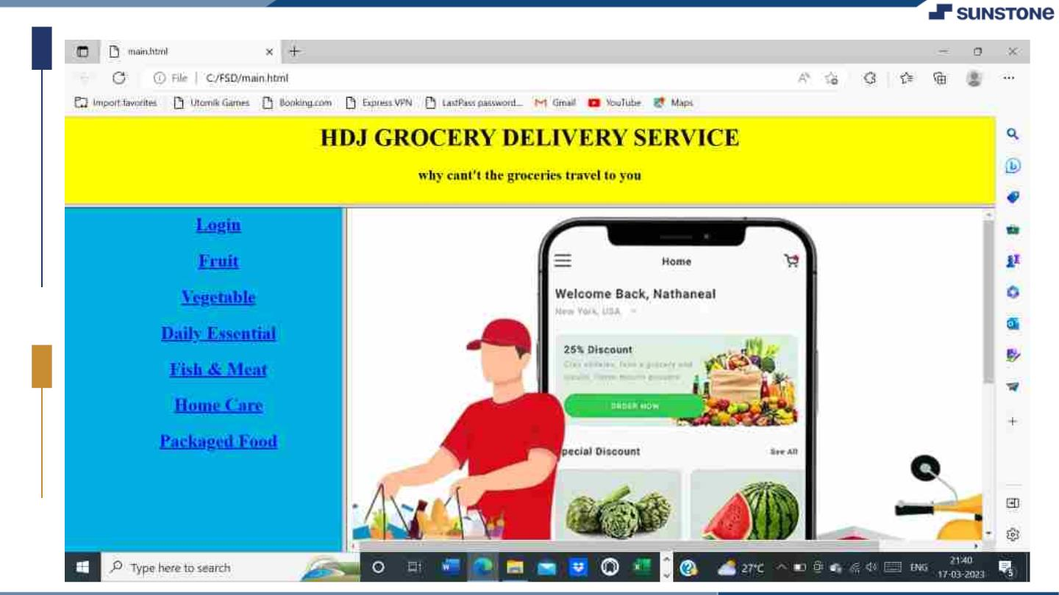

Slide 17

Submission Github
https://github.com/DHARU301/grocer
ywebsite.git

Slide 18


