Slide 1
YouTube Content Analysis
Demo on Oct-21-2020

Slide 2
Input – Youtube Link
Youtube Key is extracted from link using regex
Extracting View Count, Video Rating, Video length, Video author using Pytube Package
Downloading Youtube Video from Youtube link – Store in Directory
yt.streams.filter(progressive=True, file_extension='mp4’)
Video file (.mp4) to Audio Conversion (.wav)

Slide 3
Creating Speech resource Group – Extracting Hidden Subscription key and service key
In Custom studio for speech to text, 215mins of (audio+ transcript )Training data is given
Custom speech model is built as Hybrid model (latest base line model + model trained with 215 mins)
After training the model Inspect Word Error Rate.
In different permutations each trained model will be tested with sample test audio file. Model with error rate < 10 will be deployed. Endpoint will be generated
Continuous recognition will be defined with configuration (Sampling rate of 16hz, Channel of Mono, Encoding bit size of 16pcm)
Custom model will be called inside the Continuous Speech Recognition for getting text output
Text will be passed into Custom Spacy Model
Ingredient Entity will be extracted and placed in Ingredient column
Data is updated in DB and Power BI

Slide 4
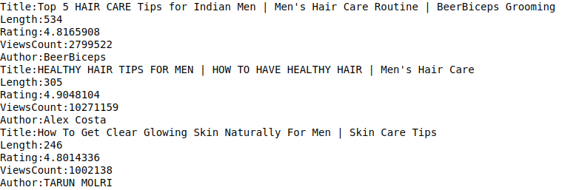
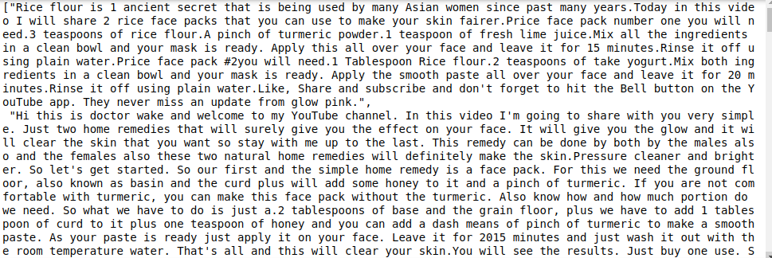
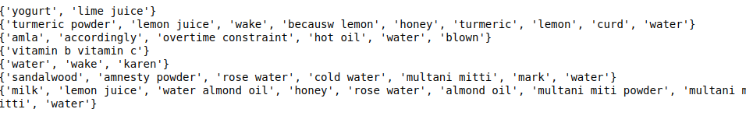
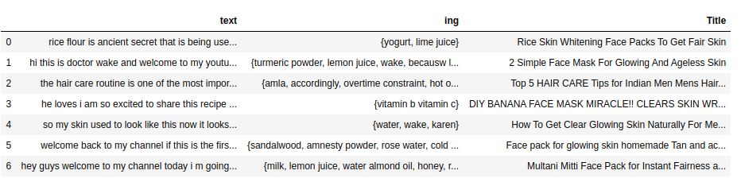
Output
Extracting required attributes of
YouTube for analytics
Custom Speech Model
Custom Spacy Model
Text + Ingredient + Title

Slide 5
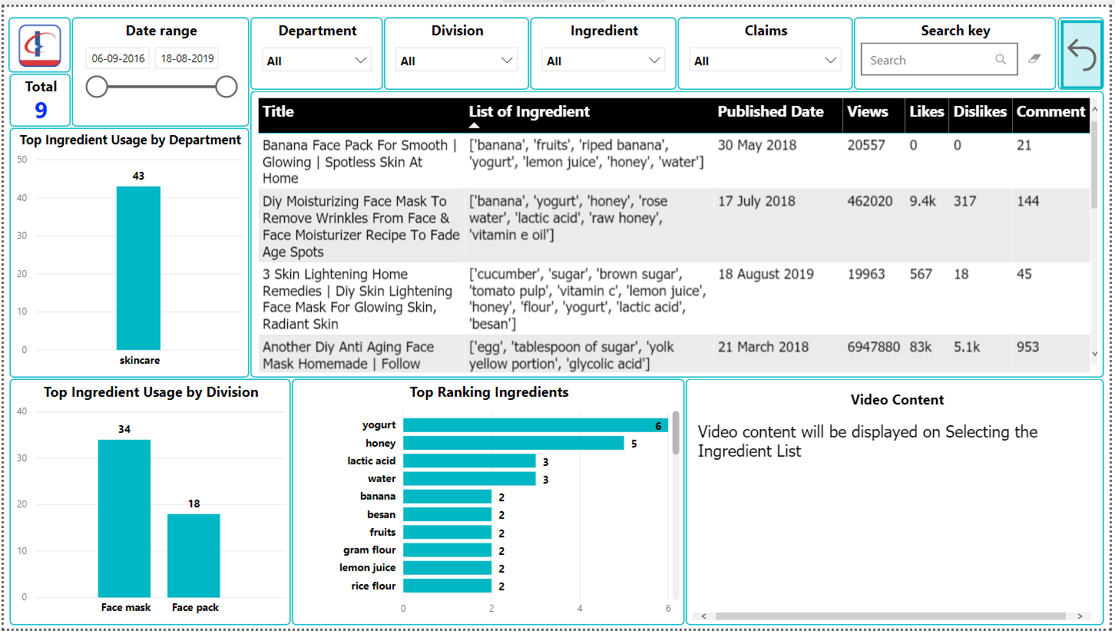
Expected PowerBi Dashboard

Slide 6
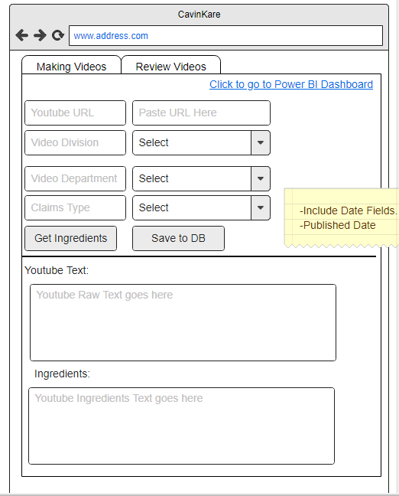
WireFraming for WebApp

