Slide 1
Sprint Nine
Team 10
Amardeep Singh
Ameer Mushani
Janani Raguram
Mohammad Kanth
Natalie Ykema
Nitin Sharma
CIS*4250

Slide 2
Summary of Accomplishments
Made existing games more responsive for other platforms
Created a ranking system for Buzz Words
Hard mode for Buzz Words
Sprint 9
2024

Slide 3
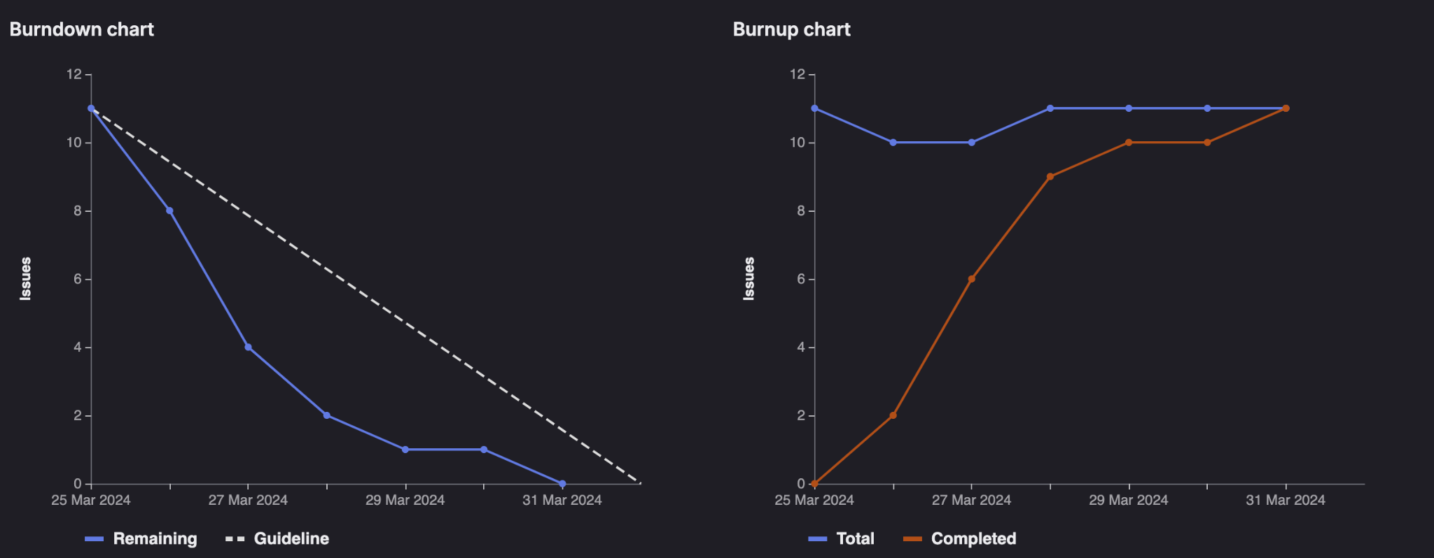
Burn Down/Up Chart
Sprint 9
2024

Slide 4
Ameer Mushani
New scoring for Buzz Words
Hard mode difficulty for Buzz Words
Time 6 Hours | Weight 12
Sprint 9
2024

Slide 5
Amardeep Singh
Unable to contribute
Sprint 9
2024

Slide 6
Janani Raguram
Update leaderboard UI
Update UI for better responsiveness
Update documentation
Update UI for new Buzz Words point system
Time 6 Hours | Weight 12
Sprint 9
2024

Slide 7
Mohammad Kanth
Updated UI for the Leaderboard page
Created a ranking system for the Buzzwords (spelling bee) game
Time 6 Hours | Weight 12
Sprint 9
2024

Slide 8
Natalie Ykema
Word search categories
Update UI for better responsiveness
Time 6 Hours | Weight 12
Sprint 9
2024

Slide 9
Nitin Sharma
Unable to contribute
Sprint 9
2024

Slide 10
What Went Well
Tasks were completed quick & efficiently
Good communication from team members during the final sprint
Sprint 9
2024

Slide 11
What Didn’t Go Well
Solely making modifications to old games was harder to create tasks for
Sprint 9
2024

Slide 12
Demo
Sprint 9
2024

Slide 13
Code Review
Sprint 9
2024

