Slide 1
Sprint #9
Team 102

Slide 2
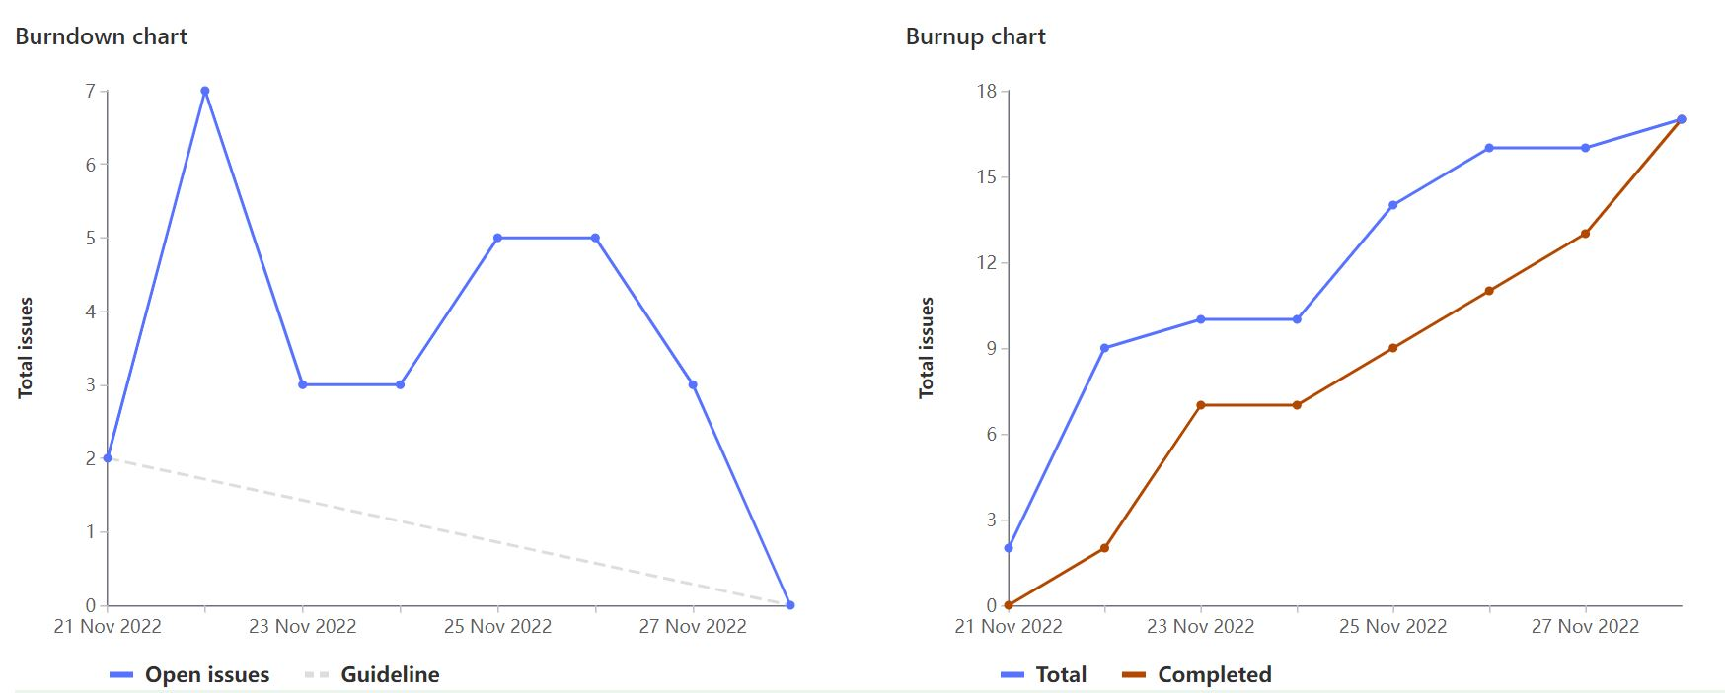
Burndown and Burnup Charts

Slide 3
What went well
All group members generated and discusses ideas to create a plan for Sprint 9
Tasks were evenly split up between group members to allow for group and individual work.
All group members actively participated in group communication channels

Slide 4
What we have improved on over the semester
Git issues
Creating and closing them on time
Creating more specific and less general issues
Assigning them early on

Slide 5
Tamara Alilovic
Code:
Implemented Fall & Winter tab calendars
Testing and error checking
Weight: 20
Hrs: 10

Slide 6
Ritchie Dimaria
Code
Integrated Sprint 9 code with the Google Compute Engine VM
Added some flair and toggle button
Testing / Error proofing
Weight: 20
Hrs: 10

Slide 7
Kurtis Hoover
Code
Fixed lecture days off functionality
Added option for lab and seminar days off
Testing
Weight: 20
Hrs: 10

Slide 8
Janani Raguram
Code
Fixing bugs for conflicting days
Website UI
Download functionality
Weight: 20
Hrs: 10

Slide 9
Megan Tibbles
Team Lead Tasks
Create presentation
Code
Add lecture and lab days off
Fix bugs
Days off, course not found
Weight: 20
Hours: 10

Slide 10
Natalie Ykema
Code
Download functionality
Testing
Documentation
Update Wiki
Weight: 20
Hrs: 10

Slide 11
User Stories
As a student, I want to search for a course and add it to my schedule, so I can see the times and days my classes are.
As a student, I want to be able to remove courses from the list of courses I chose, so I can get rid of courses I no longer want to take.
As a student, I want to see the course offerings for different semesters so I can plan ahead for the next semester.
As a student, I want to be able to filter lecture and lab days so I can choose classes for only the days I want to have classes.
As a student, I want to download my schedule so I can view it offline.

Slide 12
Live Demo

