Slide 1





SHREE DEVI INSTITUTE OF TECHNOLOGY
(ACCREDITED BY NAAC)
(AFFILIATED TO VISVESVARAYA TECHNOLOGICAL UNIVERSITY & RECOGNIZED BY AICTE)
KENJAR,MANGALURU - 574142
Team Name: Tech Legends
College Name: Canara Engineering College, Mangaluru, Karnataka.
Track: Smart Mobility & Traffic Intelligence.
Team members: Janani N
Jeevitha
Jeevitha
G K Deeksha

Slide 2

Existing solutions:
Proposed solutions:
Google Maps and navigation apps provide traffic updates and route suggestions.
Traffic police use CCTV cameras and monitoring systems to manage traffic.
Citizens report road problems through phone calls, social media and grievance portals.
Existing systems have limited integration between citizen reports, incident verification, traffic analysis and employer travel planning
Develop a web-based platform to report road incidents and traffic congestion.
Use GPS or manual location entry to identify incident locations.
Allow authorities to verify reports and update incident status.
Display incidents on maps and send traffic alerts.
Suggest alternative routes using a routing service.
Provide employer–employee travel dashboards and monthly traffic analytics.

Slide 3
Use Cases:
Report road incidents and view traffic alerts.
Verify reports and track resolution status.
Check road disruptions before travelling to work.
Understand travel delays and recurring disruptions.
Analyze historical incidents and identify problem areas.

Slide 4
Overview of the project :
RoadAlert is a web-based platform for traffic and road-incident management.
It connects citizens, commuters, employers and authorities.
Users can report road incidents and receive location-based traffic alerts.
It provides route information and alternative routes.
Authorities can verify incidents and update their status.
Historical data helps identify recurring road problems and traffic patterns.

Slide 5
Project progress:
Registration and login interfaces created.
Incident reporting form with road-problem categories added.
Manual location entry and device GPS support implemented.
Initial dashboard, verification workflow, and traffic analytics prepared.
Live traffic integration and alternative-route calculation are future tasks.

Slide 6
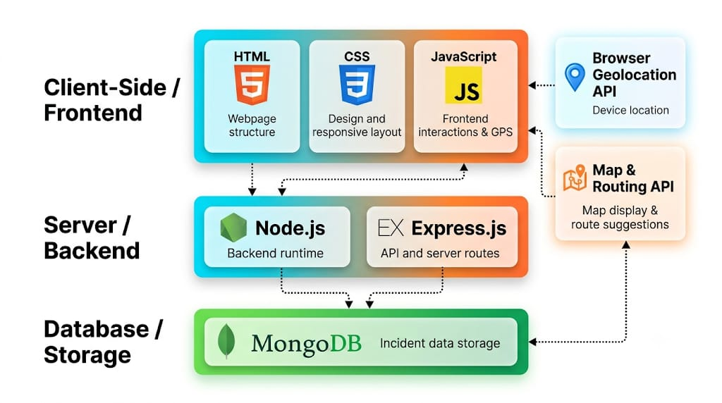
Tech stack:

Slide 7
Future Implementation:
Integrate a live traffic and mapping API.
Implement secure user authentication and role-based access for citizens and authorities.
Add image uploads and stronger incident verification.
Generate alternative routes using real-time traffic and road-closure data.
Send location-based alerts for nearby incidents.
Add recurring hotspot detection using historical incident data.
Generate downloadable monthly reports and trend charts.

