Slide 1
ADVANCED GUI CALCULATOR
USING PYTHON & TKINTER
Presented by:
Janani B
Position:
Data Science Intern
Organization:
Nexthikes IT Solutions
Project:
Advanced GUI Calculator using Tkinter-Python
Tools & Techniques:
Python | Tkinter & ttk | math | statistics | datetime | Matplotlib | Event-driven GUI
Submission Date:
10 November 2026

Slide 2
Project Overview
A single desktop application for everyday calculations and selected analytical tasks.
What it does
Why it was built
User experience
Combines basic arithmetic, scientific calculations, unit conversion, statistics, charts and calculation history.
To make common numeric tasks available in one simple window, without switching between separate tools.
A tab-based layout keeps each task separate and makes the application easy to navigate.
PROJECT GOAL
Bring calculation, conversion and basic data exploration together in one accessible GUI.
02 | 07

Slide 3
Key Features
Basic calculator
Performs addition, subtraction, multiplication and division with parentheses.
Scientific calculator
Supports trigonometry, inverse trigonometry, roots, logarithms, powers, factorials, π and e.
Statistics
Calculates count, sum, mean, median, mode, variance, standard deviation and correlation.
BMI & age
Provides BMI category output and calculates age from a birth date.
Unit conversion
Converts selected values across length, mass and temperature units.
History
Keeps recent entries for 24 hours and lets users reuse a selected result.
03 | 07

Slide 4
Tools & Development Approach
Tools used
How it works
Python — core application logic
Tkinter / ttk — window, buttons, input fields and tabs
math — scientific functions
statistics — descriptive measures
datetime — timestamps and age calculation
Matplotlib — charts embedded in the GUI
1. Enter values or choose a function
2. The application reads and validates the input
3. Python performs the calculation or prepares chart data
4. The result appears in the display, summary, graph or history
Development environment: Visual Studio Code
Interface style: Event-driven desktop GUI
04 | 07

Slide 5
Data Analysis Applications
Selected features support basic exploratory analysis and help users interpret numeric data.
Summarise
Compare
Visualise
Descriptive statistics describe a dataset using central tendency, spread and range.
Correlation estimates the relationship between paired X and Y values.
Line, scatter, bar, step and stem charts make patterns easier to inspect.
ANALYST WORKFLOW
Input data → Calculate measures → Explore relationships → View a chart
05 | 07

Slide 6
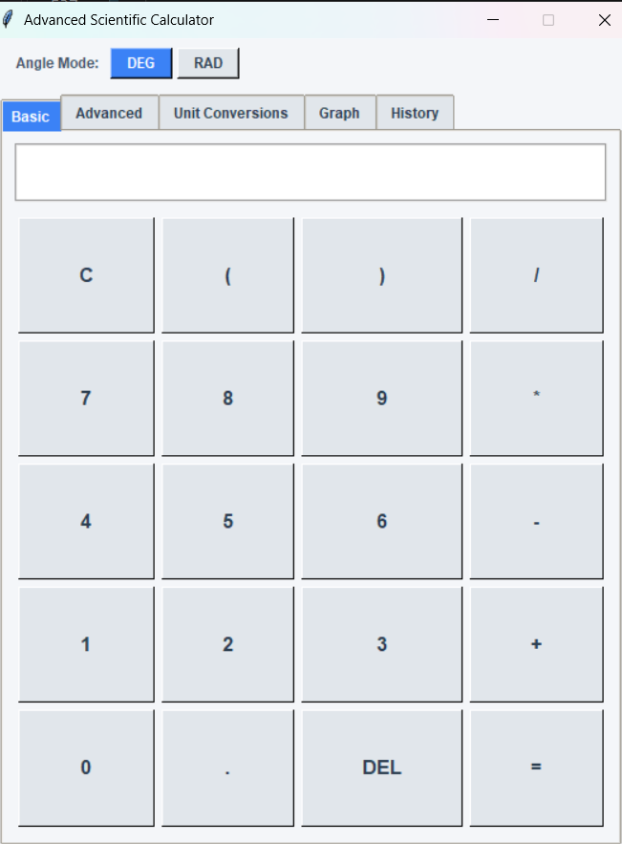
Application Output
Actual screenshot of the calculator interface developed with Tkinter.
VISIBLE IN THIS SCREENSHOT
Angle mode
Switch between degrees and radians.
Expression display
Shows the current calculation input.
Keypad
Provides number keys and arithmetic operators.
Tab navigation
Opens Basic, Advanced, Unit Conversions, Graph and History.
The image is the submitted program output.
06 | 07

Slide 7
THANK YOU
ADVANCED GUI CALCULATOR USING PYTHON & TKINTER
Presented by Janani B
Data Science Intern | Nexthikes IT Solutions

