Slide 1
BIKE SHARING DEMAND ANALYSIS
USING EXCEL
▪
Presented by:
Janani B
▪
Position:
Data Science Intern
▪
Organization:
Nexthikes IT Solutions
▪
Project:
Bike Sharing Demand Data Analysis
▪
Tools & Techniques:
Microsoft Excel | Power Query | PivotTables & Pivot Charts | Dashboard | Descriptive Statistics | Correlation Analysis | Forecasting | Anomaly Detection
▪
Submission Date:
10 October 2026

Slide 2
BIKE SHARING DEMAND ANALYSIS
Presentation roadmap
• 01 Executive summary & business framing
• 02 Dataset structure, preparation and validation
• 03 Demand patterns: time, customer segment and weather
• 04 Descriptive statistics, correlation and pivot-style summaries
• 05 Forecasting, anomaly screening and dashboard design
• 06 Recommendations, limitations and next steps
Analyst lens
Move from data reliability to business interpretation, then translate findings into operating decisions. Every chart is based on the supplied workbook's Final_DataSet sheet.
NEXTHIKES IT SOLUTIONS • DATA SCIENCE INTERN
02 / 24

Slide 3
BIKE SHARING DEMAND ANALYSIS
Executive summary | what the sample says
RECORDS ANALYZED
TOTAL RECORDED RIDES
REGISTERED SHARE
IQR OUTLIER FLAGS
1,000
58,304
91.6%
30
• Coverage spans 01 Jan 2011 to 14 Feb 2011 across 45 distinct dates.
• Average demand is 58.3 rides per recorded hourly row; median is 49.
• Demand is concentrated in morning/evening commute windows; the 17:00 hour has the highest mean.
• Registered riders dominate the recorded mix; weather and temperature show associations, not proof of causality.
NEXTHIKES IT SOLUTIONS • DATA SCIENCE INTERN
03 / 24

Slide 4
BIKE SHARING DEMAND ANALYSIS
Business question & analytical approach
CORE QUESTION
When does demand rise, what conditions align with it, and how can operations plan around that pattern?
Analysis workflow
1 Inspect workbook structure
2 Validate key fields and ride totals
3 Profile time, weather and rider mix
4 Compare simple forecast baselines
5 Flag unusual hourly counts
6 Convert insights into dashboard KPIs
Decision users: fleet operations • customer growth • service planning • reporting
NEXTHIKES IT SOLUTIONS • DATA SCIENCE INTERN
04 / 24

Slide 5
BIKE SHARING DEMAND ANALYSIS
Dataset inventory | scope and fields
• Primary analysis table: Final_DataSet — 1,000 rows and 13 usable columns after excluding empty helper columns.
• Time fields: Date, Hour, Weekday, Holiday; categorical context: Weathersit.
• Environmental inputs: Temp, Assumed_Temp, Humidity, Windspeed.
• Outcome and segment fields: Casual_Customers, Registered_Customers, Total_Count.
• Observed coverage: 45 unique dates; 24 distinct hour values (0–23).
• Workbook also contains raw/cleaned split sheets; this deck uses the consolidated final table for consistent reporting.
Interpretation guardrail
The workbook table is a 1,000-row slice, not a full-year history. Several dates do not contain a complete 24-hour cycle, so daily totals mean “sum of recorded rows” rather than guaranteed full-day demand.
NEXTHIKES IT SOLUTIONS • DATA SCIENCE INTERN
05 / 24

Slide 6
BIKE SHARING DEMAND ANALYSIS
Data quality & validation checks
CORE-FIELD NULLS
DUPLICATE INSTANT IDS
0
0
PASS
PASS
RIDE IDENTITY MISMATCHES
DATE COVERAGE
0
45 dates
PASS
LIMITED WINDOW
Validation rule: Casual_Customers + Registered_Customers = Total_Count for every analyzed row.
Next quality improvement: verify complete day coverage, reconcile weather-category definitions, and retain a documented data dictionary.
NEXTHIKES IT SOLUTIONS • DATA SCIENCE INTERN
06 / 24

Slide 7
BIKE SHARING DEMAND ANALYSIS
KPI framework | consistent definitions
Total rides
SUM(Total_Count)
Volume across included rows
Mean rides / record
AVERAGE(Total_Count)
Average hourly-record demand
Registered share
SUM(Registered) / SUM(Total_Count)
Customer mix / retention proxy
Peak hour
Hour with highest mean Total_Count
Potential fleet deployment window
Weather uplift / penalty
Weather mean vs overall mean
Contextual comparison, not causal
Outlier count
Rows outside 1.5×IQR fences
Investigation queue, not automatic errors
NEXTHIKES IT SOLUTIONS • DATA SCIENCE INTERN
07 / 24

Slide 8
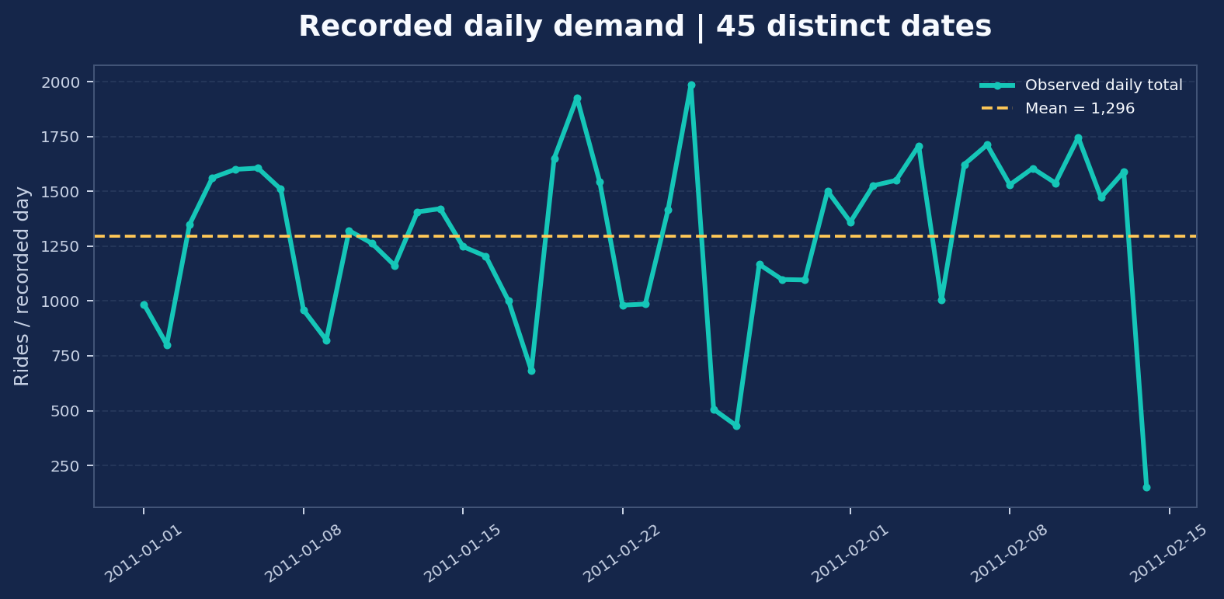
BIKE SHARING DEMAND ANALYSIS
Demand over time | recorded daily totals
Readout
Average recorded daily total: 1,296 rides.
Highest recorded daily total: 1,985 on 25 Jan.
Lowest: 151 on 14 Feb.
Daily values can be understated when fewer hourly rows are present. Compare record counts alongside daily totals.
NEXTHIKES IT SOLUTIONS • DATA SCIENCE INTERN
08 / 24

Slide 9
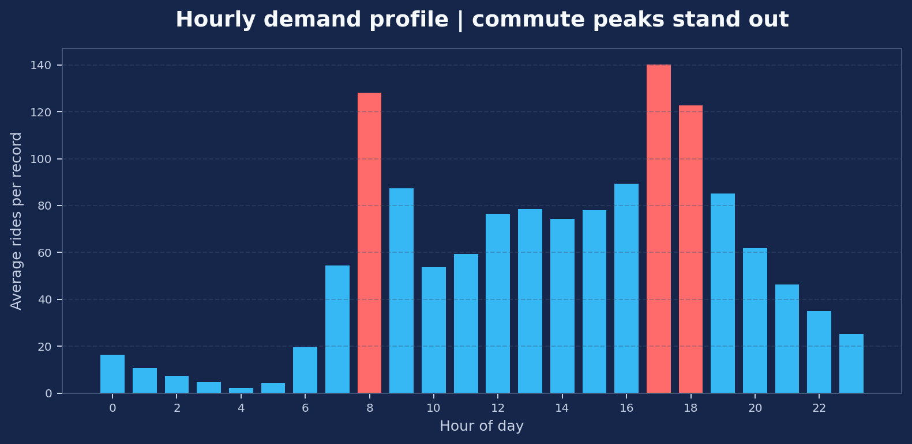
BIKE SHARING DEMAND ANALYSIS
Intraday profile | when demand concentrates
Operational signal
Highest average hour: 17:00 (140.2 rides/record).
Lowest average hour: 04:00 (2.2).
Use time-of-day patterns to stage bikes and schedule rebalancing. Validate across more months before final staffing changes.
NEXTHIKES IT SOLUTIONS • DATA SCIENCE INTERN
09 / 24

Slide 10
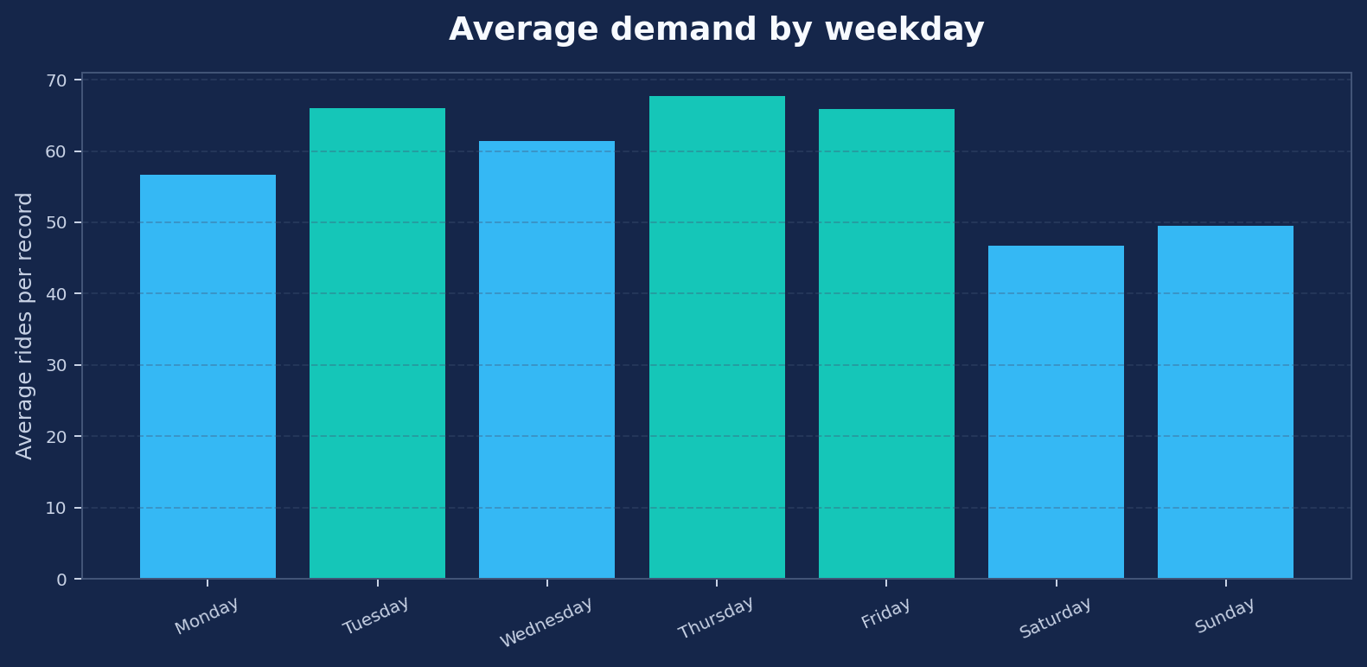
BIKE SHARING DEMAND ANALYSIS
Weekday comparison | demand is not uniform
Key comparison
Highest mean: Thursday (67.7 rides/record).
Lowest mean: Saturday (46.7).
Weekday means help distinguish commute-driven usage from leisure-oriented demand. This sample has uneven row counts by weekday.
NEXTHIKES IT SOLUTIONS • DATA SCIENCE INTERN
10 / 24

Slide 11
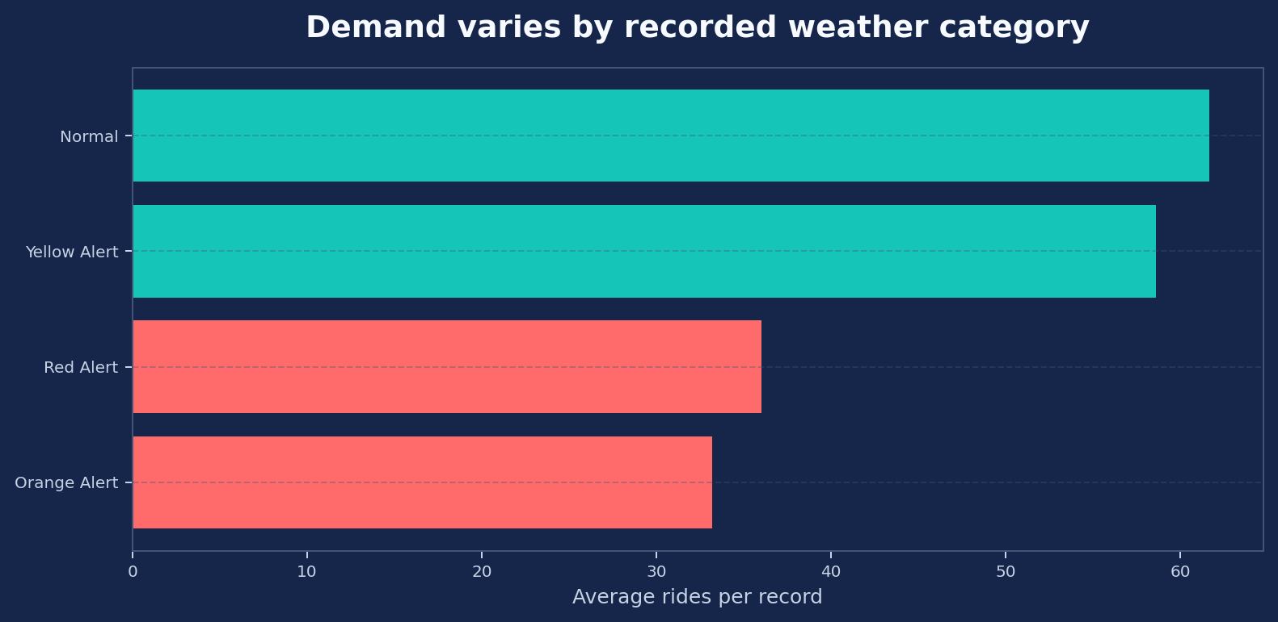
BIKE SHARING DEMAND ANALYSIS
Weather context | demand under different conditions
Interpretation
Normal-weather mean: 61.7 rides/record.
Orange-alert mean: 33.2 rides/record.
Lower observed demand in alert categories is consistent with weather sensitivity, but category frequency and timing may confound the comparison. The Red Alert category has only one row.
NEXTHIKES IT SOLUTIONS • DATA SCIENCE INTERN
11 / 24

Slide 12
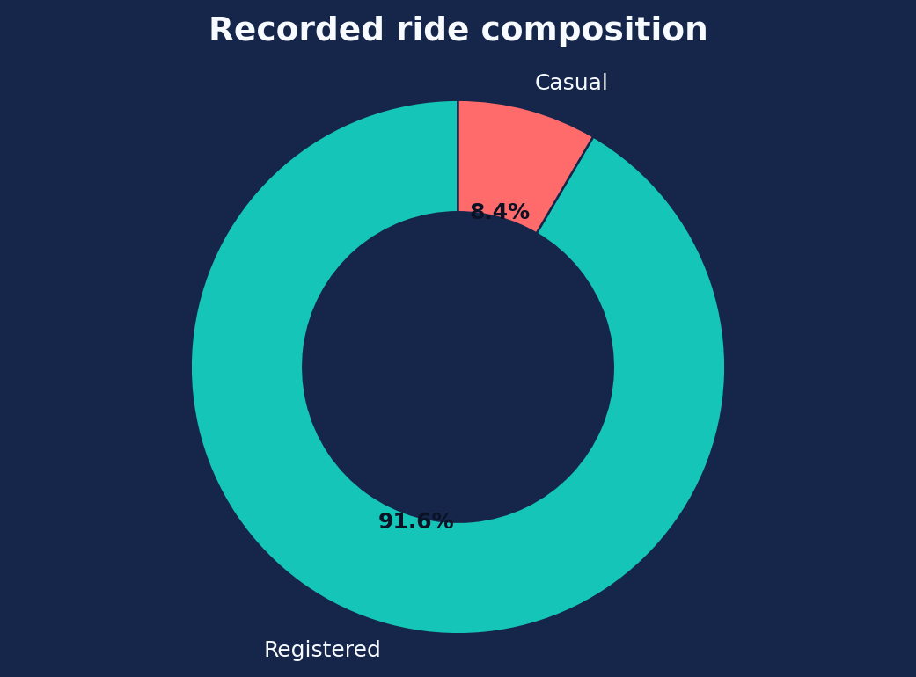
BIKE SHARING DEMAND ANALYSIS
Customer mix | registered riders dominate
REGISTERED RIDES
CASUAL RIDES
53,383
4,921
Registered riders contribute 91.6% of recorded rides; casual riders contribute 8.4%.
Growth implication: protect commuter reliability for registered users while testing off-peak offers and discovery campaigns for casual riders.
NEXTHIKES IT SOLUTIONS • DATA SCIENCE INTERN
12 / 24

Slide 13
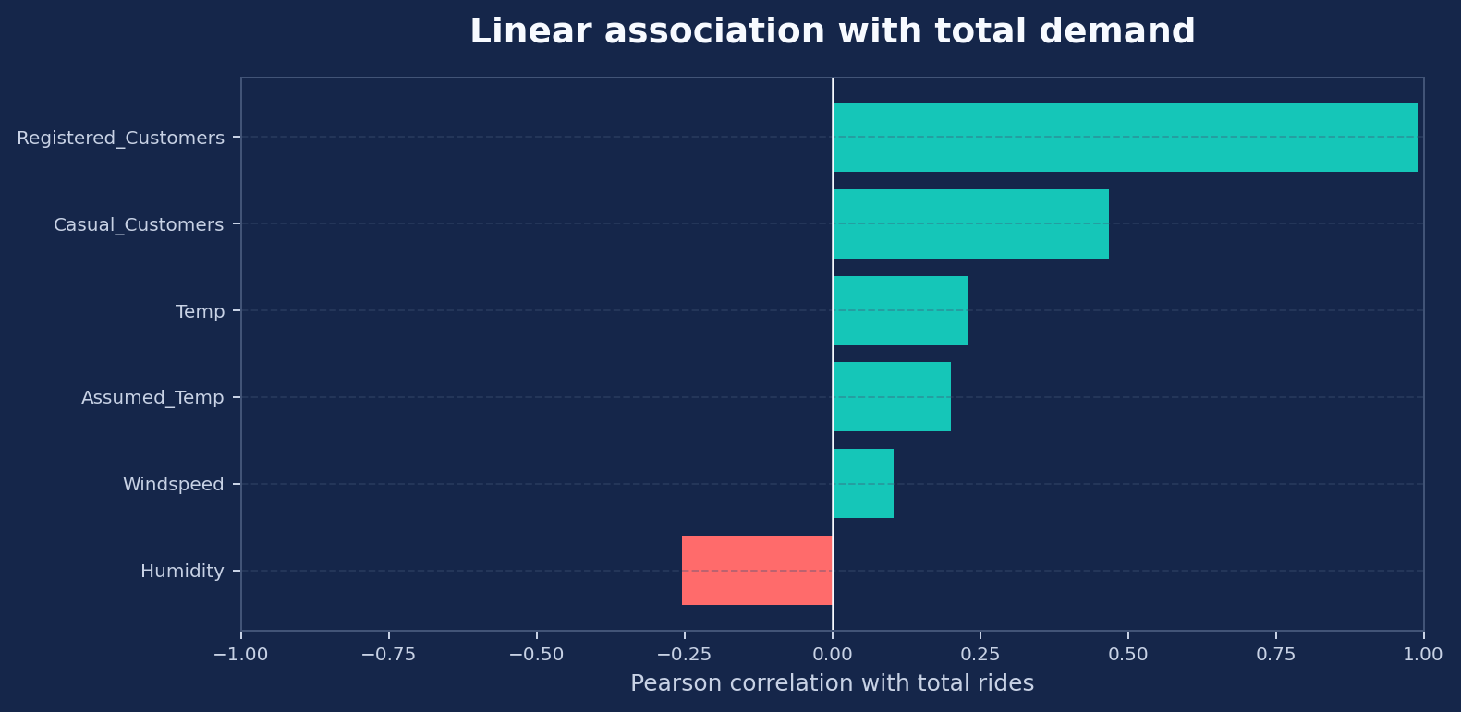
BIKE SHARING DEMAND ANALYSIS
Correlation scan | relationships to investigate
What it means
Temperature correlation: +0.23.
Humidity correlation: -0.25.
Windspeed correlation: +0.10.
Correlation captures linear association only. It does not control for hour, season, weekday or weather confounding.
NEXTHIKES IT SOLUTIONS • DATA SCIENCE INTERN
13 / 24

Slide 14
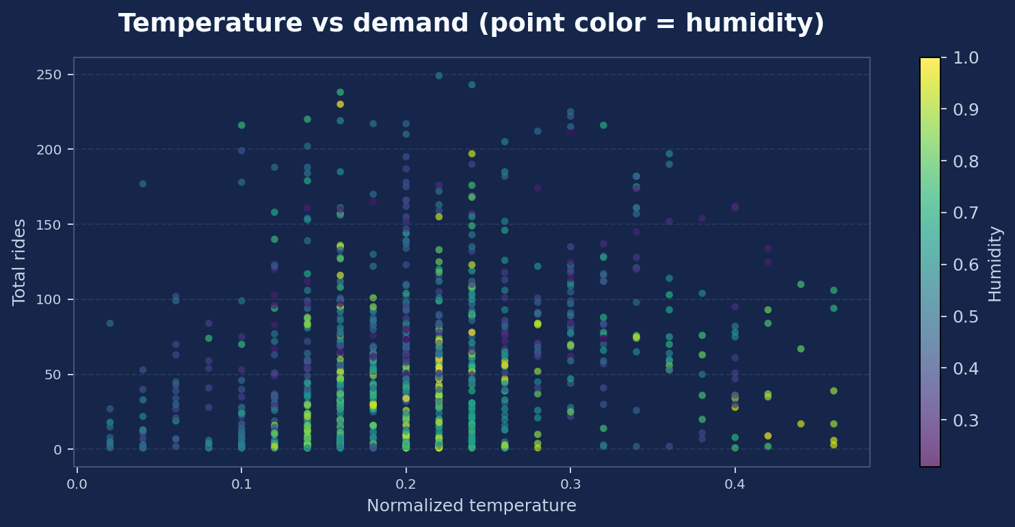
BIKE SHARING DEMAND ANALYSIS
Temperature & demand | explore non-linear effects
Analyst interpretation
The relationship is dispersed: temperature alone does not explain hourly demand. Humidity is encoded by point color to show that environmental factors overlap.
Recommended next model: multivariable regression or tree-based model with hour, weekday, weather and date features, evaluated on a chronological holdout.
NEXTHIKES IT SOLUTIONS • DATA SCIENCE INTERN
14 / 24

Slide 15
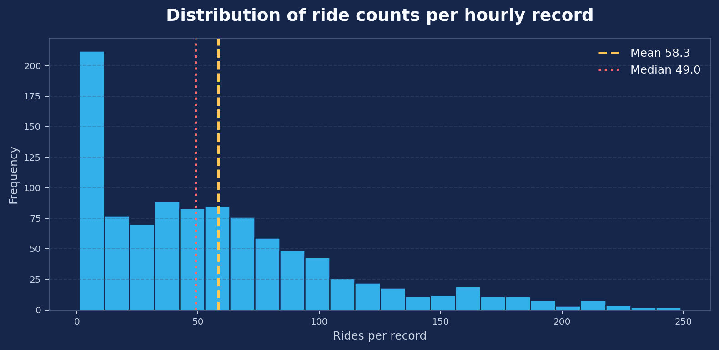
BIKE SHARING DEMAND ANALYSIS
Descriptive statistics | distribution and spread
Summary statistics
Mean: 58.3
Median: 49
Standard deviation: 51.0
Minimum / maximum: 1 / 249
Q1 / Q3: 16 / 83
The mean exceeds the median, reflecting a right tail of higher-demand hours.
NEXTHIKES IT SOLUTIONS • DATA SCIENCE INTERN
15 / 24

Slide 16
BIKE SHARING DEMAND ANALYSIS
Pivot-style summary | category comparison
Segment
Recorded rides
Share
PivotTable build in Excel
Registered
53,383
91.6%
Rows: Weathersit or Weekday
Values: Average of Total_Count, Sum of Total_Count, Count of instant
Filters / slicers: Date, Hour, Holiday
This view supports side-by-side comparison and can be refreshed when the source table is updated.
Casual
4,921
8.4%
Weather
Mean rides / row
Rows
Normal
61.7
606
Orange Alert
33.2
84
Red Alert
36.0
1
Yellow Alert
58.6
309
NEXTHIKES IT SOLUTIONS • DATA SCIENCE INTERN
16 / 24

Slide 17
BIKE SHARING DEMAND ANALYSIS
Pivot charts | choose the chart for the question
Column chart
Clustered bar
Average rides by Hour
Average rides by Weekday / Weather
Best for identifying peak and low-demand periods.
Best for ranking categories and comparing demand.
Line chart
Stacked column
Daily rides over Date
Registered vs Casual by Weekday
Best for trend, change points and forecast overlays.
Best for segment mix and acquisition opportunities.
Excel workflow: Insert → PivotTable → assign Rows / Values → Insert PivotChart → add slicers → verify aggregation.
NEXTHIKES IT SOLUTIONS • DATA SCIENCE INTERN
17 / 24

Slide 18
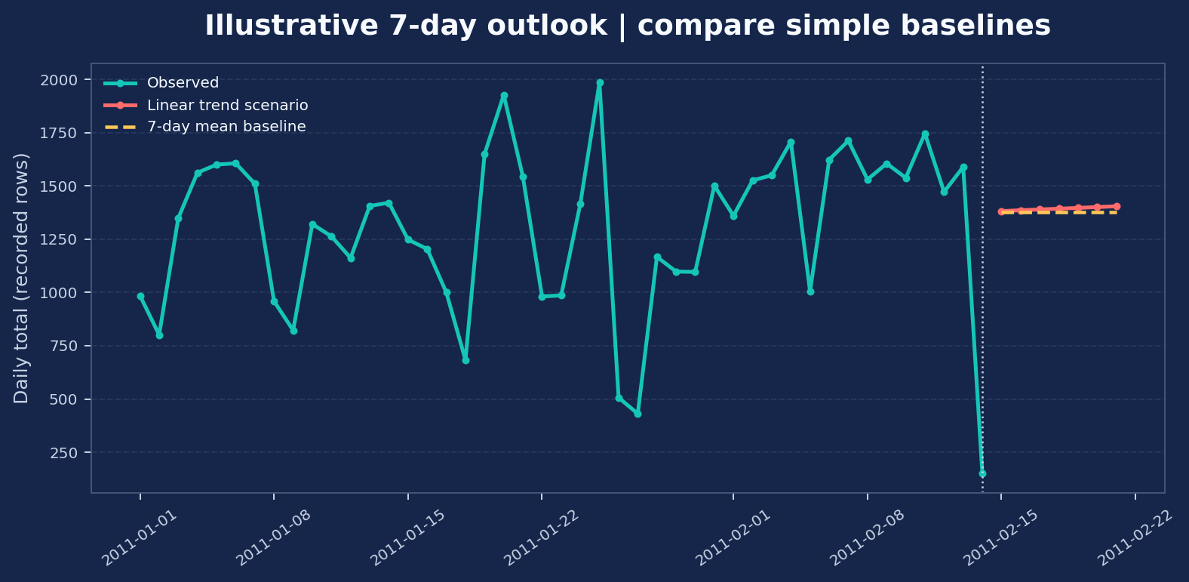
BIKE SHARING DEMAND ANALYSIS
Forecasting | short-horizon scenario, not a promise
Method & caveat
Trend scenario average: 1,393 recorded rides/day.
7-day mean baseline: 1,376 rides/day.
Method: linear trend fitted to 45 daily aggregates; compared with a flat recent-7-day baseline.
Because the sample is short and daily coverage is incomplete, treat this as a demonstration. Production forecasting should use complete daily data, seasonality and chronological backtesting.
NEXTHIKES IT SOLUTIONS • DATA SCIENCE INTERN
18 / 24

Slide 19
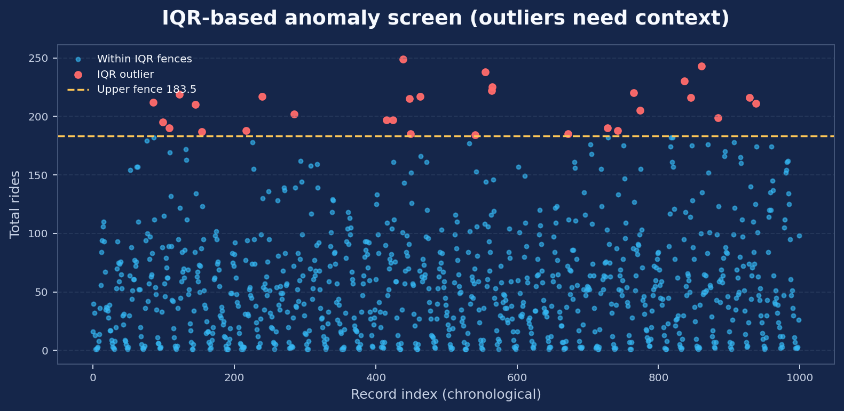
BIKE SHARING DEMAND ANALYSIS
Anomaly screening | flag, then investigate
Screening result
IQR lower fence: -84.5
IQR upper fence: 183.5
Flagged rows: 30 of 1000 (3.0%).
IQR flags include unusually high hourly demand and are not automatic data errors. Review event context, time, weather and neighboring records before action.
NEXTHIKES IT SOLUTIONS • DATA SCIENCE INTERN
19 / 24

Slide 20
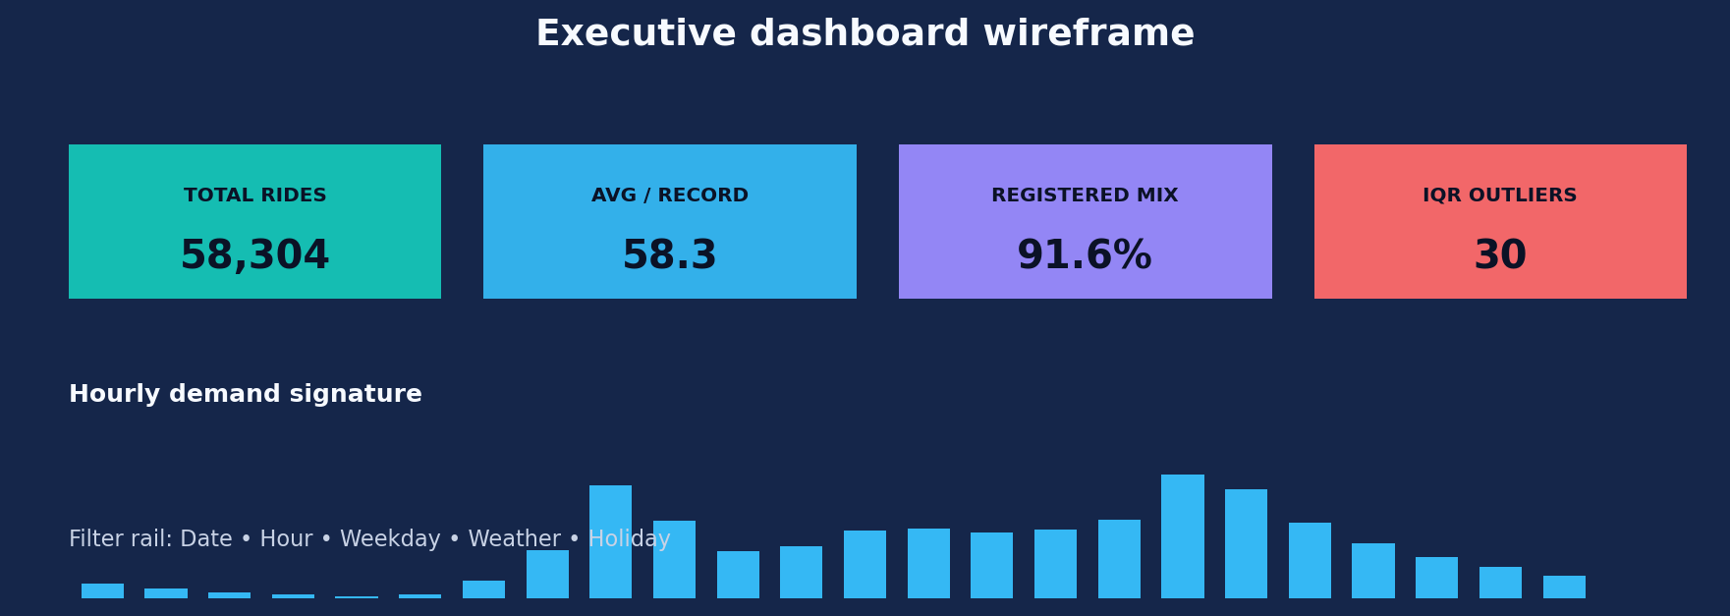
BIKE SHARING DEMAND ANALYSIS
Dashboard preparation | executive monitoring view
• KPI cards: Total rides • Average rides / record • Registered share • IQR outlier count
• Trend panel: daily recorded totals with mean line and forecast scenario
• Demand panels: hourly profile, weekday ranking and weather comparison
• Controls: Date range, Hour, Weekday, Holiday and Weathersit slicers
• Design rule: show data coverage and row-count completeness beside daily totals
NEXTHIKES IT SOLUTIONS • DATA SCIENCE INTERN
20 / 24

Slide 21
BIKE SHARING DEMAND ANALYSIS
Recommendations | turn evidence into action
01 Fleet positioning
Prioritize readiness around 08:00 and 17:00–18:00; validate by station/location data before moving inventory.
02 Segment strategy
Protect registered-user commute reliability; test casual-user offers in quieter windows.
03 Weather response
Use weather as a planning signal, but quantify impact with controls for hour and weekday.
04 Exception management
Create an anomaly review queue; distinguish real surges from missing / partial records.
05 Reporting governance
Automate refresh, document KPI definitions, and display coverage / freshness on the dashboard.
NEXTHIKES IT SOLUTIONS • DATA SCIENCE INTERN
21 / 24

Slide 22
BIKE SHARING DEMAND ANALYSIS
Implementation roadmap | from workbook to repeatable analytics
Week 1
Data foundation
Resolve full-day coverage, field definitions, date / time completeness.
Week 2
Excel model
Structured tables, Power Query transformations, validation checks.
Week 3
Reporting layer
PivotTables, PivotCharts, slicers and executive dashboard.
Week 4
Model evaluation
Backtest forecast, test anomaly rules, compare against baselines.
Ongoing
Governance
Refresh log, metric owner, version control and monthly review.
NEXTHIKES IT SOLUTIONS • DATA SCIENCE INTERN
22 / 24

Slide 23
BIKE SHARING DEMAND ANALYSIS
Limitations & next analytical layer
• Sample window is short: 45 dates from 1 Jan to 14 Feb 2011; no annual seasonality can be inferred.
• Daily aggregates may be incomplete because row counts vary by date; raw daily comparisons need a completeness filter.
• Weather category imbalance (including only one Red Alert record) limits conclusions for rare conditions.
• Correlation is descriptive; a multivariable model is needed to isolate hour, weekday, weather and temperature effects.
• Next data needed: station / geography, full historical span, service availability, pricing, events and maintenance logs.
• Forecast should be evaluated with rolling-origin backtesting and MAE / RMSE against seasonal-naïve baselines.
Professional conclusion: the workbook supports a strong exploratory analysis and dashboard prototype; operational commitments require fuller, more complete data.
NEXTHIKES IT SOLUTIONS • DATA SCIENCE INTERN
23 / 24

Slide 24
THANK YOU
Janani B | Data Science Intern
Nexthikes IT Solutions

