Slide 1
JANANI A
Applying GANs to Generate Realistic 3D Models from 2D Images

Slide 2
PROBLEM STATEMENT
Traditional methods for generating 3D models using GANs rely on labor-intensive acquisition of 3D training data, posing challenges in accessibility and scalability. The project addresses this limitation by introducing SliceGAN, which utilizes single 2D images to synthesize detailed 3D datasets. This approach enables faster, higher-resolution, and more widely available microstructure generation, facilitating future studies in high-throughput microstructural optimization.

Slide 3
Proposed system/solutions
SliceGAN Architecture: Develop a GAN architecture specifically designed for synthesizing high-fidelity 3D datasets from single 2D images. This architecture should incorporate techniques for uniform information density to ensure consistent quality across generated volumes.
Training Pipeline: Establish a robust training pipeline for SliceGAN, utilizing a diverse set of materials to showcase its widespread applicability. This pipeline should include data preprocessing, network training, and evaluation stages.
Quality Assessment: Implement metrics and techniques for evaluating the quality of generated 3D models compared to real datasets. This includes statistical comparison of microstructural metrics to validate the fidelity of synthesized volumes.
Scalability and Efficiency: Ensure that SliceGAN can generate arbitrarily large volumes efficiently, allowing for high-throughput microstructural optimization studies. Optimize generation time to enable rapid exploration of design spaces.
Integration and Deployment: Provide tools and frameworks for seamless integration of SliceGAN into existing workflows for material design and optimization. This involves creating user-friendly interfaces and documentation to facilitate adoption by researchers and industry practitioners.

Slide 4
System development approach
Research and Requirement Analysis:
Designing SliceGAN Architecture:
Data Collection and Preprocessing:
Conduct thorough research on existing GAN architectures and their applications in generating 3D models.
Analyze the requirements and constraints of the project, including data availability, computational resources, and desired output quality.
Design the SliceGAN architecture tailored to the specific requirements of generating 3D models from 2D images.
Define the neural network architecture, loss functions, and training strategies necessary for the synthesis process.
Implement the concept of uniform information density to ensure consistent quality and scalability of generated volumes.
Gather a diverse dataset of 2D images representing different materials and microstructures.
Preprocess the data to ensure uniformity in format, resolution, and quality.
Augment the dataset if necessary to increase diversity and robustness of the model.

Slide 5
Training and Validation:
Evaluation and Comparison:
Optimization and Deployment:
Train the SliceGAN model using the prepared dataset, optimizing for high-fidelity 3D reconstruction.
Validate the trained model using a separate validation dataset,assessing its ability to generate realistic 3D models from 2D images. Fine-tune the model parameters as needed to improve performance and generalization.
Evaluate the quality of generated 3D models by comparing them with ground truth 3D datasets where available.
Conduct statistical analysis to compare the microstructural metrics of synthetic and real datasets, ensuring fidelity and accuracy. Benchmark the performance of SliceGAN against existing methods in terms of quality, speed, and scalability.
Optimize the SliceGAN model and its implementation for efficiency and scalability.
Deploy the trained model as a usable tool for generating 3D models from 2D images, ensuring user-friendly interfaces and documentation.
Provide ongoing support and maintenance to address any issues and incorporate feedback from users.
Optimization and Deployment:
Continuously monitor the performance of SliceGAN in real-world applications.
Gather feedback from users and stakeholders to identify areas for improvement.
Incorporate advancements in GAN technology and research to enhance the capabilities of the system over time.

Slide 6
algorithm
Define the project name, directory, and training mode (0 for generating, 1 for training).
Specify image properties such as type (color, grayscale, or n-phase), number of channels, and data type.
Set the path to the input data, either a single 2D image for isotropic or three perpendicular 2D images for anisotropic microstructures.
Configure network architectures including image size, z vector depth, layers in the generator and discriminator, kernel sizes, strides, and filter sizes.
Create SliceGAN networks based on the defined parameters.
If training mode is enabled:
a. Train the model using the specified data, network architectures, and training parameters.
b. Save the trained generator and discriminator networks.
If training mode is disabled:
a. Load a trained generator network.
b. Generate a synthetic 3D image using the loaded generator.
c. Save the generated 3D image.

Slide 7
deployment
Open the 'run_slicegan.py' file.
Define the project settings including the project name, directory, and training mode.
Specify image properties and data paths according to the requirements.
Configure network architectures based on desired parameters.
Run the script with 'python run_slicegan.py 1' to train a new generator or 'python run_slicegan.py 0' to generate and save an example .tif file.
If interested in trying new architectures, adjust the networks in the 'networks.py' file.
To modify training parameters or algorithms, edit the 'train.py' file.
To add new preprocessing methods, update the 'preprocessing.py' file.
Optionally, use the 'raytrace.py' script to visualize the generated 3D model using OptiX ray tracing.

Slide 8
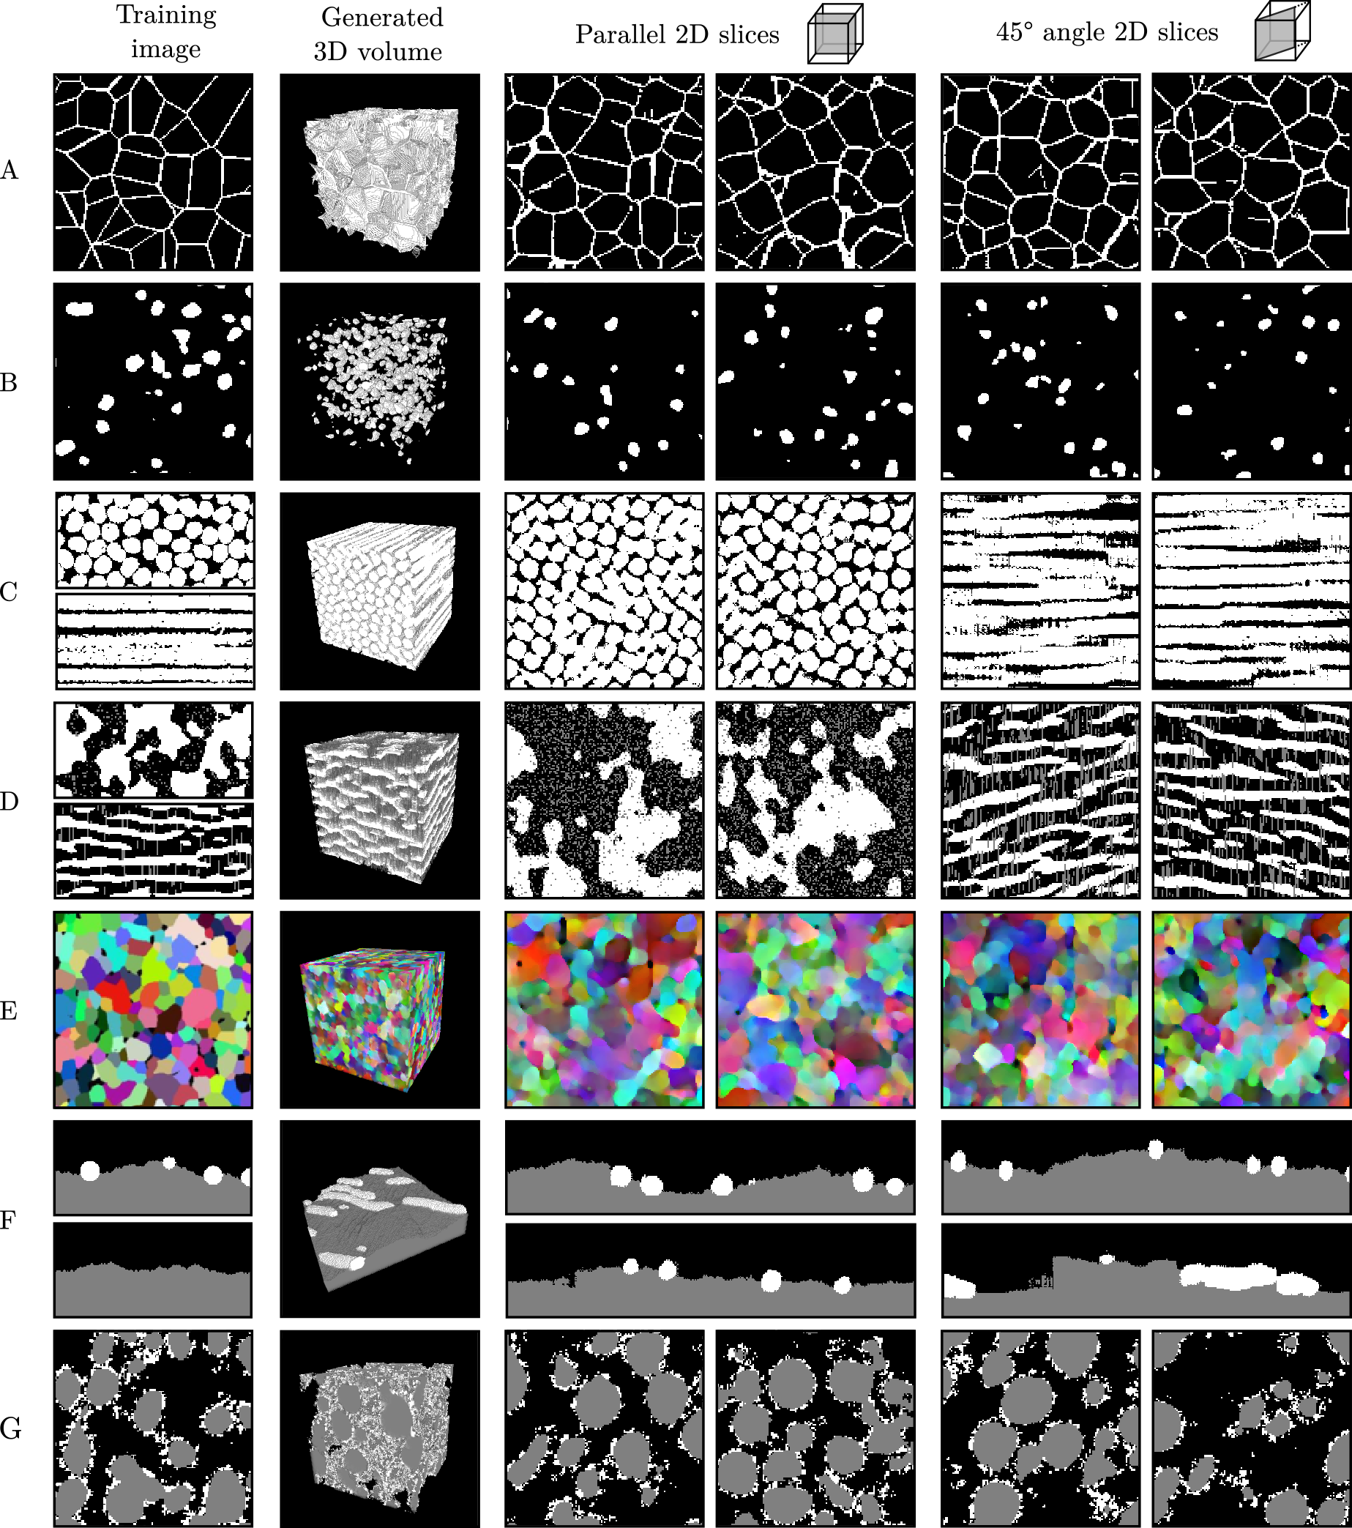
result

Slide 9
conclusion
In conclusion, the SliceGAN framework presents a novel approach to generating realistic 3D models from 2D images, overcoming the limitations of traditional 3D data acquisition. By harnessing the power of generative adversarial networks (GANs), SliceGAN enables efficient and high-fidelity synthesis of diverse material microstructures. The project demonstrates the efficacy of SliceGAN across various materials, showcasing its versatility and potential for widespread application in design optimization and material science. With its ability to generate detailed 3D models rapidly, SliceGAN offers a promising pathway for future studies in high-throughput microstructural analysis and optimization.

Slide 10
references
Reusability report: Feature disentanglement in generating a three-dimensional structure from a two-dimensional slice with sliceGAN: https://www.researchgate.net/publication/355181817_Reusability_report_Feature_disentanglement_in_generating_a_three-dimensional_structure_from_a_two-dimensional_slice_with_sliceGAN

Slide 11
THANK YOU
Janani A

