Slide 1
IBM University Engagement Project Submission
“Exploring the Power of Agentic AI with IBM Granite and LangFlow”

Slide 2

Project Tile – Agentic AI for Mental Health Awareness & Suicide Prevention
Domain of Project –Healthcare
Student Name | Recent Passport Photo | Email ID | Mobile number [WhatsApp]
Janani K Reddy |  | jananikreddy2007@gmail.com | 7418387454

Slide 3
Problem Statement -
Problem Statement : Agentic AI for Mental Health Awareness & Suicide Prevention
The Challenge:
Mental health issues such as depression, anxiety, and suicidal thoughts are growing worldwide. Stigma, lack of awareness, and limited access to timely help prevent many individuals from seeking support. Traditional systems are often reactive, leaving gaps in early detection and preventive care.
The Objective:
Build an Agentic AI-powered Mental Health Awareness & Suicide Prevention Agent that is empathetic, proactive, and safe. The solution should:
Promote Awareness & Education – Share accessible resources on mindfulness, coping strategies, and self-care.
Enable Early Detection (RAG) – Use Retrieval-Augmented Generation to identify distress signals in conversations, journaling inputs, or safe online data.
Provide Empathetic Support – Build a conversational agent that listens actively and responds with empathy (with clear disclaimers: not a substitute for professional medical advice).
. Predict & Prevent Risks – Forecast stress peaks, suggest preventive strategies, and issue alerts when high-risk signals are detected (with consent).
Connect to Human Support – Link users to helplines, counselors, or community support for timely intervention.
Tech Stack (Mandatory)
• LangFlow + IBM watsonx.ai + IBM Granite Models

Slide 4
Technology Used
Tech Stack (Mandatory)
Use any one of the following approaches:
LangFlow + IBM watsonx.ai + Granite Models
IBM Cloud Agentic Lab with IBM Granite Models
Replicate with LangChain + RAG + IBM Granite Models
I used LangFlow + IBM watsonx.ai + Granite Models

Slide 5
Proposed Solution:
The proposed solution is a multi-agent AI-powered Mental Health Awareness & Suicide Prevention Agent built using LangFlow, IBM watsonx.ai, and Granite Models to provide empathetic, proactive, and safe mental health support. The system addresses challenges such as lack of awareness, delayed emotional intervention, social stigma, and limited access to professional care through an intelligent agent-based architecture.
At its core, the solution uses a Retrieval-Augmented Generation (RAG) pipeline to retrieve trusted mental health resources from verified sources such as WHO guidelines, mental health awareness articles, suicide prevention resources, counseling datasets, and wellness documentation. This information is embedded and stored in a vector database, enabling the system to retrieve context-aware knowledge and generate safe, empathetic, and informative responses using Granite models.
The system consists of four key agents:
Mental Health Knowledge Agent retrieves and summarizes reliable mental health information using RAG, including stress management techniques, mindfulness practices, coping strategies, and self-care recommendations.
Emotion Detection & Risk Analysis Agent analyzes user conversations, journaling inputs, or voice/text interactions to identify emotional distress signals such as anxiety, hopelessness, depression, stress, or suicidal tendencies through sentiment analysis and behavioral pattern recognition.
Empathetic Support Agent provides emotionally supportive and human-like conversations using safe AI responses, active listening techniques, and mental wellness guidance while clearly stating that the system is not a replacement for professional medical advice.
Crisis Prevention & Support Agent predicts high-risk emotional conditions, suggests preventive actions, and connects users to human support systems such as counselors, helplines, emergency contacts, or mental health communities when severe distress signals are detected.
The solution includes a user-friendly dashboard (built using Streamlit or React) that visualizes emotional trends, stress levels, mood tracking, journaling insights, wellness progress, and personalized self-care recommendations. Users can also access meditation exercises, breathing activities, daily affirmations, and mental health educational resources through the platform.
LangFlow is used to orchestrate multi-agent workflows and manage interaction pipelines, while watsonx.ai ensures scalable model deployment, embeddings, governance, and secure AI operations. Granite models power empathetic reasoning, emotional understanding, summarization, and personalized mental health recommendations.
Overall, this solution delivers an end-to-end intelligent mental health support assistant that promotes awareness, enables early emotional distress detection, provides empathetic guidance, and supports suicide prevention through proactive AI-driven intervention and human support integration.

Slide 6
Langflow component Used -
1) Chat Input – Interface where users enter their queries, preferences, or meal details (text/voice/image).
2) IBM watsonx AI Agent - Processes user input using Granite models to generate personalized nutrition insights and recommendations.
3) Name of IBM Granite model - Granite-4.0-8B-Instruct → Fast, efficient for real-time diet recommendations
4) Chat output -Displays AI-generated responses such as diet plans, nutritional analysis, and health suggestions.

Slide 7
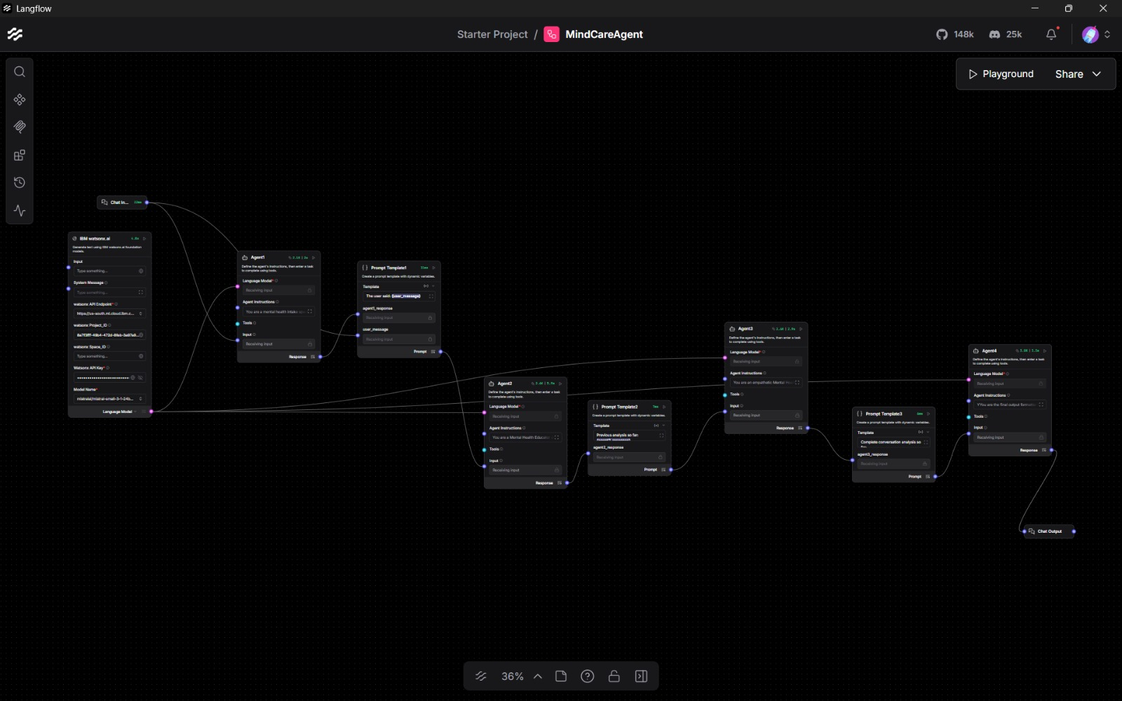
Langflow workflow -

Slide 8
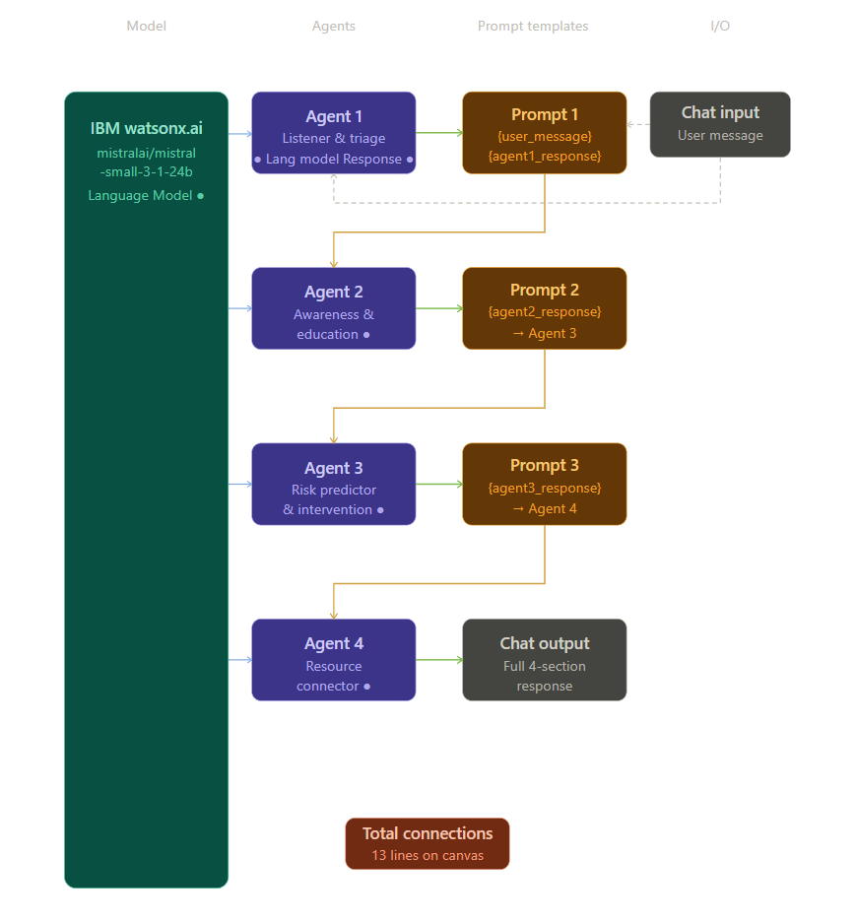

Slide 9

Role of Agentic AI in the solution
Role of Agentic AI in Mental Health Agent
Agentic AI plays a central role in the proposed *Mental Health Awareness & Suicide Prevention System* by enabling the platform to act intelligently, proactively, and autonomously instead of functioning like a basic chatbot. Unlike traditional AI systems that only respond to direct questions, Agentic AI can analyze situations, make decisions, coordinate multiple tasks, and take supportive actions based on user behavior and emotional condition.In this solution, the Agentic AI architecture is designed using multiple specialized agents, where each agent performs a dedicated responsibility while collaborating with other agents to provide complete mental health support. The *Mental Health Knowledge Agent* acts as an information retrieval agent that uses Retrieval-Augmented Generation (RAG) to fetch trusted mental health resources, awareness content, mindfulness exercises, coping strategies, and self-care recommendations from verified datasets.The *Emotion Detection Agent* continuously analyzes user conversations, journaling entries, or voice/text inputs to identify emotional states such as stress, anxiety, sadness, hopelessness, or suicidal tendencies using sentiment analysis and behavioral pattern recognition. The *Risk Prediction Agent* proactively monitors emotional patterns and distress signals over time to predict potential mental health risks or crisis situations before they escalate. It identifies high-risk behaviors and triggers preventive actions when necessary.The *Crisis Prevention & Alert Agent* autonomously recommends helplines, counselors, emergency support, or community resources whenever severe emotional distress or suicidal intent is detected. With user consent, it can also issue alerts for timely human intervention.Through this multi-agent collaboration, Agentic AI enables the system to:* Understand emotional context intelligently* Make proactive decisions* Provide personalized mental health guidance* Predict emotional risks early* Coordinate preventive support actions* Deliver continuous empathetic assistance

Slide 10
Technology Used
Langflow platform -For designing and orchestrating multi-agent workflows visually
IBM Grainte model - for eg – ibm-granite-3-2-8b – For natural language understanding, reasoning, and personalization
IBM Cloud – It provides the infrastructure to build, deploy, and scale the Nutrition Agent efficiently. IBM Cloud enables a reliable, secure, and scalable environment for deploying the Nutrition Agent.
RAG– RAG to fetch real data first, then generate intelligent answers, making the Nutrition Agent more trustworthy and effective.
IBM Watsonx.ai - For model deployment, embeddings, and AI governance

Slide 11
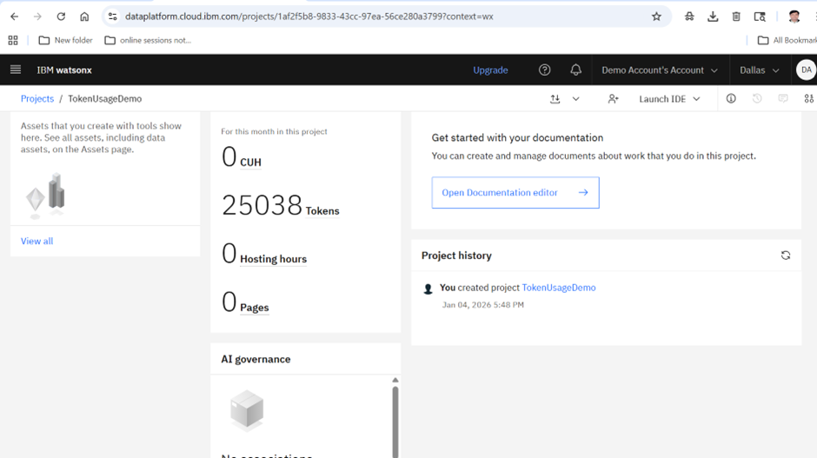
Token Usage
25038 token are used
·
·
·

Slide 12
Novelty and Uniqueness
The novelty and uniqueness of the proposed Agentic AI-Powered Mental Health Awareness & Suicide Prevention System lies in its ability to provide proactive, intelligent, and empathetic mental health support rather than functioning as a simple reactive chatbot. Unlike traditional systems that only answer user queries, this solution uses an Agentic AI architecture where multiple intelligent agents work together to analyze emotions, retrieve trusted mental health information, predict risks, and provide personalized support.
One of the major unique features of the system is the integration of Retrieval-Augmented Generation (RAG), which allows the AI to retrieve real-time mental health knowledge from trusted sources such as WHO guidelines and suicide prevention resources. This improves the accuracy, reliability, and safety of the responses generated by the system.
Another important innovation is the early detection and prediction of emotional distress. The system continuously analyzes conversations, journaling inputs, and behavioral patterns to identify stress, anxiety, depression, hopelessness, or suicidal tendencies at an early stage. Instead of waiting for a crisis to occur, the AI proactively recommends preventive strategies and emotional wellness activities.
The proposed solution also focuses heavily on empathetic AI interactions. Using IBM Granite models, the conversational agent can generate emotionally supportive and context-aware responses that make users feel heard, understood, and supported while maintaining ethical and safe communication practices.
A unique aspect of the system is its intelligent escalation capability. When high-risk emotional conditions are detected, the AI can connect users to counselors, suicide prevention helplines, emergency support systems, or mental health communities for timely human intervention.
Additionally, the integration of Langflow, IBM watsonx.ai, and IBM Granite models creates a scalable, explainable, and enterprise-grade mental healthcare solution capable of delivering personalized, safe, and real-time support.
Overall, the uniqueness of the proposed system lies in combining Agentic AI, RAG, emotional intelligence, predictive analytics, empathetic communication, and human support integration into one unified platform for mental health awareness and suicide prevention.

Slide 13
Git Hub Link
https://github.com/jananikreddy2007-cloud/MentalCare-Agent

Slide 14
Future Scope
The proposed Agentic AI-Powered Mental Health Awareness & Suicide Prevention System has significant future potential for expansion and real-world impact. In the future, the system can be enhanced with advanced multimodal AI capabilities such as facial emotion recognition, voice stress analysis, and behavioral monitoring to improve the accuracy of emotional distress detection. By analyzing facial expressions, speech patterns, and tone variations, the AI can better understand the mental state of users and provide more personalized support.
The platform can also be integrated with wearable devices and smart health trackers to monitor stress levels, sleep patterns, heart rate variability, and physical activity in real time. This would allow the system to predict mental health risks more accurately and recommend preventive wellness activities proactively.
Another important future enhancement is multilingual and regional language support, which would make the platform accessible to users from diverse backgrounds and rural communities where mental health awareness resources are limited. This can greatly improve inclusivity and accessibility.
The system can further evolve into a fully personalized AI mental wellness companion by learning long-term behavioral patterns, emotional triggers, and coping preferences of users. This would help deliver highly customized self-care plans, meditation exercises, therapy suggestions, and emotional wellness strategies.
Future versions of the platform can also integrate with hospitals, telemedicine systems, counseling centers, educational institutions, and workplace wellness programs to provide large-scale mental health support and early intervention services.
Additionally, advanced predictive analytics and AI forecasting models can be incorporated to identify suicide risks, burnout conditions, or severe emotional crises at a much earlier stage. This would strengthen preventive mental healthcare and reduce emergency mental health incidents.
The integration of augmented reality (AR) and virtual reality (VR) environments for guided meditation, stress relief therapy, and virtual counseling sessions can further improve user engagement and emotional recovery experiences.
Overall, the future scope of the proposed solution is vast, with opportunities to develop it into a comprehensive AI-driven mental healthcare ecosystem capable of providing accessible, personalized, preventive, and real-time emotional support on a global scale.

Slide 15


