Slide 1
Portfolio of Janani Manikandan
Aspiring Web Developer | Creative Designer | BCA Student

Slide 2
Agenda
Introduction
Career objective
Technical skills & soft skills
Project Highlights
Hobbies & Interests
Contact & Networking
Final tips & takeaways

Slide 3

introduction
Name: Janani Manikandan
Currently pursuing BCA, 2nd Year
Institution: SRM Arts and Science College, Kattankulathur
Passion: Exploring creativity in both technical and design fields.
Quote: “Curiosity has always driven me. Small steps in learning lead to big leaps in growth.”

Slide 4
Career objective
To build a career in web development and creative design where I can apply my technical knowledge and creativity to create impactful digital experiences.
Long-Term Goal: Becoming a skilled professional capable of blending technology with design.
I am a motivated and detail-oriented aspiring web developer and data enthusiast, eager to apply my skills in HTML, CSS, JavaScript, and data science to real-world projects.
With a strong foundation in programming and a passion for continuous learning, I aim to contribute innovative solutions and collaborate effectively within a dynamic team.
I am committed to growing my expertise in full-stack web development, machine learning, and software engineering to build impactful and user-friendly applications.

Slide 5
TECHNICAL ​and soft skills
​Programming / Web Development: Python, HTML, CSS, JavaScri
Creative & Editing Tools: Canva, InShot
Languages: Tamil,
English
Strong communication & presentation
Teamwork & collaboration
Problem-solving attitude
Time management & adaptability
Willingness to learn and experiment

Slide 6
Project highlight
Personal Portfolio Website
Developed a fully responsive and visually appealing portfolio site using HTML, CSS, and JavaScript.
Features included smooth scrolling, navigation menu, animated elements, and project showcases.
Implemented JavaScript for interactivity such as form validation, dynamic content loading, and modal pop-ups.
Showcased professional skills, projects, and contact information.

Slide 7
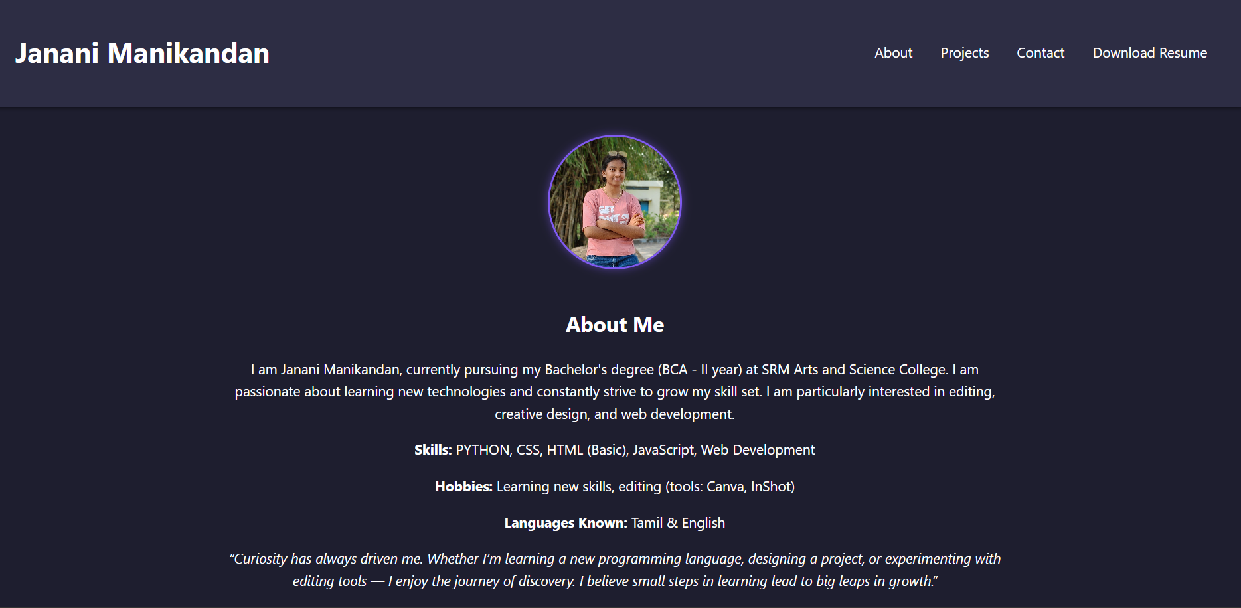
portfolio

Slide 8
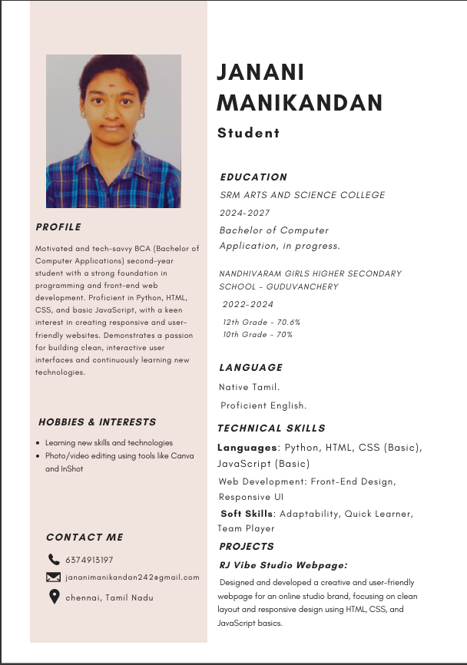
resume

Slide 9
HOBBIES AND INTERESTS
Passionate about exploring new technologies and programming languages.
Interested in web design and UI/UX trends to enhance user experiences.
Likes photography and graphic design as creative outlets.

Slide 10
Github link
  https://jananim-bca.github.io/nm/​
Contact & connect
Email: jananimanikandan242@gmail.com
Call to action: "Let's Connect and Collaborate!"

Slide 11
THANK YOU
Thank you for viewing my portfolio.
Let’s connect and grow together!
“The journey of learning never ends, it only evolves.”

