Slide 1
Credit Risk Analysis & Loan Underwriting System
Machine Learning-Powered Decision Support Platform
Author: Janani Priya N. | B.Tech Information Technology

Slide 2
The Challenge of Modern Lending
Banks lose a lot of money when borrowers default on loans.
Manual loan checking is slow, and different officers can reach different decisions on similar cases.
Our aim was to build a system that checks an applicant instantly, gives a default probability, and explains why it made its decision.

Slide 3
Data Engineering & Preparation
Source Data: I used a credit risk dataset with applicant details, financial history and loan informationand cleaned them.
Handling missing values : Every column was checked for missing values, and nulls in the affected columns were replaced with the median.
Feature Engineering : Loan grades (A to G) were converted to numbers and created a debt-to-income (DTI) ratio and a credit history length feature.
Handling Imbalance : Safe loans far outnumber defaults in the data, so used class_weight='balanced' to make sure the model pays attention to the defaulters.

Slide 4
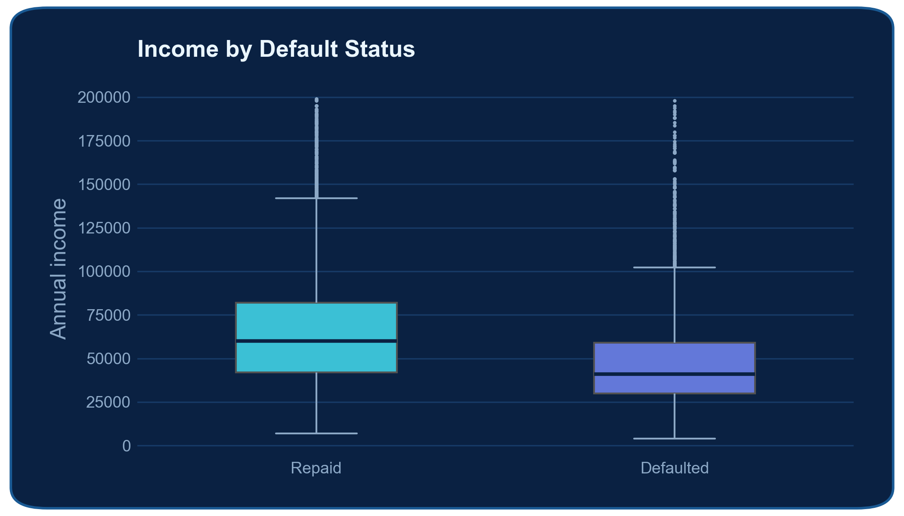
Key Risk Drivers & Data Insights
Income vs. Default :
Applicants who defaulted tend to earn less.
The median annual income of defaulters is about 40,000, compared with about 60,000 for applicants who repaid.
However, the two groups overlap considerably, so income alone cannot decide an application. Low income calls for a closer look, but it should be weighed together with the other factors.
[ Insert eda_income_patterns_dark.png here ]

Slide 5
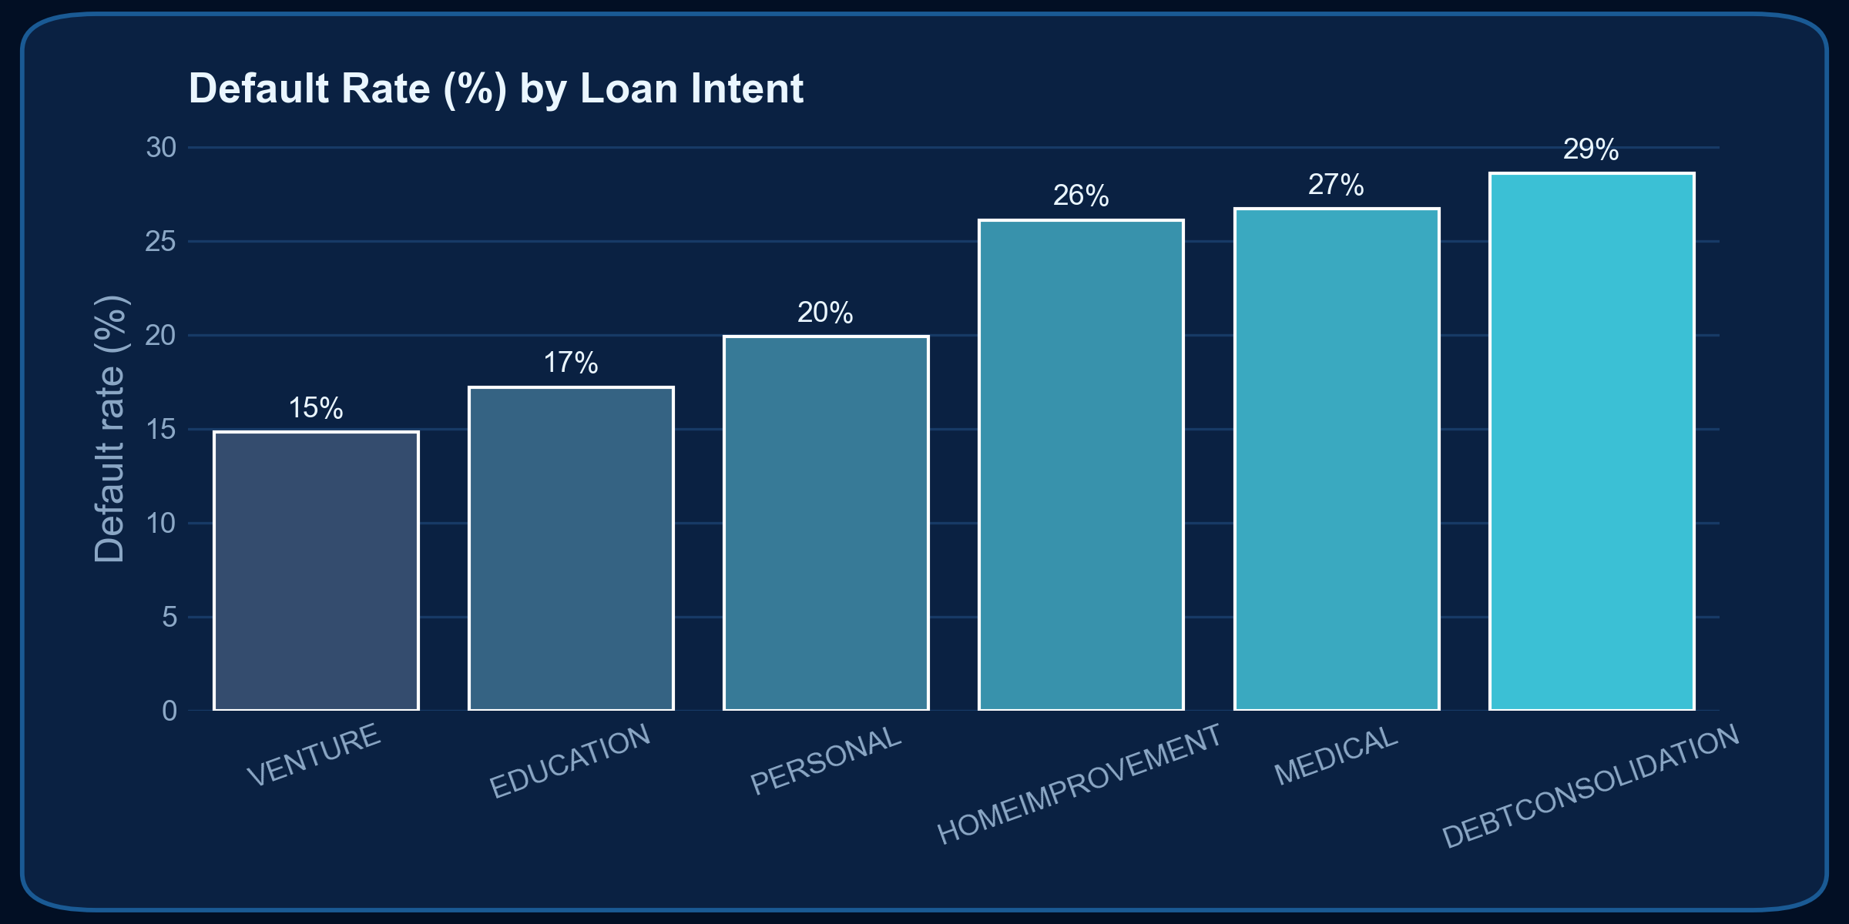
Loan Intent and Default Rate
Default rates differ clearly by loan purpose.
Debt consolidation (29%), medical (27%) and home improvement (26%) loans default most often.
Personal loans sit in the middle at 20%, while education (17%) and
venture (15%) loans are the safest purposes.
This suggests that higher-risk categories may need closer manual review or different interest rates.

Slide 6
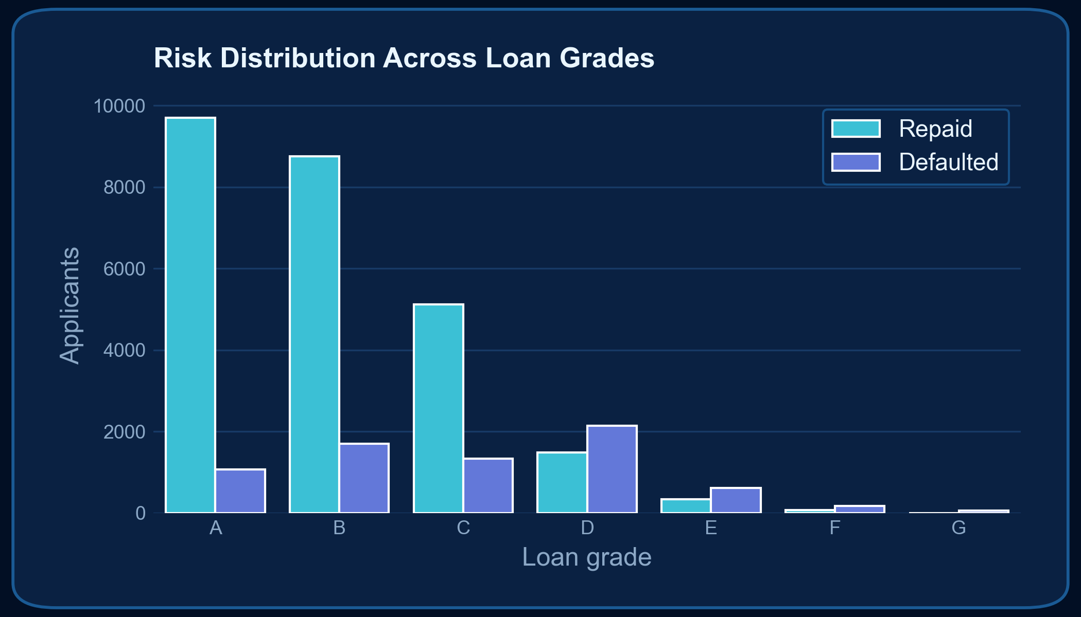
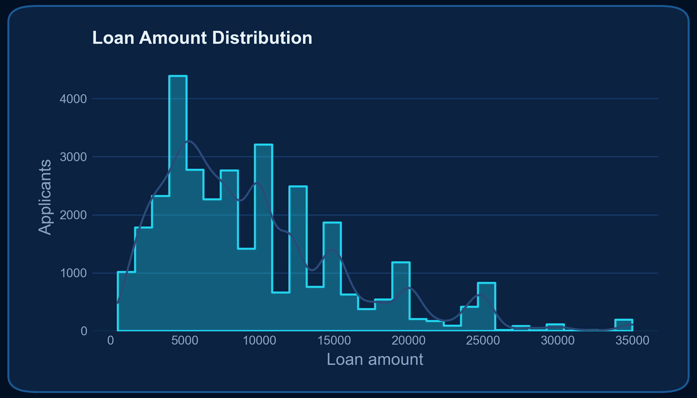
Loan Amount Distribution and Risk Across Loan
Grades
Loan Amount Distribution:
Most loan requests fall between 5,000 and 15,000.
Requests above about 20,000 are rare, so the model has seen fewer similar cases and its score is less certain for large loans.
Loan Grades:
Loan grade is a strong indicator of risk.
Applicants in grades A to C mostly repaid their loans.
From grade D onwards, defaulters outnumber those who repaid, so grades D to G should be treated as high risk.

Slide 7
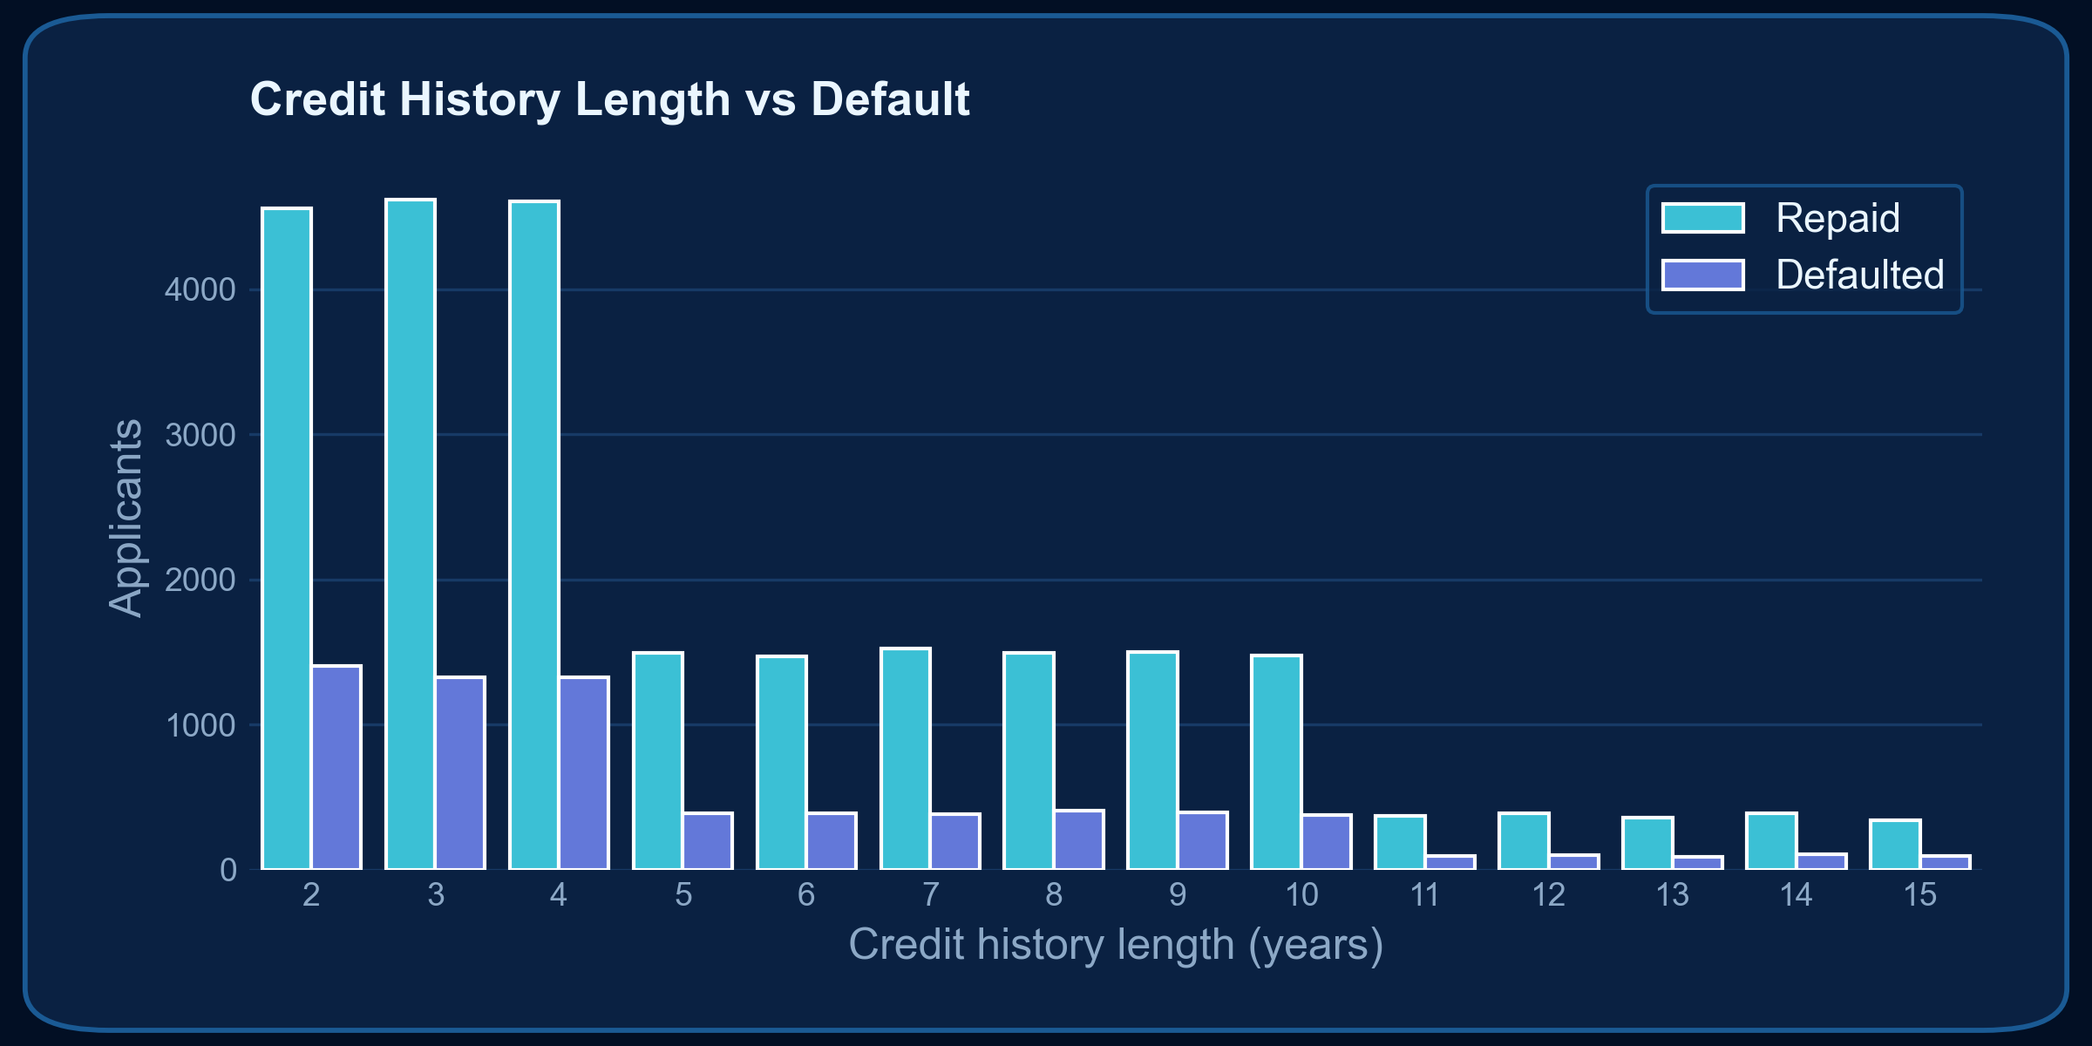
Credit History Length
Most applicants have only 2 to 4 years of credit history, so most defaults also come from this group.
Defaults become much less common for applicants with longer histories.
A short credit history gives less proof of repayment behaviour, which makes these applicants harder to assess.

Slide 8
Predictive Modeling: Random Forest Classifier
Model Selection : I chose Random Forest because it handles non-linear relationships well and is less likely to overfit.
Evaluation Metrics : It reached a ROC-AUC of about 0.93, which means it separates safe borrowers from risky ones very well.
Model Artifacts : The trained model (credit_risk_rf_model.pkl), the scalers and the feature list are saved so the web app can load them directly.

Slide 9
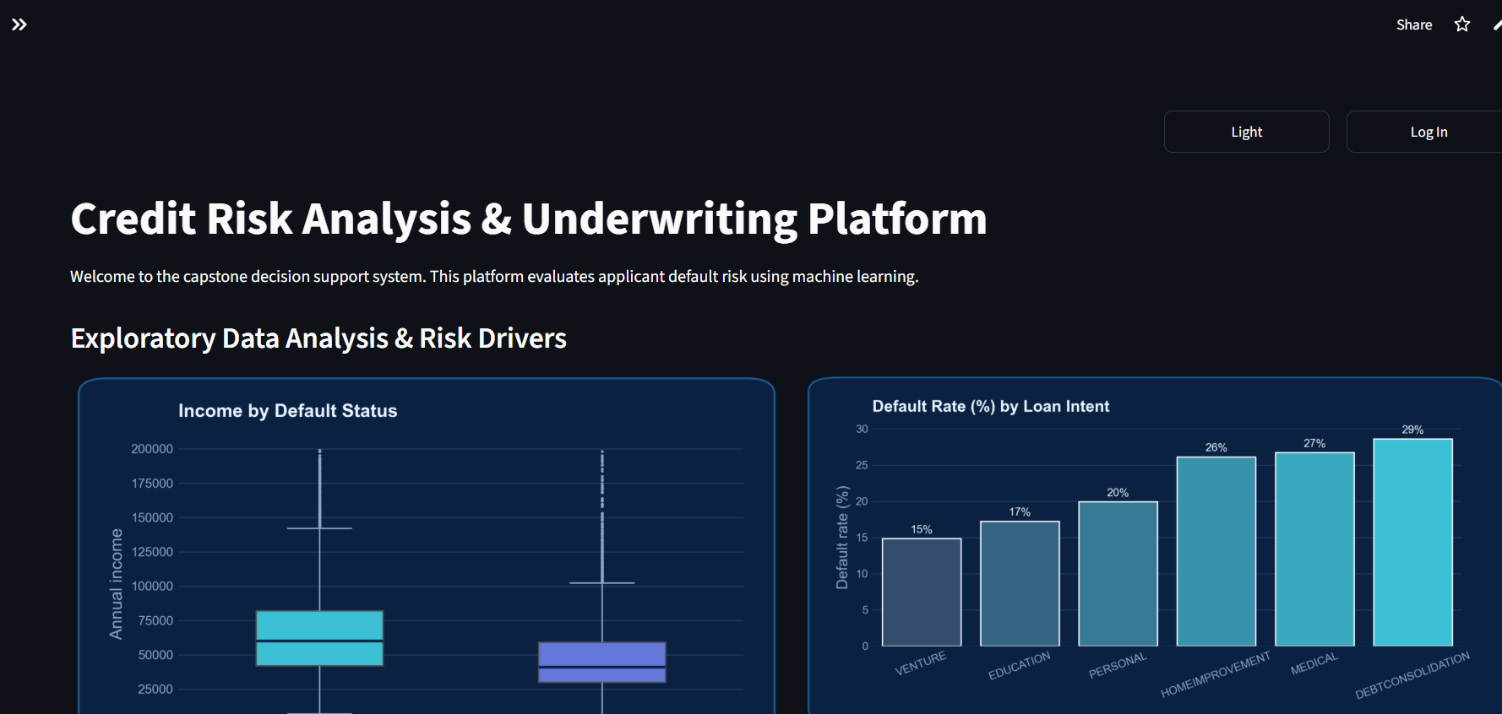
Production Deployment & Interactive Interface
Technology Used : Built with Python, Scikit-learn, Streamlit, Pandas and Seaborn, with the code on GitHub.
UI Features : It has a sidebar for moving between pages, a login popup, and a log of past evaluations.
Explainability : The “Why This Score” section explains each result using the applicant’s DTI ratio, loan grade and credit history length.
[ Insert Streamlit Input & Prediction Screenshot / Chart here ]

Slide 10
Impact & Future Enhancements
Loan officers get a decision recommendation in seconds instead of reviewing every file by hand.
Every evaluation is logged, so decisions can be traced and checked later.
Connect to credit bureau APIs so an applicant’s credit report can be pulled automatically.
Add monitoring for the deployed app so we can see how it performs over time.

