Slide 1
Real Estate Market analysis

Slide 2
Agenda
Introduction
What is in my data
Insample forecast for National Aggregate
Outsample forecast for National Aggregate
Insample Forecast For state Aggregate
Out of Sample Forecast for State Aggregate

Slide 3

Data Cleaning

Slide 4

Removal of NULL values
Median_listing_price – 63(Mean)
Active_listing_count - 45 (Median)
New_listing_count – 43 (Median)
Pending_listing_count – 23871 (Median)

Slide 5
Fill Gaps
Filled Gaps using Linear Interpolation

Slide 6
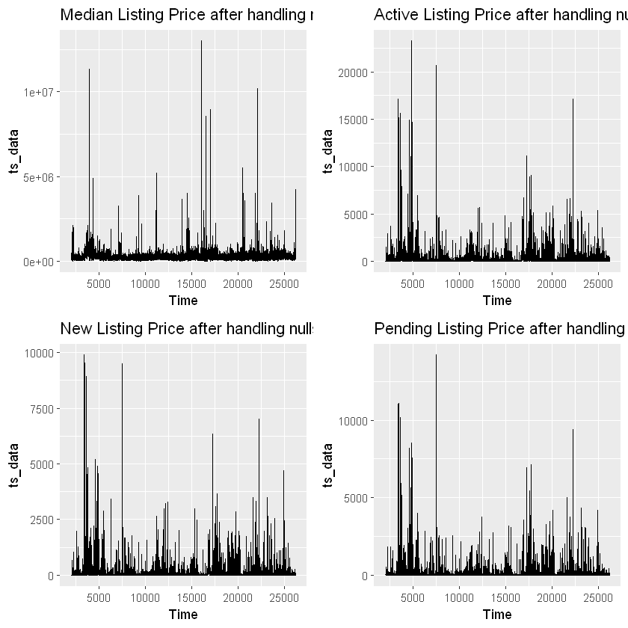
Data Distribution
Median Listing Price: There are notable peaks and troughs, indicating periods of highsignificant fluctuations and low median listing prices. The large spikes could indicate market responses to external events or changes in housing demand and supply.
Active Listing Price:The active listing count graph shows a trend where listings peak before gradually declining. The rise in active listings may be seasonal or due to market growth phases, followed by declines which could be due to increased sales or removals of listings from the market.
New Listing Price:This represents new listings coming onto the market. The plot shows regular peaks and troughs which might suggest a seasonal pattern, such as more properties being listed during specific times of the year (common in residential real estate markets).
Pending Listing Price: Pending listings are those that have moved from being listed to under contract. The pattern here is somewhat similar to new listings, suggesting a close relationship between new listings and those that are going under contract shortly after. The frequent peaks and valleys suggest active trading periods followed by quieter times, potentially aligning with peak buying seasons.

Slide 7
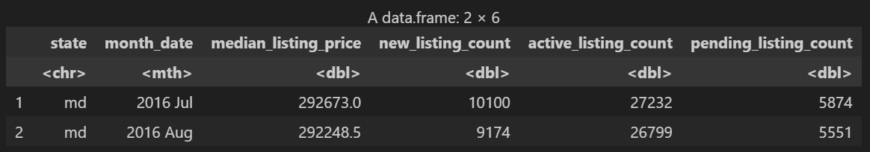
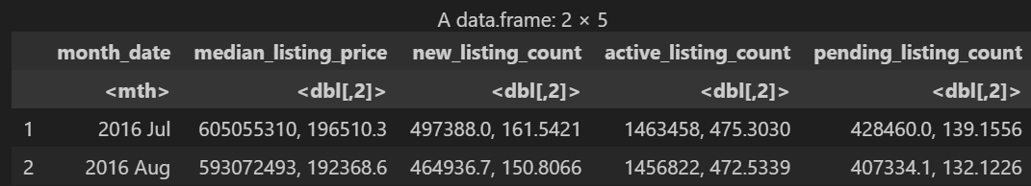
Performing National and State Level Aggregates

Slide 8
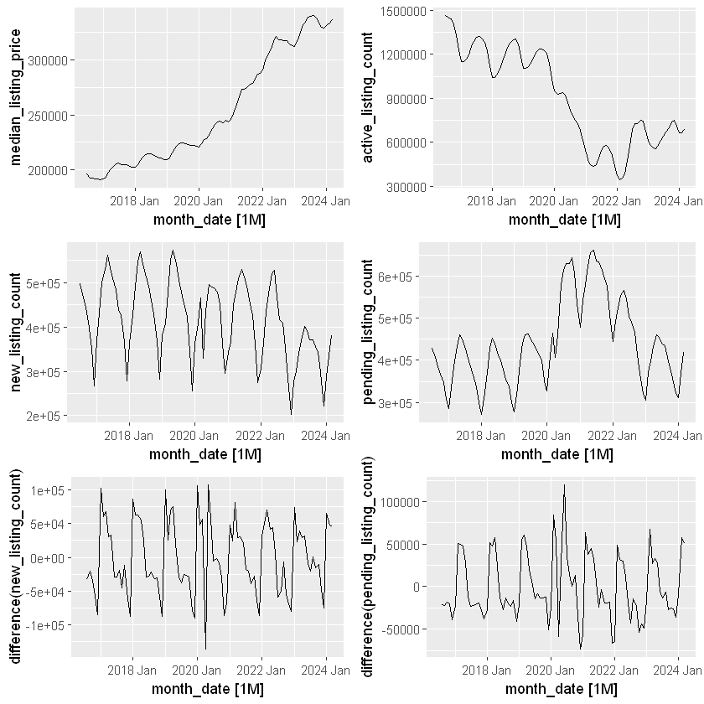
Working on National Aggregates
Here Percentage Change among months are showing some seasonality for new listing count and pending listing count

Slide 9
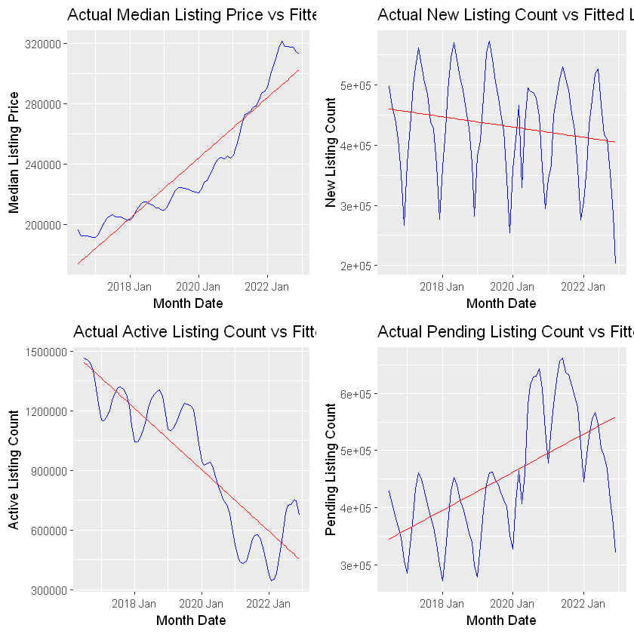
Fitting Linear Model
A comparative analysis of actual real estate listing data and linear regression predictions illustrating trends in the housing market from January 2018 to 2022.
The median listing price shows a consistent upward trajectory well captured by the regression model, indicating stable growth.
However, the new listings count displays significant seasonal fluctuations with a slight declining trend that the linear model simplifies, failing to capture the variability.
Similarly, active listings exhibit a general decline not fully aligned with the more stable predictions, particularly deviating around market disruptions like the COVID-19 pandemic.
The pending listings also demonstrate an upward trend with seasonal peaks, which the linear model only modestly reflects, suggesting complex market dynamics at play. Collectively, these graphs reveal that while linear regression can capture overarching trends in real estate data, it often oversimplifies or misses short-term fluctuations and seasonal variations.

Slide 10
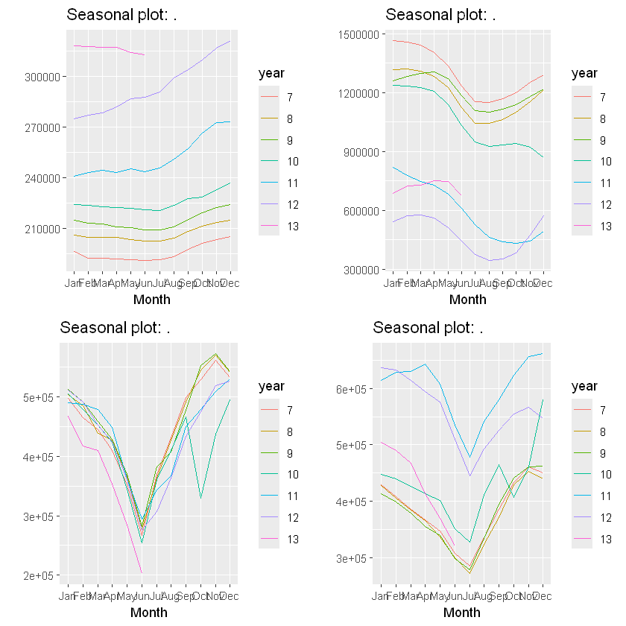
Analysing Seasonality
The four seasonal plots provided display variations in a dataset across different months and years, each showing an upward trend over time.
The median listing price plot reveals strong end-of-year growth, suggesting significant seasonal influences possibly related to consumer behavior or fiscal year-end activities.
The Active Listing Count plot shows more variability in its peaks, indicating fluctuations potentially driven by external factors.
The New listing Count plot exhibits a pronounced mid-year dip followed by a sharp rise, highlighting a significant recovery or seasonal effect towards year-end.
Lastly, the pending listing count plot similarly shows dips mid-year with peaks towards the end, consistent with seasonal cycles influencing the metrics. Each plot, while unique in its specific patterns, collectively underscores the impact of seasonal trends across various years, illustrating the importance of understanding these cycles for effective forecasting and strategic planning

Slide 11
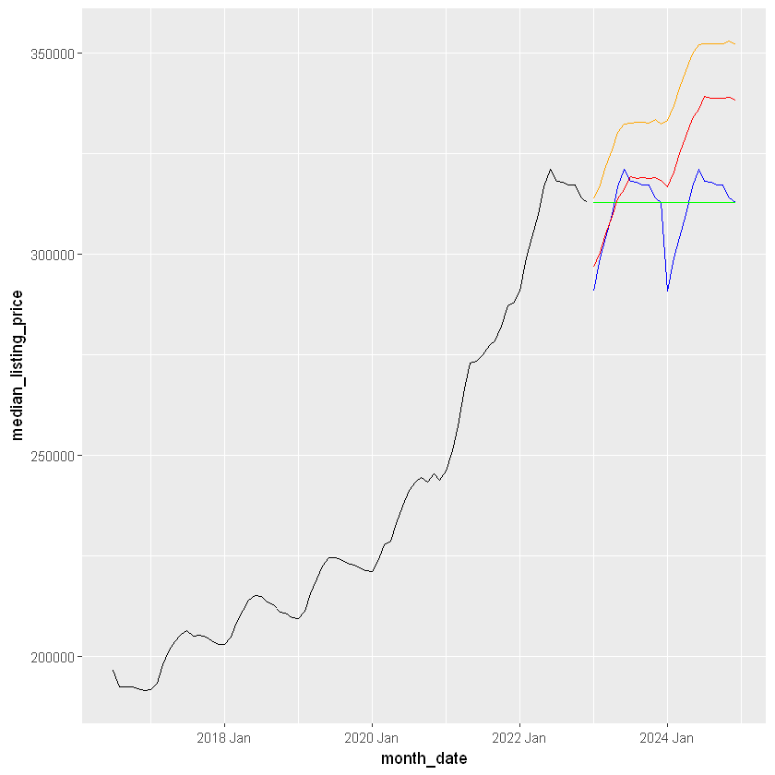
Developing models
Model Name | AIC | AICc | BIC | R_2
TSLM(Seasonal) | 1504.4969 | 1511 | 1537 | 0.895
TSLM (Trend) | 1677.2389 | 1683 | 1708 | 0.0144
TSLM(Seaosn+trend) | 1489. | 1489 | 1496 | 0.887

Slide 12
Final tips & takeaways
Consistent rehearsal
Strengthen your familiarity
Refine delivery style
Pacing, tone, and emphasis
Timing and transitions
Aim for seamless, professional delivery
Practice audience
Enlist colleagues to listen & provide feedback
Seek feedback
Reflect on performance
Explore new techniques
Set personal goals
Iterate and adapt

Slide 13
Speaking engagement metrics
Impact factor | Measurement | Target | Achieved
Audience interaction | Percentage (%) | 85 | 88
Knowledge retention | Percentage (%) | 75 | 80
Post-presentation surveys | Average rating | 4.2 | 4.5
Referral rate | Percentage (%) | 10 | 12
Collaboration opportunities | # of opportunities | 8 | 10

Slide 14
Thank you
Brita Tamm
502-555-0152
brita@firstupconsultants.com
www.firstupconsultants.com

