Slide 1
DIABETES PREDICTION FROM TONGUE IMAGE
Avinashilingam institute for home science and Higher Education for Women
School Of Engineering
Department Of Computer Science and Engineering
Domain: Machine learning
PRESENTED BY
DHARSHINI.K
YAMUNA.A

Slide 2
ABSTRACT
Diabetes is often diagnosed late due to reliance on invasive blood tests and symptomatic observations. Early detection is crucial, but current methods can be time-consuming, expensive, and inaccessible. This project proposes a non-invasive system for early diabetes detection using tongue image analysis. It uses OpenCV for preprocessing, including color correction and ROI extraction, followed by a Convolutional Neural Network (CNN) for feature extraction and classification. Trained on a labeled dataset, the system offers an accurate, cost-effective, and user-friendly method for diagnosing diabetes, enabling timely intervention and improved health outcomes.

Slide 3
OBJECTIVES
The objective of this project is to create a non-invasive, cost-effective system for early diabetes detection using tongue image analysis. By leveraging OpenCV for preprocessing and CNNs for feature extraction and classification, the system will identify key visual markers indicative of diabetes. It aims to provide an accessible tool that can analyze tongue images, offering users an instant diagnosis along with confidence levels. The system will be scalable for use in various settings, ensuring broad accessibility and early intervention. Ultimately, it seeks to improve diabetes detection and outcomes through an innovative, AI-driven approach.

Slide 4
PROBLEM DEFINITION
Late Diagnosis of Diabetes: Diabetes is often diagnosed at later stages due to reliance on invasive blood tests and symptomatic observations.
Inaccessibility and High Costs: Current diagnostic methods can be time-consuming, expensive, and inaccessible, particularly in underserved or remote areas.
Lack of Non-Invasive Solutions: Traditional medicine uses tongue analysis to detect underlying health conditions like diabetes, but modern systems have not leveraged this approach effectively.
Existing Methods Limitations: Existing diabetes detection methods do not provide a simple, cost-effective, and accessible solution for early diagnosis.
Need for Early, Non-Invasive Diagnosis: There is a critical need for an early, non-invasive diagnostic tool that can detect diabetes in its early stages, enabling timely intervention.
Opportunity for AI Integration: The project aims to use computer vision and AI techniques for a reliable, non-invasive, and accessible method of diabetes detection using tongue image analysis.

Slide 5
EXISTING SYSTEM
Fasting blood sugar test
Measures your blood sugar after fasting overnight. A fasting blood sugar level of 126 mg/dL (7 mmol/L) or higher on two separate tests indicates diabetes.
PROPOSED SYSTEM
The CNN processes the tongue images to automatically learn and extract relevant features, eliminating the need for manual feature engineering. The proposed method uses a well-structured CNN architecture to analyze the global and local patterns in tongue texture and classify the presence of diabetes with high accuracy.
By evaluating the model's performance on a reference dataset, the system demonstrates the effectiveness of combining image analysis with deep learning for non-invasive diabetes detection. This method offers a practical and efficient solution for early diabetes diagnosis, emphasizing the role of artificial intelligence in modern healthcare. The proposed system is designed to improve the accuracy and accessibility of diabetes screening, making it a valuable tool for timely prevention and treatment.

Slide 6
HOW IT WORKS
🔷 Workflow for Diabetic Analysis Using Tongue Images.The process is divided into four main steps:
1️⃣ Image Preprocessing Using OpenCV
Since raw tongue images may contain noise, shadows, and unwanted background, they need preprocessing before deep learning analysis. OpenCV is used for:
1.Noise Reduction - Apply Gaussian Blur or Median Filtering to remove unwanted noise
2. Color Normalization - Adjust brightness/contrast using histogram equalization.
3. Tongue Segmentation - Use Thresholding, Watershed Algorithm, or Deep Learning-based U-Net for separating the tongue from the background.
4. Feature Enhancement - Convert to HSV color space for better tongue color analysis.
2️⃣ Feature Extraction Using CNN
CNN automatically detects tongue color, texture, cracks, swelling, and coating. - The architecture consists of Convolutional Layers (feature extraction), Pooling Layers (downsampling), and Fully Connected Layers (classification).
CNN detects: - Redness (linked to inflammation). - Purple shades (blood stagnation). - Coating texture (linked to digestive health and diabetes). - Cracks & dryness (indicate dehydration or metabolic imbalance).

Slide 7
3️⃣ ML / Deep Learning for Classification
After extracting features, we classify the tongue image as Diabetic or Non-Diabetic using:
Machine Learning (ML) Classifiers - SVM (Support Vector Machine), Decision Trees, or Random Forests. - If features are manually extracted from OpenCV (e.g., color histograms, texture), ML classifiers can be trained.
Deep Learning (CNN, LSTM, ResNet, MobileNet) - CNNs classify images directly from pixel data. - Transfer Learning(ResNet, VGG16, MobileNet) can be used for higher accuracy.
4️⃣ Feature Selection Using Optimization Algorithms
If feature selection is needed to reduce redundant data, optimization techniques like FODPSO (Fractional-Order Darwinian Particle Swarm Optimization) or Genetic Algorithm (GA) are applied. - These methods improve classification accuracy by selecting the most relevant features.

Slide 8
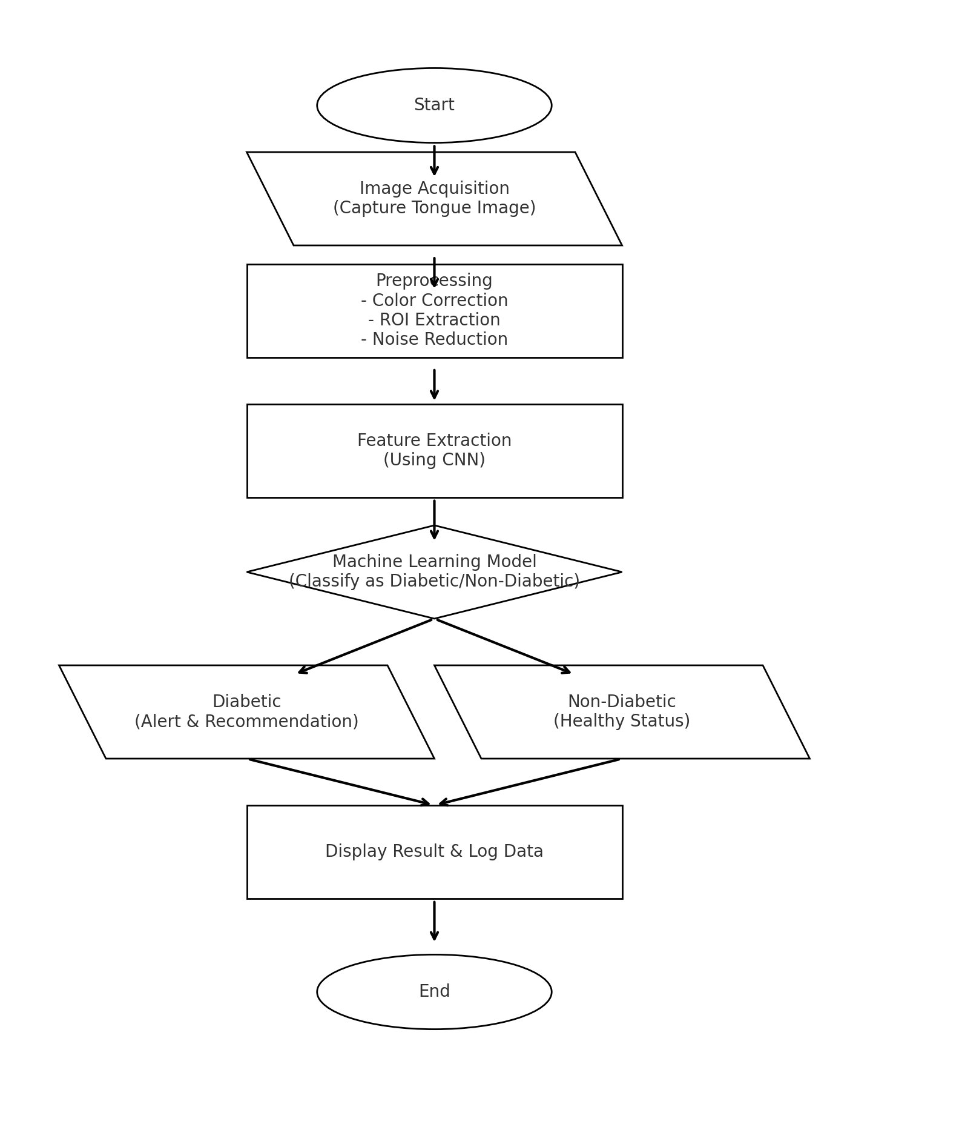
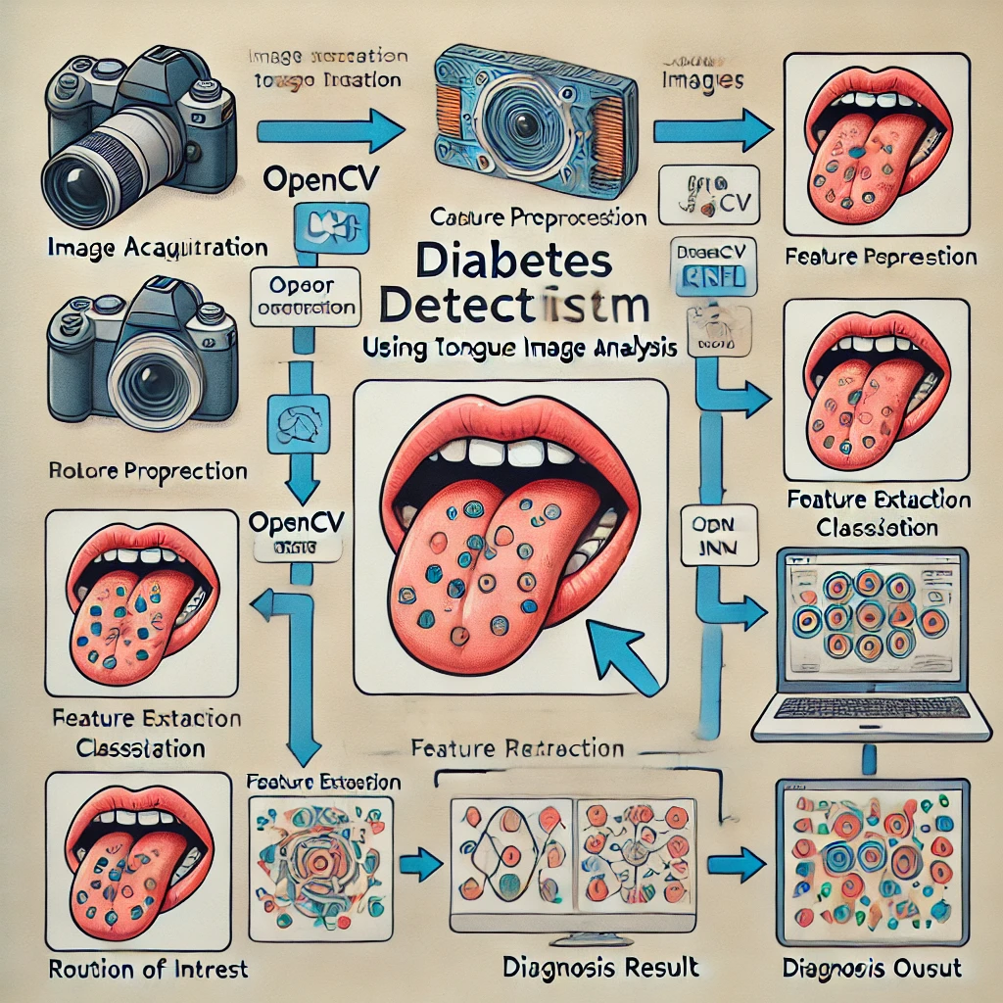
FLOW CHART

Slide 9
CONCLUSION
The proposed system for diabetes detection using tongue image analysis presents a non-invasive,
cost-effective, and accessible alternative to traditional diagnostic methods.
By leveraging OpenCV for image preprocessing and CNN for feature extraction and classification,
the system can identify diabetes-related visual indicators with high accuracy.
This approach eliminates the need for invasive blood tests and offers a rapid screening tool, especially beneficial for early detection and monitoring.
With further optimization, a larger dataset, and integration with mobile applications, this AI-driven system has the potential to revolutionize diabetes diagnosis, making healthcare more efficient and widely available.
Future work may involve improving model accuracy, expanding the dataset to include diverse demographics, and integrating real-time feedback for enhanced usability.

Slide 10
References:
https://scholar.google.com/scholar?hl=en&as_sdt=0,5&q=diabetes+prediction+using+tongue#d=gs_qabs&t=1734626834963&u=%23p%3D8CAEyPXMQLgJ
Patel, R., et al. (2020). "Deep Learning for Non-Invasive Diagnosis." IEEE Transactions on Artificial Intelligence in Medicine.
Gupta, S., et al. (2021). "Diabetes Detection Using CNN and Image Processing." IEEE Access.
Journal of biomedical informatics 115, 103693, 2021

Slide 11
THANK YOU!

