Slide 1
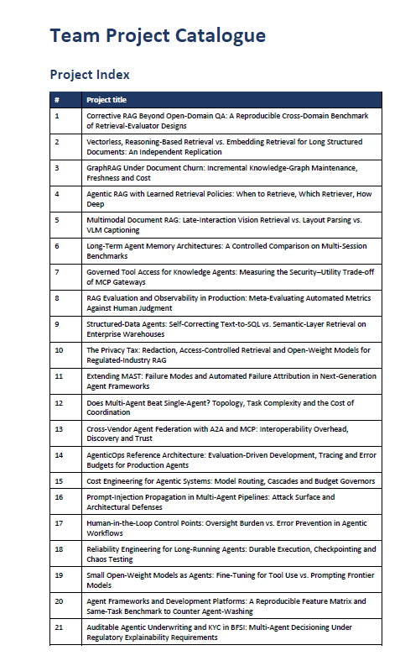

Slide 2
Paper 1 — AgentOps: Enabling Observability of LLM Agents
Liming Dong, Qinghua Lu & Liming Zhu (2024) | Literature foundation for AgenticOps observability
What I understood
Difficulty identified
How the authors addressed it
LLM agents are autonomous and non-deterministic, so final success/failure alone is not enough.
Agent behaviour must be observable across its lifecycle using traces, logs and operational data.
There was no clear standard for exactly what should be observed in an AI agent.
Existing AgentOps tools captured different artifacts and data, making monitoring inconsistent.
They systematically mapped existing AgentOps tools.
They proposed an AgentOps taxonomy describing artifacts and data that should be traced for monitoring, analytics and anomaly detection.
How this supports the Oracle Fusion project
We can instrument an Oracle Fusion agent so every important action is traceable before and after deployment.
Example: if an AP/Tax agent starts giving incorrect tax decisions after a prompt, model or tool change, the AgenticOps layer should expose the behavioural change and trigger containment.
https://arxiv.org/abs/2411.05285 - 2024
Oracle Fusion Agent
Trace / Log
Monitor
Detect Regression
Alert / Contain
Source: arXiv 2411.05285

Slide 3
Paper 2 — AgentBoard: Analytical Evaluation of Multi-turn LLM Agents
Chang Ma et al. (NeurIPS 2024) | Literature foundation for fine-grained regression evaluation
What I understood
Difficulties identified
How the authors addressed them
A simple final task-success score does not show where a multi-step agent started failing.
Agent evaluation should measure intermediate progress and behaviour, not only the final outcome.
Agents had to be compared across different tasks and multi-round interactions.
Evaluation also had to work in partially observable environments and reveal failure points rather than only PASS/FAIL.
They created AgentBoard with 9 tasks and 1,013 environments.
They introduced fine-grained progress-rate analysis and tools for examining trajectories, grounding and long-range agent interactions.
How this supports our Oracle Fusion project
We can compare a baseline Oracle Fusion agent with a changed version and define regression thresholds before release.
Example: V1 = 95% task success → new prompt/model/tool → V2 = 82% plus poorer intermediate progress → regression detected → release blocked or production version contained.
https://proceedings.neurips.cc/paper_files/paper/2024/hash/877b40688e330a0e2a3fc24084208dfa-Abstract-Datasets_and_Benchmarks_Track.html - 2024
Baseline V1
Change
Evaluate V2
Regression?
Block / Contain
Source: NeurIPS 2024 — AgentBoard: An Analytical Evaluation Board of Multi-turn LLM Agents

Slide 4
PAPER 1 · BENCHMARKING & EVALUATION
AIOpsLab: A Holistic Framework to Evaluate AI Agents for Enabling Autonomous Clouds
Chen, Y., Shetty, M., Somashekar, G., et al. arXiv:2501.06706, 2025
i
T
!
What It Proposes
4-Level Task Taxonomy
Key Findings & Gaps
An orchestrator-based benchmark suite that evaluates AI agents on real, live cloud microservice deployments (SocialNetwork, HotelReservation, Astronomy Shop, TiDB).
Formalizes an AIOps problem as a triple: Task, Context, and expected Solution (oracle).
Agent-Cloud Interface (ACI) standardizes actions and observations (get_logs, get_metrics, get_traces, submit).
Level 1 — Detection: flag anomalies/deviations (Time-to-Detect).
Level 2 — Localization: pinpoint the faulty microservice.
Level 3 — Root Cause Analysis: identify the underlying cause.
Level 4 — Mitigation: recover the environment (hardest task).
Faults span symptomatic (network loss, pod failure) and functional (app/virtualization-level) categories.
LLM agents (GPT-4, ReAct, Flash) beat classical baselines (PDIAGNOSE, RMLAD, MKSMC) but accuracy drops sharply from detection (~70-100%) to mitigation (~27-55%).
Agents waste steps: repeated API calls, hallucinated scripts (e.g., non-existent analyze_data.py).
Metrics/traces are under-used — agents struggle to interpret raw telemetry without visualization.
Relevance to Capstone: Provides a rigorous, reusable evaluation harness (tasks, fault library, metrics) that our project can adopt or adapt to benchmark our own AIOps/incident-management agent against realistic microservice failures.
Literature Survey — Capstone Project
1 / 2
Notes:
Cloud systems have outgrown manual operations. Modern microservice clouds generate huge volumes of logs, metrics and traces, and incidents must be detected, localized, diagnosed and mitigated faster than humans can react.
LLM agents raise a new question. With GenAI, agents can reason over telemetry and take action — but the field lacks (a) rigorous ways to evaluate whether they actually work, and (b) an agreed architecture for how autonomy should be governed.
P = ⟨T, C, S⟩ — every benchmark problem is a Task, a Context and an expected Solution
“Can an agent do this task well?” (measurement)
Real running microservice clouds + injected faults
Implicit — agent acts within a sandboxed ACI
Working open-source benchmark, reusable & extensible

Slide 5
PAPER 2 · CONCEPTUAL FRAMEWORK
A Practical Approach to Defining a Framework for Developing an Agentic AIOps System
Zota, R.D., Bărbulescu, C., Constantinescu, R. Electronics, 14(9), 1775, 2025 (MDPI)
V
F
P
Vision & Definition
3-Dimensional Framework
Principles & Limitations
Traces AIOps evolution: Observability → Predictive AIOps → Agentic AIOps (autonomous, hyper-automated).
Defines Agentic AIOps as a system that autonomously understands, decides, and acts on incidents/requests — aligned with ITIL Service Operation practice.
Positions Agentic AIOps as the next step beyond current tools (Watson AIOps, Splunk, ServiceNow), which remain largely observability-focused.
Process dimension: ITIL/PRM-IT processes — Event, Service Execution, Request Fulfillment, Incident & Problem Management.
Service dimension: Application → Platform → Infrastructure layers (NIST cloud model).
Capability dimension: Understand → Decide → Take Action loop, mapped to AI components (classifier, RAG, automation, LLM).
Core principles: progressive autonomy (10 levels), process standardization, service-aware design, continuous learning, human oversight.
Worked example: incident management mapped to discriminative-AI, RAG, and automation components.
Purely conceptual — no experimental validation yet; security/governance left as future work.
Relevance to Capstone: Offers a top-down architectural blueprint (process x service x autonomy) to design our system's components and justify autonomy levels, complementing AIOpsLab's bottom-up empirical benchmarking.
Literature Survey — Capstone Project
2 / 2
Notes:
Conceptual / architectural framework
What should an autonomous, ITIL-aligned AIOps system look like?
A 3-D framework + 10-level autonomy model + working definition
No empirical results — vision / design paper
ITIL , PRM-IT integration and enterprise architecture
Proposed direction:
No study benchmarks an ITIL-aligned Agentic AIOps design (Paper 2's framework) using a rigorous, reproducible evaluation harness (Paper 1's methodology).
Autonomy-level governance (10-level model) is proposed conceptually but never measured against agent behavior in a live benchmark.
Failure modes identified in AIOpsLab (wasted steps, overloaded telemetry) are exactly the risks Paper 2's “Human Oversight” principle is meant to catch — untested in practice.
Design a small Agentic AIOps prototype for one ITIL process (e.g., Incident Management) following the Understand–Decide–Act loop, then evaluate it using an AIOpsLab-style benchmark (fault injection + task metrics) to quantify accuracy, steps taken, and failure modes at each autonomy level.
Conclusion : the future of AIOps relies on bridging the gap between rigorous academic benchmarking and practical, secure enterprise integration

Slide 6
Area | AgentOps (2024) | AgentBoard (2024) | What we can add
Agent observability | ✅ Strong | Limited | Use it
Fine-grained evaluation | Limited | ✅ Strong | Use it
Pre-release regression testing | ❌ Not the main contribution | Partial foundation | Build automated regression gate
Baseline vs new agent version | ❌ | Evaluation supports comparison conceptually | Explicit V1 vs V2 regression framework
Automatic release blocking | ❌ | ❌ | Add it
Production regression detection | Observability foundation | ❌ | Add continuous detection
Automatic containment | ❌ | ❌ | Major addition
Rollback/fallback | ❌ | ❌ | Add it
Human escalation | ❌ | ❌ | Add it
Enterprise ERP validation | ❌ | ❌ | Oracle Fusion use case
Financial/ERP business-risk metrics | ❌ | ❌ | Add domain-specific metrics
End-to-end AgenticOps pipeline | ❌ | ❌ | Your main contribution

