Slide 1
M.TECH CAPSTONE | INITIAL PROOF OF CONCEPT
Evaluation-Driven AgenticOps
Tracing, regression detection and release safety for automated workflows
PROGRESS REVIEW
Working LangGraph baseline • Controlled regression • OpenTelemetry spans
Scope: rule-based prototype; advanced workflow experiments are planned.
AgenticOps Reference Architecture • 24 October 2026
01 / 08

Slide 2
CAPSTONE PROGRESS REVIEW
Research problem and objectives
Production agents can regress after changes to prompts, tools or workflows.
Execution visibility alone does not establish answer correctness.
Research objective: combine tracing, evaluation and release decisions.
Evaluate whether automated gates detect and contain controlled regressions.
AgenticOps Reference Architecture • 24 October 2026
02 / 08

Slide 3
CAPSTONE PROGRESS REVIEW
Proposed AgenticOps architecture
INPUT TASK
User request
↓
OBSERVABILITY
LANGGRAPH
Classify → respond
OpenTelemetry
Parent + node spans
Timing and attributes
↓
EVALUATION
Accuracy • latency • failures
↓
RELEASE GATE
Pass / block candidate
Planned: Phoenix/Langfuse, advanced workflows, CI evaluation and longitudinal study.
AgenticOps Reference Architecture • 24 October 2026
03 / 08

Slide 4
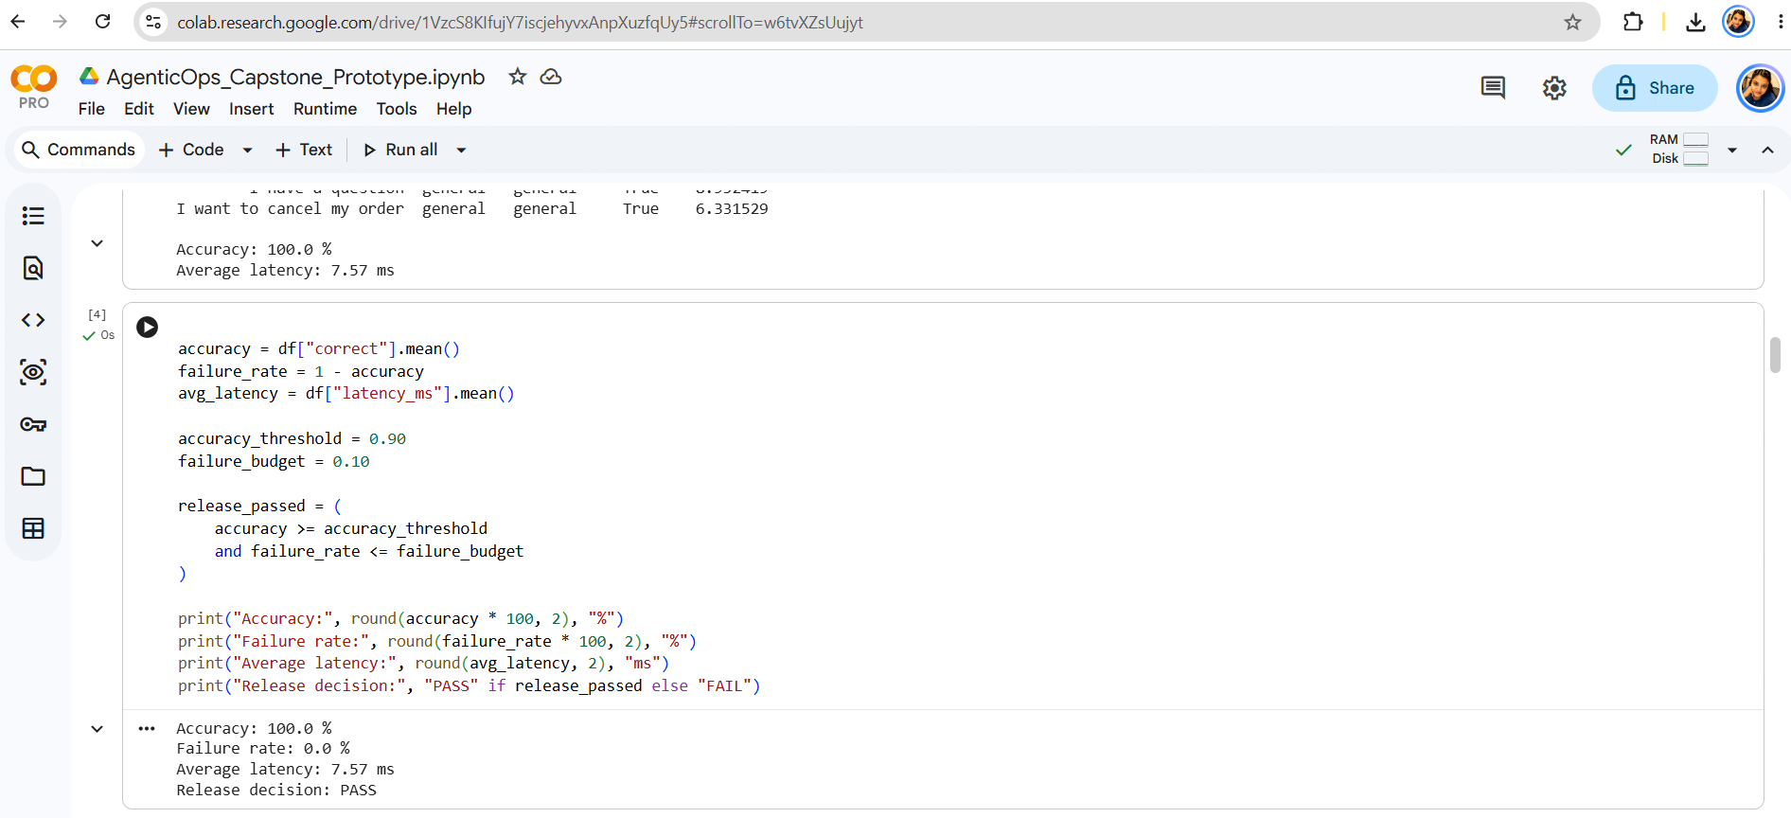
CAPSTONE PROGRESS REVIEW
Implemented baseline and evaluation
10/10 correct | 100% accuracy | 7.57 ms mean latency | PASS
AgenticOps Reference Architecture • 24 October 2026
04 / 08

Slide 5
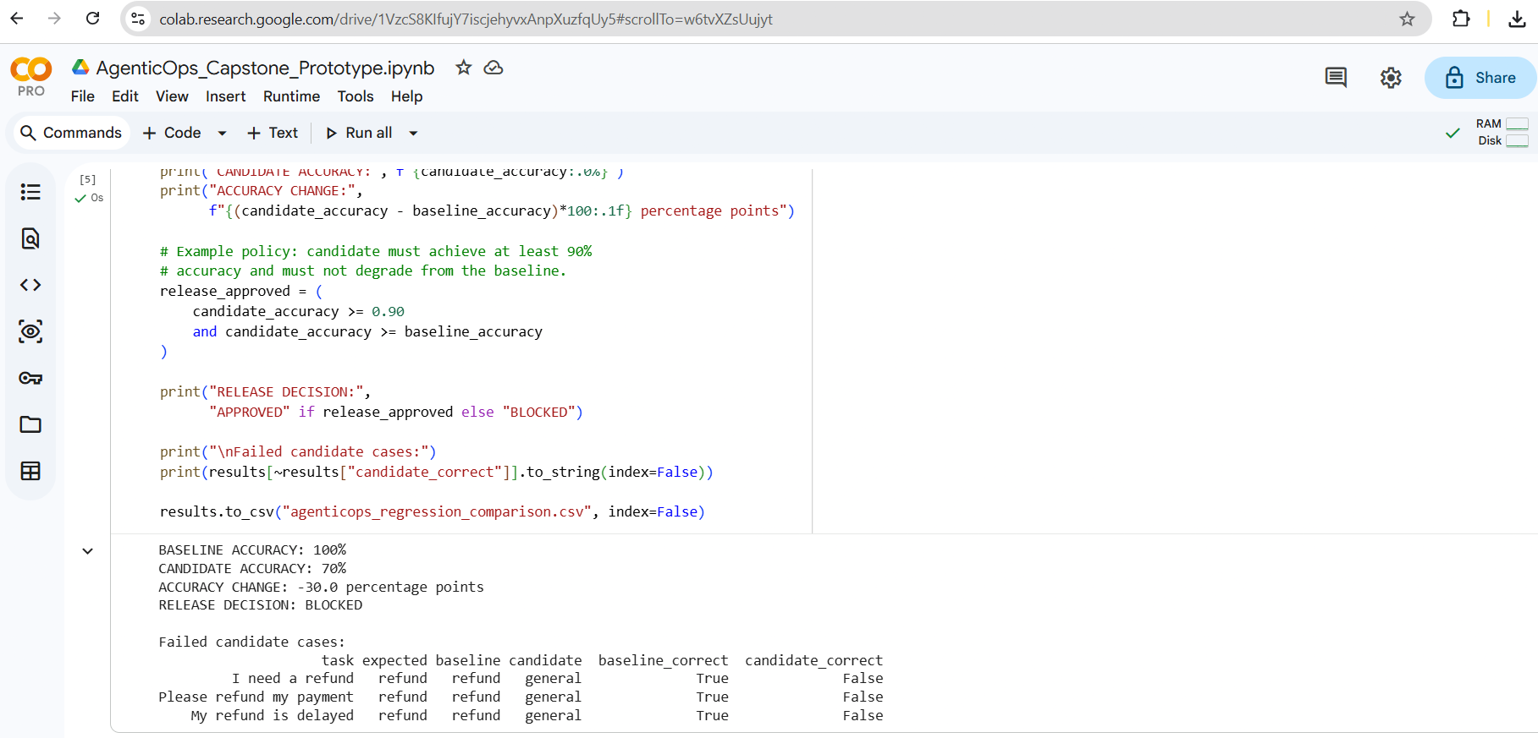
CAPSTONE PROGRESS REVIEW
Controlled regression experiment
Baseline 100% → Candidate 70% | −30 percentage points | BLOCKED
AgenticOps Reference Architecture • 24 October 2026
05 / 08

Slide 6
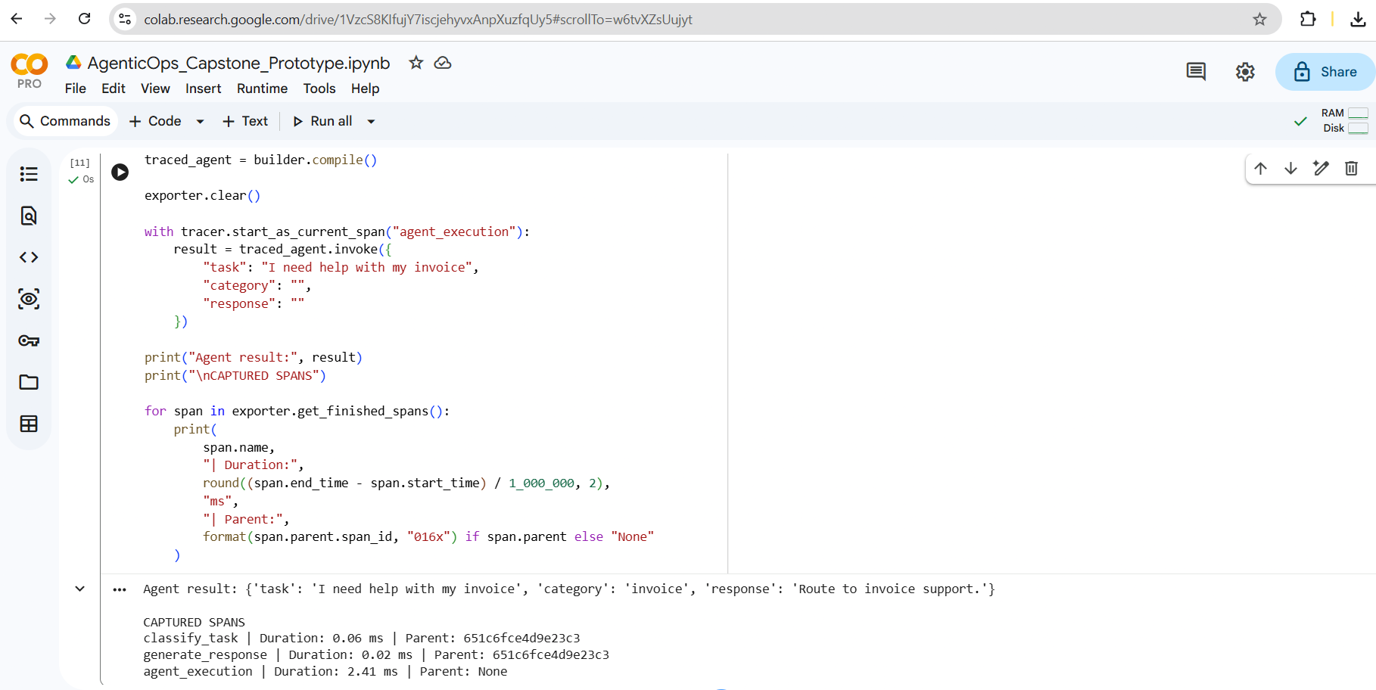
CAPSTONE PROGRESS REVIEW
OpenTelemetry trace verification
3 spans: agent_execution (2.41 ms), classify (0.06 ms), respond (0.02 ms)
AgenticOps Reference Architecture • 24 October 2026
06 / 08

Slide 7
CAPSTONE PROGRESS REVIEW
What these results establish — and do not
VERIFIED TODAY
NOT YET CLAIMED
Executable rule-based LangGraph workflow
Advanced workflow evaluation
10-case baseline evaluation
Real-world accuracy or robustness
Intentional regression detected
Phoenix/Langfuse dashboard
Threshold-based release block
Automated CI/CD deployment
Parent/child OpenTelemetry spans
Longitudinal 12-week results
AgenticOps Reference Architecture • 24 October 2026
07 / 08

Slide 8
CAPSTONE PROGRESS REVIEW
Next milestones and discussion
Near term: add Phoenix visualization and export structured traces.
Build two advanced workflows with a larger, independently labeled test set.
Define error budgets, regression thresholds and CI evaluation gates.
Run repeated experiments; compare trace fidelity, failures and containment.
Document methodology, limitations and reproducible results in GitHub/Overleaf.
Discussion: feedback on scope, evaluation metrics and study design
AgenticOps Reference Architecture • 24 October 2026
08 / 08

