Slide 1
M.TECH CAPSTONE | INITIAL PROOF OF CONCEPT
Continuous Evaluation & Regression Detection
Continuous regression evaluation, execution tracing and release safety
PROGRESS REVIEW
Baseline validated • Regression blocked • GitHub Actions PASS verified
Scope: rule-based prototype; advanced workflow experiments are planned.
AgenticOps Reference Architecture • 24 October 2026
01 / 08

Slide 2
CAPSTONE PROGRESS REVIEW
Research problem and objectives
Production agents can regress after changes to prompts, tools or workflows.
Execution visibility alone does not establish answer correctness.
Research objective: continuously evaluate changes using traces and release gates.
Validated in Colab; automated CI evaluation passed on GitHub Actions.
AgenticOps Reference Architecture • 24 October 2026
02 / 08

Slide 3
CAPSTONE PROGRESS REVIEW
Proposed AgenticOps architecture
INPUT TASK
User request
↓
OBSERVABILITY
LANGGRAPH
Classify → respond
OpenTelemetry
Parent + node spans
Timing and attributes
↓
CONTINUOUS EVAL
Accuracy • latency • failures
↓
RELEASE GATE
Pass / block candidate
GitHub Actions evaluation runs on changes, manually and daily; dashboard and longitudinal study planned.
AgenticOps Reference Architecture • 24 October 2026
03 / 08

Slide 4
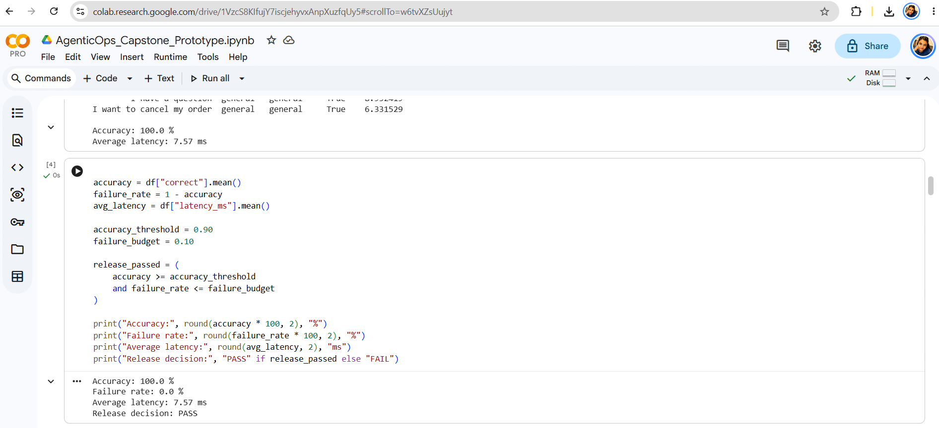
CAPSTONE PROGRESS REVIEW
Baseline: initial evaluation result
10/10 correct | 100% accuracy | 7.57 ms mean latency | PASS
AgenticOps Reference Architecture • 24 October 2026
04 / 08

Slide 5
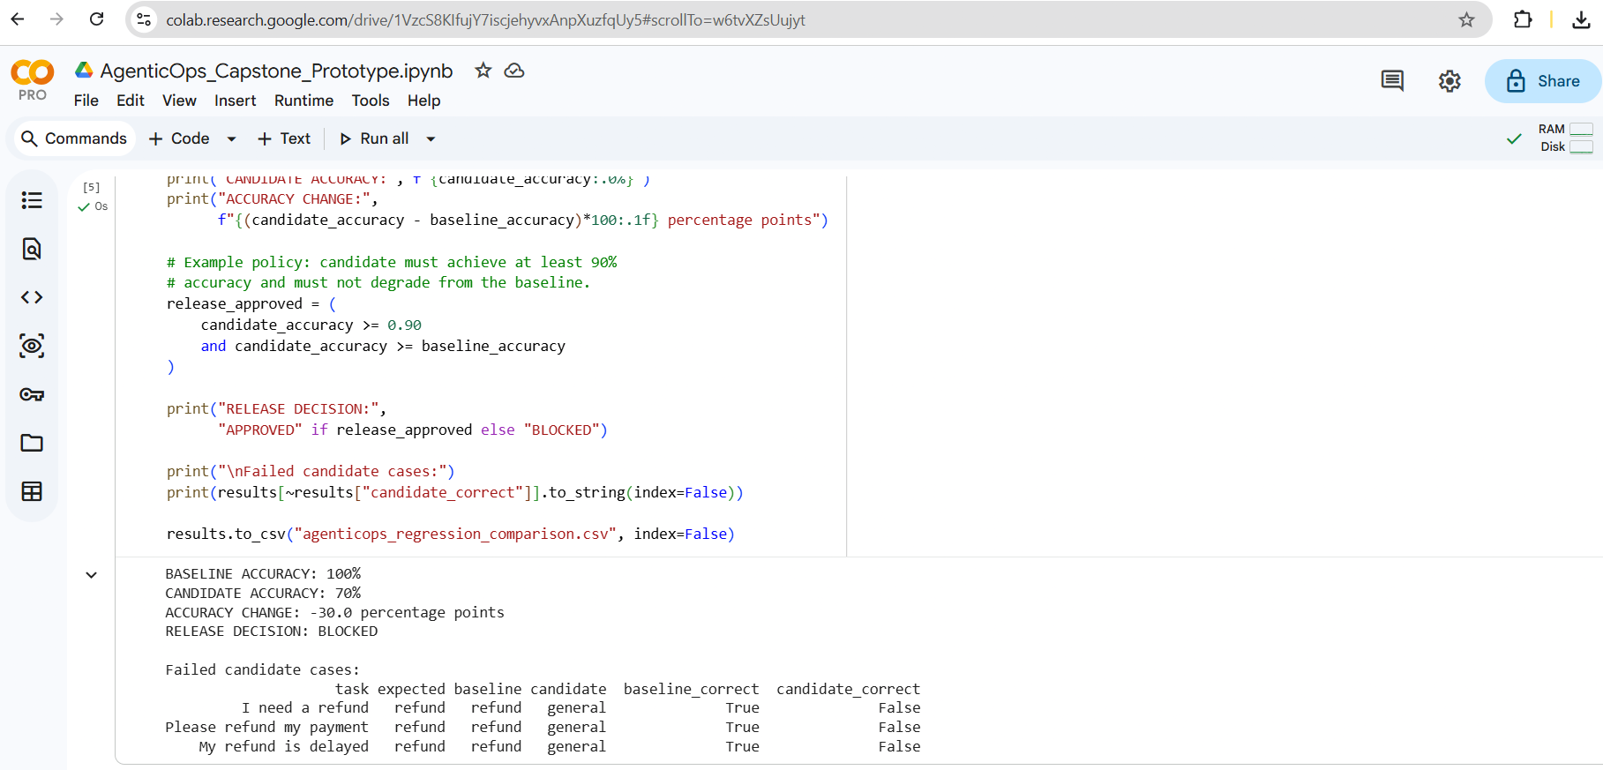
CAPSTONE PROGRESS REVIEW
Regression detection: initial validation
Baseline 100% → Candidate 70% | −30 percentage points | BLOCKED
AgenticOps Reference Architecture • 24 October 2026
05 / 08

Slide 6
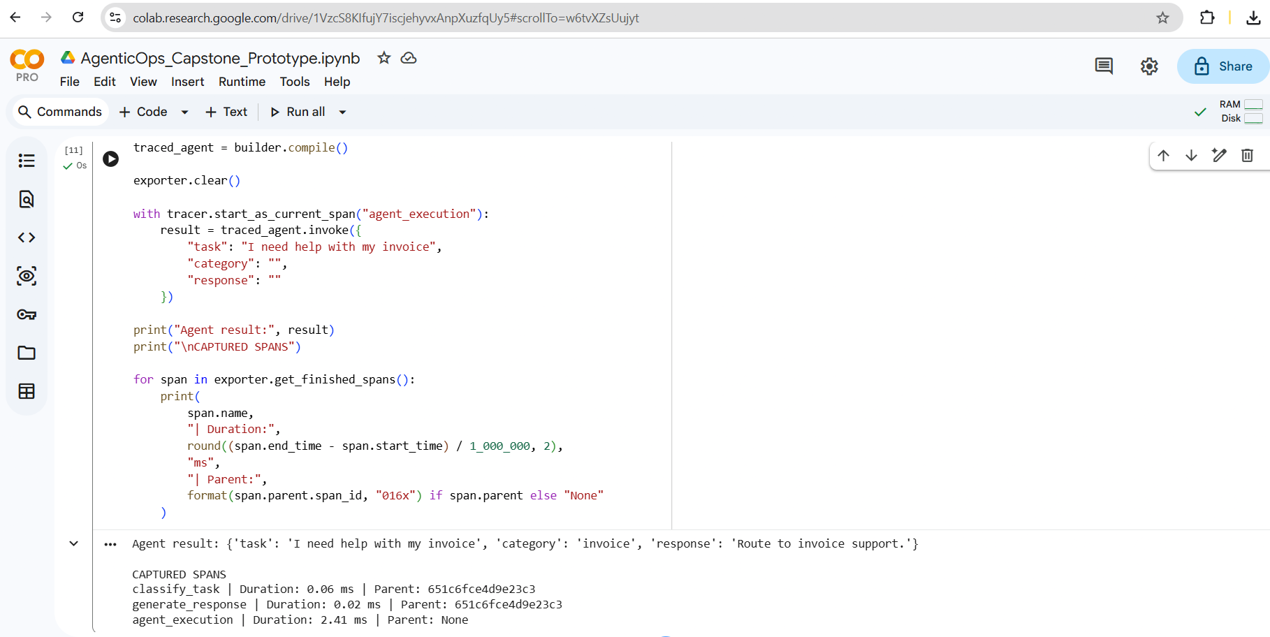
CAPSTONE PROGRESS REVIEW
Tracing evidence for continuous evaluation
3 spans: agent_execution (2.41 ms), classify (0.06 ms), respond (0.02 ms)
AgenticOps Reference Architecture • 24 October 2026
06 / 08

Slide 7
CAPSTONE PROGRESS REVIEW
Continuous evaluation: CI run verified
VERIFIED PROTOTYPE
VERIFIED IN GITHUB ACTIONS
Executable rule-based LangGraph workflow
Workflow #9 succeeded (35 seconds)
10-case baseline evaluation
10/10 baseline and candidate correct
Intentional regression detected
Baseline: 100% | Candidate: 100%
Threshold-based release block
Release gate PASS; artifact exported
Parent/child OpenTelemetry spans
Mean latency: 0.931 / 0.700 ms
AgenticOps Reference Architecture • 24 October 2026
07 / 08

Slide 8
CAPSTONE PROGRESS REVIEW
Continuous evaluation: next milestones
Completed: GitHub Actions #9 passed; evaluation report archived.
Next: verify CI BLOCK on deliberately regressed candidate (70%).
Strengthen CI gate thresholds; define error budgets and latency criteria.
Extend to two workflows; add dashboard and repeated regression studies.
Record CI run artifacts, methodology and evidence in GitHub/Overleaf.
Discussion: feedback on scope, evaluation metrics and study design
AgenticOps Reference Architecture • 24 October 2026
08 / 08

