Slide 1
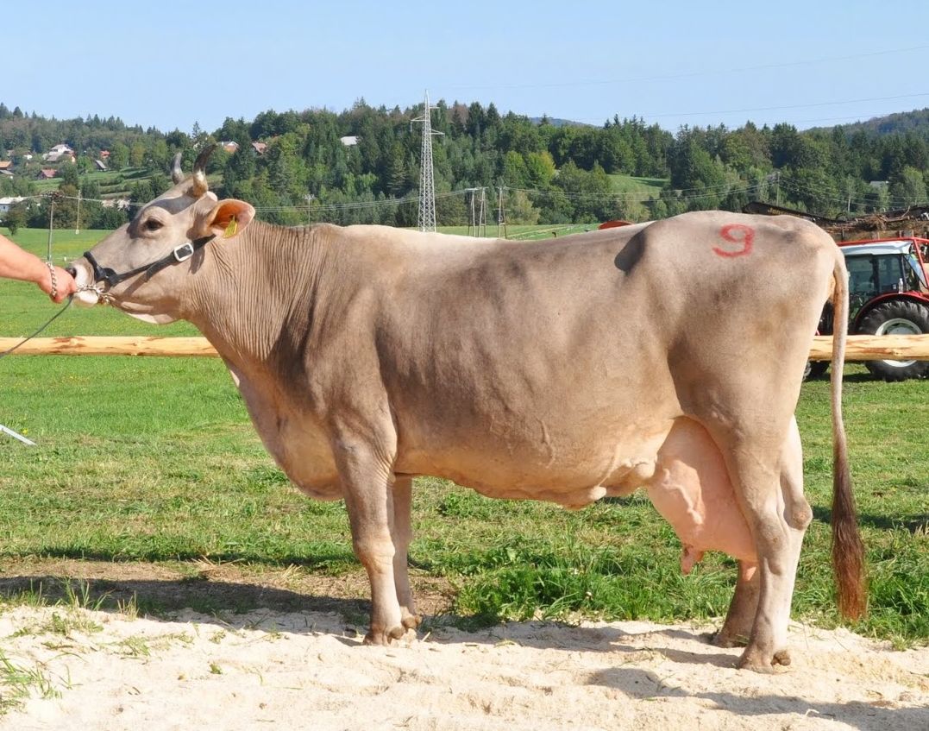
ESTIMATION OF INBREEDING IN SLOVENIAN BROWN - SWISS POPULATION
Jana Obšteter¹, Betka Logar¹
¹Kmetijski Inštitut Slovenije
Ptuj, 21.9.2016

Slide 2
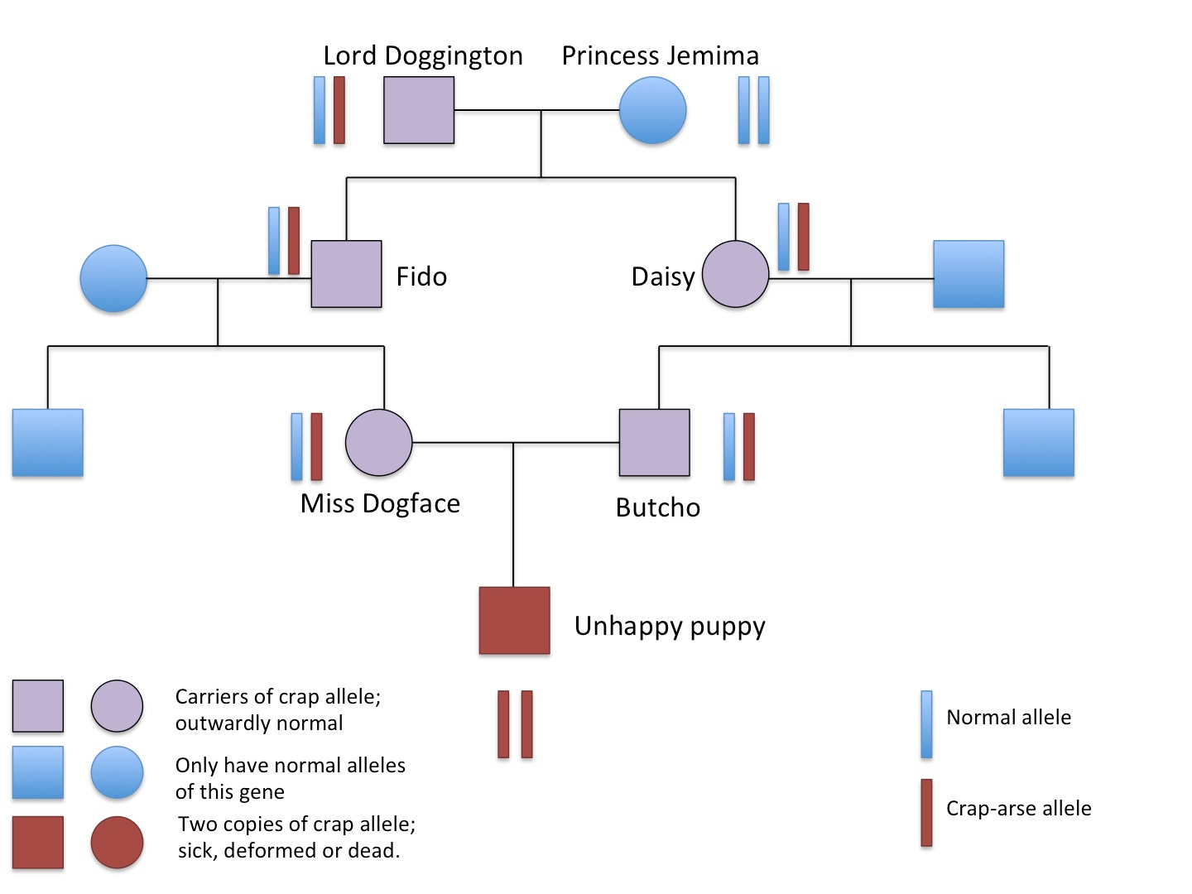
INBREEDING
Inbreeding: probability of the two alleles at a locus being identical by descend

Slide 3
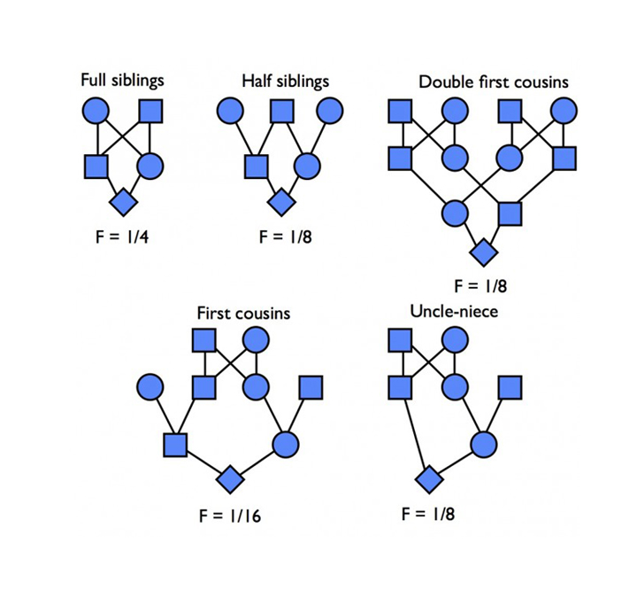
1) Estimation from pedigree
Base population: F= 0, unrelated
PROBLEM:
pedigrees not complete
→ F underestimated

Slide 4
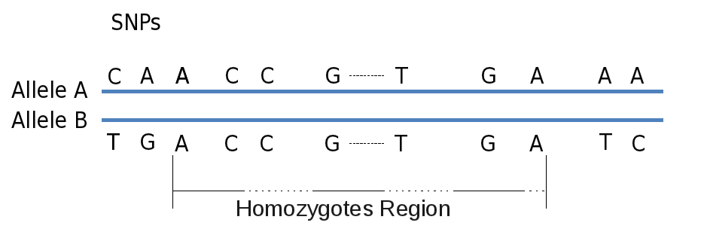
2) Estimation from genomic data
  Runs of homozygosity
  initiation of cattle domestication (~12,000 years ago), and the intensification of population isolation and current population bottleneck that breeds have experienced worldwide within the last ~700 years
  Recombination breaks up LD blocks

Slide 5
MATERIALS AND METHODS
    DATA
Genotypes of 214 Slovenian Brown-Swiss animals, 2003 - 2016
Served as a reference population for pedigree construction
    PEDIGREE INBREEDING
Pedigree: 2653 animals, 880 males + 1773 females (Govedo)
F_{ped} = , PEDIG / POPREP

Slide 6
    GENOMIC INBREEDING
Different genotyping chips → FIMPUTE: imputation onto Illumina 50K version 2
PLINK 1.9: ROH analysis
F_{ROH} = Σ L _{ROH} / Σ L _{AUTO}
Cut-off for ROH length: >1MB, >2MB, >4MB, >8MB, >16MB
    RATE OF INBREEDING AND EFFECTIVE POPULATION SIZE
ln (1 – F_{Y}) = ln (1 – F₀) + βY + e
ΔF = (1 – e^{β}) * average generation interval
N_{e} = 1 / (2*ΔF)

Slide 7
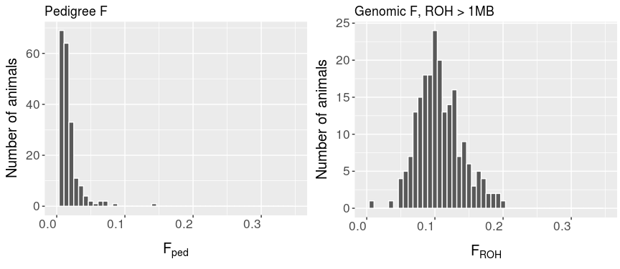
RESULTS

