Slide 1




Testing different genomic selection scenarios in a small cattle population by simulation
JANA OBŠTETER
Janez JENKO
Gregor GORJANC
John M. HICKEY
WCGALP 2018
Auckland, New Zealand, 13th February 2018

Slide 2
1) Develop the simulator
2) Test conventional and genomic breeding scenarios
3) Compare efficiencies of scenarios

Slide 3
1) Develop the simulator
Cattle population under selection
Overlapping generation
User-defined selection parameters
  % selected, years in use , dosage, selection criterion ...
Progeny and genomic testing
Python wrapper around AlphaSim (Faux et al., 2012) and blupf90 (Misztal et al., 2002)

Slide 4
ID FID MID TGV Ph
...
10 1 3 3.45 2.31
11 1 7 5.31 6.98
12 2 8 2.31 3.42
INITIAL POPULATION
- 40 generations
- 10 chromosomes
- 10.000 QTNs
- h² = 0.25
AGTCTTATATTTGCGTA …
CTGCATAAAAGCGCGC…
TGCATTTTGACGATATA ...
ID FID MID TGV Ph
...
10 1 3 3.45 2.31
11 1 7 5.31 6.98
12 2 8 2.31 3.42
EBV
…
2.88
6.01
2.76
1) BREEDING VALUE ESTIMATION
blupf90
AGTCTTATATTTGCGTA …
CTGCATAAAAGCGCGC…
TGCATTTTGACGATATA ...
EACH SELECTION CYCLE
ID FID MID TGV Ph
...
10 1 3 3.45 2.31
11 1 7 5.31 6.98
12 2 8 2.31 3.42
30 11 12
31 11 23
32 2 19
EBV
…
2.88
6.01
2.76
AGTCTTATATTTGCGTA …
CTGCATAAAAGCGCGC…
TGCATTTTGACGATATA ...
2) SELECTION
Python script
User defined parameters
ID FID MID TGV Ph
...
10 1 3 3.45 2.31
11 1 7 5.31 6.98
12 2 8 2.31 3.42
…
30 11 12 1.55 2.10
31 11 23 4.71 3.45
32 2 19 5.33 6.76
EBV
…
2.88
6.01
2.76
AGTCTTATATTTGCGTA …
CTGCATAAAAGCGCGC…
TGCATTTTGACGATATA ...
3) MATING
AlphaSim
CTGCTGAGATGTTTTT ...
AATACGCGGGGCATAT…
TGCGTGCAGTAGCGT ...

Slide 5
2) Test the scenarios
 | SIRES OF SIRES | SIRES OF DAMS
Conventional
Genomic A
Genomic B
Genomic C
Genomic D
Progeny testing
- pre-selection on parent average
Progeny testing
- pre-selection on gEBV
Genomic testing

Slide 6
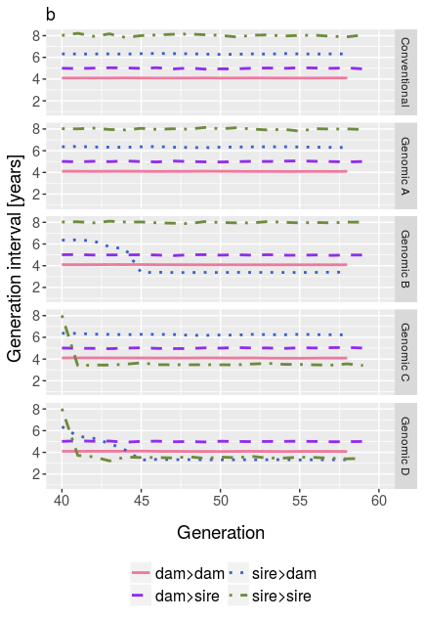
2) Test the scenarios – generation interval

Slide 7
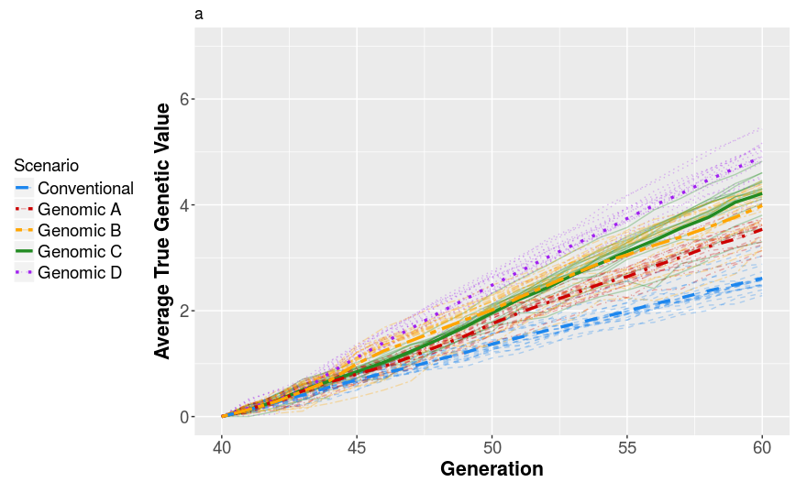
2) Test the scenarios – genetic gain

Slide 8
1 bull every year / 5 years
5 bulls every year / 1 year

Slide 9
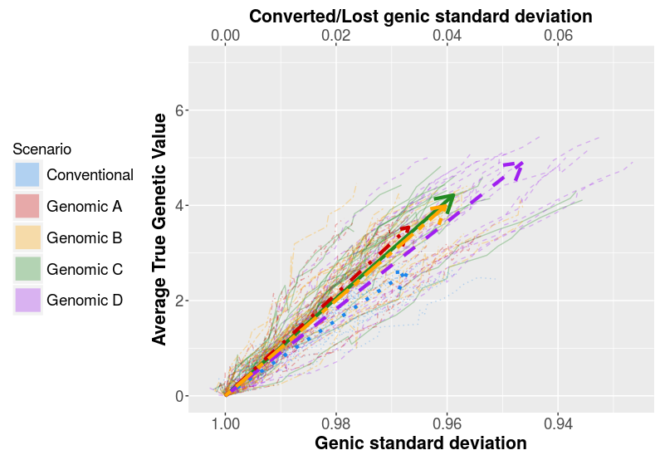
3) Compare selection efficiencies

Slide 10
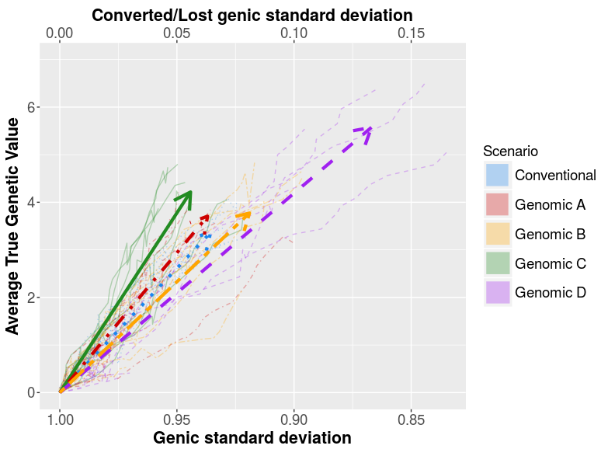
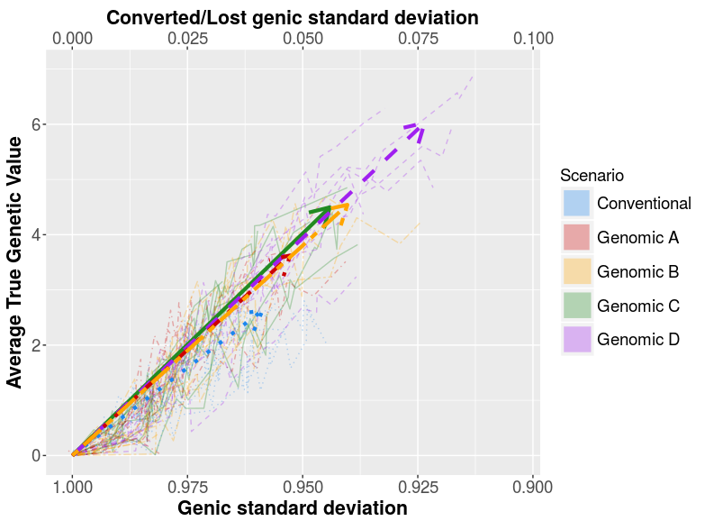
1 bull every year / 5 years
5 bulls every year / 1 year

Slide 11
CONCLUSION
Stochastic simulation to obtain genetic gain
Developed tool for testing scenarios on a realistic cattle population
Genomic selection: decreased generation interval → increased genetic gain
Most comprehensive genomic scenarios not the most efficient
Replicates in progress

