Slide 1

5 bulls / 5 years
1 bull / 5 years
5 bulls / 1 year
Conventional
Genomic A
Genomic B
Genomic C
Genomic D
Conventional
Genomic A
Genomic B
Genomic C
Genomic D
Conventional
Genomic A
Genomic B
Genomic C
Genomic D
shorter generation interval
reduced Ne

Slide 2



Testing different genomic selection scenarios in a small cattle population by simulation
JANA OBŠTETER
Janez JENKO
Gregor GORJANC
John M. HICKEY
WCGALP 2018
Auckland, New Zealand, 13th February 2018

Slide 3
1) Develop the simulator
2) Test conventional and genomic breeding scenarios
3) Compare efficiencies of scenarios

Slide 4
1) Develop the simulator
Cattle population under selection
Overlapping generation
User-defined selection parameters
  % selected, years in use , dosage, selection criterion ...
Progeny and genomic testing
Python wrapper around AlphaSim (Faux et al., 2012) and blupf90 (Misztal et al., 2002)

Slide 5
ID FID MID TGV Ph
...
10 1 3 3.45 2.31
11 1 7 5.31 6.98
12 2 8 2.31 3.42
INITIAL POPULATION
- 40 generations
- 10 chromosomes
- 10.000 QTNs
- h² = 0.25
AGTCTTATATTTGCGTA …
CTGCATAAAAGCGCGC…
TGCATTTTGACGATATA ...
ID FID MID TGV Ph
...
10 1 3 3.45 2.31
11 1 7 5.31 6.98
12 2 8 2.31 3.42
EBV
…
2.88
6.01
2.76
1) BREEDING VALUE ESTIMATION
blupf90
AGTCTTATATTTGCGTA …
CTGCATAAAAGCGCGC…
TGCATTTTGACGATATA ...
EACH SELECTION CYCLE
ID FID MID TGV Ph
...
10 1 3 3.45 2.31
11 1 7 5.31 6.98
12 2 8 2.31 3.42
30 11 12
31 11 23
32 2 19
EBV
…
2.88
6.01
2.76
AGTCTTATATTTGCGTA …
CTGCATAAAAGCGCGC…
TGCATTTTGACGATATA ...
2) SELECTION
Python script
User defined parameters
ID FID MID TGV Ph
...
10 1 3 3.45 2.31
11 1 7 5.31 6.98
12 2 8 2.31 3.42
…
30 11 12 1.55 2.10
31 11 23 4.71 3.45
32 2 19 5.33 6.76
EBV
…
2.88
6.01
2.76
AGTCTTATATTTGCGTA …
CTGCATAAAAGCGCGC…
TGCATTTTGACGATATA ...
3) MATING
AlphaSim
CTGCTGAGATGTTTTT ...
AATACGCGGGGCATAT…
TGCGTGCAGTAGCGT ...

Slide 6
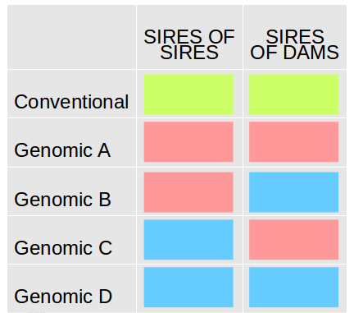
2) Test the scenarios
 | SIRES OF SIRES | SIRES OF DAMS
Conventional
Genomic A
Genomic B
Genomic C
Genomic D
Progeny testing
- pre-selection on parent average
Progeny testing
- pre-selection on gEBV
Genomic testing

Slide 7
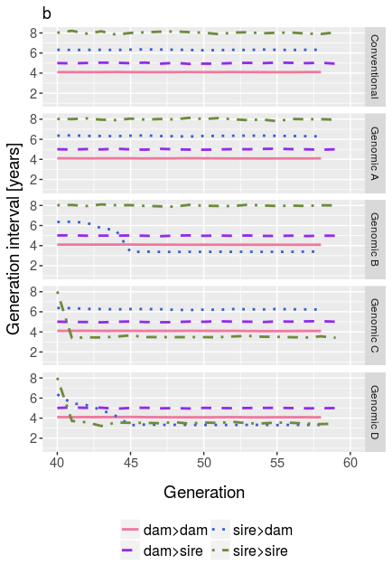
2) Test the scenarios – generation interval

Slide 8
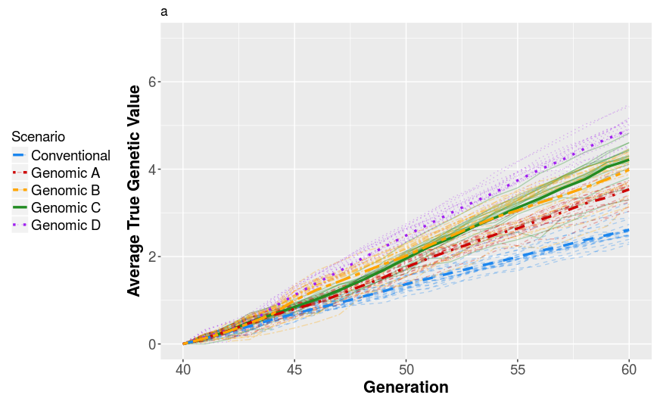
2) Test the scenarios – genetic gain

Slide 9
Genetic gain of the tested scenarios in the last generation.
 | 5 bulls / 5 years | 1 bull / 5 years | 5 bulls / 1 year
Conventional | 2.61 | 3.36 | 2.62
Genomic A | 3.54 | 3.71 | 3.62
Genomic B | 3.99 | 3.77 | 4.54
Genomic C | 4.22 | 4.22 | 4.49
Genomic D | 4.90 | 5.57 | 6.03

Slide 10
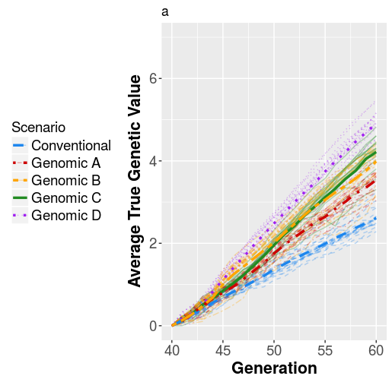
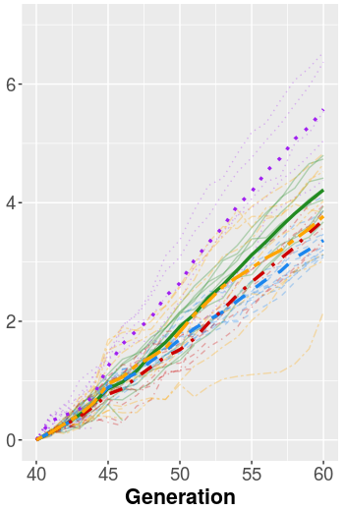
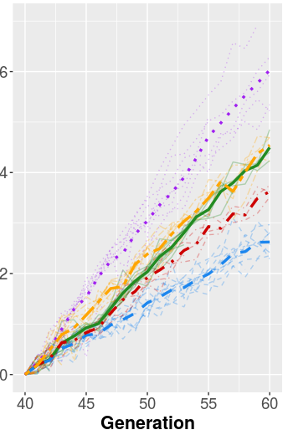
5 bulls / 5 years
1 bull / 5 years
5 bulls / 1 year

Slide 11
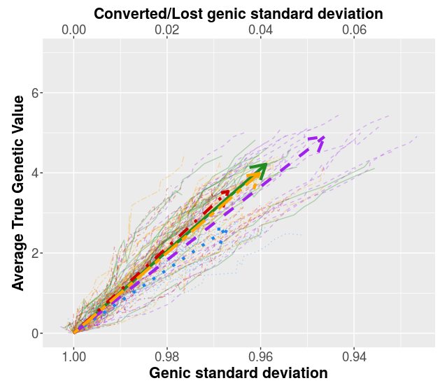
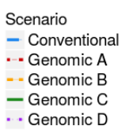
3) Compare selection efficiencies

Slide 12
Selection efficiency [regression slope] of the tested scenarios.
 | 5 bulls / 5 years | 1 bull / 5 years | 5 bulls / 1 year
Conventional | 36.6 | 25.3 | 31.9
Genomic A | 50.8 | 24.4 | 28.0
Genomic B | 48.4 | 18.6 | 30.0
Genomic C | 51.2 | 32.7 | 33.5
Genomic D | 41.8 | 15.2 | 32.4

Slide 13
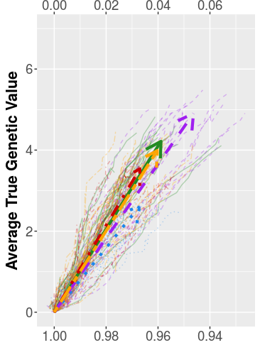
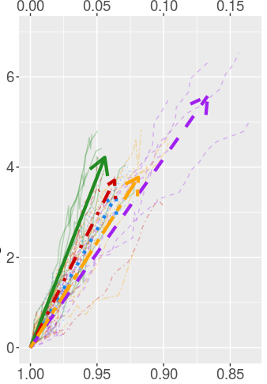
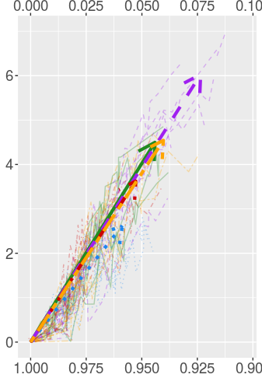
5 bulls / 5 years
1 bull / 5 years
5 bulls / 1 year
Converted/Lost genic standard deviation
Genic standard deviation

Slide 14
CONCLUSION
Developed tool for testing scenarios on a realistic cattle population
Genetic gain:
  increases with the use of genomic information
  Increased differences with reduced
Efficiency:
  most comprehensive genomic scenarios not the most efficient
  Scenarios re-ranked with reduced Ne

