Slide 1
Jana
Lab meeting
2020-03-19
@HighlanderLab

Slide 2
1) AlphaPart R package
2) Pig breeding example 3) Future work

Slide 3
1) AlphaPart R package
2) Pig breeding example 3) Future work

Slide 4
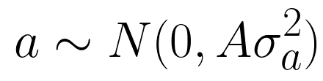
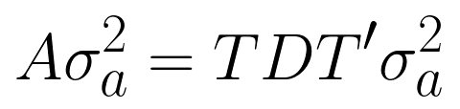
Current version
AlphaPart
R-package (CRAN)
Partitioning of genetic trend (García-Cortés et al., 2008)
Paths of information (females-males, import-domestic, AI centres ...)
Pedigree data, breeding values

Slide 5
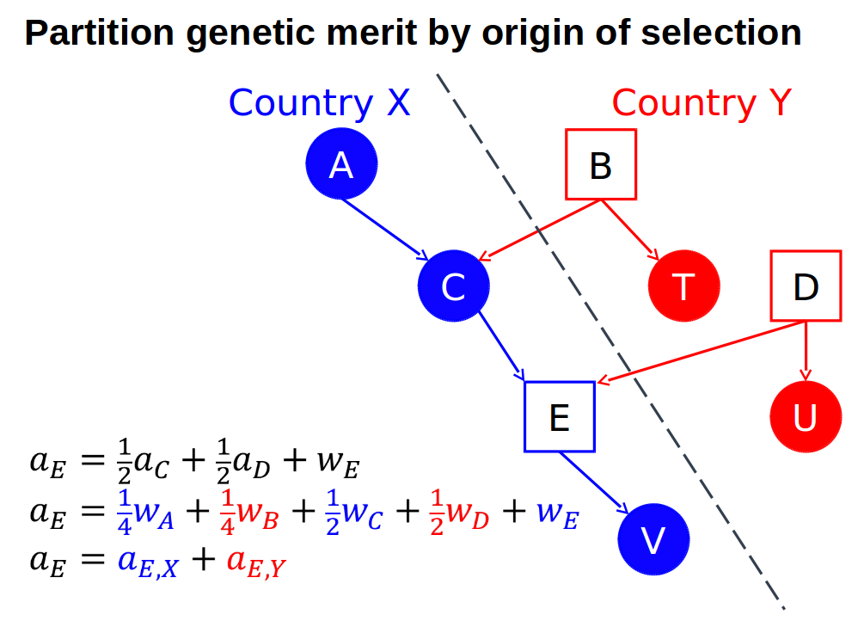
Current version
AlphaPart
PA
MST

Slide 6
Country X
Country Y

Slide 7
Indiv 6
True genetic value
True genetic value
Parent average
MST
MST
MST
MST
Founder
Founder
Indiv 1
True genetic value
True genetic value
Indiv 2
True genetic value
True genetic value
MST
MST
MST

Slide 8
Indiv 8
True genetic value
True genetic value
MST
MST
MST
Parent average
MST
Founder
Founder
Indiv 1
True genetic value
True genetic value
Indiv 3
True genetic value
True genetic value
MST
MST
MST

Slide 9
Indiv 10
True genetic value
True genetic value
Parent average
MST
Father
Mother
Indiv 6
True genetic value
True genetic value
Indiv 8
True genetic value
True genetic value
Parent average
Parent average
MST
MST
MST
MST
MST
Parent average
MST
MST
MST
Parent average
MST
MST

Slide 10
Indiv 10
True genetic value
True genetic value
Parent average
Parent average
MST
MST
Father
Mother
Indiv 6
True genetic value
True genetic value
Indiv 8
True genetic value
True genetic value
Parent average
Parent average
MST
MST
MST
MST
MST
Parent average
MST
MST
MST
Parent average
MST
MST

Slide 11
Country X
Country Y
Indiv 10
True genetic value
True genetic value
Contribution of
country 1
Contribution of
country 2

Slide 12
Country 1
Country 2
True genetic value
True genetic value
Indiv 1
Average
Indiv 1
Generation 1
Indiv 2
Indiv 3
Partial genetic trends
Indiv 1
Indiv 4
Generation 2
Indiv 5
Indiv 6

Slide 13
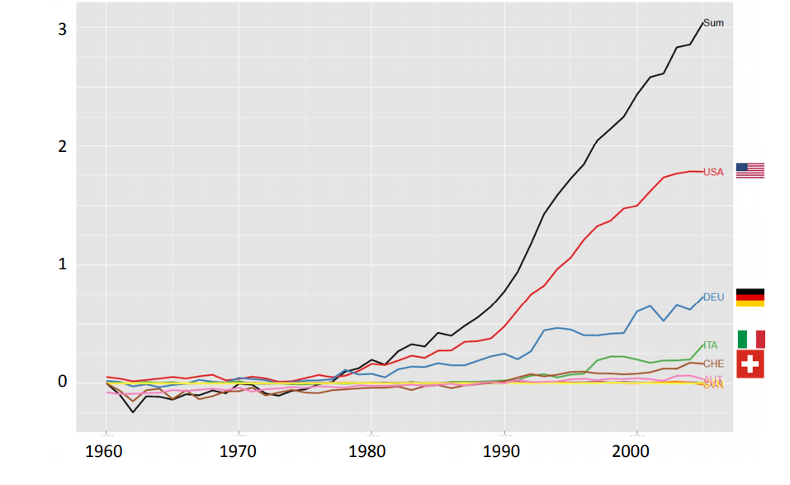
Current version
Example: international genetic trends for protein yield in Brown Swiss bulls (Gorjanc, 2011)

Slide 14
Functions
AlphaPart()

Slide 15
1) AlphaPart R package
2) Pig breeding example 3) Future work

Slide 16

Paper - pig breeding example
Simulation
Single breed
two tiers (nucleus, multiplier)
Two traits
Import into multiplier
Partition
By gender-tier
Males and females
recycled
NUCLEUS
Males imported to multiplier from nucleus
Trait 1
h² = 0.25
Trait 2
h² = 0.1
MaleFlow100 = 100% import
Females
recycled
MaleFlow20 = 20% import, 80% recycled
MULTIPLIER
Trait 1
h² = 0.25

Slide 17
Paper - results
Distribution of BVs

Slide 18
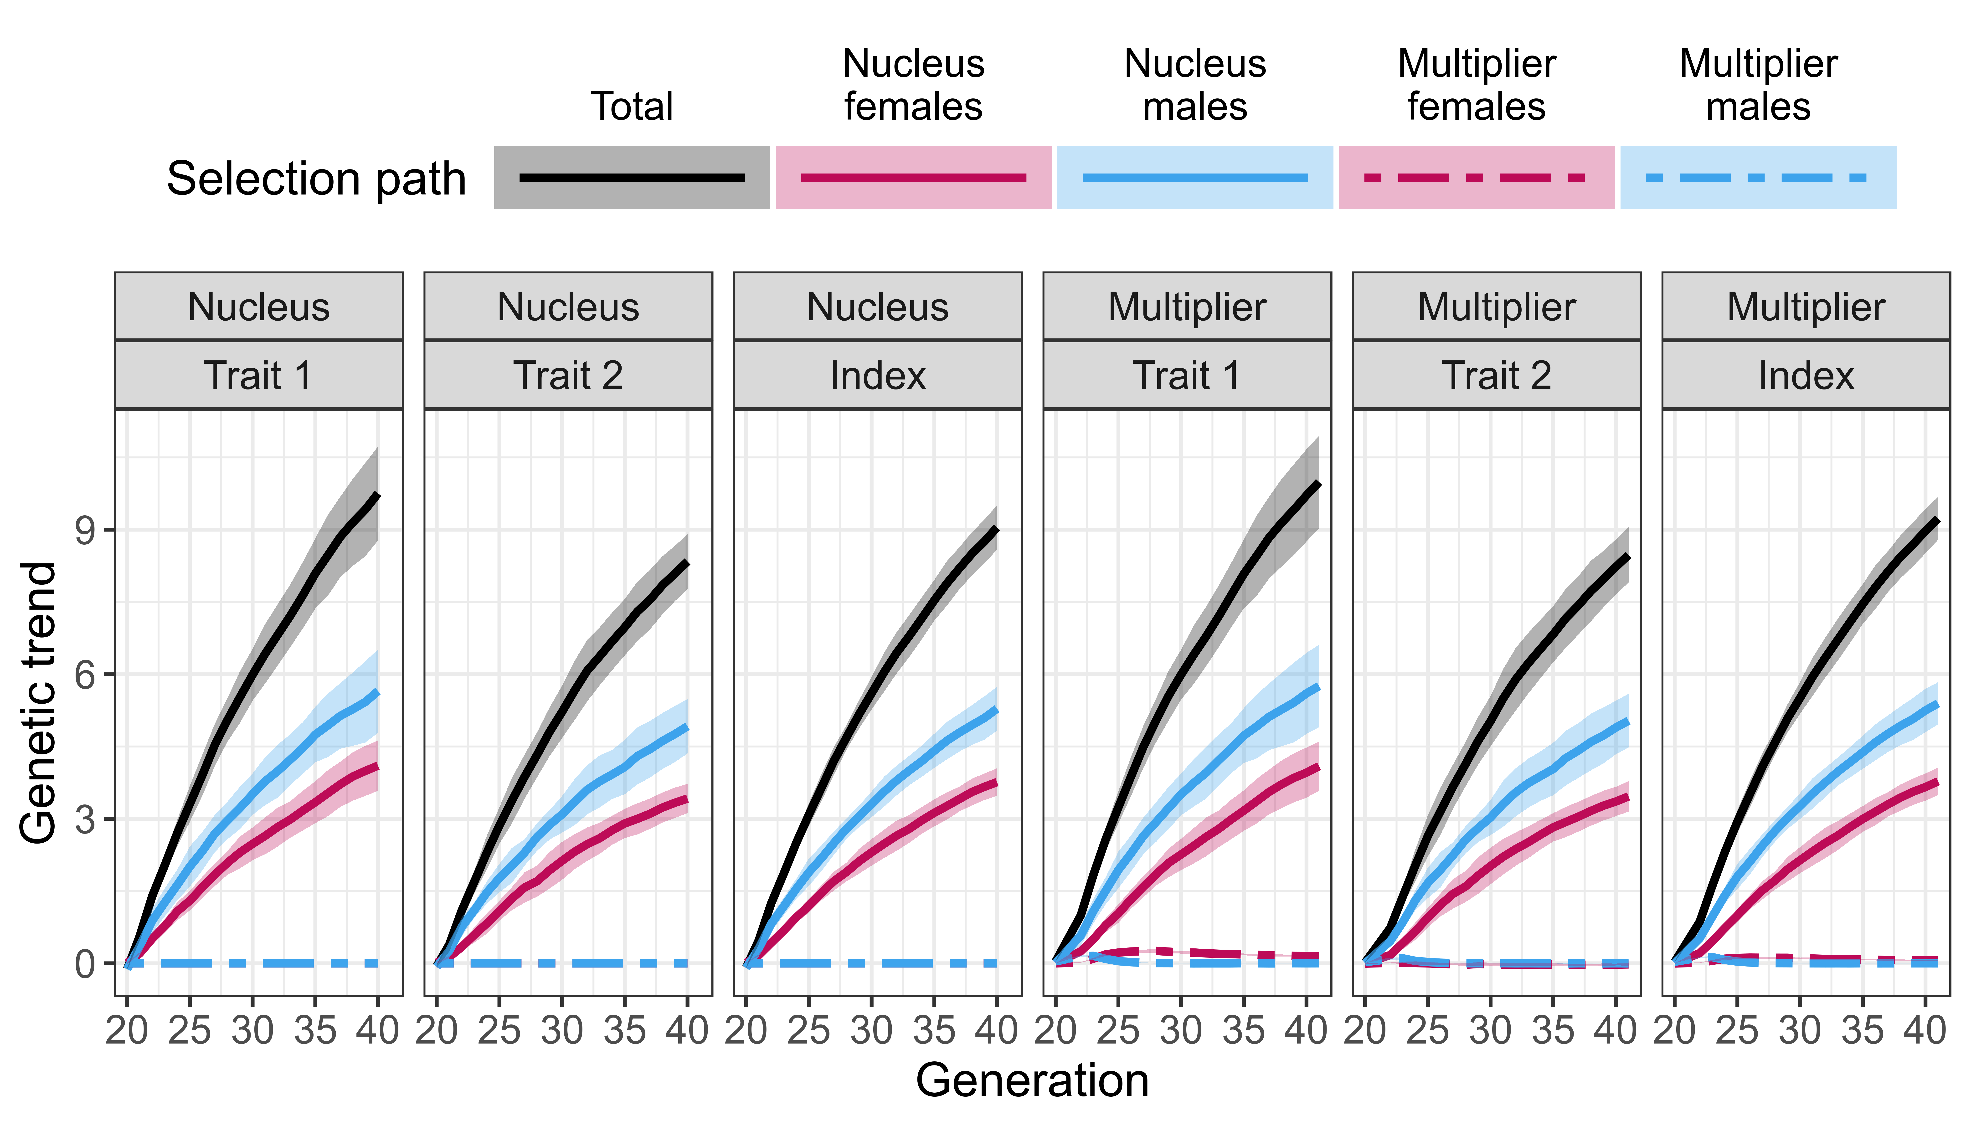
Paper - results
Partition: MaleFlow100

Slide 19
Paper - results
Partition: MaleFlow100

Slide 20
Paper - results
Freely available AlphaPart
Multiplier outperforms nucleus
Nucleus-multiplier gene flow
Direct, indirect
Multiplier selection
Accuracy of selection

Slide 21
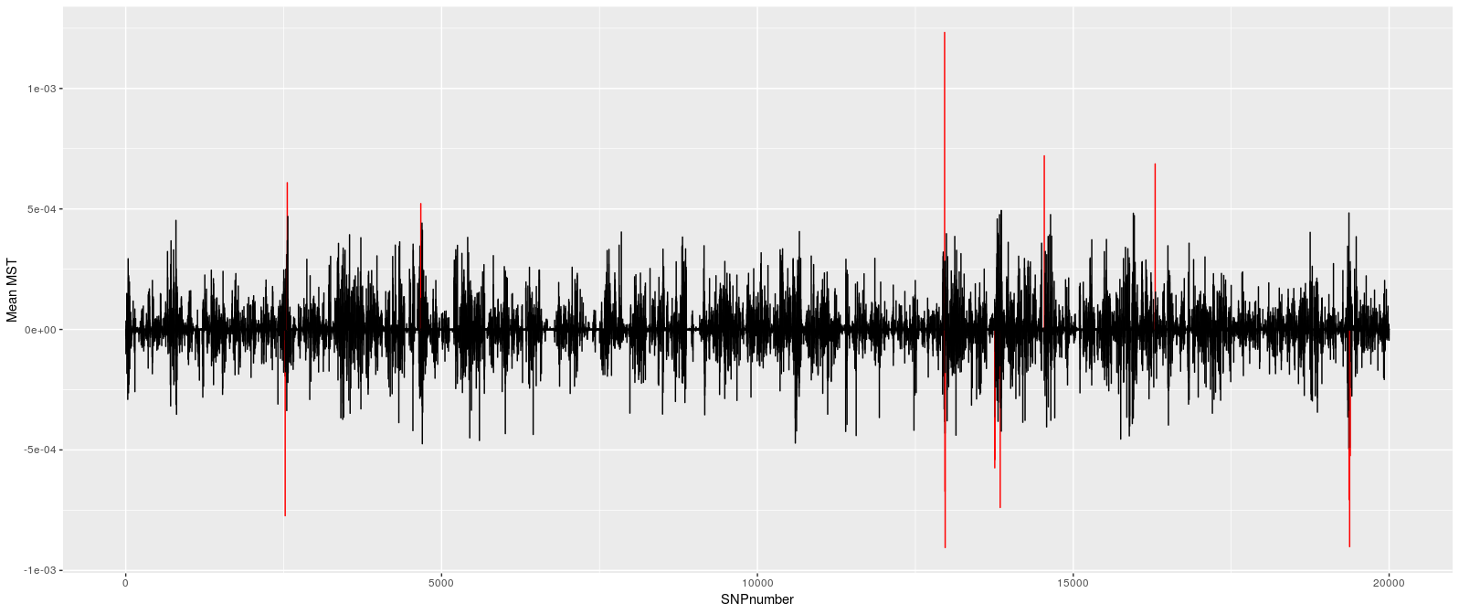
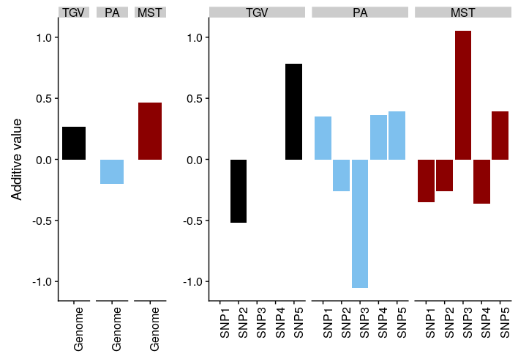
AlphaPart – future work
1. “loci unpacking”
Which genome regions drive genetic gain
Sources of haplotypes / alleles

Slide 22
AlphaPart – future work
2. partitioning of genetic variance
Change the function
3. uncertainty of contributions – sampling from posterior distribution
Multiple samples (structure)

