Slide 1
Jana
Lab meeting
2020-03-19
@HighlanderLab

Slide 2
1) AlphaPart R package
2) Pig breeding example
3) Future work

Slide 3
1) AlphaPart R package
2) Pig breeding example
3) Future work

Slide 4
AlphaPart - methodology
R-package (CRAN)
Partitioning of genetic trend (García-Cortés et al., 2008)

Slide 5
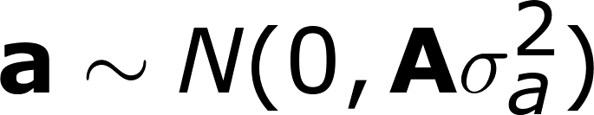

AlphaPart - methodology
FOUNDERS
a = Mendelian sampling term Φ
NON-FOUNDERS
a = 0.5a_{sire} + 0.5a_{dam} + Mendelian sampling term Φ
T relates animal to ancestors
Dσ²_{a} includes variability of founders and
MST of non-founders

Slide 6


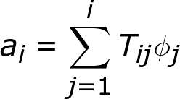
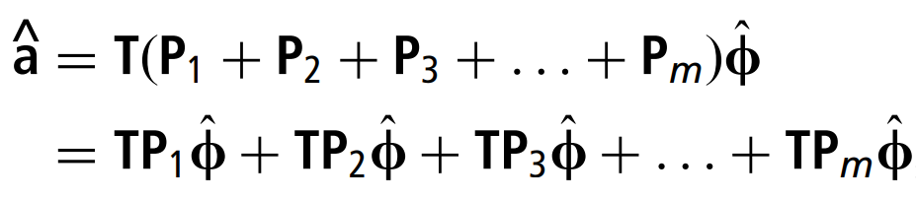
AlphaPart - methodology
Complete partition of each breeding value
Contribution of i founders and non-founders
males-females
ASSIGN individuals to m groups P generating MST
countries
AI centres

Slide 7
AlphaPart - methodology
Complete partition of breeding value by groups
a = a₁ + a₂ + … + a_{m}
Part of the BV assigned to group 1
Part of the BV assigned to group m
Part of the BV assigned to group 2

Slide 8
Country X
Country Y

Slide 9
Country X
Country Y
Indiv 6
True genetic value
Breeding value
Parent
average
MST
MST
MST
MST
Founder
Founder
Indiv 1
True genetic value
Breeding value
Indiv 2
True genetic value
Breeding value
MST
MST

Slide 10
Country X
Country Y
Indiv 8
True genetic value
Breeding value
MST
MST
MST
Parent
average
MST
Founder
Founder
Indiv 1
True genetic value
Breeding value
Indiv 3
True genetic value
Breeding value
MST
MST
MST

Slide 11
Country X
Country Y
Indiv 10
True genetic value
Breeding value
Parent
average
Parent
average
MST
MST
Father
Mother
True genetic value
True genetic value
Indiv 8
Breeding value
Indiv 6
Breeding value
Parent
average
MST
MST
MST
Parent
average
MST
Parent
average
MST
Parent
average
MST
MST
MST
MST
MST

Slide 12
Country X
Country Y
Indiv 10
True genetic value
Breeding value
Contribution of
country 1
Contribution of
country 2

Slide 13
Country X
Country Y
True genetic value
Breeding value
Indiv 1
Average
Indiv 1
Generation 1
Indiv 2
Indiv 3
Partial genetic trends
Indiv 1
Indiv 4
Generation 2
Indiv 5
Indiv 6

Slide 14
AlphaPart - functions
Sample dataset AlphaPart.ped

Slide 15
AlphaPart - functions
Sample dataset AlphaPart.ped
IId | FId | MId | gen | country | gender | bv1 | bv2
A |  |  | 1 | domestic | F | 100 | 88
B |  |  | 1 | import | M | 105 | 110
C | B | A | 2 | domestic | F | 104 | 100

Slide 16
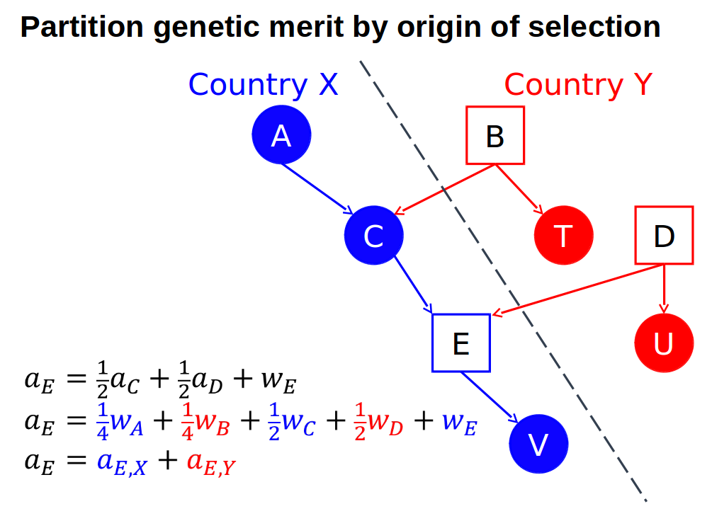
AlphaPart - functions
AlphaPart.ped
PA
MST

Slide 17
AlphaPart - functions
Sample dataset AlphaPart.ped
Main function: AlphaPart()
Recurse pedigree oldest → youngest individual (C++)
part <- AlphaPart(x = AlphaPart.ped,
colPath = “country”,
colBV = “bv1”)
Size:
- individuals: 8
- traits: 1 (bv1)
- paths: 2 (domestic, import)
- unknown (missing) values:
bv1
0

Slide 18
AlphaPart - functions
Summary function summary()
> sumPartByGen <- summary(part, by = “gen”)
> print(sumPartByGen)
IId | gen | bv1_domestic | bv1_import
A | 1 | 100 | 0
B | 1 | 0 | 105
C | 2 | 51.5 | 52.5
T | 2 | 0 | 102
D | 2 | 0 | 108
E | 3 | 26.75 | 80.25
U | 3 | 0 | 107
V | 4 | 68.875 | 40.125
gen | N | Sum | domestic | import
1 | 2 | 102.5 | 50 | 52.5
2 | 3 | 104.7 | 17.2 | 87.5
3 | 2 | 107 | 13.4 | 93.6
4 | 1 | 109 | 68.9 | 40.1

Slide 19
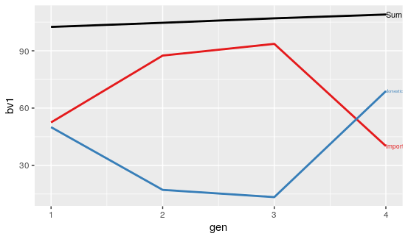
AlphaPart - functions
Function plot()
> plot(sumPartByGen)

Slide 20
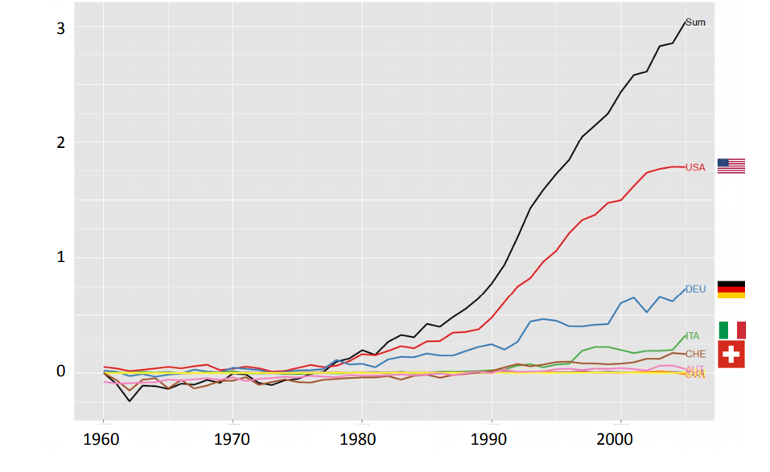
Example
International genetic trends for protein yield in Brown Swiss bulls (Gorjanc, 2011)

Slide 21
1) AlphaPart R package
2) Pig breeding example
3) Future work

Slide 22

Pig breeding example
Simulation
      Single breed
      two tiers (nucleus, multiplier)
      Two traits
      Import into multiplier
Males and females
recycled
NUCLEUS
Males imported to multiplier from nucleus
Trait 1
h² = 0.25
Trait 2
h² = 0.1
MaleFlow100 =
100% import
Females
recycled
MaleFlow20 =
20% import, 80% recycled
MULTIPLIER
Trait 1
h² = 0.25

Slide 23
Pig breeding example
Simulation
      Single breed
      two tiers (nucleus, multiplier)
      Two traits
      Import into multiplier
Partition
  By gender-tier
NUCLEUS
MALES
MaleFlow100
FEMALES
MaleFlow20
MULTIPLIER
MALES
FEMALES

Slide 24
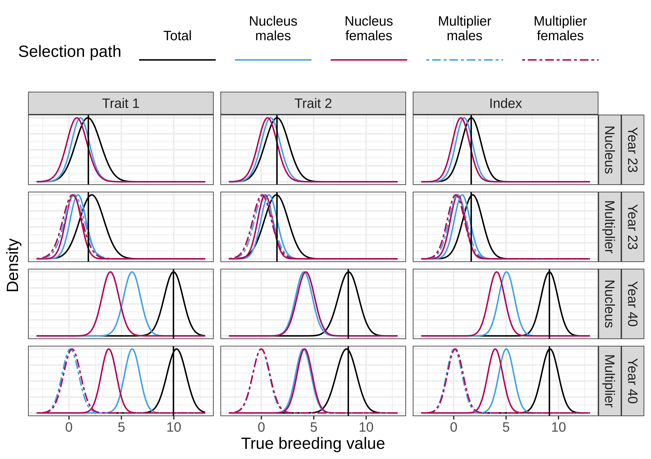
Paper - results
Distribution of BVs

Slide 25
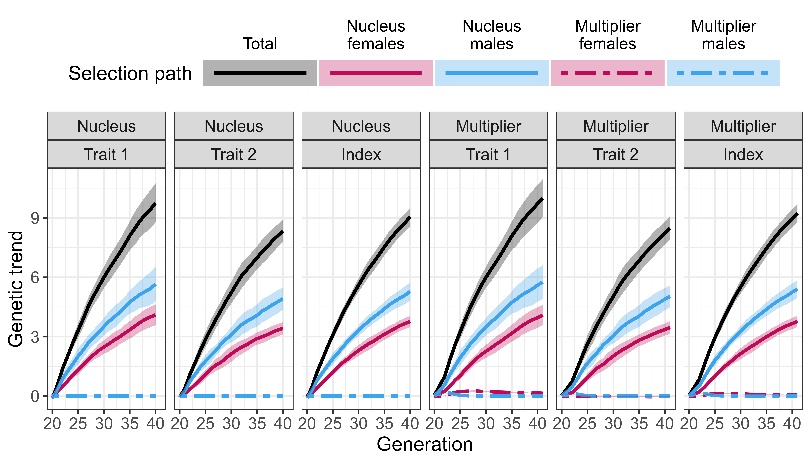
Paper - results
Partition: MaleFlow100

Slide 26
Paper - results
Partition: MaleFlow100

Slide 27
Paper - results
Partition: MaleFlow100

Slide 28
Paper - results
Freely available AlphaPart
Multiplier outperforms nucleus
  Nucleus-multiplier gene flow
    Direct, indirect
  Multiplier selection
    Accuracy of selection

Slide 29
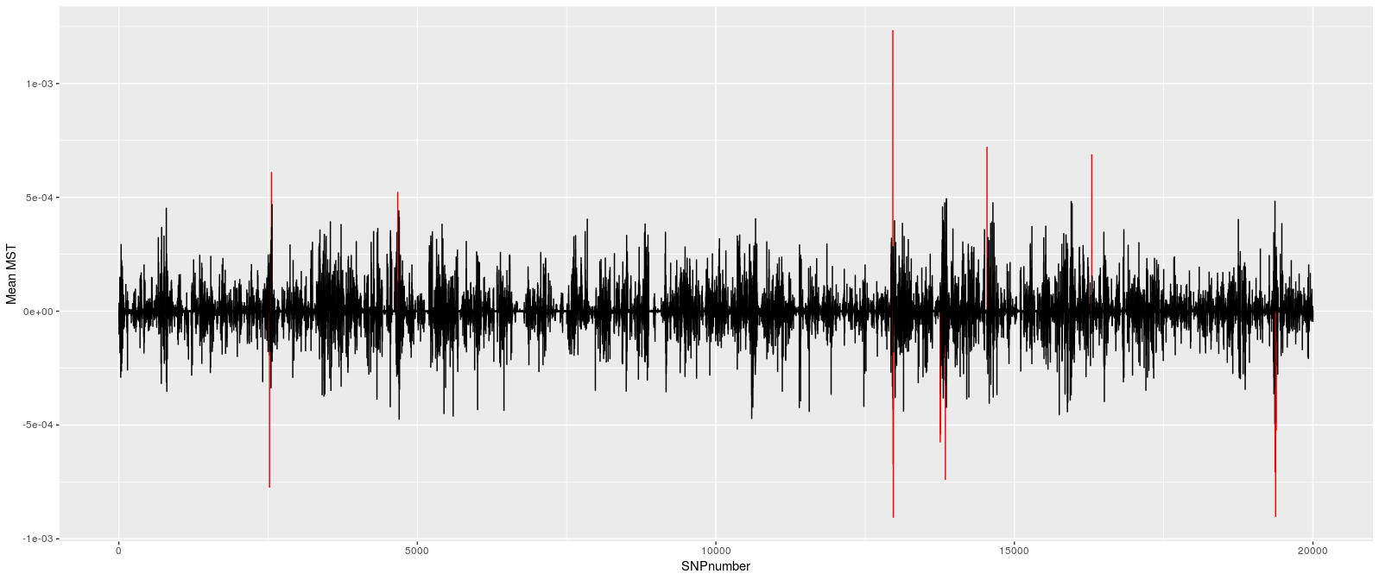
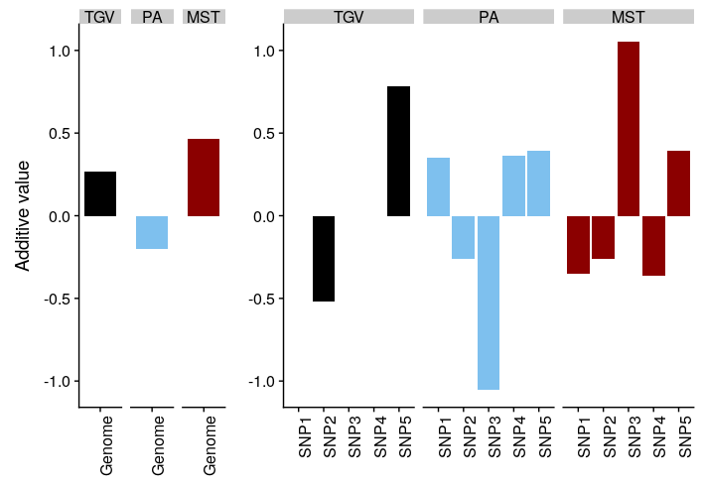
AlphaPart – future work
1. “loci unpacking”
  Which genome regions drive genetic gain
  Sources of haplotypes / alleles

Slide 30
AlphaPart – future work
2. partitioning of genetic variance
  Change the function
3. uncertainty of contributions – sampling from posterior distribution
  Multiple samples (structure)

